Slide 1
About me
Xamarin Forms Developer at Microsoft
https://www.pingaring.com
@PureWeen
Github.com/PureWeen
Notes:
I started with ASP.NET FORMS
My first experience with MVVM was Silverlight where I’ve used a number of FWS
Prism, Caiburn, before settling on ReactiveUI which mainly came around when I was trying to fix memory leaks.
I’ve done WPF, UWP, Native Xamarin and now Primarily Xamarin Formss

Slide 2
Term and Library Clarification
ReactJS
A view library that shares 5 letters with the word Reactive
Can work with reactive libraries Mobx, Meteor, RxJS, etc..
ReactiveX
What we’re mainly talking about today
ReactiveUI
Cross platform MVVM library built on top of ReactiveX
Notes:
First point of clarity is the difference between ReactJS and Reactive. This happens less now that RxJS has started picking up steam. Does anyone know when RxJS first came available? I first started messing with it probably around 6 or 7 years ago but couldn’t find info
The next idea which we’re mainly talking today is ReactiveX which is the umbrella term and source of all the terms http://reactivex.io/
ReacitveUI is a set of libraries and extensions used to turn MVVM based event streams into ReactiveX concepts

Slide 3
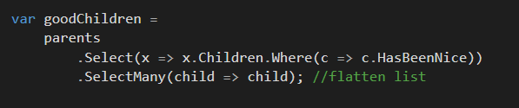
Start with the familiar iterator pattern
Notes:
So here we have the iterator pattern. We have a list of parents each with a set of children that we want to filter over and flatten into a list so that we have all the good children.
Giving us a very imperative way to ask the Iterator for information. Any questions about what’s happening here?
Now let’s take this idea and convert it over to a mouse event because at this point we’re equating the idea of an array and an event

Slide 4
IEnumerable<T> comparison
IEnumerable<T> is to Lists what IObservable<T> is to events
Iterators
In computer programming, an iterator is an object that enables a programmer to traverse a container, particularly lists. Various types of iterators are often provided via a container's interface.
IEnumerable<T> let’s us pull the data from a package
Notes:
How many people are familiar with System.Reactive Programming? And how many people have used it extensively?
How many people have used LINQ? Let’s start with the familiar world of LINQ over IEnumerable
What is an iterator?

Slide 5
IObservable<T>
Pushes data to a stream
Doesn’t really have an end or may have an end
Filter on your packages
Notes:
How many people are familiar with System.Reactive Programming? And how many people have used it extensively?
How many people have used LINQ? Let’s start with the familiar world of LINQ over IEnumerable
What is an iterator?

Slide 6
Creating Observables
var range = Observable.Range(10, 15);
singleValue = Observable.Return("Value");
Observable.Timer(TimeSpan.FromSeconds(1));
Observable.Interval(TimeSpan.FromSeconds(1));
Observable.FromEventPattern (
x => tbUserName.TextChanged += x,
x => tbUserName.TextChanged -= x
)
Notes:
This is the particular entity creating the observables. Placing data onto a stream and producing bubbles for you to use

Slide 7
Subscribing
Receives the values produced by observable
Values are processed by Action<T>
Multiple subscribes can watch an observer
Dispose pattern to stop listening
Notes:
This is the particular entity creating the observables. Placing data onto a stream and producing bubbles for you to use

Slide 8
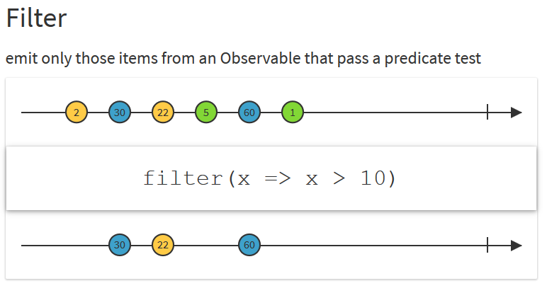
Filter (where) Operator
Notes:
This is your basic transform operator

Slide 9
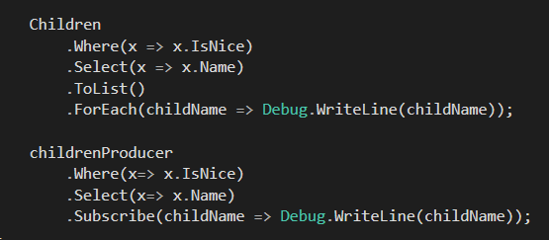
Apply same iterator idea to observables
Notes:
Now think about this same idea applied to the Observer pattern or to the pub sub model. In both models you have a set of messages you want to iterate over the main difference is the direction of the iteration.
With the observer pattern the producer controls the iteration whereas with the iterator pattern you control it. One extension that Reactive brings to the equation of the Observer pattern is the idea of declaratively stating when you’re done.

Slide 10

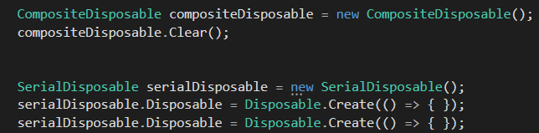
Disposable Bonanza
CompositeDisposable
SerialDisposable
Disposable.Create(Action)
Notes:
Super charges your disposables to allow for lots of ways to indicate when you want something to conclude

Slide 11
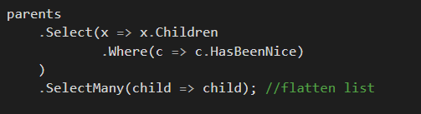
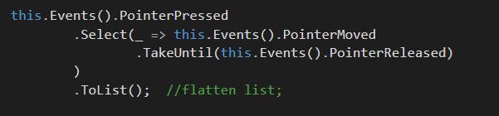
Apply same iterator idea to observables
Notes:
Now think about this same idea applied to the Observer pattern or to the pub sub model. In both models you have a set of messages you want to iterate over the main difference is the direction of the iteration.
With the observer pattern the producer controls the iteration whereas with the iterator pattern you control it. One extension that Reactive brings to the equation of the Observer pattern is the idea of declaratively stating when you’re done.

Slide 12


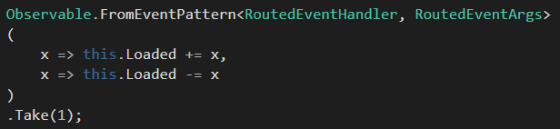
Declare when the rules of your events conclude
Notes:
Prism EventAggregator and that overload you conveniently ignored until all your memory leaked everywhere.

Slide 13
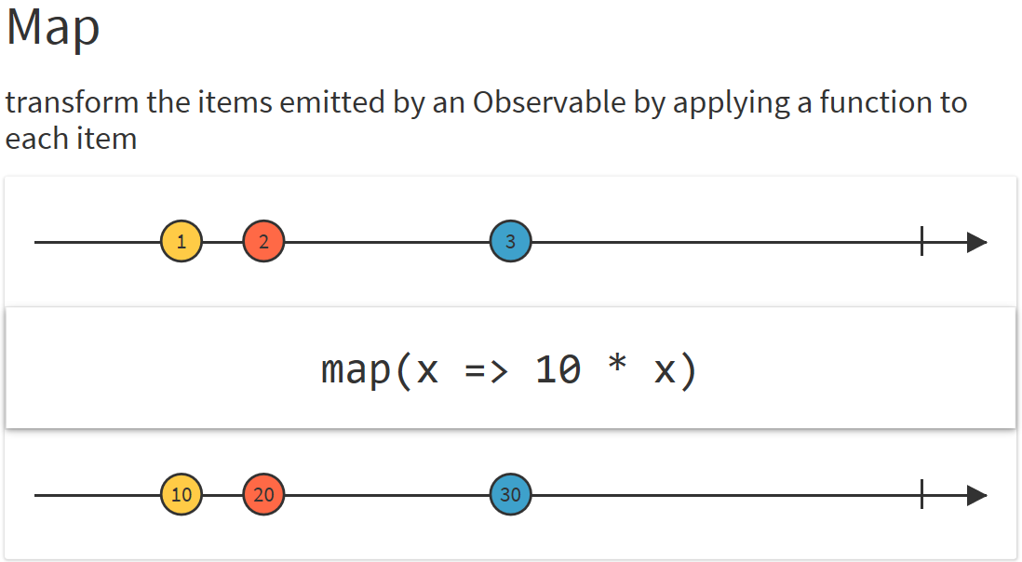
Map (Select)
Notes:
This is your basic transform operator

Slide 14

Greatly reduce leaky events
Notes:
How many people here have had to track down and fix leaky events? Alright for the 6 of you that didn’t raise your hand I have some bad news for you about your code base.
This was the first place I started in on with Reactive programming. The idea of being able to aggregate together all your events and then declaratively indicate when you no longer care about them.

Slide 15
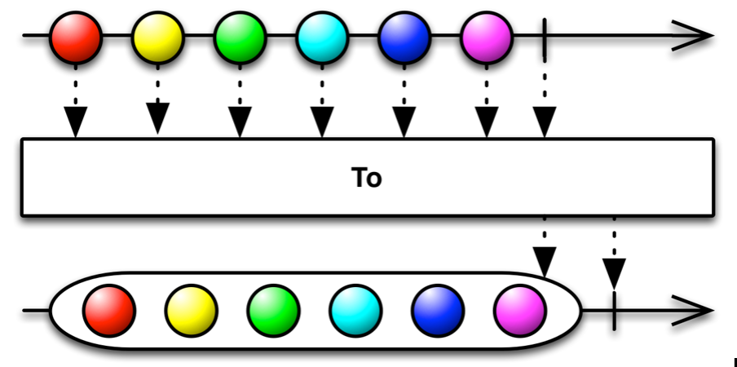
Observable.ToList()
Notes:
Once you’ve concluded round up all the emitted events into a list

Slide 16
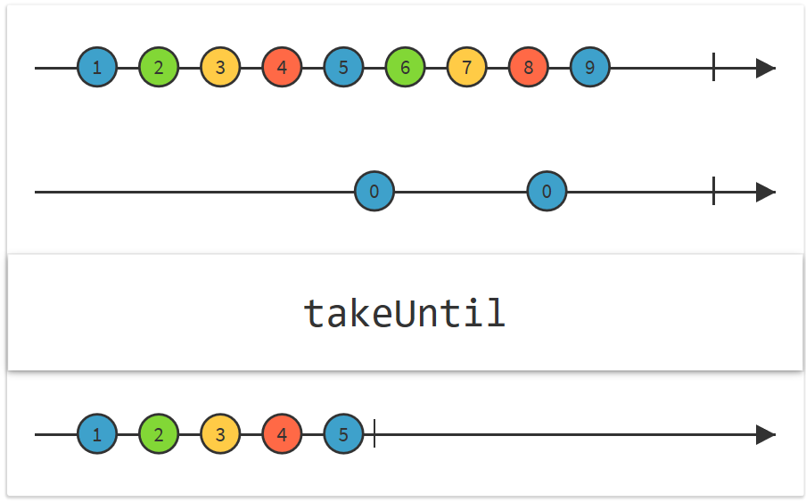
TakeUntil
Notes:
The take operators are ways to describe the termination of your events. This is where you declare the intention of your stream to conclude It could be a page unloading or maybe the user clicks the CANCEL button for an operation. The world of events are the liit

Slide 17
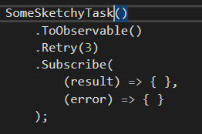
Retry and Exception handling made easy
Notes:
There are a lot of really cool things once you’re able to describe your events with these Observable objects because that gives you a tactile element to work with. You can start doing really cool things with exception handling and retrying your Observables by describing your intent.
Everything just becomes a stream of events and information

Slide 18
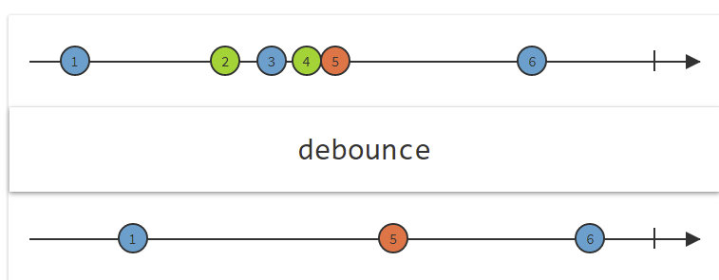
Throttle
Notes:
Review concepts of managing your streams with marble diagrams real quick before jumping into RxUI

Slide 19
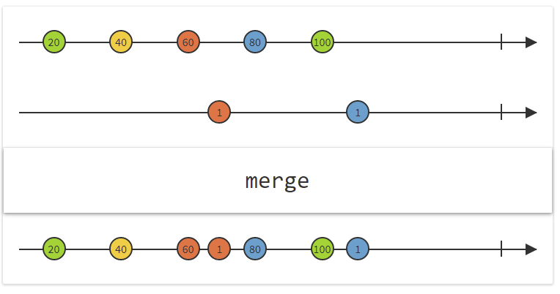
MERGE

Slide 20
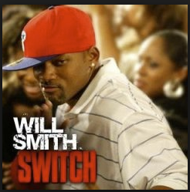
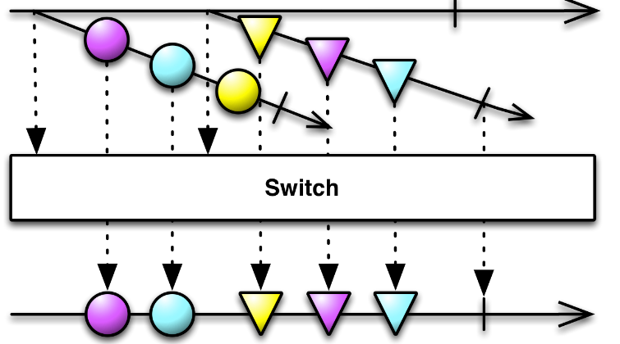
Switch is great
Transforms an observable sequence of observable sequences into an observable sequence producing values only from the most recent observable sequence.

Slide 21
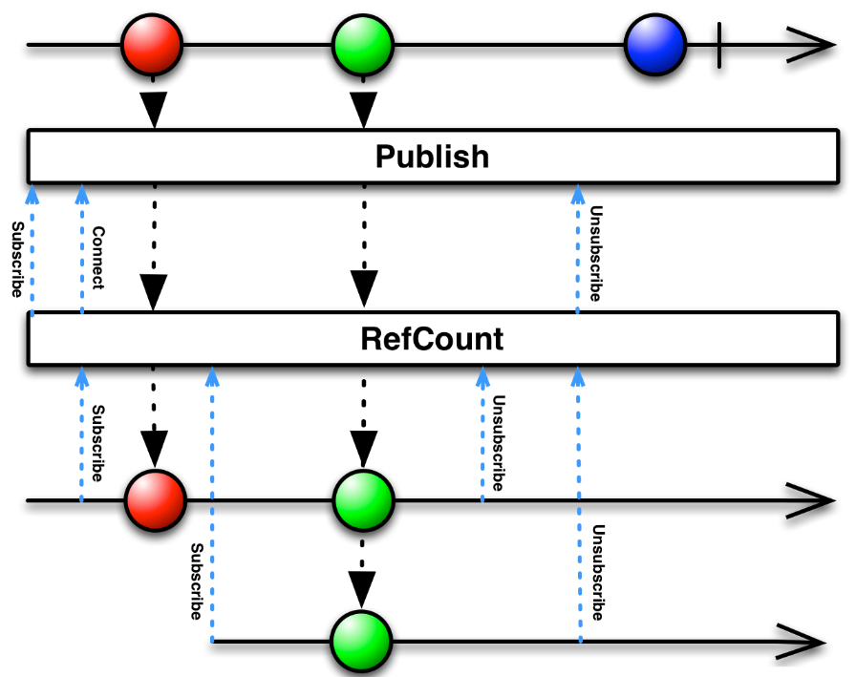
Multicast Your Streams

Slide 22
Additional operators
Retry
Catch
Replay
Group
Window
reactivex.io/documentation/operators.html

Slide 23
Reactive UI for a Reactive MVVM
Multi-platform native MVVM framework
XAML not required
Platform extensibility
Integrates Reactive Extensions
INotifyPropertyChanged
INotifyCollectionChanged
Notes:
You see this a lot now in JS with Angular 2 becoming popular now there’s a much larger excitement around tying in Reactive features to your UI.
You’re basically turning all of your properties into streams of events. You’re turning them into time based arrays that you can “iterate” over and perform the same type of LINQ like interactions against

Slide 24
Why am I excited?
Turn all those property notifications into Observables
Express all of your UI interactions declaratively
Fully unit testable
Easily emulate time based events virtually for instant testing
Harder to achieve with async (task) based designs
Notes:
MVVM is largely about the eventing from both sides. You have your Views eventing to the VM and the VM responding and services produces streams of data back to the VM and need to tie together to your View

Slide 25
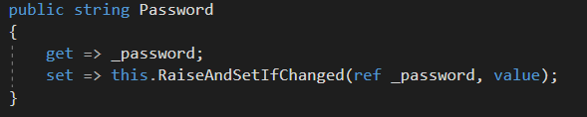
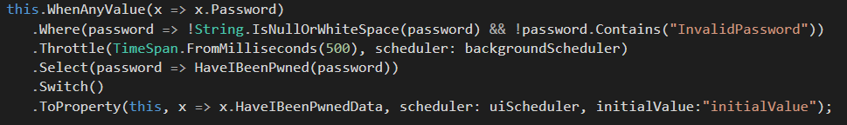
Property events as Observables

Slide 26
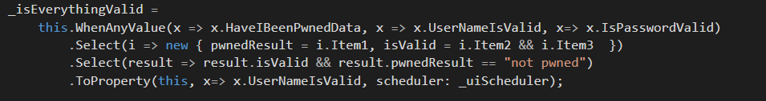

Tie together all your streams

Slide 27
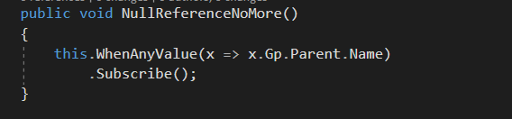
You don’t care about when something is initialized
Notes:
It also won’t give you any Null Reference exceptions from the watched exception. This is really powerful because now you describe Observable intents over expressions and you don’t care at all if any of the parts aren’t initialized. All you care about is describing the aggregated into of your properties.

Slide 28
Now tie this to some Commands

Slide 29
Reactive UI Demo

Slide 30

Platform agnostic bindings
Notes:
This is all achieved through RxUI’s features with being able to describe new types of binding types and models

Slide 31
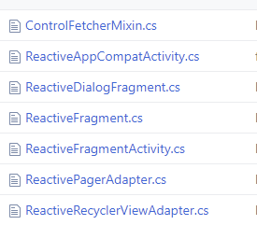
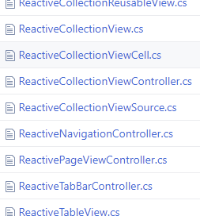
Range of platform specific controls

Slide 32
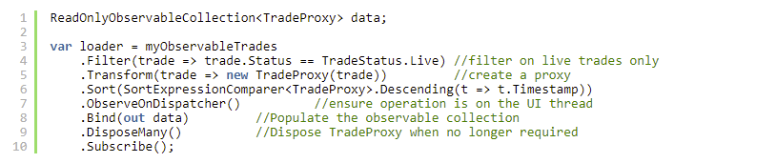
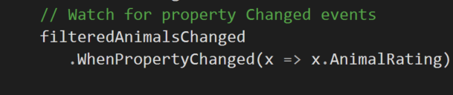
Dynamic Data Super Powered Reactive Lists
Notes:
So much of what you want to be doing in MVVM deals around lists of data… Filter, Sort, transform your models into VMs or in this sample proxies.

Slide 33
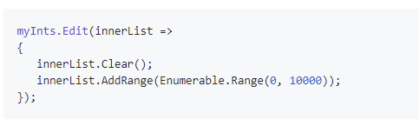
Thread safe single notification batch editing

Slide 34
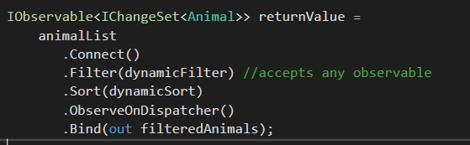
IObservable power everything
Notes:
This is similar to what we saw earlier but you’ll see a version of this in the demo I’ll show you. The Filter and Sort here are powered by Observables. They ingest an observable stream that tells the list when it needs to update it’s filter or sort. Streams on streams on streams on streams

Slide 35
Additional operators
DisposeMany
MergeMany
Virtualise
Bind
WhenPropertyChanged
Caching
Complex Grouping
Aggregates

Slide 36

Roland is great join him in Slack

Slide 37

UWP Events/DynamicData Demo
UWP
WPF
Xamarin.iOS
Xamarin.Android
Tizen being built
?
EVENTS
EVENTS
EVENTS
EVENTS
EVENTS

Slide 38
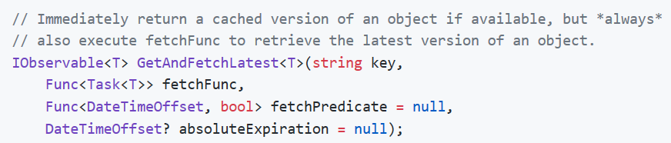

Akavache

Slide 39
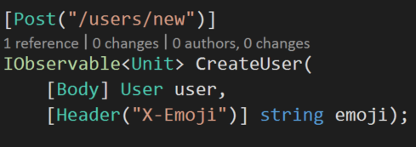
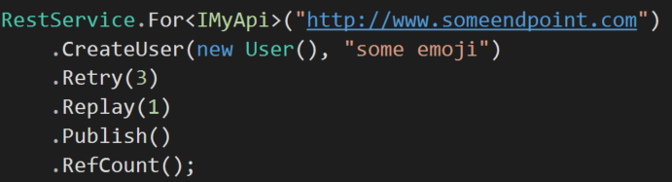
Refit

Slide 40
Additional Libraries
Akavache for cross platform key value store
Refit for a simple web client

Slide 41
Links
http://www.introtorx.com/
https://github.com/RolandPheasant/DynamicData
https://reactiveui.net/
silversalmon.com/
Pingaring.com
LinqPad has great integration
reactivex.io
https://github.com/paulcbetts/refit
https://github.com/akavache/Akavache

