Slide 1












w e l c o m e
Denver Dev Day – November 17, 2017
Notes:
I’m a note

Slide 2
About me
https://www.silversalmon.com
https://www.pingaring.com
Billy and His Dog Design
@PureWeen
Github.com/PureWeen
Notes:
WPF first MVVM Silverlight some time
KO
Xamarin
SQL Azure
Built lots of Uis through WPF, Silverlight (it’s the future), Prism, Caliburn, ReactiveUI

Slide 3
The Common Patterns
Iterators
In computer programming, an iterator is an object that enables a programmer to traverse a container, particularly lists. Various types of iterators are often provided via a container's interface.
Observers
Flip that and make it a function of time
Notes:
How many people are familiar with System.Reactive Programming? And how many people have used it extensively?
How many people have used LINQ? Let’s start with the familiar world of LINQ over Ienumerable
What is an iterator?

Slide 4
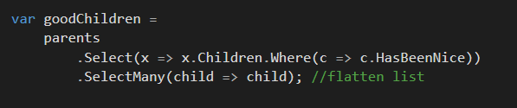
Start with the familiar iterator pattern
Notes:
So here we have the iterator pattern. We have a list of parents each with a set of children that we want to filter over and flatten into a list so that we have all the good children.
Giving us a very imperative way to ask the Iterator for information. Any questions about what’s happening here?
Now let’s take this idea and convert it over to a mouse event because at this point we’re equating the idea of an array and an event

Slide 5
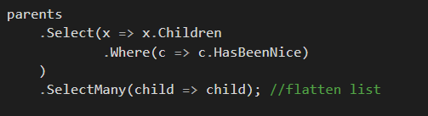
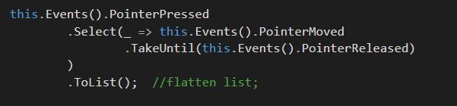
Apply same iterator idea to observables
Notes:
Now think about this same idea applied to the Observer pattern or to the pub sub model. In both models you have a set of messages you want to iterate over the main difference is the direction of the iteration.
With the observer pattern the producer controls the iteration whereas with the iterator pattern you control it. One extension that Reactive brings to the equation of the Observer pattern is the idea of declaratively stating when you’re done.

Slide 6
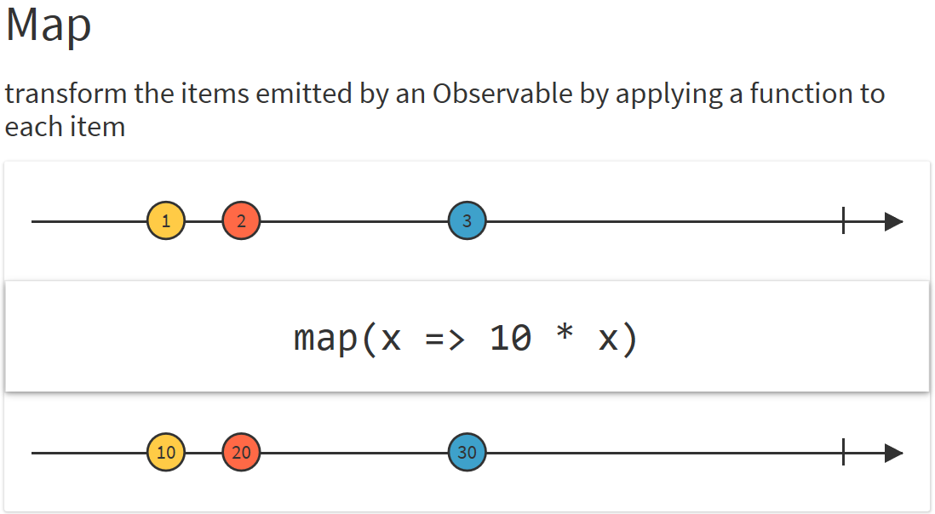
Map (Select)
Notes:
This is your basic transform operator

Slide 7
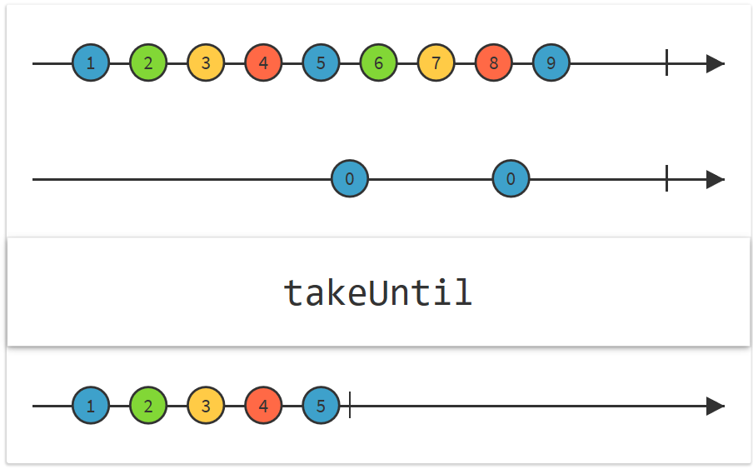
TakeUntil
Notes:
The take operators are ways to describe the termination of your events. This is where you declare the intention of your stream to conclude It could be a page unloading or maybe the user clicks the CANCEL button for an operation. The world of events are the liit

Slide 8
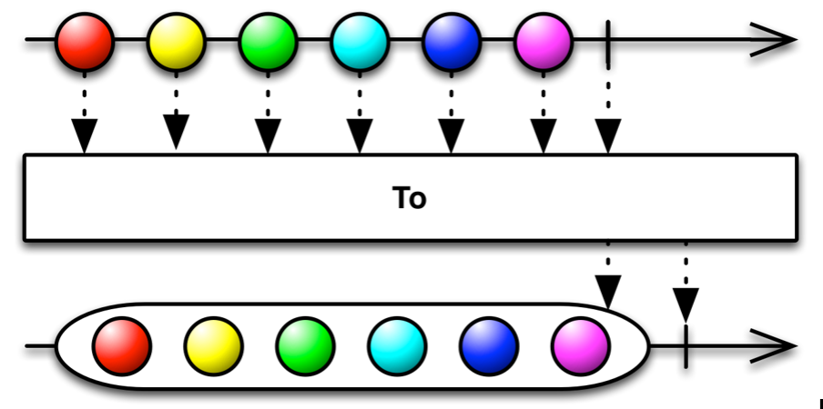
Observable.ToList()
Notes:
Once you’ve concluded round up all the emitted events into a list

Slide 9


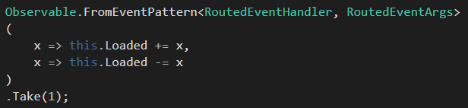
Declare when the rules of your events conclude
Notes:
Prism EventAggregator and that overload you conveniently ignored until all your memory leaked everywhere.

Slide 10

Disposable Bonanza
CompositeDisposable
SerialDisposable
SingleAssignmentDisposable
Disposable.Create(Action)
System.Reactive.Disposables.*
Notes:
Super charges your disposables to allow for lots of ways to indicate when you want something to conclude

Slide 11

Greatly reduce leaky events
Notes:
How many people here have had to track down and fix leaky events? Alright for the 6 of you that didn’t raise your hand I have some bad news for you about your code base.
This was the first place I started in on with Reactive programming. The idea of being able to aggregate together all your events and then declaratively indicate when you no longer care about them.

Slide 12
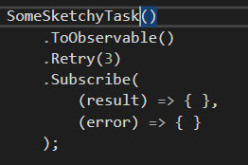
Retry and Exception handling made easy
Notes:
There are a lot of really cool things once you’re able to describe your events with these Observable objects because that gives you a tactile element to work with. You can start doing really cool things with exception handling and retrying your Observables by describing your intent.
Everything just becomes a stream of events and information

Slide 13
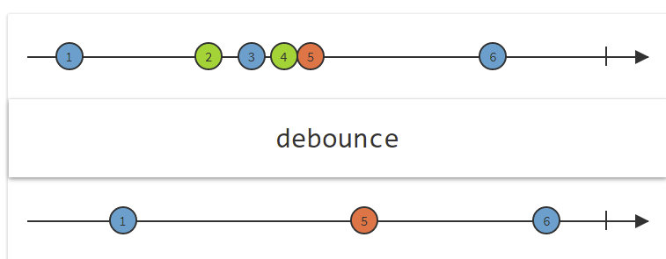
Throttle
Notes:
Review concepts of managing your streams with marble diagrams real quick before jumping into RxUI

Slide 14
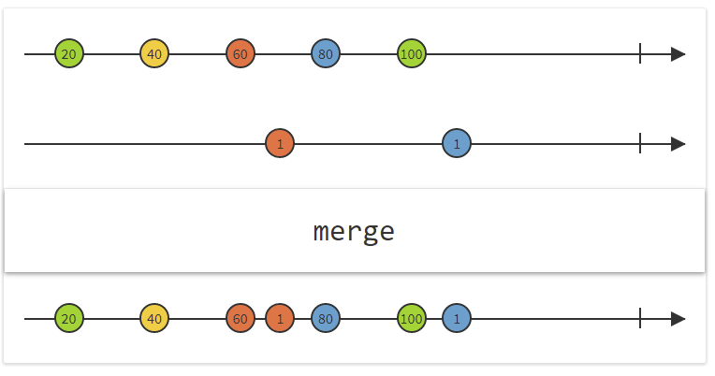
MERGE

Slide 15
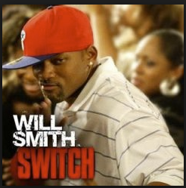
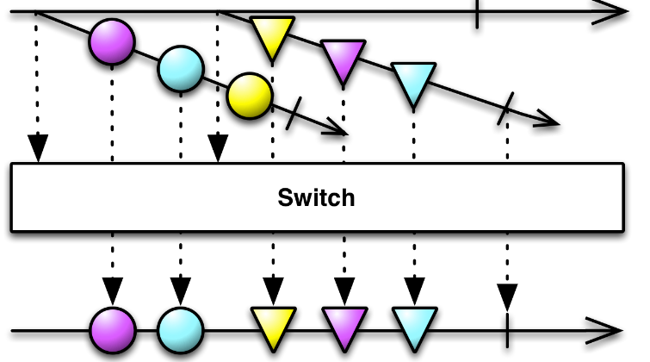
Switch is great
Transforms an observable sequence of observable sequences into an observable sequence producing values only from the most recent observable sequence.

Slide 16
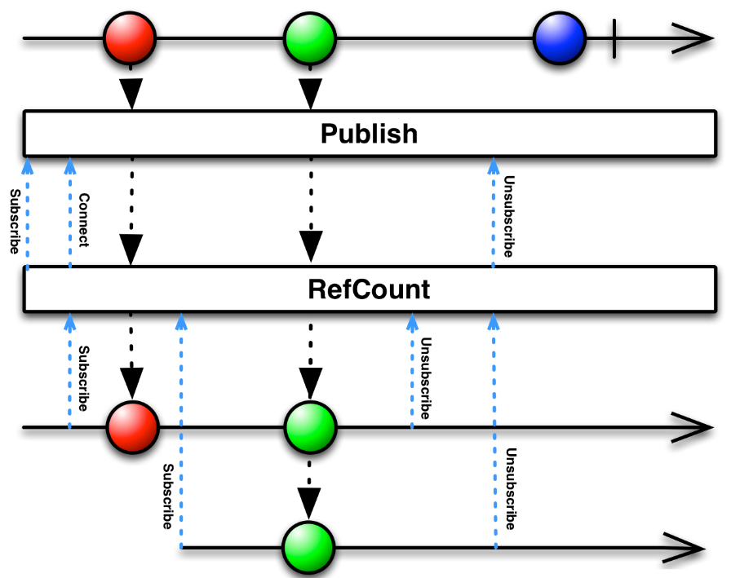
Multicast Your Streams

Slide 17
Additional operators
Retry
Catch
Replay
Group
Window
reactivex.io/documentation/operators.html

Slide 18
Reactive UI for a Reactive MVVM
Multi-platform native MVVM framework
XAML not required
Platform extensibility
Integrates Reactive Extensions
INotifyPropertyChanged
INotifyCollectionChanged
Notes:
You see this a lot now in JS with Angular 2 becoming popular now there’s a much larger excitement around tying in Reactive features to your UI.
You’re basically turning all of your properties into streams of events. You’re turning them into time based arrays that you can “iterate” over and perform the same type of LINQ like interactions against

Slide 19
Why am I excited?
Turn all those property notifications into Observables
Express all of your UI interactions declaratively
Fully unit testable
Easily emulate time based events virtually for instant testing
Harder to achieve with async (task) based designs
Notes:
MVVM is largely about the eventing from both sides. You have your Views eventing to the VM and the VM responding and services produces streams of data back to the VM and need to tie together to your View

Slide 20
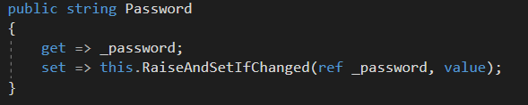
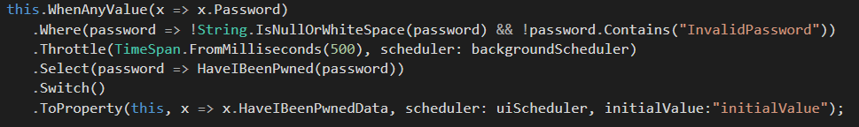
Property events as Observables

Slide 21
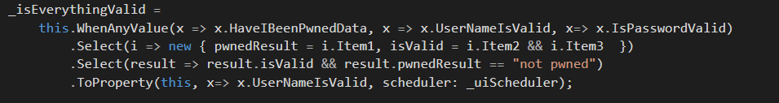

Tie together all your streams

Slide 22
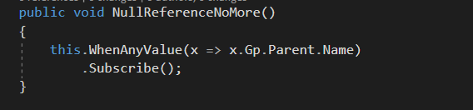
You don’t care about when something is initialized
Notes:
It also won’t give you any Null Reference exceptions from the watched exception. This is really powerful because now you describe Observable intents over expressions and you don’t care at all if any of the parts aren’t initialized. All you care about is describing the aggregated into of your properties.

Slide 23
Now tie this to some Commands

Slide 24
Reactive UI Demo

Slide 25

Platform agnostic bindings
Notes:
This is all achieved through RxUI’s features with being able to describe new types of binding types and models

Slide 26
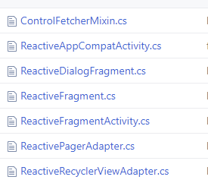
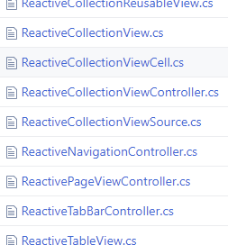
Range of platform specific controls

Slide 27
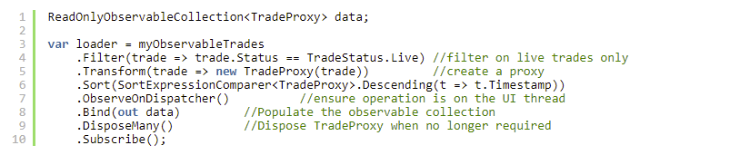
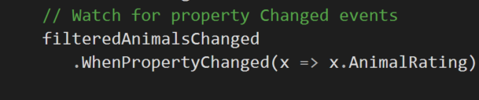
Dynamic Data Super Powered Reactive Lists
Notes:
So much of what you want to be doing in MVVM deals around lists of data… Filter, Sort, transform your models into VMs or in this sample proxies.

Slide 28
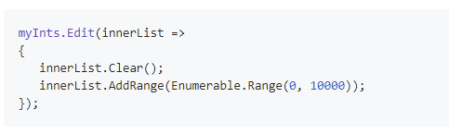
Thread safe single notification batch editing

Slide 29
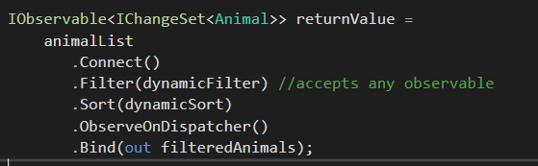
IObservable power everything
Notes:
This is similar to what we saw earlier but you’ll see a version of this in the demo I’ll show you. The Filter and Sort here are powered by Observables. They ingest an observable stream that tells the list when it needs to update it’s filter or sort. Streams on streams on streams on streams

Slide 30
Additional operators
DisposeMany
MergeMany
Virtualise
Bind
WhenPropertyChanged
Caching
Complex Grouping
Aggregates

Slide 31

Roland is great join him in Slack

Slide 32

UWP Events/DynamicData Demo
UWP
WPF
Xamarin.iOS
Xamarin.Android
Tizen being built
?
EVENTS
EVENTS
EVENTS
EVENTS
EVENTS

Slide 33
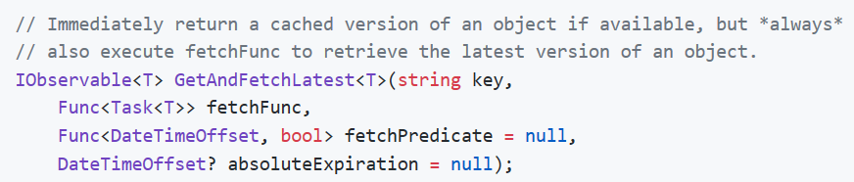

Akavache

Slide 34
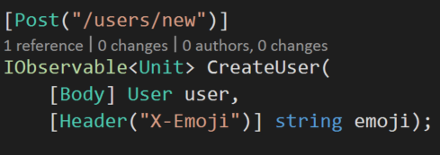
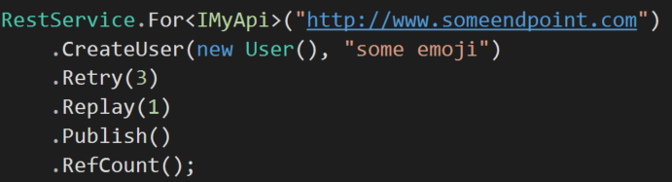
Refit

Slide 35
Additional Libraries
Akavache for cross platform key value store
Refit for a simple web client

Slide 36
Links
http://www.introtorx.com/
https://github.com/RolandPheasant/DynamicData
https://reactiveui.net/
silversalmon.com/
Pingaring.com
LinqPad has great integration
reactivex.io
https://github.com/paulcbetts/refit
https://github.com/akavache/Akavache

