Slide 1
About me
Xamarin Forms Developer at Microsoft
https://www.pingaring.com
@PureWeen
Github.com/PureWeen
Notes:
I started with ASP.NET FORMS
My first experience with MVVM was Silverlight where I’ve used a number of FWS
Prism, Caiburn,
I’ve done WPF, UWP, Native Xamarin and now Primarily Xamarin Forms
ReactiveUI which mainly came around when I was trying to fix memory leaks. Being able to tie a bow around all your event hook ups then just letting them go easily.

Slide 2
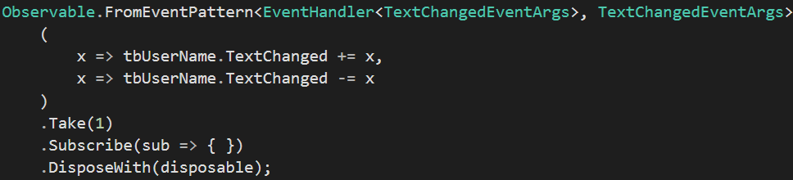

The first idea that hooked me

Slide 3
Term and Library Clarification
ReactJS
A view library that shares 5 letters with the word Reactive
Can work with reactive libraries Mobx, Meteor, RxJS, etc..
ReactiveX
What we’re mainly talking about today
ReactiveUI
Cross platform MVVM library built on top of ReactiveX
Notes:
First point of clarity is the difference between ReactJS and Reactive. This happens less now that RxJS has started picking up steam. Does anyone know when RxJS first came available? I first started messing with it probably around 6 or 7 years ago but couldn’t find info
The next idea which we’re mainly talking today is ReactiveX which is the umbrella term and source of all the terms http://reactivex.io/
In this talk I’ll start with basic ideas around observables and then move on to
ReacitveUI is a set of libraries and extensions used to turn MVVM based event streams into ReactiveX concepts

Slide 4
IEnumerable<T> Comparison
IEnumerable<T> is to Lists what IObservable<T> is to events
Iterators
In computer programming, an iterator is an object that enables a programmer to traverse a container, particularly lists. Various types of iterators are often provided via a container's interface.
IEnumerable<T> let’s us pull the data from a package
Pulling data from a source
Notes:
Ienumerable and pulling data from a source

Slide 5
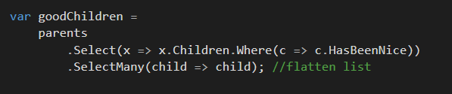
Start with the familiar iterator pattern
Notes:
So here we have the iterator pattern. We have a list of parents each with a set of children that we want to filter over and flatten into a list so that we have all the good children.
Giving us a very imperative way to ask the Iterator for information. Any questions about what’s happening here?
Now let’s take this idea and convert it over to a mouse event because at this point we’re equating the idea of an array and an event

Slide 6
IObservable<T>
Pushes data to a stream
Doesn’t really have an end or may have an end
Filter on your packages
Notes:
How many people are familiar with System.Reactive Programming? And how many people have used it extensively?
How many people have used LINQ? Let’s start with the familiar world of LINQ over IEnumerable
What is an iterator?

Slide 7
Creating Observables
var range = Observable.Range(10, 15);
singleValue = Observable.Return("Value");
Observable.Timer(TimeSpan.FromSeconds(1));
Observable.Interval(TimeSpan.FromSeconds(1));
Observable.Create(Obs => {})
Observable.FromEventPattern {
x => tbUserName.TextChanged += x,
x => tbUserName.TextChanged -= x
Notes:
This is the particular entity creating the observables. Placing data onto a stream and producing bubbles for you to use

Slide 8
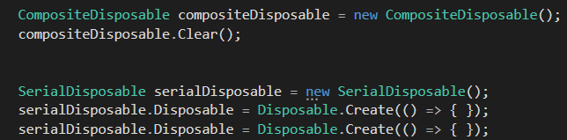
Easy to Cleanup
CompositeDisposable
SerialDisposable
Disposable.Create(Action)
Notes:
Super charges your disposables to allow for lots of ways to indicate when you want something to conclude

Slide 9
Subscribing
Receives the values produced by observable
Values are processed by Action<T>
Multiple subscribes can watch an observer
Dispose pattern to stop listening
Notes:
This is the other side of the observable . This is the consumer listening to the conveyor belt of information

Slide 10
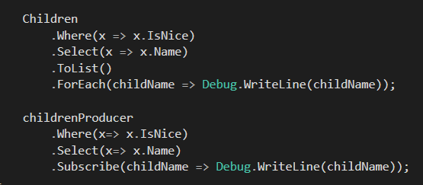

Apply same iterator idea to observables
Notes:
Now think about this same idea applied to the Observer pattern or to the pub sub model. In both models you have a set of messages you want to iterate over the main difference is the direction of the iteration.
With the observer pattern the producer controls the iteration whereas with the iterator pattern you control it. One extension that Reactive brings to the equation of the Observer pattern is the idea of declaratively stating when you’re done.

Slide 11
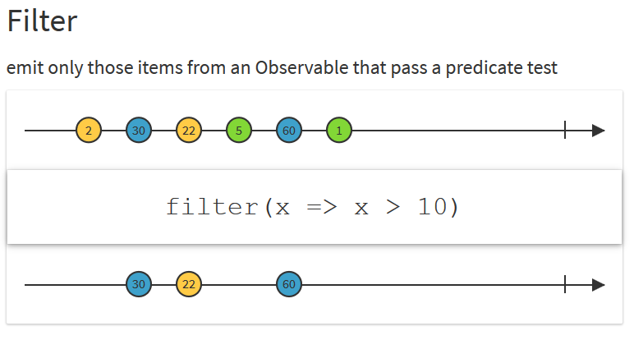
Filter (where) Operator
Notes:
This is your basic transform operator

Slide 12

Retry and Exception handling made easy
Notes:
There are a lot of really cool things once you’re able to describe your events with these Observable objects because that gives you a tactile element to work with. You can start doing really cool things with exception handling and retrying your Observables by describing your intent.
Everything just becomes a stream of events and information

Slide 13
Start Login Page Demo
Notes:
Who’s used ReactiveX in some form somewhere? Who’s excited to see another auto complete demo with ReactiveX?
Next slides have marble diagrams and also remember to go back to slides during RxUI demo

Slide 14
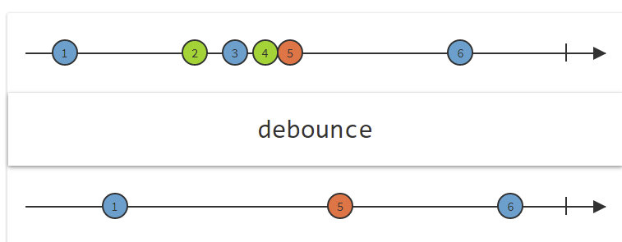
Throttle (debounce)
Notes:
Review concepts of managing your streams with marble diagrams real quick before jumping into RxUI

Slide 15
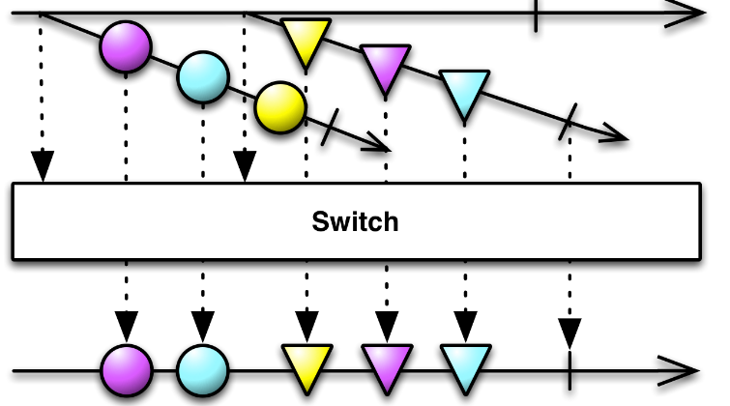
Switch is great
Transforms an observable sequence of observable sequences into an observable sequence producing values only from the most recent observable sequence.

Slide 16
Additional operators and Tools
Connected Observables
Multi Casting
Switch
Vs SelectMany
reactivex.io/documentation/operators.html
LINQPad

Slide 17
Reactive UI for a Reactive MVVM
Multi-platform native MVVM framework
XAML not required
Platform extensibility
Integrates Reactive Extensions
INotifyPropertyChanged
INotifyCollectionChanged
Observable versions of all platform events
Notes:
You see this a lot now in JS with Angular 2 becoming popular now there’s a much larger excitement around tying in Reactive features to your UI.
You’re basically turning all of your properties into streams of events. You’re turning them into time based arrays that you can “iterate” over and perform the same type of LINQ like interactions against

Slide 18
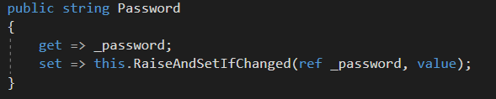
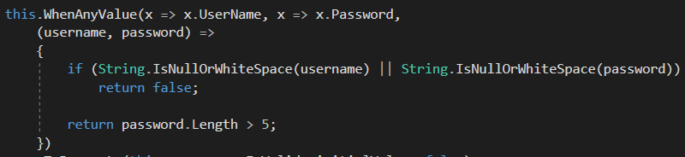
INPC Observables

Slide 19
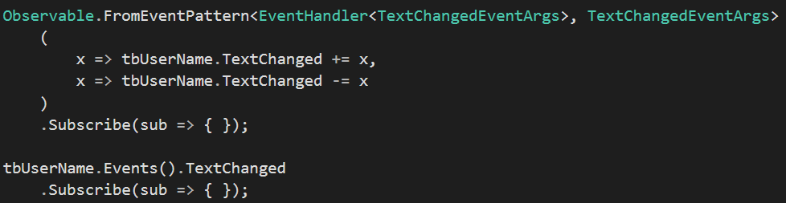
UI Events on all Platforms
Notes:
Use this independently of ReactiveUI to more easily work with UI Events

Slide 20
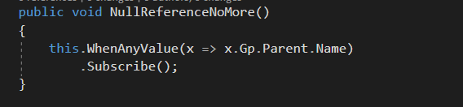
You don’t care about when something is initialized
Notes:
It also won’t give you any Null Reference exceptions from the watched exception. This is really powerful because now you describe Observable intents over expressions and you don’t care at all if any of the parts aren’t initialized. All you care about is describing the aggregated into of your properties.

Slide 21

Now tie this to some Commands

Slide 22

Platform agnostic bindings
Notes:
This is all achieved through RxUI’s features with being able to describe new types of binding types and models

Slide 23
Reactive UI Demo
Notes:
The great thing is that you’re setting up your VM events then you can just go crazy tying data streams together
Make sure to show them the tests!!

Slide 24
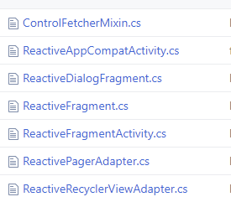
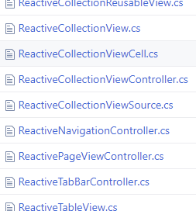
Range of platform specific controls

Slide 25
Mouse Pressed Demo

Slide 26
Moving a square demo

Slide 27
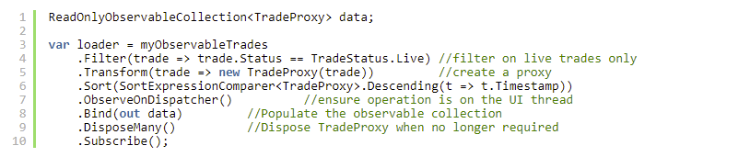
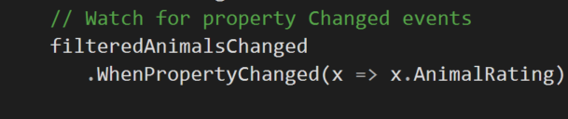
Dynamic Data Super Powered Reactive Lists
Notes:
So much of what you want to be doing in MVVM deals around lists of data… Filter, Sort, transform your models into VMs or in this sample proxies.

Slide 28
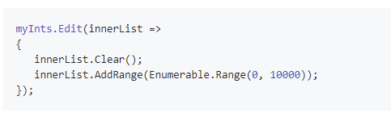
Thread safe single notification batch editing

Slide 29
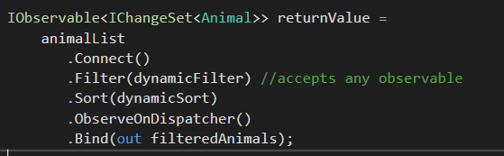
IObservable power everything
Notes:
This is similar to what we saw earlier but you’ll see a version of this in the demo I’ll show you. The Filter and Sort here are powered by Observables. They ingest an observable stream that tells the list when it needs to update it’s filter or sort. Streams on streams on streams on streams

Slide 30
Additional operators
DisposeMany
MergeMany
Virtualise
Bind
WhenPropertyChanged
Caching
Complex Grouping
Aggregates

Slide 31

Roland is great join him in Slack

Slide 32
UWP Events/DynamicData Demo
UWP
WPF
Xamarin.iOS
Xamarin.Android
Tizen being built
Xamarin.Forms
EVENTS
EVENTS
EVENTS
EVENTS
EVENTS

Slide 33
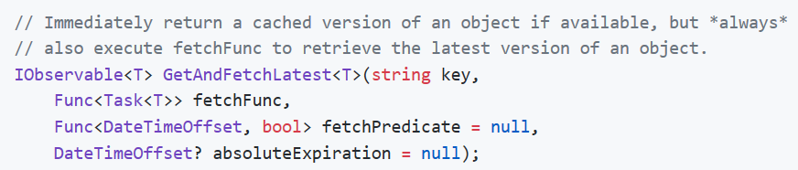

Akavache

Slide 34
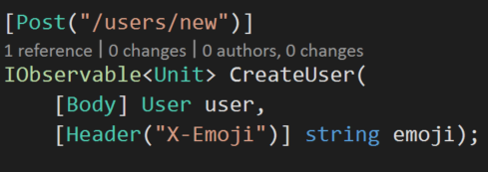
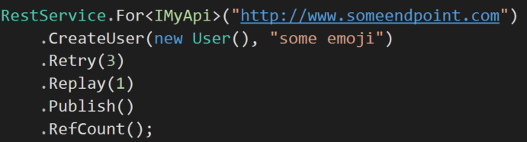
Refit

Slide 35
Additional Libraries
Akavache for cross platform key value store
Refit for a simple web client

Slide 36
Links
http://www.introtorx.com/
https://github.com/RolandPheasant/DynamicData
https://reactiveui.net/
Pingaring.com
LinqPad has great integration
reactivex.io
https://github.com/paulcbetts/refit
https://github.com/akavache/Akavache
Michael Stonis

Slide 37
About me
Xamarin Forms Developer at Microsoft
https://www.pingaring.com
@PureWeen
Github.com/PureWeen
Notes:
WPF first MVVM Silverlight some time
KO
Xamarin
SQL Azure
Built lots of Uis through WPF, Silverlight (it’s the future), Prism, Caliburn, ReactiveUI

