Slide 1
Cinema Booking System
Represented by:
Ikhbayar
Surenkhuu
Purevdorj

Slide 2
Overview
Cinema booking system is responsible for getting clients booking movies on the internet. Since, it reduces the long line that occurs when people getting ticket in the movie theater. Also, it’s one of the ways that increases benefits of the movie theater.

Slide 3
Technologies
Derby
Java FX
Star UML
Git

Slide 4
Feature
# | Class | Description
1 | Person | It implements from “iPerson” interface and generates Member and Staff classes.
2 | Member | Member is a person who booking movie in the system.
4 | Staff | Staff is a person who manages the movie, schedule, and hall. For example, add, update, or delete movies.
2 | Movie | It will presents in the hall. Which has a name, rate, type, during time, and released date.
3 | Schedule | This class shows the all possible schedules of the one movie
5 | Hall | Represents room and seats which represents the movies
6 | Booking | It contains the all history of the booking that customers made.
7 | Payment | It computes member’s payment who made booking ticket.
8 | MovieScheduleFactory | It creates package level of an instance of a movie, a hall, and a schedule class.

Slide 5
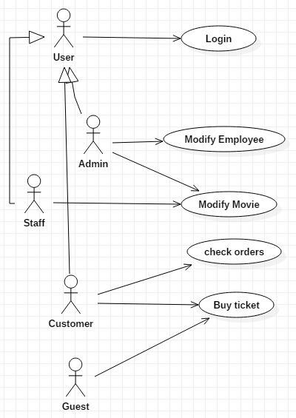
Use cases

Slide 6
Main use cases
Staff creates a movie
Staff creates a movie schedule to show in a particular hall
Member books a movie for a particular schedule

Slide 7
Goals
Cinema booking need to have many movies for the clients
Cinema booking need to have many halls, seats and schedules to present movies
Cinema booking need to have members who booking tickets
Cinema booking need to have staff who manages movies
Cinema booking need to have payment to receive deposit from user

Slide 8
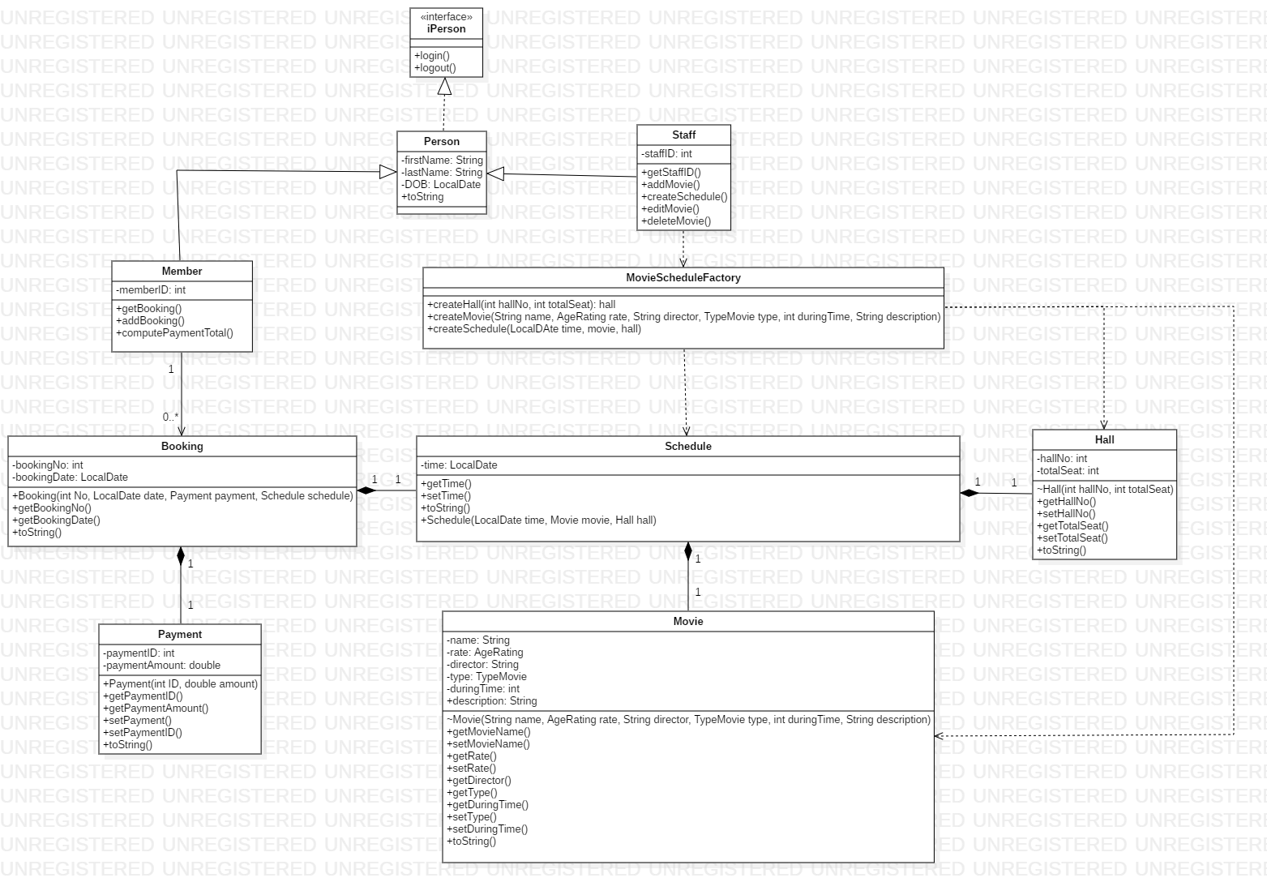
Class diagram (Inheritance, associations and dependency)

Slide 9
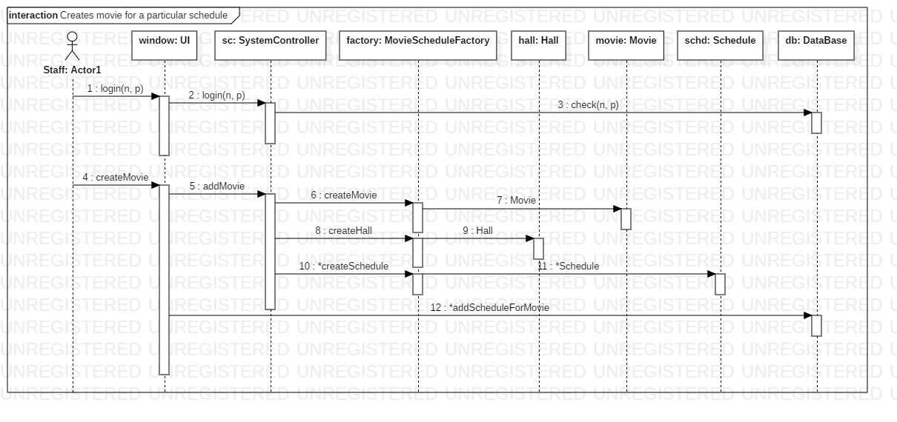
Sequence diagram-1
Staff creates a movie for particular schedule.

Slide 10
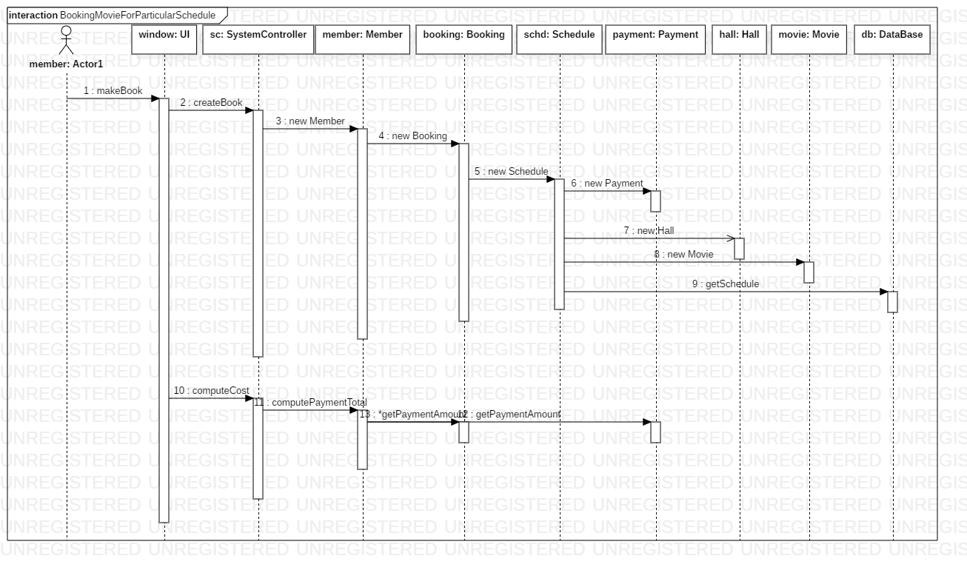
Sequence diagram-2
Member books a movie for particular schedule.

Slide 11
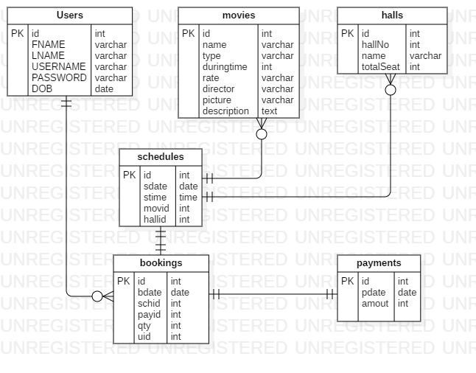
Entity Relationship Diagram

Slide 12
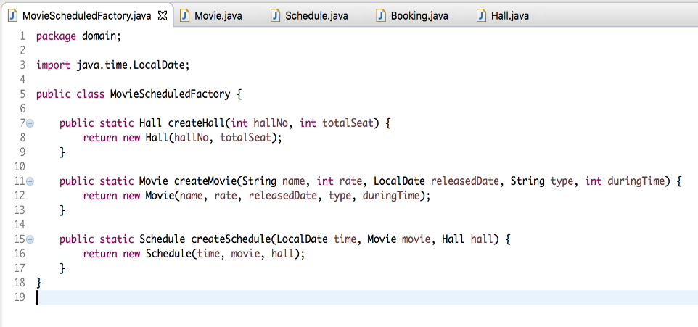
Factory design
It creates an instance of movie, hall, and schedule classes
which are package level classes.

Slide 13
Thank you for attention!

