Slide 1
5COSC020W DATABASE SYSTEMS – LECTURE 09
XPath and XSLT – Navigating through & transforming XML docs

Slide 2
LECTURE 09 – OUTLINE
Extending XML – XPath, XSLT, XQuery (recap)
XPath – XML Path Language (essential recap)
Definition.
Addressing mechanism and terminology in XPath.
Main expressions and operators in XPath.
Predicates with ordered position, with conditions on elements and on attributes.
Wildcards and logical operators.
XSLT – Extensible Stylesheet Language Transformations
Definition and benefits.
Declaration and main elements in XSLT:
<xsl:value-of> , <xsl:sort>, <xsl:if> and <xsl:choose>.

Slide 3
Extending XML – XPath, XSLT and Xquery (recap)
Additional languages to (1) address and navigate through; (2) transform and render; and (3) query XML documents
XPath – XML Path Language
Language to address and navigate through an XML document.
It uses path expressions to select and return nodes by following tree structure.
XSLT – eXtensible Stylesheet Language Transformations
Language to render and transform an XML document into a viewable output file.
It uses XPath to navigate through and locate specific elements and attributes.
XQuery – XML Query Language
Query-based language to extract and retrieve data stored in XML format.
It uses XPath to navigate through and locate specific elements and attributes.

Slide 4
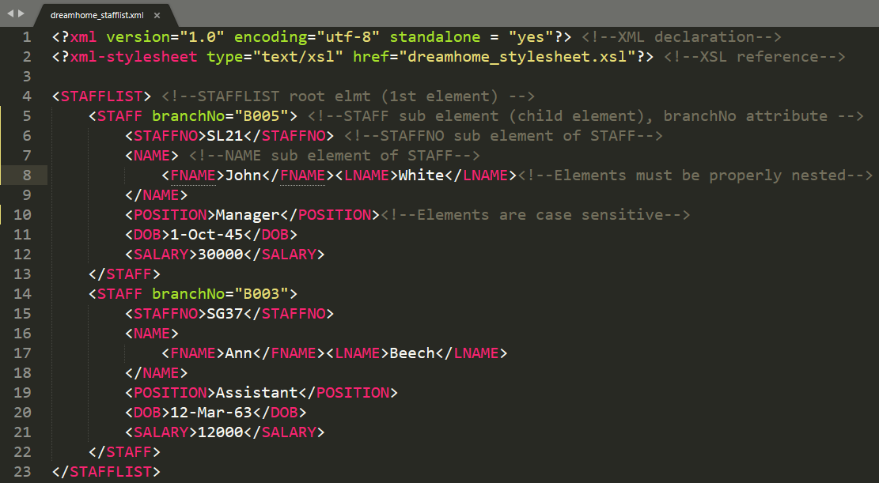
EXAMPLE: XML DOCUMENT – dreamhome_stafflist.xml

Slide 5
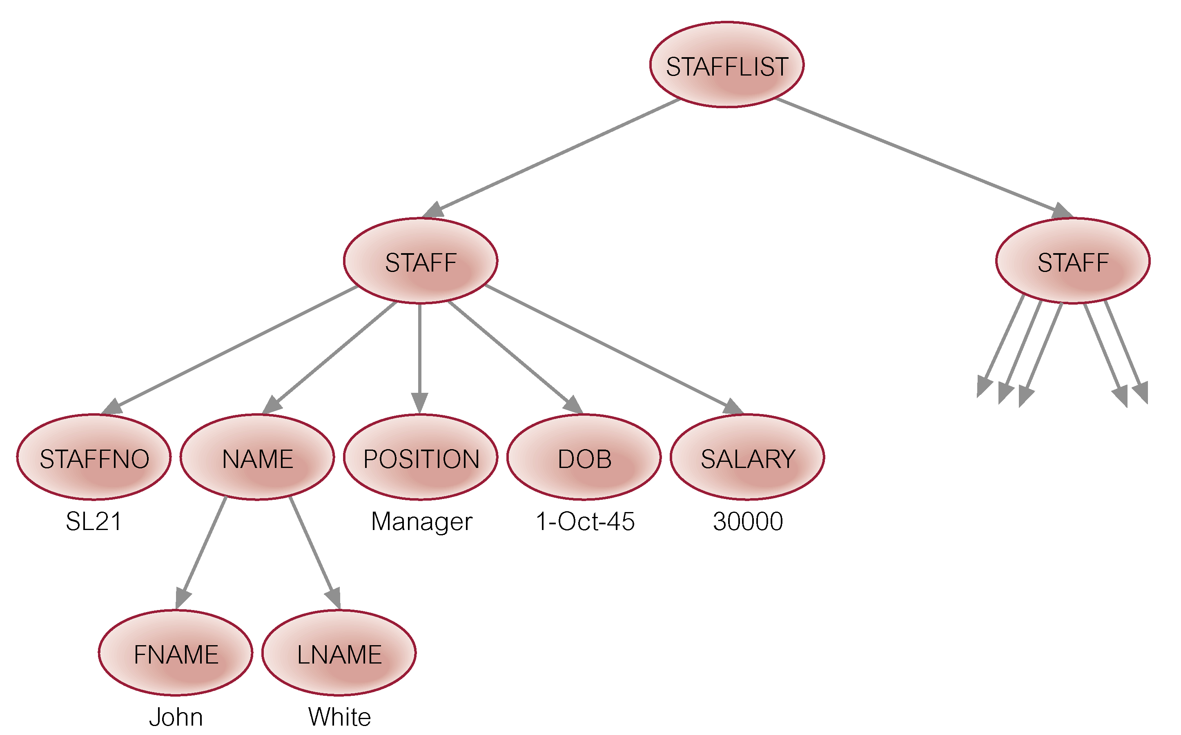
EXAMPLE: TREE STRUCTURE– dreamhome_stafflist.xml

Slide 6
XPath – XML Path Language (recap)
Language used (with XSLT) to address and navigate through elements and attributes in an XML document.
It uses "path like" syntax to identify and navigate nodes in XML document with predicates (e.g. conditions) placed on the path.
It treats an XML doc as a logically ordered tree with nodes for each
Root e.g. <STAFFLIST>
Element e.g. <STAFF>
Attribute e.g. branchNo
Text e.g. Ann
Processing instruction when used with XSLT
Namespace when using data from multiple documents
Comments e.g. <!--elements are case sensitive!>

Slide 7
XPath – Addressing Mechanism (recap)
Context Node: starting point.
Location path: path from 1 point to another in XML document.
Composed of a series of steps joined with a “/”.
Each “/” moves down the tree from parent to child.
Each “..” moves up the tree from child to parent.
Each step has:
A basis: axis which specifies direction of the navigation.
A node test: a type of node in a document.
Name of an Element.
Function such as text() for text nodes.
Function such as node () for any type of node.
Optional predicate in square brackets
Contains a condition that uses logical operators
Position()=number to select from one of many sub-elements.

Slide 8
XPath – Terminology (recap)
Parent: directly higher node within which a specific node is embedded.
e.g. STAFF node is parent node for NAME node.
Ancestor: all higher nodes within which a specific nodes are embedded.
e.g. STAFF and STAFFLIST nodes are ancestor nodes for the NAME node
Child: directly lower node embedded within a specific node.
e.g. NAME node is child node for STAFF node.
Descendant: all lower nodes embedded within a specific node.
e.g. NAME, FNAME, LNAME nodes are descendent nodes for STAFF node.

Slide 9
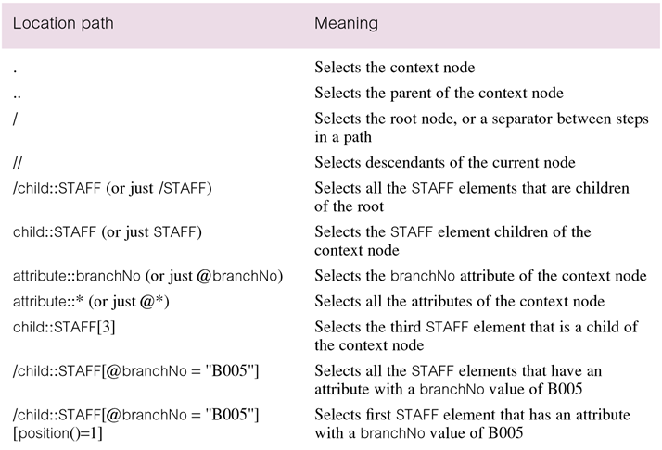
XPath – Location Paths (recap)

Slide 10
XPath – Main Expressions (recap)
Expression | Description | Example | Explanation
nodename | Selects all nodes with name “nodename" | POSITION | Selects all nodes with name POSITION
/rootnode | Selection starts from root node “rootnode” | /STAFFLIST | Selects the root node STAFFLIST (absolute path)
//nodename | Selection starts from context node “nodename”, no matter where in doc | //NAME | Selects all nodes NAME, no matter where in doc (relative path)
//node/childnode | Selection of the child nodes “childnode” of context node “node” | //STAFF/NAME | Selects NAME nodes as child nodes of the node STAFF.
//@attributename | Selection of attributes “attributename”, no matter where in doc | //@branchNo | Selects branchNo attributes, no matter where in doc
//node [predicate] | Selection of the node for which the predicate in square brackets is verified. | //NAME [FNAME="Ann"] | Selects NAME nodes for which FNAME node matches “Ann”
* | Wild card to select any node | //*[FNAME="Ann"] | Select any node for which FNAME matches “Ann”
. | Selection of the current node | //*[FNAME="Ann"]/. | Select node at same level of node for which FNAME matches “Ann”
.. | Selects the parent of the current node | //*[FNAME="Ann"]/.. | Select parent node of node for which FNAME matches “Ann”

Slide 11
XPath – Mathematical and Logical Operators (recap)
Operator | Description | Example
| | Computes two node-sets | //POSITION | //SALARY
+ | Addition | 30000 + 12000
- | Subtraction | 30000 – 12000
* | Multiplication | 30000 * 12000
= | Equal | SALARY = 12000
!= | Not equal | SALARY != 12000
< | Less than | SALARY < 12000
<= | Less than or equal to | SALARY <= 12000
> | Greater than | SALARY > 12000
>= | Greater than or equal to | SALARY >= 12000
or | or | SALARY = 12000 or SALARY = 30000
and | and | SALARY > 12000 AND SALARY < 30000
not | not | not (POSITION="Manager")

Slide 12
XPath – Predicates (recap)
Predicate: written expression in [ ] that defines a position or a condition
Retrieving elements using their ordered position
//STAFF[1] Selects the 1st element of the STAFF node
//STAFF[2] Selects the 2nd element of the STAFF node
//STAFF[last()] Selects the last element of the STAFF node
//STAFF[position()<=2] Selects the first 2 elements of the STAFF node
Retrieving elements using a condition
//STAFF[SALARY >= 30000]
Selects elements of STAFF node for which salary >=30000
//STAFF [POSITION = "Manager"] / SALARY
Selects SALARY node as a child of STAFF node for which POSITION node matches “Manager”
//STAFF [@branchNo="B003"] / NAME
Selects NAME node as a child of STAFF node for which branchNo attribute matches “B003”
//STAFF [@branchNo="B003"] // FNAME
Selects FNAME node as descendent of STAFF node for which branchNo attribute matches “B003”

Slide 13
XPath – Predicates with conditions on elements (recap)
//STAFF [POSITION = "Manager"]/SALARY
Return SALARY node as a child of the STAFF NODE only for the value of the POSITION node that matches "Manager“.
//STAFF [SALARY >= 30000]/NAME/LNAME
Return LNAME node as a child of the NAME node and the STAFF node but only for the SALARY node for which the value is greater or equal to 30000.
//STAFF/NAME [FNAME = "Ann"]/../POSITION
Return the POSITION node for the STAFF node for which the value of the FNAME node matches "Ann“.

Slide 14
XPath – Predicates with wildcards (recap)
//*[SALARY = 30000]/STAFFNO
Return any node for which a SALARY node matches the value 30000, then only return the STAFFNO node.
//*[FNAME="Ann"]/..
Return any ancestor node for which FNAME node matches "Ann" with wildcard.
//*[@branchNo="B005"]//FNAME
Return all the values of the STAFF node for which the attribute branchNo matches "BOO5" then return the FNAME descendent node.

Slide 15
XPath – Predicates with logical operators (recap)
//STAFF [not(@branchNo="B005")]
Return all the nodes at STAFF level for which the attribute branchNo does not match "B005" or "B003".
//STAFF [(@branchNo="B005") or (@branchNo= "B003")]
Return all the nodes at STAFF level for which the attribute branchNo either matches "B005" or "B003".
//STAFF [SALARY >= 10000 and SALARY < 25000]//FNAME
Return all FNAME nodes for which the salary is between 10000 and 25000.
//STAFF [(SALARY >= 10000) and (SALARY < 25000) or (POSITION = "Manager")]/NAME/FNAME
Return all FNAME nodes level for which either the salary is between 10000 and 25000 or the position is Manager.

Slide 16
XSLT: eXtensible Stylesheet Language Transformations
Language to render and transform an XML source document into result document e.g. output HTML file recognizable by a browser.
XSLT can be used to add, remove, rearrange and sort elements to be rendered and to make decisions about which elements to hide or display.
XSLT uses XPath to navigate through and locate specific parts of the source document that should match a predefined template (i.e. transformation rules).
When match found XSLT transforms the matching part of source document into result document.

Slide 17
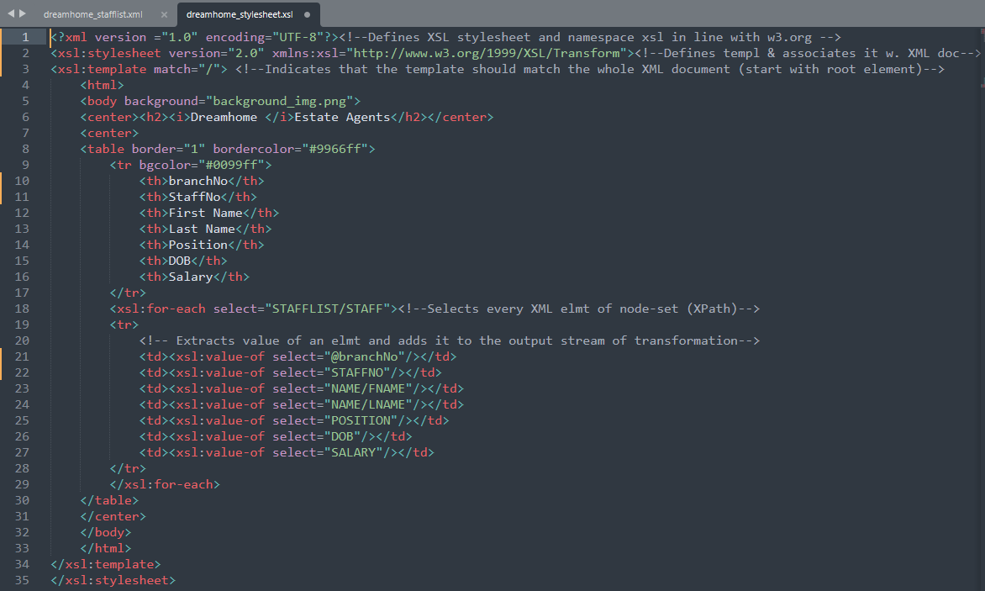
EXAMPLE
XSLT file for
prev. XML doc

Slide 18
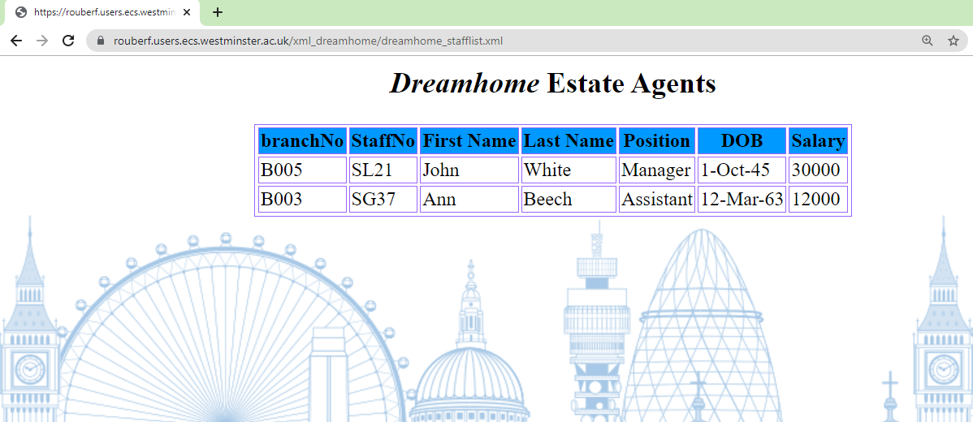
EXAMPLE: Output for dreamhome_stafflist.xml with XSLT

Slide 19
Benefits of using XSLT
Independent of programming:
Transformations are written in a separate XSL stylesheet i.e. a .xsl file.
Output can be altered by simply modifying the transformations in xsl file.
No need to change the XML source document.
Developers can just edit the XSL stylesheet and view the changes made immediately.

Slide 20
XSLT – Declaration and <xsl:template> Element
<?xml version="1.0" encoding="UTF-8"?>
XML declaration since XSL Stylesheet is an XML document.
<xsl:stylesheet version = "2.0" xmlns:xsl = "http://www.w3.org/1999/XSL/Transform">
XSL Stylesheet declaration with a 'xsl' namespace.
The namespace indicates:
which element is to be processed
which is used for output purpose only
<xsl:template match="/">
The template element indicates which section of XML doc needs to be transformed.
The match attribute is used to associate a template (transfo. rules) to XML doc.
It takes an XPath expression, in this case / to indicate the root element.
Therefore it tells the XSLT processor to transform the entire XML document,

Slide 21
XSLT – <xsl:value-of> element and <xsl:for-each> element
<xsl:value-of select="NAME/FNAME"/>
The <xsl:value-of> element extracts the value of an XML element and add it to the output stream of the transformation.
The select attribute contains XPath expression to navigate to required element.
<xsl:for-each select="STAFFLIST/STAFF">
<xsl:value-of select="NAME/FNAME"/>
<xsl:value-of select="NAME/LNAME"/>
</xsl:for-each>
The <xsl:for-each> element iterates and retrieves the specified element repeatedly.
The select attribute contains XPath expression to navigate to required element.

Slide 22
XSLT – <xsl:sort> element
<xsl:for-each select="STAFFLIST/STAFF">
<xsl:sort select="NAME/LNAME"/>
<xsl:value-of select="NAME/FNAME"/>
<xsl:value-of select="NAME/LNAME"/>
</xsl:for-each>
The <xsl:for-each> element provides a sort criteria to sort output.
The select attribute contains XPath expression to navigate to required element.
Default is ascending

Slide 23
XSLT – <xsl:if> element
<xsl:for-each select="STAFFLIST/STAFF">
<xsl:if test="SALARY &gt; 20000">
<xsl:value-of select="NAME/FNAME"/>
<xsl:value-of select="NAME/LNAME"/>
<xsl:value-of select="SALARY"/>
</xsl:if>
</xsl:for-each>
The <xsl:if> element specifies a conditional test against content of the XML doc.
The test attribute contains XPath expression to navigate to required element.
Use &gt; instead of > to avoid conflict with the tag!

Slide 24
XSLT – <xsl:choose> element
<xsl:for-each select="STAFFLIST/STAFF">
<xsl:value-of select="NAME/LNAME"/>
<xsl:choose>
<xsl:when test="SALARY &lt;= 12000">
<xsl:value-of select="0.25*SALARY"/>
</xsl:when>
<xsl:otherwise>
No Bonus
</xsl:otherwise>
</xsl:choose>
</xsl:for-each>
The <xsl:choose> element is used in conjunction with <xsl:when> and <xsl:otherwise> to express multiple conditional tests.
Use &lt;= instead of <= to avoid conflict with the tag!

Slide 25
Comparison operators used within attributes
 | Operator | Within Attribute
equals | = | =
not equals | != | !=
less than | < | &lt;
less than or equal to | <= | &lt;=
greater than | > | &gt;
greater than or equal to | >= | &gt;=

Slide 26
REFERENCES
Connolly, T. & Begg, C. E. (2015). Database systems: a practical approach to design, implementation and management. 6th Edition (Global Edition). Pearson Ed.
Elmasri, R. & Navathe, S. (2017). Fundamentals of Database Systems. 7th Edition (Global Edition). Pearson Education.
Tutorialspoint (2022). XPath Tutorial. Available from https://www.tutorialspoint.com/xpath/index.htm. [Accessed 15 Sept 2022]
Tutorialspoint (2022). XSLT Tutorial. Available from https://www.tutorialspoint.com/xslt/index.htm. [Accessed 15 Sept 2022]
W3Schools (2022). XPath Tutorial. Available from https://www.w3schools.com/xml/xpath_intro.asp. [Accessed 15 Sept 2022]
W3Schools (2022). XSLT Tutorial. Available from https://www.w3schools.com/xml/xsl_intro.asp. [Accessed 15 Sept 2022]
Tidwell, D. (2008). XSLT. 2nd Edition. O’Reilly.

