Slide 1
Hello
This is the subtitle

Slide 2
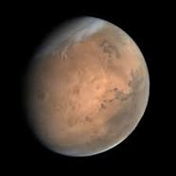
This is the first topic – Solar systems
Planets
Mars
Earth
Venus
Jupiter

Slide 3
Distance
This is a new slide

Slide 4
table
Navigation Apps | Monthly unique users in millions
154.6468 | Google Maps
25.87361 | Waze
23.49442 | Apple Maps*
21.11524 | Mapquest
5.055762 | Google Earth
2.67658 | Yahoo! Maps

Slide 5


Slide 6
Text 1
Text
2sdffs df
Sd
Fsd
F

