Slide 1
ScriptGenAI

Slide 2
We make informative script for your presentation slide deck ScriptGenAI allows to upload a slide deck and generate a complete script to deliver an excellent presentation out of it.

Slide 3
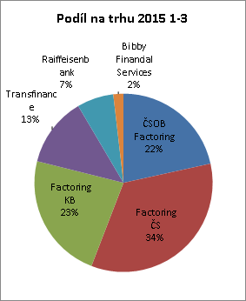

Slide 4


Slide 5
