Slide 1
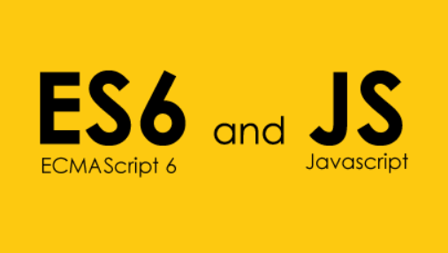
ECMAScript 2016 and JavaScript

Slide 2
JavaScript
Array Object and methods
Bind, Call and Apply
Scope, Closures, and Captures

Slide 3
Array Object and Methods
Concat
Join
Push
Pop
Shift
Unshift
Slice
Splice
Reverse
Sort
indexOf
lastIndexOf
forEach
Map
Filter
Every
Some
Reduce
reduceRight

Slide 4
Bind, Call and Apply
Call
run in the context of the first argument
In call the subsequent arguments are passed in to the function as they are.
Apply
run in the context of the first argument
apply expects the second argument to be an array that it unpacks as arguments for the called function.
Bind
The bind method enables you to pass arguments to a function without invoking it. Instead, it returns a new function with the arguments bound preceding any further arguments.

Slide 5
Scope, Closures, and Captures
Scope
Closure Function
Captures of function
Note that the outer function captures a reference to the target element and also defines a function to update it. The inner code doesn’t reference the DOM at all, instead it uses a generic setVal call and passes in the element reference and new value.
Using this approach allows you to further abstract logic from presentation and enable a better designer/developer workflow. In fact, for testing you could inject a mock object and/or a mock function and the inner code will work the same. These concepts are just as useful when applied to projects using jQuery, Kendo UI, Angular, or any other framework.

Slide 6
Introduction ES
ECMAScript specification: history
1st ed. 1997
2nd ed. 1998
3rd ed. 1999
4th ed. 2008 (Abandoned)
5th ed. 2009
6th ed. June 2015

Slide 7
Introduction ES
Ecmascript 5 Strict mode
How many of you have heard of ECMAScript 5 strict mode?
How many of you are writing all of their code in strict mode?

Slide 8
Strict Mode
Explicit opt-in to avoid backwards compatibility constraints
How to opt-in
Per “program” (file, script tag, ...)
Per function
Strict and non-strict mode code can interact (e.g. on the same web page)
Advantages
Strict mode makes it easier to write "secure" JavaScript.
Strict mode changes previously accepted "bad syntax" into real errors.
Eliminate JavaScript silent errors by throwing error.
Fixes mistake that make it difficult for JavaScript engine to perform optimization.
Make code run faster sometime than identical code that’s not in strict mode
Prohibits some syntax likely to be defined in future version of ECMAScript.

Slide 9
Get Started with learning ES6
Variable hoisting/declaration
Lambda Functions (Arrow functions)
Destructuring rest parameters
Enumerable Properties
Classes

Slide 10
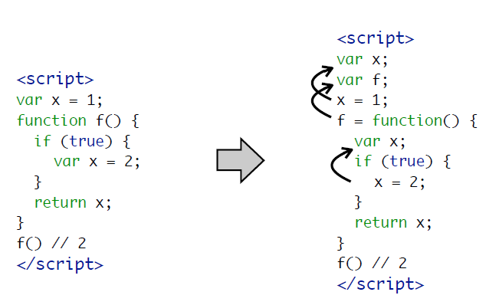
Variable hoisting

Slide 11
Variable hoisting : ES6
Variable hoisting - Let
Global Variable
Scoped Variable
Closure in Loop

Slide 12
Variable hoisting : ES6
Variable hoisting - const
Global Variable
Read Only Variable
Immutable binding

Slide 13
Thank You
Any Questions…???

Slide 14


