Slide 1

Exploratory Data Analysis
G2M CAB INDUSTRY CASE STUDY
10TH AUG 2021

Slide 2
Background
XYZ is a private firm in US. Due to remarkable growth in the Cab Industry in last few years and multiple key players in the market, it is planning for an investment in Cab industry .

Slide 3
Problem Statement
Go-to-Market(G2M) strategy for XYZ is to understand the market before taking final decision.
Objective: To help XYZ to find the best cab company to invest in.
The objective will be achieved by using data to find insights that will help identify the right company to invest in.

Slide 4
Data Analysis Approach
Explore and understand the data
Find the company with the best financial health:
Find the company with the most revenue and profits
Analyze the profit and revenue trends
Get the company that has a competitive advantage in terms of customer retention and a stream of new customers.
Give recommendations for investments

Slide 5
Data Exploration
Four files merge together to form one dataset
359,392 data points
20 features (6 derived features)
Timeframe of the data: 2016-01-31 to 2018-12-31
Assumptions:
Only Price_Charged and Cost_of_Trip features used to calculate profit. Other factors are kept constant
Users feature represents the number of all cab users in a city no matter what cab it is
Outliers are present in Price_Charged feature but due to unavailability of trip duration details ,we are not treating this as outlier.

Slide 6
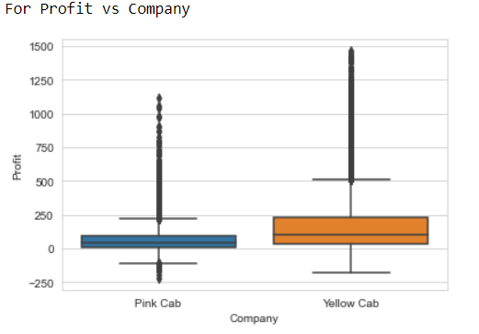
Profit Analysis
.On average Yellow Cab has got more profits than the Pink Cab.

Slide 7
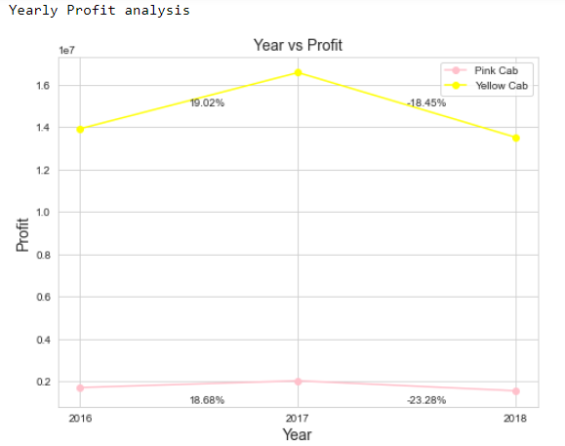
Yearly Profit Analysis

Slide 8
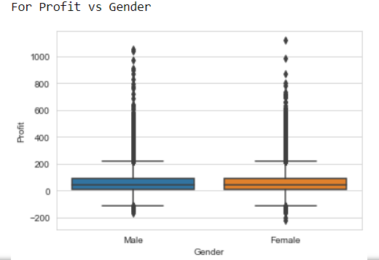
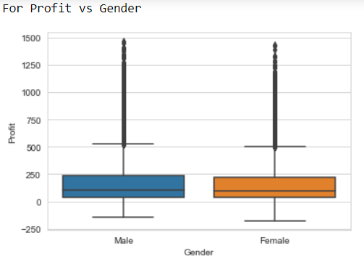
Gender Contribution in the profit
Pink Cab
Yellow Cab
Equal distribution of gender in the profit for both the Pink and Yellow Cab

Slide 9
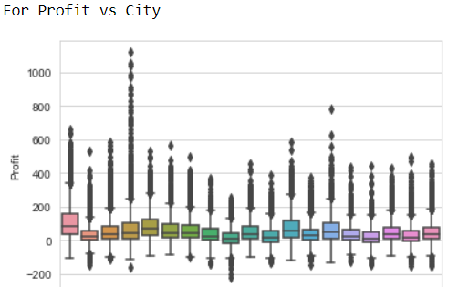
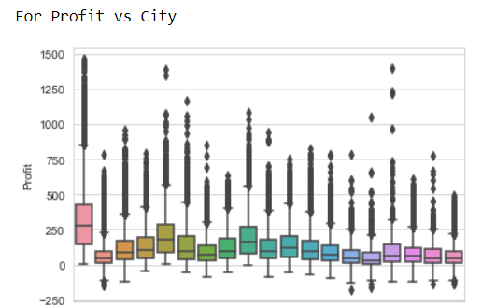
City wise Contribution in Profit
Pink Cab
Yellow Cab
Contribution in the profit differs from city to city with New York having the highest for both companies.

Slide 10
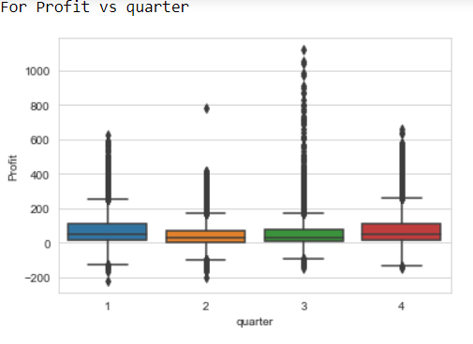
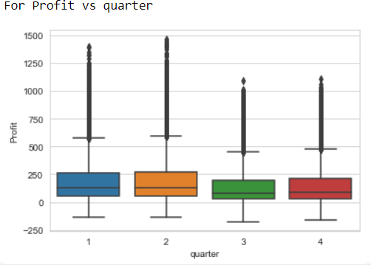
Profit Amount by Quarter
Pink Cab
Yellow Cab
For the Pink cab quarter 1 and 4 have on average higher contribution in profit than 2 and 3.
For the Yellow cab quarter 1 and 2 have on average higher contribution in profit than 3 and 4

Slide 11
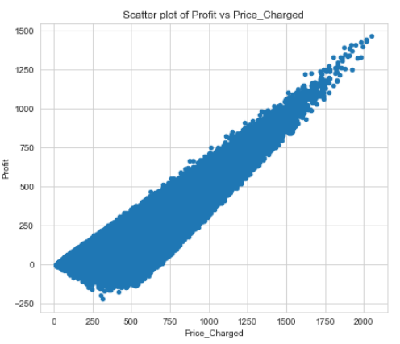
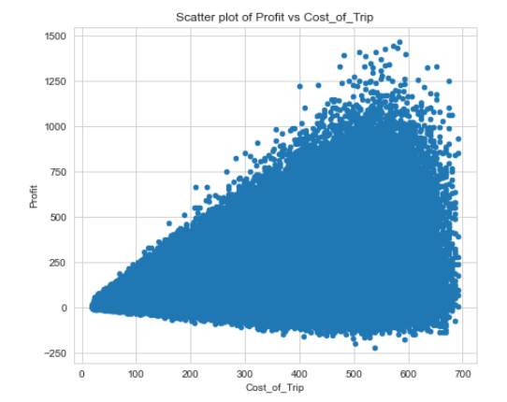
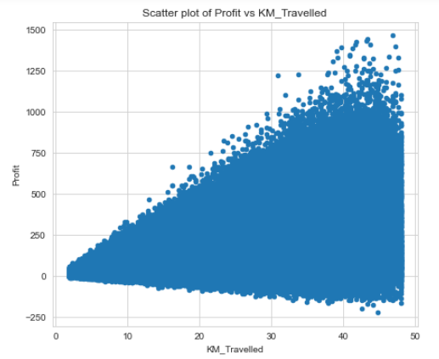
Profit Correlation with Features
High correlation: 0.86
Moderate correlation:0.48
Moderate correlation:0.46

Slide 12
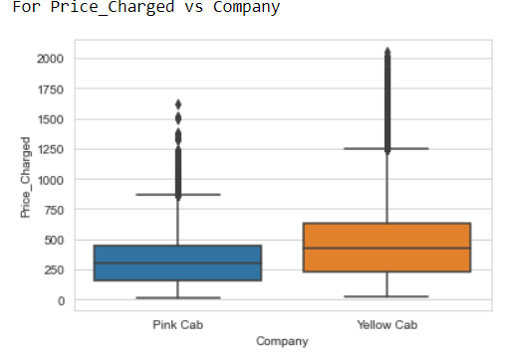
Revenue Trends
Higher Price charged for the Yellow Cab means that it has higher revenue than Pink Cab.

Slide 13
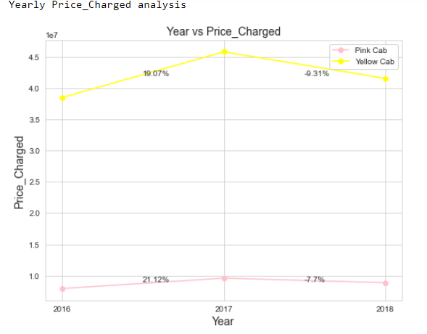
Revenue Yearly Analysis

Slide 14
Number of Customers by Company
Company | Number of Customers
Pink Cab | 32330
Yellow Cab | 39896
Yellow Cab has got more customers as compared to the Pink Cab.

Slide 15
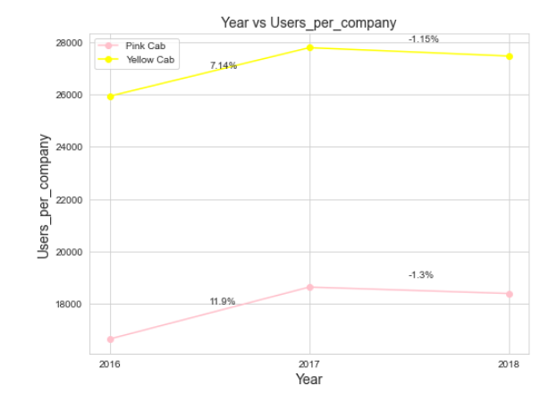
Yearly Customer Analysis

Slide 16
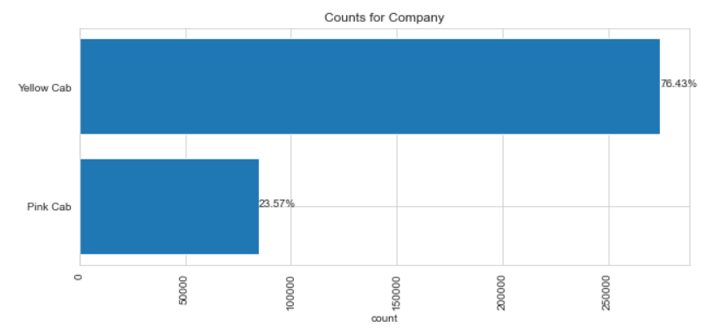
Transactions by Company
Company | Transactions
Yellow Cab | 274681
Pink Cab | 84711
Yellow Cab has got more transactions than Pink Cab.

Slide 17
Customer Analysis by Transactions
About 14% of the total transactions for yellow cab were from unique customers while for the pink cab, about 38% of the total transactions were from unique customers.
The lower the number of customers out of the total transactions, the better the company is in customer retention
Company | Total transactions | No. of customers | % transaction of unique customers
Pink Cab | 84711 | 32330 | 38.17%
Yellow Cab | 274681 | 39896 | 14.52%

Slide 18
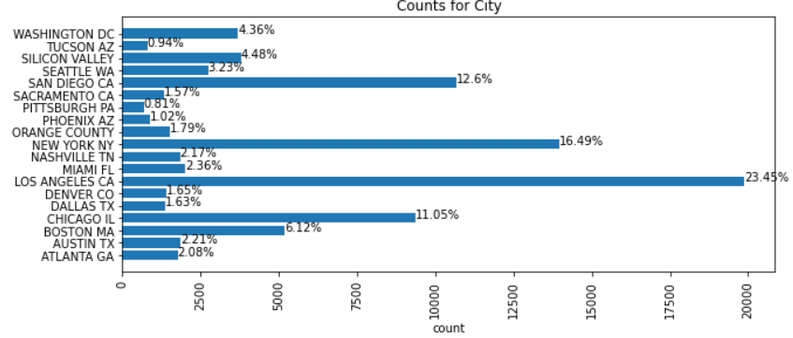
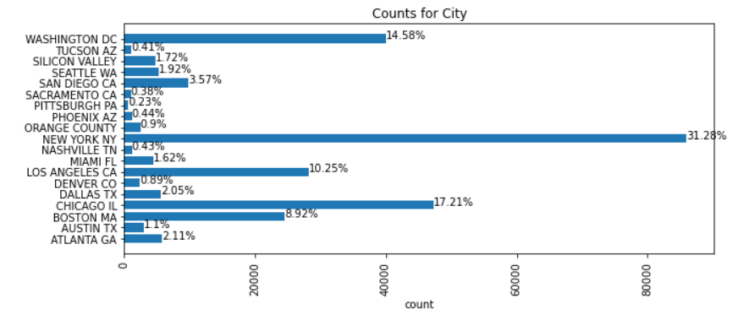
Transactions by city
Pink Cab
Yellow Cab
Pink cab has most of it’s transactions from Los Angeles with about 23% of it’s total transactions while Yellow cab has most of it’s transactions from New York with about 31% of it’s total transactions.

Slide 19
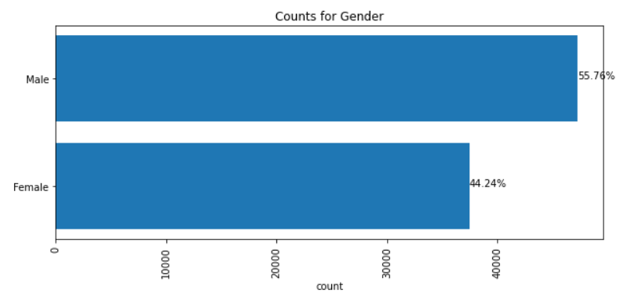
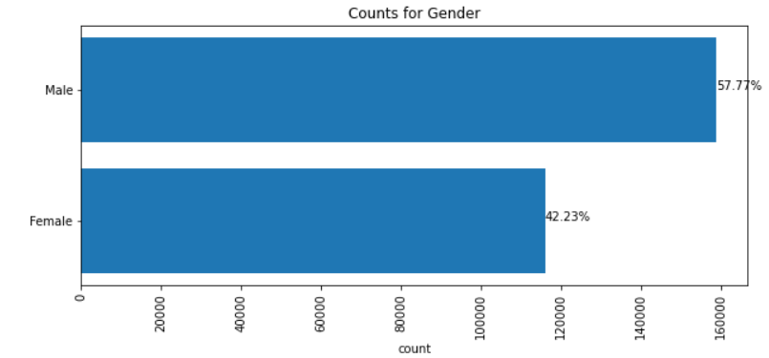
Transactions by Gender
Pink Cab
Yellow Cab
Pink Cab has a greater percentage of transactions from female customers than that of Yellow Cab.

Slide 20
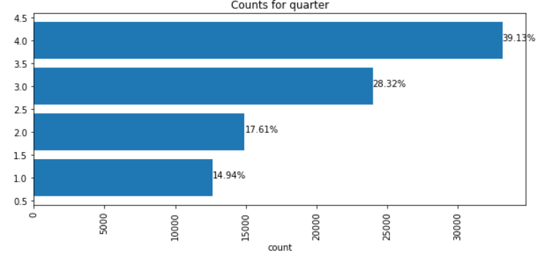
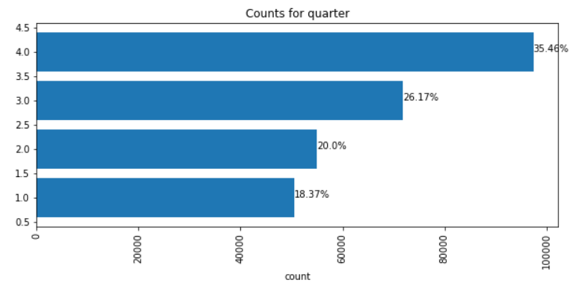
Transactions by quarter
Pink Cab
Yellow Cab
Both cabs have transactions increase from the first to the last quarter, though performance of the first two quarters is better for the Yellow Cab than the Pink Cab.

Slide 21
Recommendations
From the evaluation of the points below, Yellow Cab is found to be a better cab than Pink Cab for investing in.
Average profit per company – On average Yellow Cab has a higher profit than Pink Cab.
Income – On average Yellow Cab has a higher income than Pink Cab. Income is highly correlated to profit with correlation of 0.86, thus with a higher income, Yellow Cab has a higher profit.
Transactions – Yellow Cab has got more number of transactions than the Pink Cab.
Customer Retention – Yellow Cab is better in customer retention than Pink Cab. About 14% of the total transactions for yellow cab were from unique customers while for the pink cab, about 38% of the total transactions were from unique customers.
Performance in New York – New York is the highest contributor to profit in both companies. When looking at transactions per city, Yellow Cab has highest transactions in New York with about 31% of it’s transactions while Pink Cab has highest transactions in Los Angeles followed by New York which has about 16% of it’s total transactions. Yellow Cab is in a better position to making profits since it’s best performance is in a city that produces high profits.
Stability – In 2018, both companies had losses in the profit and number of customers. The Pink Cab had greater percentage in the losses than the Yellow Cab. Thus Yellow Cab is more stable in it’s profit and the number of customers than Pink Cab.
As per the points above Yellow Cab is recommended for investment.

Slide 22

Thank You

