Slide 1

AfricaR Initiative
SatRday Kampala, 2019

Slide 2
Who are we?

Slide 3
Mission:
To achieve improved representation and empower the African population of all genders, who are underrepresented in the global R community.
Support already existing R Users across Africa, and R enthusiasts to embrace the full potential of R programming
Through fostering a collaborative continental network of R gurus, mentors, learners, developers and leaders, to help facilitate individual and collective progress worldwide.

Slide 4
Why AfricaR?
Many R Users in Africa, who did not know of the larger global #rstats community.
Lack of awareness about R Conferences that we can apply for, and attend, through diversity scholarships.
People learning R, but are not aware of where to apply the skills they learn.
Education system is lacking. Some campuses teach R, but the curriculum is not exhaustive.
“Battle” between R and Python:
Employers JDs prioritize Python over R
Python community stronger than R community. Conferences such as
Pycon
IndabaX

Slide 5
What ideas do we have for AfricaR?

Slide 6

01: Adopt an Africa R User Group
Notes:
Developed R User Groups mentoring/supporting new R User Groups

Slide 7
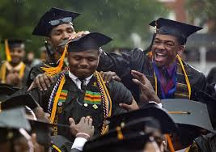
02: Seek remote internships / jobs for students fresh from school

Slide 8
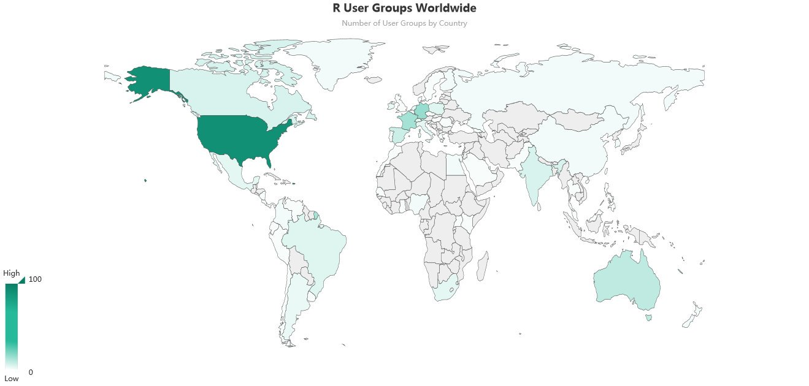
03: Spring up as many ARUGs

Slide 9
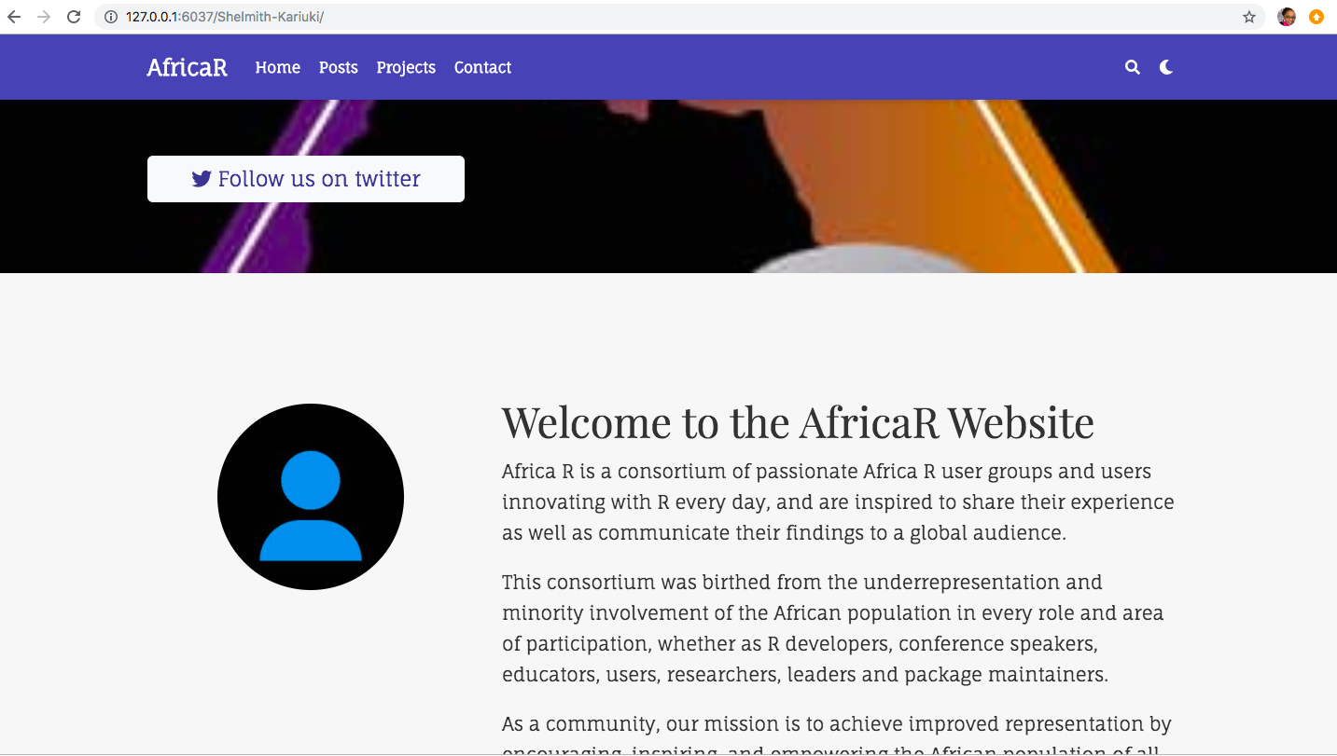
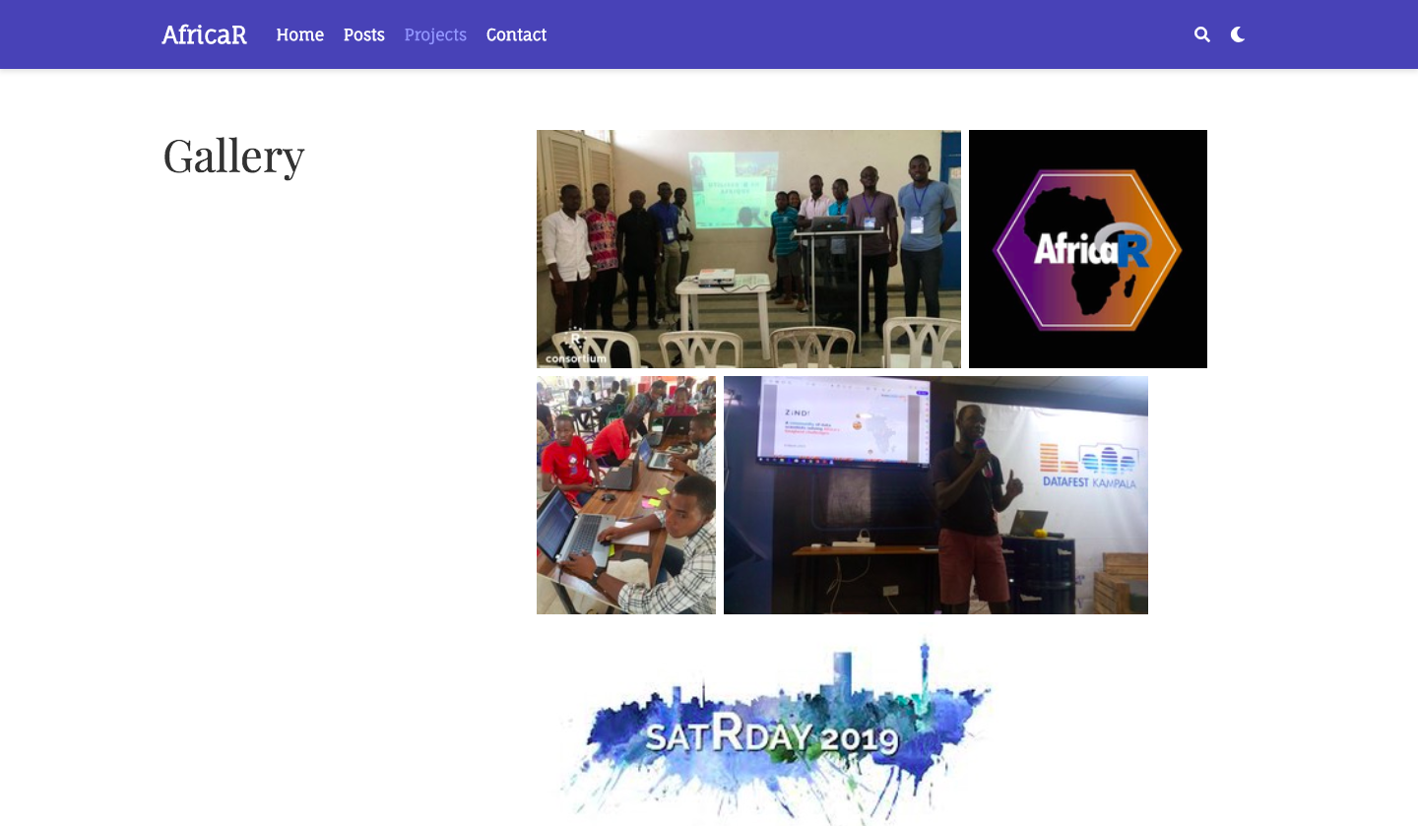
04: Develop a website

Slide 10
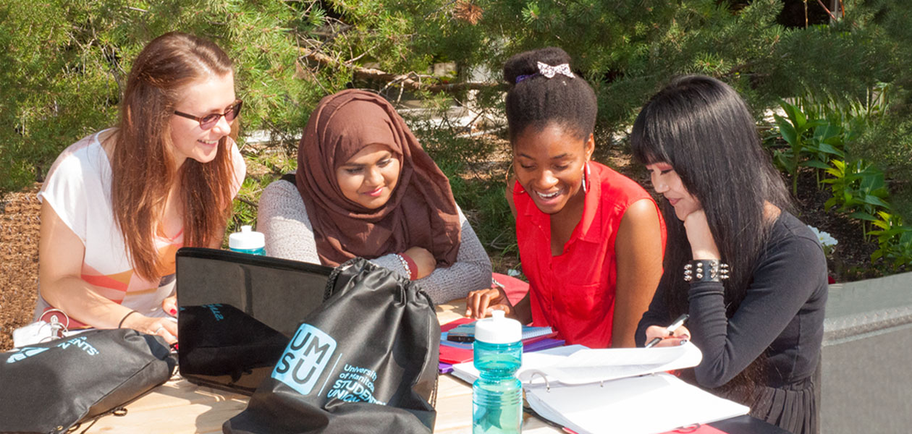
05: Set up R Clubs in Campuses

Slide 11

06: AfricaR Monetary Fund
Notes:
Funds to support developing ARUGs

Slide 12
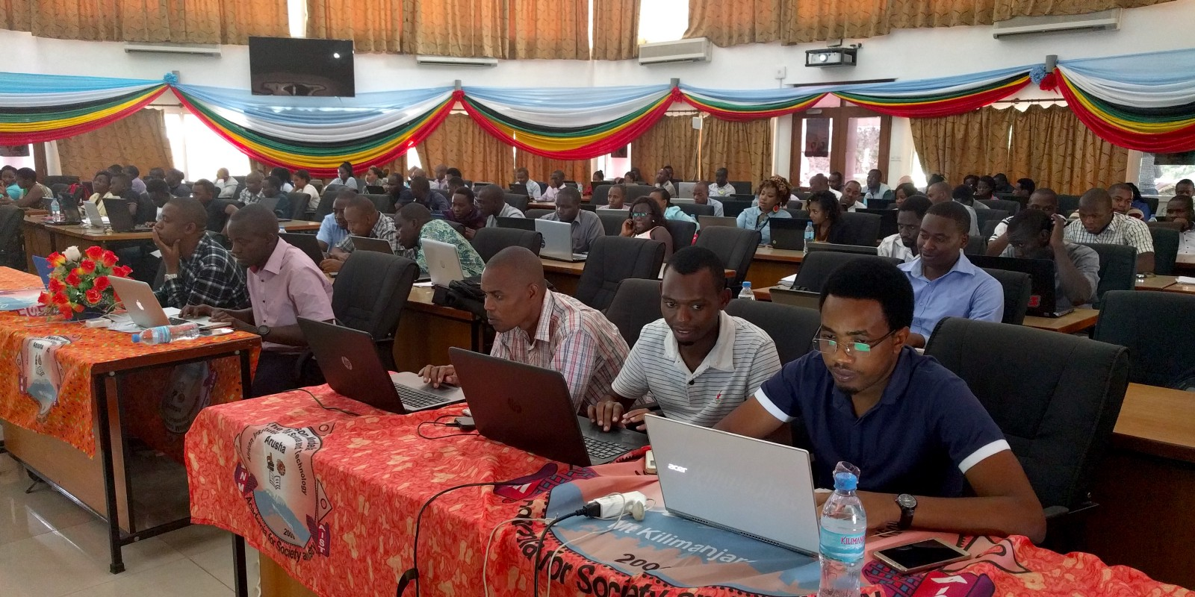
07: Have a grand AfricaR Conference
Notes:
African version of erum
3 days summer school, 2 days workshop
Venue should be a country with lenient travel rules (visas and passports)

Slide 13
What have we done so far?
Jan
Feb
Mar
April
May
Inception call with R Consortium
Gathered people who led/planning to initiate ARUGs in their respective countries.
Inception call with the ARUGs leads team
Discussions about potential R Clubs in campuses
Discussions with different ARUG leads who needed support e.g Cairo, Lagos
SatRday Kampala
First remote internship opportunity
Discussions about 2020 AfricaR Conference
AfricaR Logo
Kikckstarting the website
Discussions with potential partners and sponsors
@AfricaRUsers
twitter account

Slide 14
Quick Wins …

Slide 15
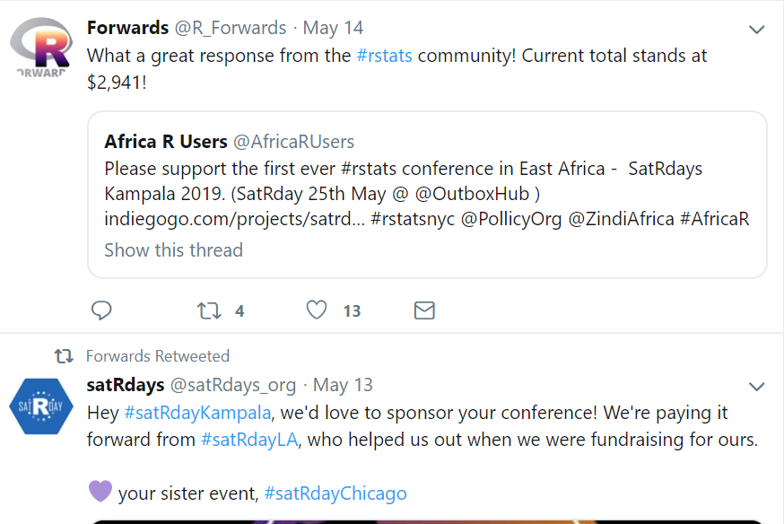



Notes:
Immense support from the #rstats community, for SatRday Kampala
Invitation to travel to France

Slide 16

Weebale Nnyo !!!
Notes:
African version of erum
3 days summer school, 2 days workshop
Venue should be a country with lenient travel rules (visas and passports)

