Slide 1
Purity Moraa Kinaro
Web Tech Summer 2024 Final Exams

Slide 2
Purity is developing a data-powered website to help the Office of Diversity and International Programs solve the Ashesi Buddy-up pairing system.

Slide 3
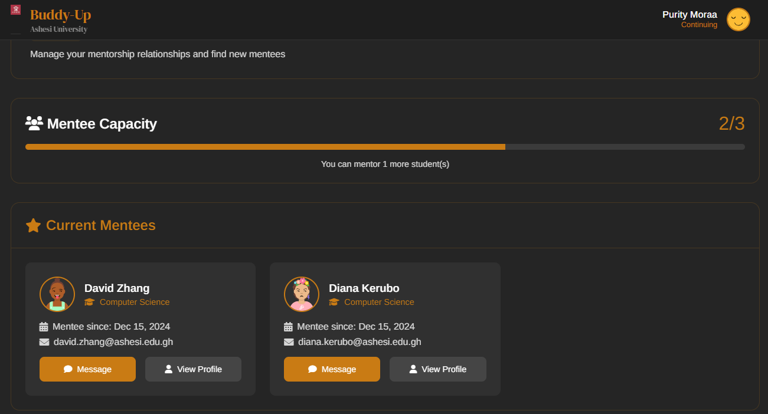
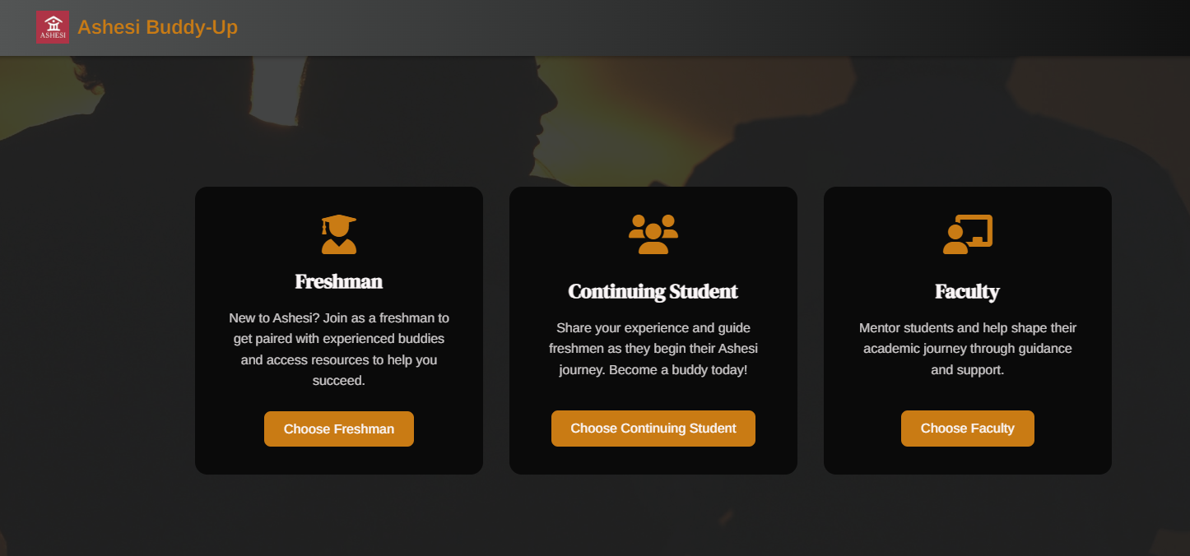
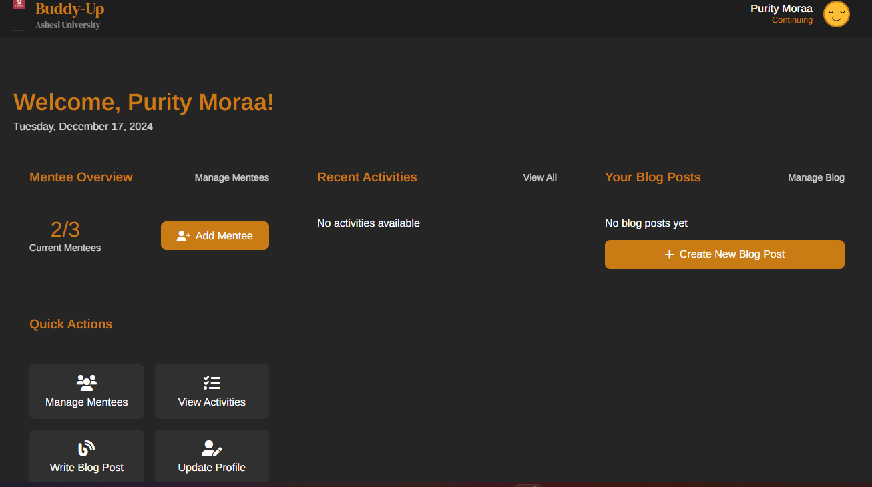
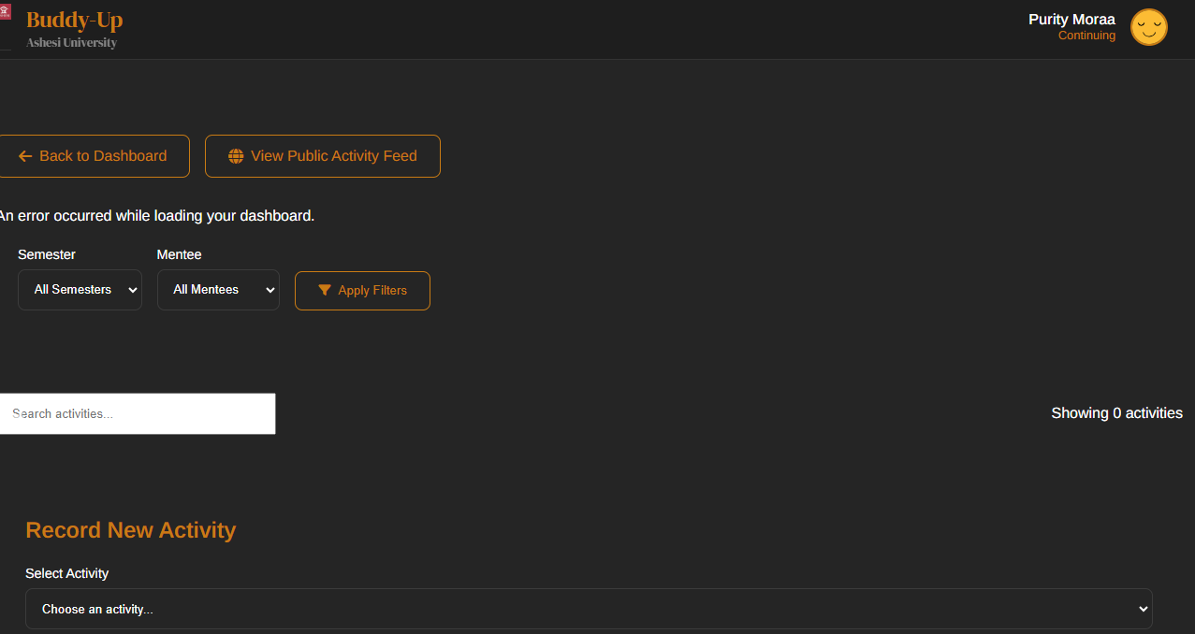
Ashesi Buddy-up
ddd
The Ashesi Buddy up platform will help pair freshmen to continuing students as mentors, blog about their experiences, get to select the activities that have been created for them by the faculty and the paired buddies will be able to send and receive messages to each other.
PAYOFF: This is a screenshot of a student who has been paired with two freshmen. This is the main functionality of the website. Pairing freshmen to continuing students as their mentors.
1. Freshmen 2. Continuing students 3. Faculty 4. A super admin from the ODIP offices.
The ODIP will save time because initially, they have been pairing students by hand, and this is very tiresome and time-consuming. With this new platform, they don’t have to do that.

Slide 4
User / Customer
Description of the Organization
The Ashesi Buddy-Up Program is an initiative designed to help incoming freshmen at Ashesi University integrate smoothly into the university environment. It pairs freshmen with continuing students (buddies) who can offer guidance, support, and mentorship during the transition into university life.
Users and Roles:
Freshmen: Sign up and get paired with a buddy. (mentor). Blog about their experiences and send and receive messages from their buddies.
Continuing Students: Act as buddies and mentor up to 3 freshmen. Blog about their experiences and send and receive messages from their buddies. They can also select activities to do with their busied.
Faculty: Create activities for the paired buddies and students and provide support.
Super Admin: Manage the entire website.

Slide 5
Main Functions of the Website
Pair freshmen to continuing students as buddies.
Buddies can message each other.
The users can blog about anything.
Faculty creates activities that students will do with their buddies.

Slide 6
Architecture
HTTP Requests SQL Queries
CRUD Operations
SQL Queries
Front end: HTML, CSS, JavaScript.
Backend: PHP
MySQL Database
Data storage.
MySQL Database
Data storage

Slide 7
Links:
Website:Ashesi Buddy-Up Program
GitHub: https://github.com/Puritymoraa/ASHESI-BUDDY-UP-PLATFORM
Demo video: https://youtu.be/8B_OcZ1SFHY

