Slide 1
FUNCTION
By
Nupur Boral

Slide 2
What is Function ?
A function is a self-contained block of statements that perform a coherent task of some kind. Every C program can be thought of as a collection of these functions. As we noted earlier, using a function is something like hiring a person to do a specific job for you. Sometimes
the interaction with this person is very simple; sometimes it’s complex.

Slide 8


Slide 10
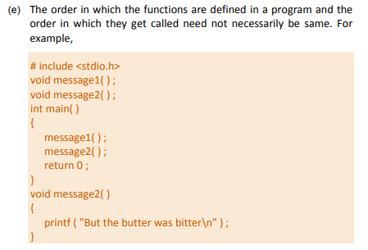

Slide 11
There are basically two types of functions:
Library functions Ex. printf( ), scanf( ), etc.
User-defined functions Ex. argentina( ), brazil( ), etc.

Slide 12
Why use functions ?
Writing functions avoids rewriting the same code over and over.
By using functions it becomes easier to write programs and keep track of what they are doing.

Slide 13
Passing Values between functions

Slide 14
Scope Rule of Functions

Slide 15
Thank you

