Slide 1
Chapter 14
Bitwise Operators
Objectives
❏ To be able to use the bitwise logical operators in programs
❏ To be able to use the bitwise shift operators in programs
❏ To understand how to create and use masks to manipulate bits
Computer Science: A Structured Programming Approach Using C

Slide 2
14-1 Exact Size Integer Types
The integer types, such as int and long, are machine dependent. In one computer, the size of int may be four bytes; in another computer it may be two bytes. While many bitwise applications work well on machine-dependent integer types, other applications need to assure that the size is fixed. C allows us to define integer types of sizes 8, 16, 32, and 64 bits.
Computer Science: A Structured Programming Approach Using C

Slide 3
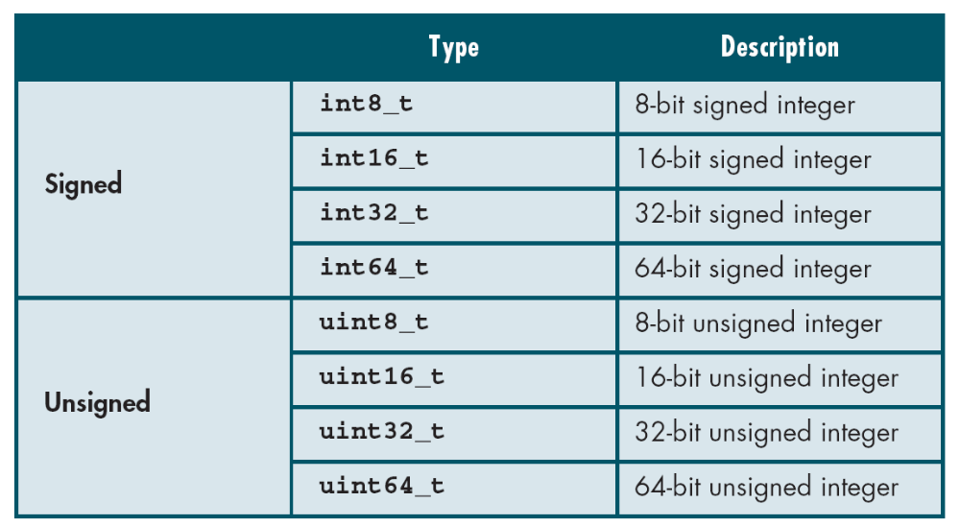
Table 14-1
Fixed-size Integer Types
Computer Science: A Structured Programming Approach Using C

Slide 4
14-2 Logical Bitwise Operators
The logical operators look at data as individual bits to be manipulated. Four operators are provided to manipulate bits: bitwise and (&), bitwise inclusive or (|), bitwise exclusive or (^), and one’s complement (~). The first three are binary operators; the one’s complement is a unary operator.
Topics discussed in this section:
Bitwise and Operator
Bitwise Inclusive or Operator
Bitwise Exclusive or Operator
One’s Complement Operator
Computer Science: A Structured Programming Approach Using C

Slide 5
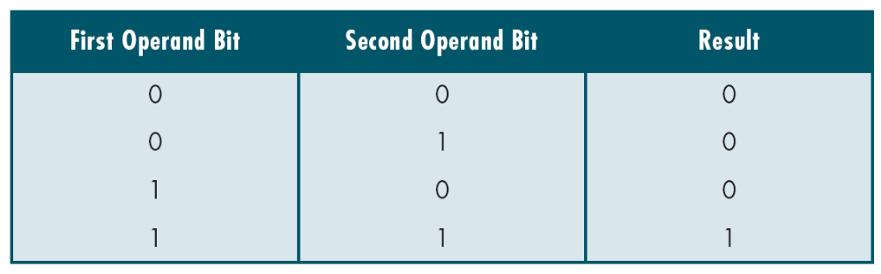
Table 14-2
And Truth Table
Computer Science: A Structured Programming Approach Using C

Slide 6
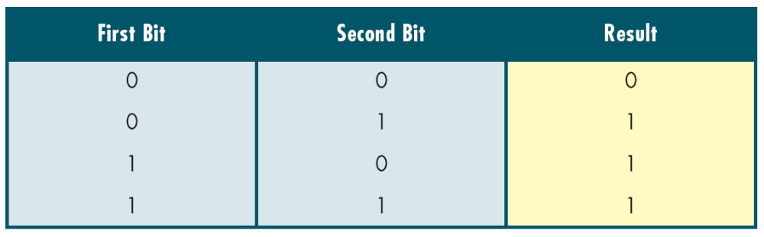
Table 14-3
Inclusive Or Truth Table
Computer Science: A Structured Programming Approach Using C

Slide 7
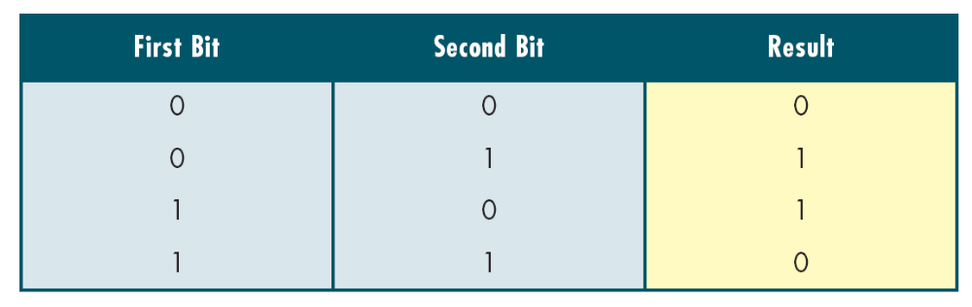
Table 14-4
Exclusive Or Truth Table
Computer Science: A Structured Programming Approach Using C

Slide 8

Table 14-5
One’s Complement Truth Table
Computer Science: A Structured Programming Approach Using C

Slide 9
14-3 Shift Operators
The shift operators move bits to the right or the left. When applied to unsigned numbers, these operators are implementation independent. When used with signed numbers, however, the implementation is left to the discretion of the software engineer who designs the compiler.
Topics discussed in this section:
Shift Operator
Computer Science: A Structured Programming Approach Using C

Slide 10
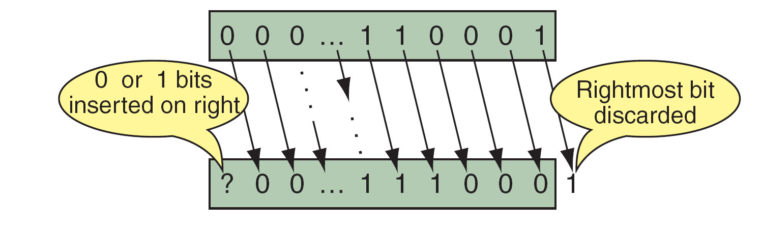
FIGURE 14-2 Shift-right Operation
Computer Science: A Structured Programming Approach Using C

Slide 11
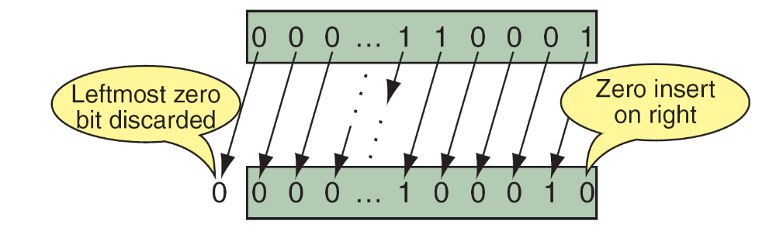
FIGURE 14-3 Shift-left Operation
Computer Science: A Structured Programming Approach Using C

