Slide 1
Welcome To Quick Shopping (Android Application)

Slide 2

Guide Teacher : Mrs. Nibedita Rout Student Name : Purnendu Sahoo Regd.No : 1905106019
College of Engineering and Technology, Bhubaneswar
Branch : CSA

Slide 3
CONTENT
Introduction
Aim of project
FLOW DIAGRAM
Technology used
Proposed work
Functionality
conclusion

Slide 4
INTRODUCTION
Shopping is an activity in which a customer browses the available goods or services presented by one or more retailers with the potential intent to purchase a suitable selection of them.
Although Traditional shopping is a tedious and time consuming job, but still some difference in actually going to shops, and buy a product.
Customers also feel wary to carry out online purchases due to fear of less product quality.

Slide 5
AIM OF PROJECT
The customer himself can scan the barcode using his mobile while making purchases, retrieve essential details of all products from the shop's database and generate bills himself.
This bill can be sent to the cashier’s computer using web service. Thus the user can make quick payment at the counter and leave the shop early.

Slide 6

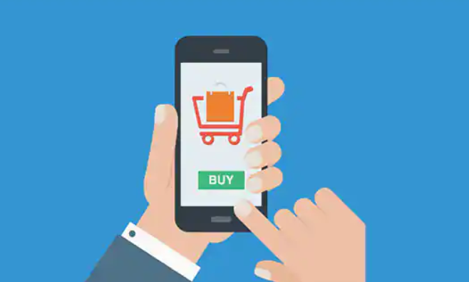
(Satisfaction But Time taking. Here we have to wait for payment)
(Satisfaction with quick payment. Here we haven't to wait for payment)​

Slide 7
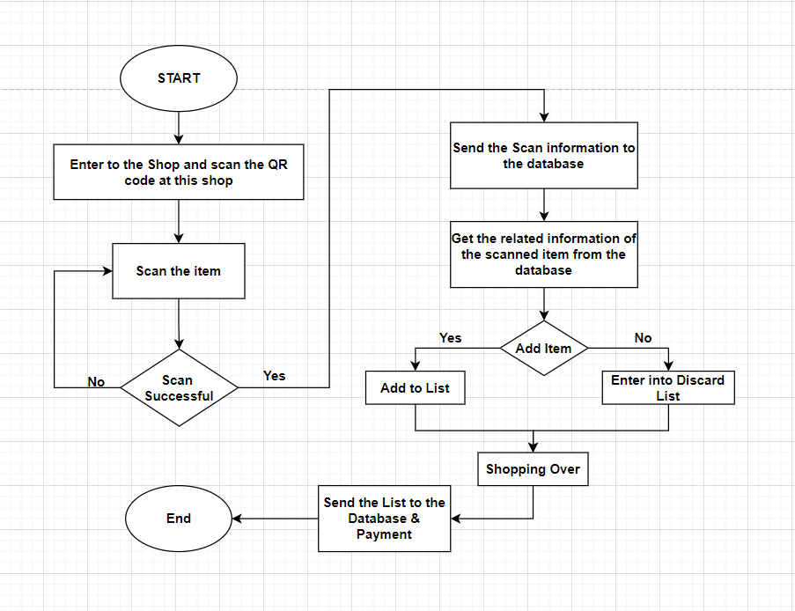
FLOW DIAGRAM

Slide 8
TECHNOLOGY USED
Software
Frontend
Android Development Tool
XML
Backend
Java
Firebase
IDE
Android Studio
Hardware
Developing Environment
Intel i5 8th generation
windows 10
Android Studio installed
Application Requirement
Android version 5.1(Lollipop onwards)
2GB RAM & Above

Slide 9
PROPOSED WORK
The user will scan the item which he wants to purchase with the help of a scanner provided by this app. After scanning the item a web service will get called which will create a connection with the database of the shop. As the connection is established, the user is now synched with the database and information related to that item is provided to him. In this whole procedure the overall time of scanning of individual items is saved and thus reducing the time of the shopping.
The assumptions for the app are-
Shop has Wi-Fi facility
User has installed the app in their Mobile

Slide 10
FUNCTIONALITY
Sign In
Sign Up
Add Product
Delete Product
View Product
View Inventory
Payment
Logout

Slide 11
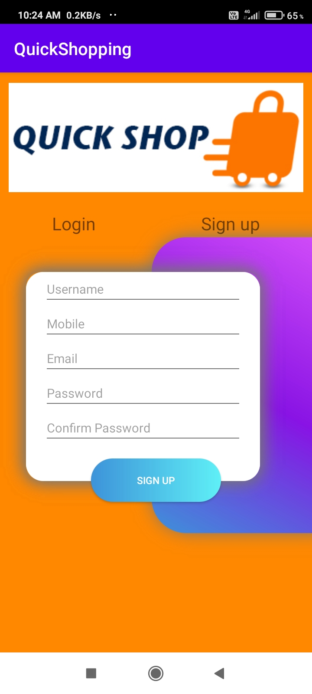
SIGN UP
This is user sign up page. In this page users have to give his/her Bio data(i.e. Name, Mob, Email) and have to set their own password .

Slide 12
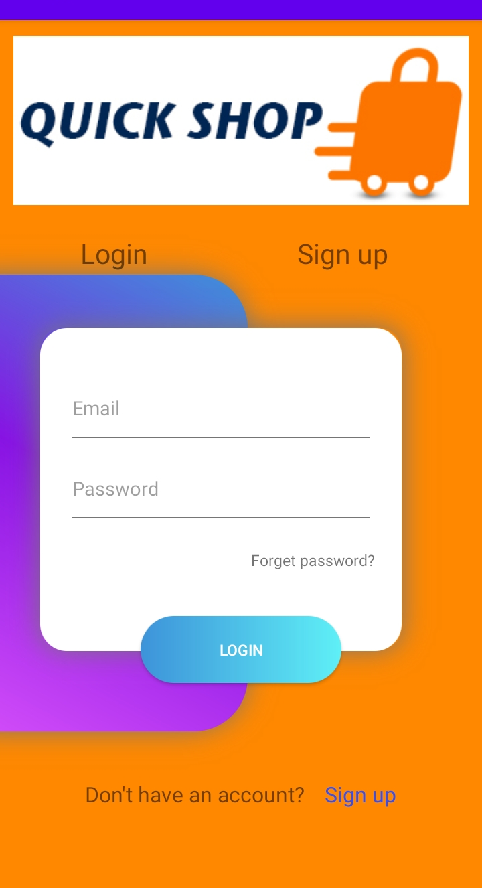
LOG IN
This is user log in page. In this page the existing user have to log in give with email id and password.

Slide 13
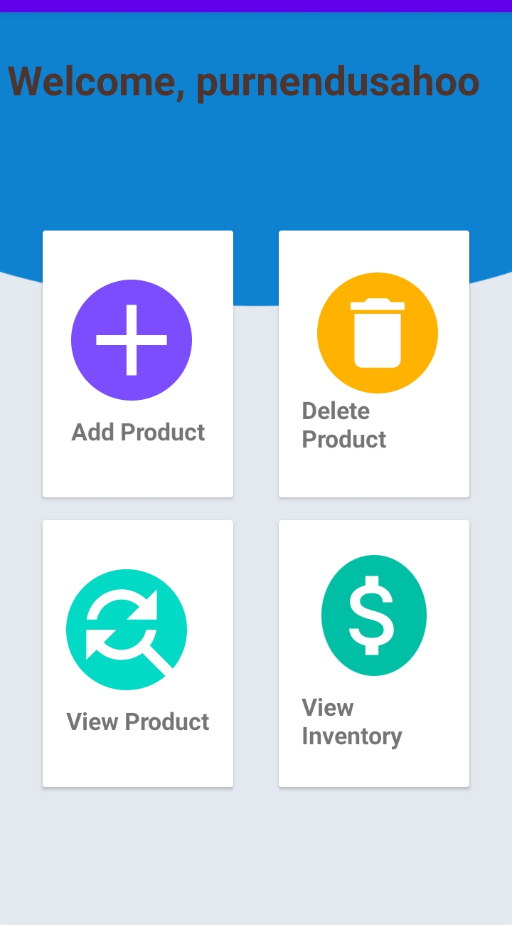
DASHBOARD
This is my main activity page. In this page, user have many option like add product, delete product, view product, view inventory.

Slide 14
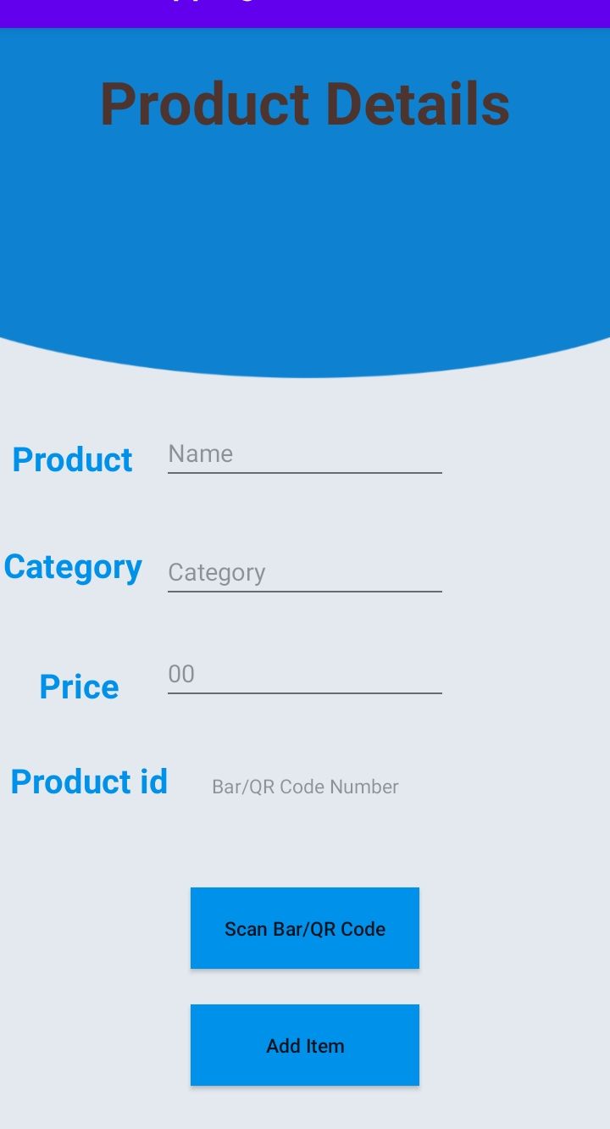
ADD PRODUCT
After click the add item option this page will appear. In this page users have to click scan button after that product details will show then users have to add this item by clicking Add Item button. Then the item will added to this user’s account.

Slide 15
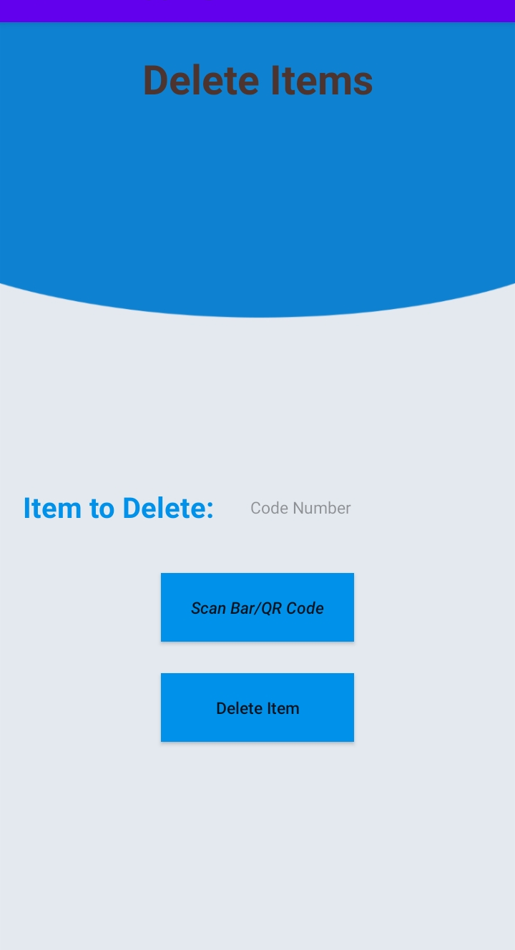
DELETE ITEM
If a user want to delete an item from his/her account for any reason then he/she can delete the product by using barcode number or by using scanning.

Slide 16
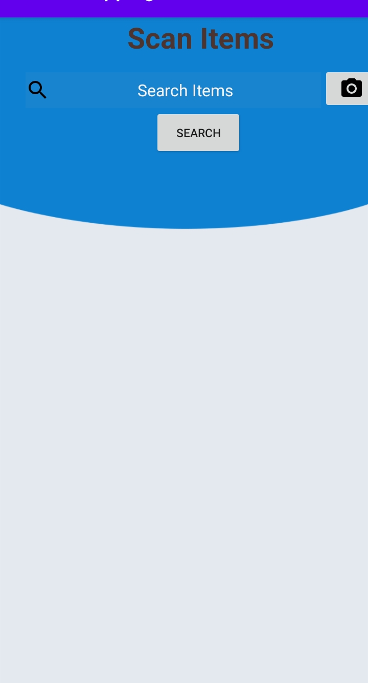
SCAN ITEM
This page is use only for knowing the product details purpose. Like availability, price, product details etc.

Slide 17
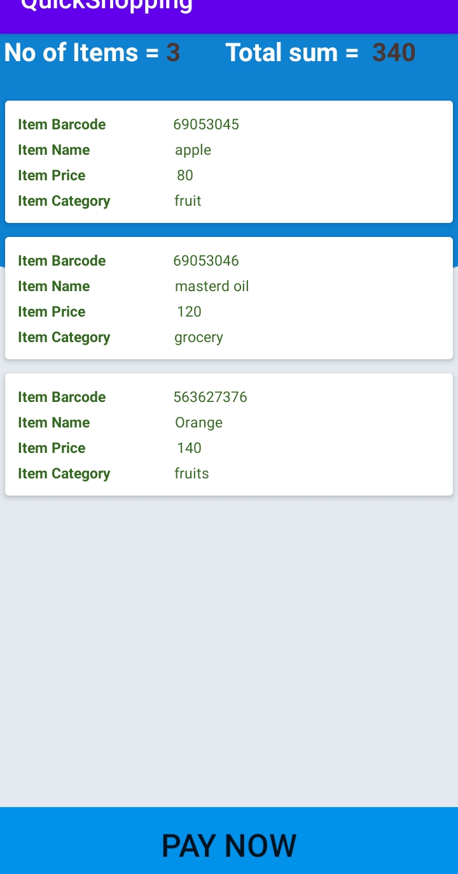
INVENTORY VIEW
This page show the list of the product which the user has added and in this page has a payment button for paying the total amount and end the shopping.

Slide 18
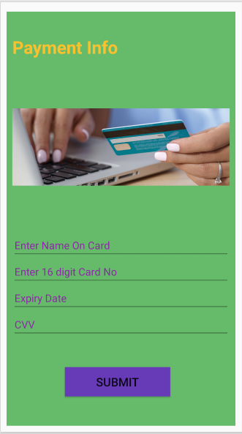
PAYMENT
This page show to user for payment. The user has to fill payment details like his/her name, 16 digit credit/debit card No, Expiry Date, CVV number for payment

Slide 19
CONCLUSION
As the demand for the online shopping is increasing the requirement of more secure, safe and reliable transaction is of utmost demand. Smart phones, that have become an important part of today’s life, have reduced all the efforts that are required for shopping. With camera feature in it, the user can scan the barcode of the item to be purchased and then directly add it into the cart.
There are two advantages of it: first no need to stand in the queue for a long time in malls just for scanning the item, second there will be no scope for the frauds that happen in online shopping. The items so far purchased by the customer will be maintained in the app that can be used by the customer in the next purchase. The transactions that will take place frequently with the shop’s database will be made secured. This will ensure no modifications in the shop’s database either by the customer or by any unauthorized user.

Slide 20
THANK YOU

