Slide 1





Why Half Our Learners
Never Finish
An engagement-first diagnosis of course drop-off
100,000 enrollments | 40 fields | 8 courses | 5 categories
Group 6 · Data Analytics Capstone · Preprocessing, EDA, Visualization & Dashboarding

Slide 2
Student Course Completion Analysis
|
2
Drop-off is behavioural, not demographic
The answer up front. The next fifteen slides are the evidence.
49.0%
18.4 pts
+3.1 pts
COMPLETION TODAY
ENGAGEMENT GAP
POTENTIAL LIFT
Just over half of 100,000 enrollments never finish.
High tier 58.2% against Low tier 39.7%. No demographic variable moves completion more than 3.8 points.
Roughly 3,070 additional learners completing, from the Low tier alone.
* If half of the gap between the High and Low engagement tiers were closed. Gap computed on unrounded rates (58.15% and 39.72%).
Engagement is the one driver the platform can observe early and change.
Group 6 | Data Analytics Capstone

Slide 3
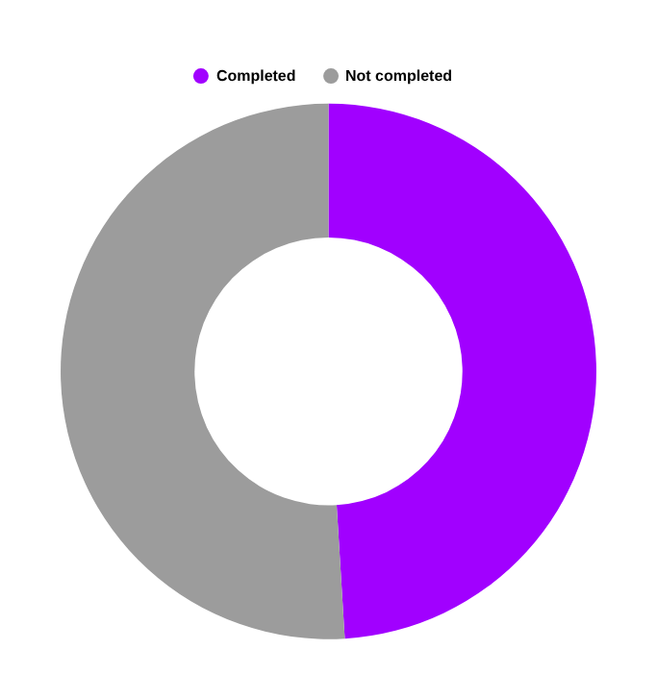

Student Course Completion Analysis
|
3
51% of enrollments never reach completion
The platform can measure the problem. It does not yet have a reliable early-warning signal.
50,970
49,030
learners who enrolled and did not finish
learners who completed their course
Every non-completion is acquisition effort that produced no learning outcome
The student success team has no reliable way to flag at-risk learners while there is still time to act
Stakeholder: platform student success and academic operations team
Group 6 | Data Analytics Capstone

Slide 4
Student Course Completion Analysis
|
4
Three questions the business needs answered
Objectives framed as decisions, not as analytical tasks.
01
Who is least likely to complete - and how early can we see it?
Requires a signal observable during the course, not after it.
02
What separates completers from non-completers?
Three competing explanations tested against each other: who they are, what they study, how they behave.
03
What should the platform fund first?
Findings ranked by size of gap and by how directly the platform can act on them.
Scope | This dataset only. No external data, no deployed model. An analysis and reporting deliverable.
Group 6 | Data Analytics Capstone
Group 6 | Data Analytics Capstone

Slide 5
Student Course Completion Analysis
|
5
From a raw enrollment table to a decision system
Four moves, each one feeding the next.
01
02
03
04
DIAGNOSE
ENGINEER
SEGMENT
ACT
Profile 100,000 rows and test every field for logical consistency - not just for missing values
>
Expand 40 fields to 48, adding a composite engagement score and Low / Medium / High tiers
>
Test demographic, course and behavioural explanations against each other
>
Convert the surviving driver into a live early-warning dashboard
The order matters: we only engineered an engagement score after the quality checks told us the behavioural fields were trustworthy, and we only built the dashboard after the segmentation told us which driver was worth tracking.
Group 6 | Data Analytics Capstone

Slide 6

Student Course Completion Analysis
|
6
Four decisions the dashboard makes possible
Built for the question the student success team asks every Monday.
1
Is completion above or below benchmark?
2
Which cohorts sit below it, and by how much?
KPI cards track the 49.0% overall rate and flag movement against it.
Segment comparison across tier, payment mode, category and device.
3
Who should we contact this week?
4
Did last month's intervention work?
Drill-down isolates the specific at-risk segment in two clicks.
Enrollment-date filters let the team compare cohorts over time.
Filters: enrollment date · category · payment mode · course level · engagement tier · employment status · Device Type
Group 6 | Data Analytics Capstone

Slide 7

Student Course Completion Analysis
|
7
From data to decision: one pipeline, five stages
TOOL STACK · the value sits in the analytical decisions, not the libraries
RAW DATA
NOTEBOOK 01
NOTEBOOK 02
NOTEBOOK 03
DASHBOARD
Course_Completion
_Prediction.csv
Data quality
assessment
Cleaning and
feature engineering
Exploratory
data analysis
Streamlit
application
>
>
>
>
100,000 x 40
quality_report.csv
100,000 x 48
16 charts
live filters
Kaggle
pandas
pandas / NumPy
Matplotlib / Seaborn / scikit-learn
Streamlit / Plotly
Notebooks run in order, each consuming the previous one's output. Every figure in this deck was produced by running that chain against the full 100,000-row dataset. Random Forest feature importance was used only as a second opinion on the correlation ranking, not as a predictive model.
Repository: github.com/Purnima-Vats/Group6_Capstone_Project
Group 6 | Data Analytics Capstone
Group 6 | Data Analytics Capstone

Slide 8
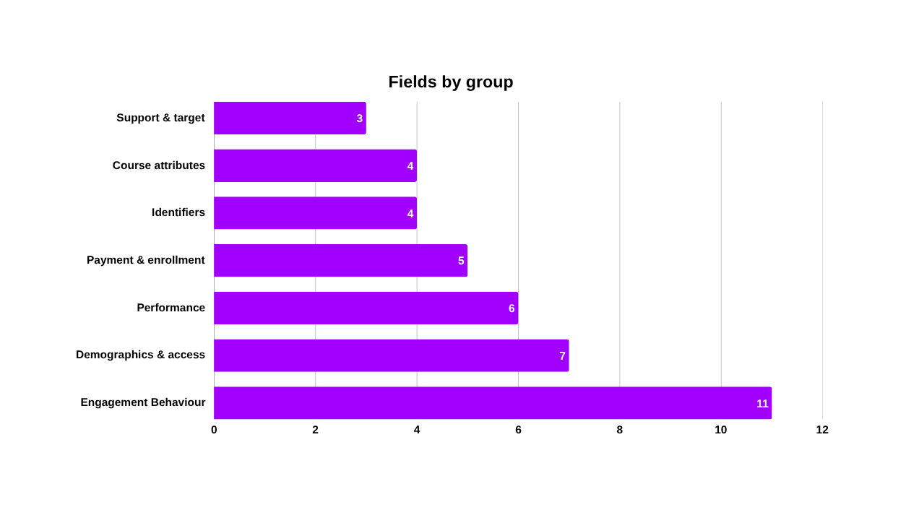
Student Course Completion Analysis
|
8
100,000 enrollments, 40 fields, one row per learner
A single table spanning identity, behaviour, performance and payment.
Target KPI
Completion rate, currently 49.03%
Key dimensions
Category, Course_Level, Employment_Status, Payment_Mode, Device_Type, engagement_tier
Date range
Enrollment dates spanning Oct 2023 to Oct 2025, parsed from dd-mm-yyyy text
Granularity
One row per learner-course enrollment. No repeated Student_IDs
Excluded
Name dropped from all analysis and from the dashboard as personally identifying
Behaviour is the richest part of this dataset - 11 of 40 fields describe what a learner did, against 7 describing who they are. That balance is what made a behavioural hypothesis testable at all.
Group 6 | Data Analytics Capstone
Group 6 | Data Analytics Capstone

Slide 9

Student Course Completion Analysis
|
9
Zero missing values - and 23,106 rows that contradict themselves
Standard checks came back clean. Cross-field logic checks did not.
WHAT STANDARD CHECKS FOUND
WHAT CROSS-FIELD LOGIC CHECKS FOUND
0 missing 0 duplicates 0 out of range
23,106 rows where fields disagree with each other
Issue | Scale | Resolution
Missing values / duplicate rows / out-of-range numerics | 0 of 100,000 | None needed
Enrollment_Date stored as text | 100% of rows | Parsed to datetime, dd-mm-yyyy
Fee_Paid = No but Payment_Amount > 0 | 10,039 (10.0%) | Traced to the Scholarship rule. Flagged as is_scholarship_partial_pay, not overwritten
Completed = Yes but Progress < 50% | 14,342 (29.3% of completers) | Not a data error. Escalated to EDA and became finding 3
Statistical outliers (IQR method) | 0.15% - 6.19% per field | Retained as genuine learner behaviour, not capped
A clean dataset is a trap. Zero nulls invites you to declare the data fine and move on - so we tested whether fields agree with each other, not just whether they are populated.
Group 6 | Data Analytics Capstone

Slide 10
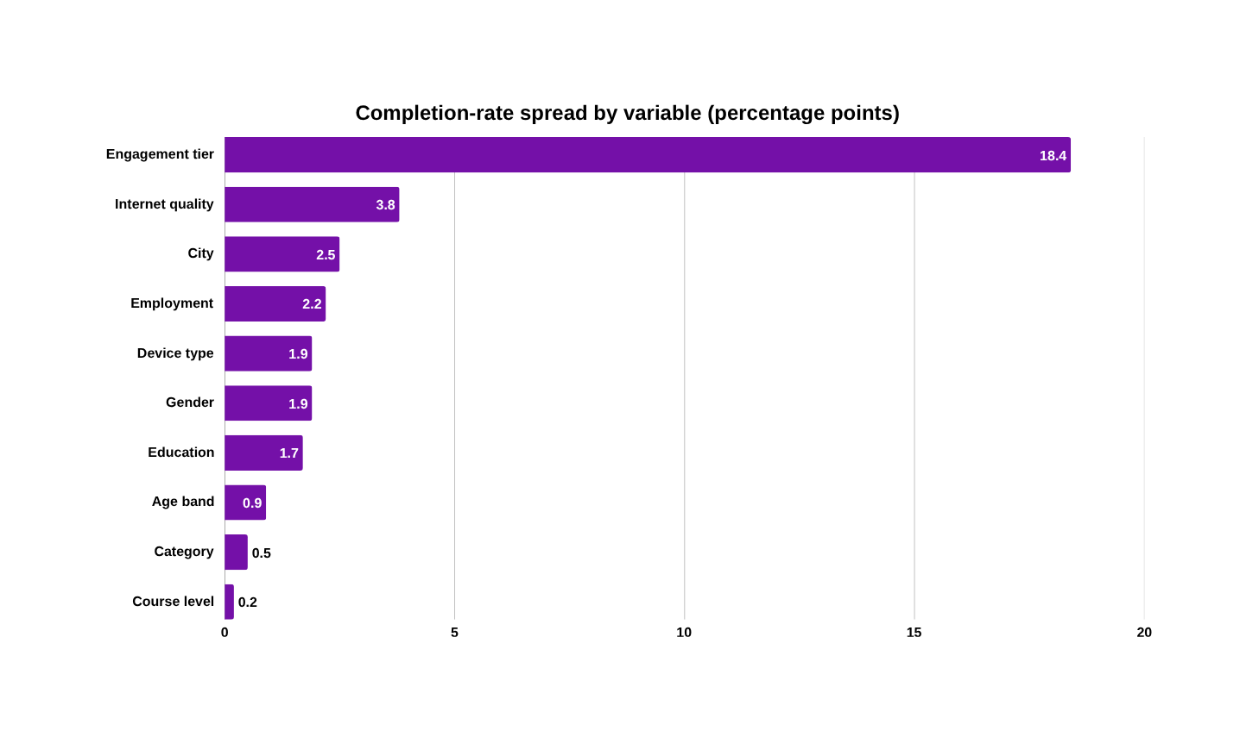
Student Course Completion Analysis
|
10
We tested who they are against how they behave
Nine demographic and course variables. None of them move completion.
Method
16 charts across univariate, bivariate and multivariate analysis
Correlation ranking cross-checked against Random Forest feature importance - both agree
At n = 100,000 almost everything is statistically significant, so we report effect size and segment gaps instead of p-values
The null result is the point
We expected course difficulty to drive drop-off. It moves completion by 0.2 points. Reporting that honestly is what tells you the engagement finding on the next slide is not an accident.
Group 6 | Data Analytics Capstone

Slide 11
Student Course Completion Analysis
|
11
An 18.4-point gap - the largest in the dataset
Three equal thirds of the learner base. The only thing separating them is behaviour.
58.2%
49.2%
EFFORT
39.7%
+45%
more time spent
3.2 hrs vs 2.2 hrs
+7.7 pts
more video watched
67.7% vs 60.0%
ABILITY
Low
Medium
High
+2.0
quiz points
74.4 vs 72.4
33,334 learners
33,333 learners
33,333 learners
+1.2
project points
68.9 vs 67.7
+18.4 pts High versus Low engagement tier
Non-completers are not performing worse when they engage. They are engaging less.
The gap is behavioural, not academic.
Group 6 | Data Analytics Capstone

Slide 12
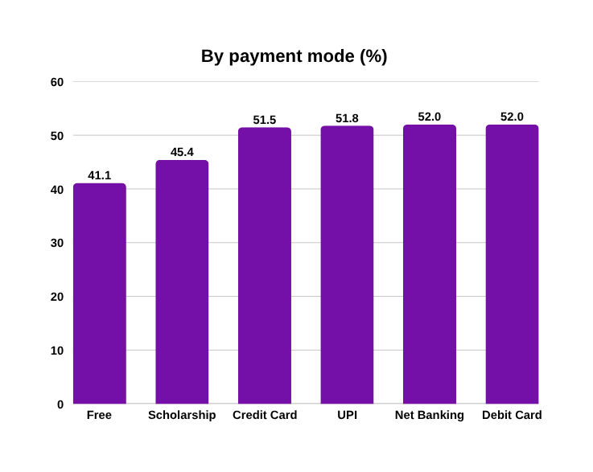
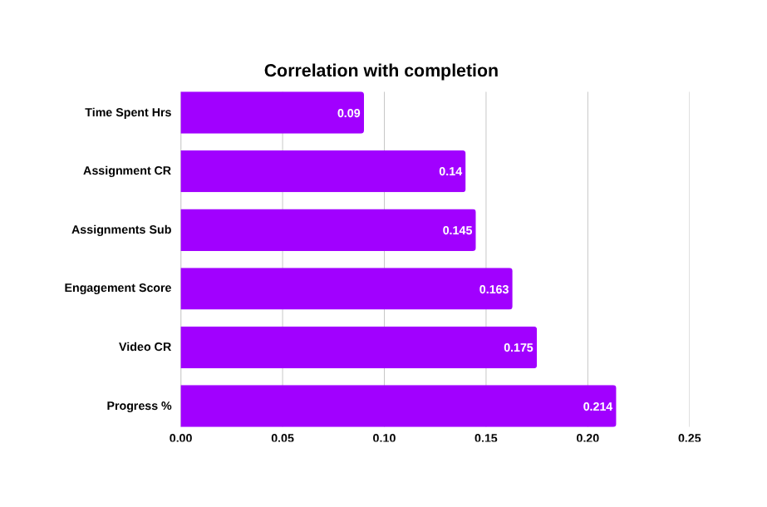
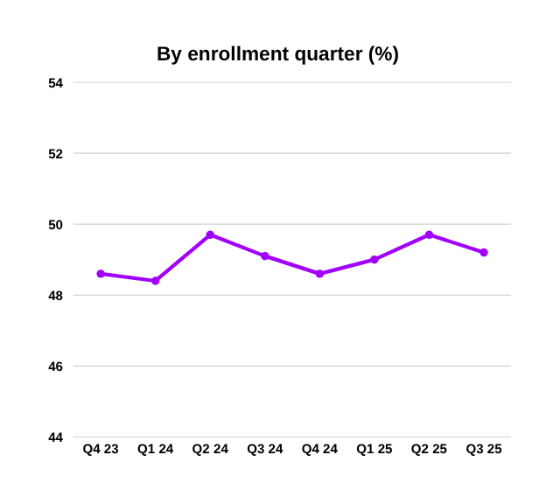
Student Course Completion Analysis
|
12
The same pattern holds across payment, progress and time
Three independent views, all pointing at behaviour rather than circumstance.
9.9 pts
Free enrollments complete 9.9 points below every paid mode
Progress percentage is the strongest single field - and still weak
Completion is flat over two years
41.1% against 51-52%, with Scholarship between at 45.4%. Financial commitment tracks follow-through.
0.21 correlation, with video completion and engagement score immediately behind it.
Between 48.4% and 49.7% every quarter. This is structural, not a recent decline.
Group 6 | Data Analytics Capstone

Slide 13
Student Course Completion Analysis
|
13
Six findings, six funded actions
Ranked by size of gap and by how directly the platform can act.
 | Observation | Recommendation | Expected benefit
HIGH | Low tier completes 18.4 pts below High tier | Early-warning flag on engagement_score; trigger outreach on entry to the Low tier | +3.1 pts overall completion, ~3,070 learners
HIGH | Free completes at 41.1% vs 51-52% paid | Milestone-based progress nudges targeted at Free-tier learners | Narrows the largest payment-related gap, 9.9 pts
HIGH | Progress% correlates 0.21; 29.3% of completers logged under 50% | Replace progress-percentage at-risk dashboards with engagement_score and Video_Completion_Rate | More accurate flagging, fewer missed interventions
MED | Completers spend ~45% more time; scores nearly identical | Watch-time reminders and streaks rather than academic remediation | Targets effort, the real gap, not ability, which is not a gap
LOW | Category 0.5 pts, Course_Level 0.2 pts | Do not fund course-level redesign as a completion lever; redirect to engagement tooling | Avoids spending budget on a problem the data does not support
LOW | Low internet quality: 45.8% vs 49.6% | Low-bandwidth and downloadable content mode | Removes a cheap barrier for an identifiable segment
One of these recommendations is to spend nothing. Testing the intuitive hypothesis and finding it false is worth as much as finding a driver.
Group 6 | Data Analytics Capstone
Group 6 | Data Analytics Capstone

Slide 14
Student Course Completion Analysis
|
14
Where to spend first
The same six findings, placed by business impact against ease of implementation.
HIGH
What this says
PLAN AND FUND
DO FIRST
The two highest-impact actions are also among the cheapest. Both are dashboard and messaging changes, not product rebuilds.
The one genuinely expensive item, instrumenting time-stamped activity, is what unlocks the early-warning claim we cannot yet prove.
Course redesign sits alone in deselect, and the data is what put it there.
Instrument time-stamped activity
Engagement early-warning flag
BUSINESS IMPACT
Free-tier milestone nudges
DESELECT
QUICK WINS
Course-level redesign
Replace progress% with engagement metrics
Low-bandwidth content mode
LOW
EASE OF IMPLEMENTATION
HARDER
EASIER
Group 6 | Data Analytics Capstone
Group 6 | Data Analytics Capstone

Slide 15
Student Course Completion Analysis
|
15
Challenges & Learnings
Two findings that didn't go the way we expected, and what we did about them.
Category & course level didn't matter
A quirk in the payment data
We expected course category and difficulty level to drive drop-off. At full scale, completion stayed flat: 48.7–49.2% across every category, 49.0–49.2% across every level.
10,039 rows (10% of the data) showed Fee_Paid = No but Payment_Amount > 0. Every single one was tagged Payment_Mode = Scholarship, not corrupted data, just an unrecorded partial payment.
So we engineered a feature instead
So we flagged it instead of overwriting it
engagement_score, built from 4 behavioral fields, revealed an 18.5-point completion gap between High and Low engagement tiers, the strongest signal in the dataset.
is_scholarship_partial_pay keeps the pattern visible and auditable, a documented business rule instead of a silently "corrected" data point.
The pattern in both: what looked like noise on first pass became a deliberate, documented decision once we dug in, a new feature in one case, a new flag in the other.
Group 6 | Data Analytics Capstone
Group 6 | Data Analytics Capstone

Slide 16

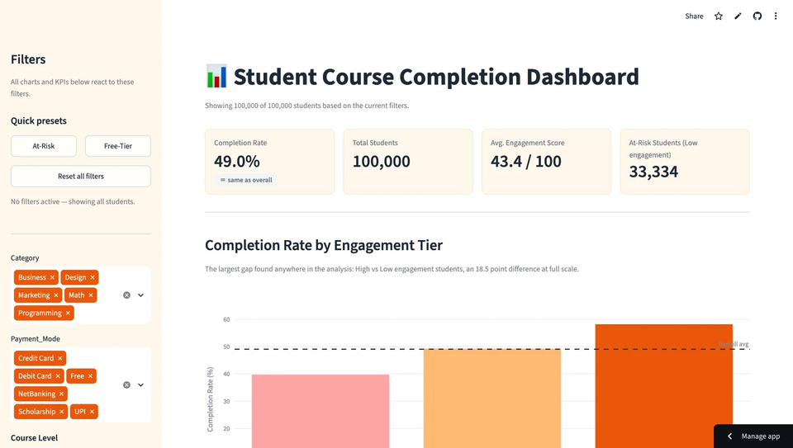
Student Course Completion Analysis
|
16
The dashboard, live
Demo path
1
Land on the overview - KPI cards against the 49.0% benchmark
2
Filter to engagement_tier = Low, and watch completion fall to 39.7%
3
Add Payment_Mode = Free, and watch it fall further
4
Stop. That is the at-risk segment, identified in two clicks
Repository
github.com/Purnima-Vats/Group6_Capstone_Project
Every figure in this deck was produced by running that code against the full 100,000 rows.
Three notebooks · quality report · cleaned dataset · Streamlit application
Group 6 | Data Analytics Capstone
Group 6 | Data Analytics Capstone

Slide 17
Student Course Completion Analysis
|
17
Engagement is the only lever we can actually pull
Drop-off is behavioural, and behaviour is the one thing the platform can observe early and change.
NOW
NEXT
THEN
>
>
Ship the engagement-based early-warning flag and retire progress percentage as the at-risk signal
Instrument time-stamped activity so first-two-week scoring can be validated properly
Run a controlled intervention test on the Low tier to move from correlation to measured causal impact
We can tell you where the gap is and what it is worth. We cannot yet tell you it is causal - that needs an experiment, and that is the next thing we would build.
Group 6 | Data Analytics Capstone

Slide 18




Thank you
Group 6 >
Kumar Abhishek
Mohan Krishna
Nancy
Purnima
Shivam

