Slide 1
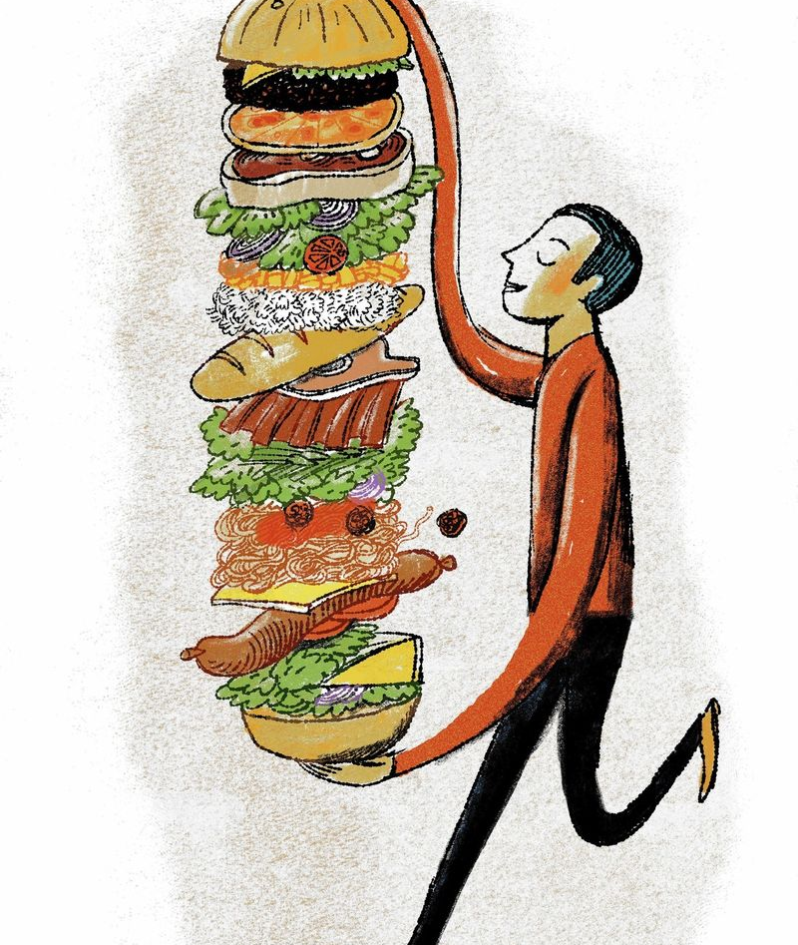
Dining Out : Places to eat near University of Toronto
Purnima Chandel and Swati Madan

Slide 2
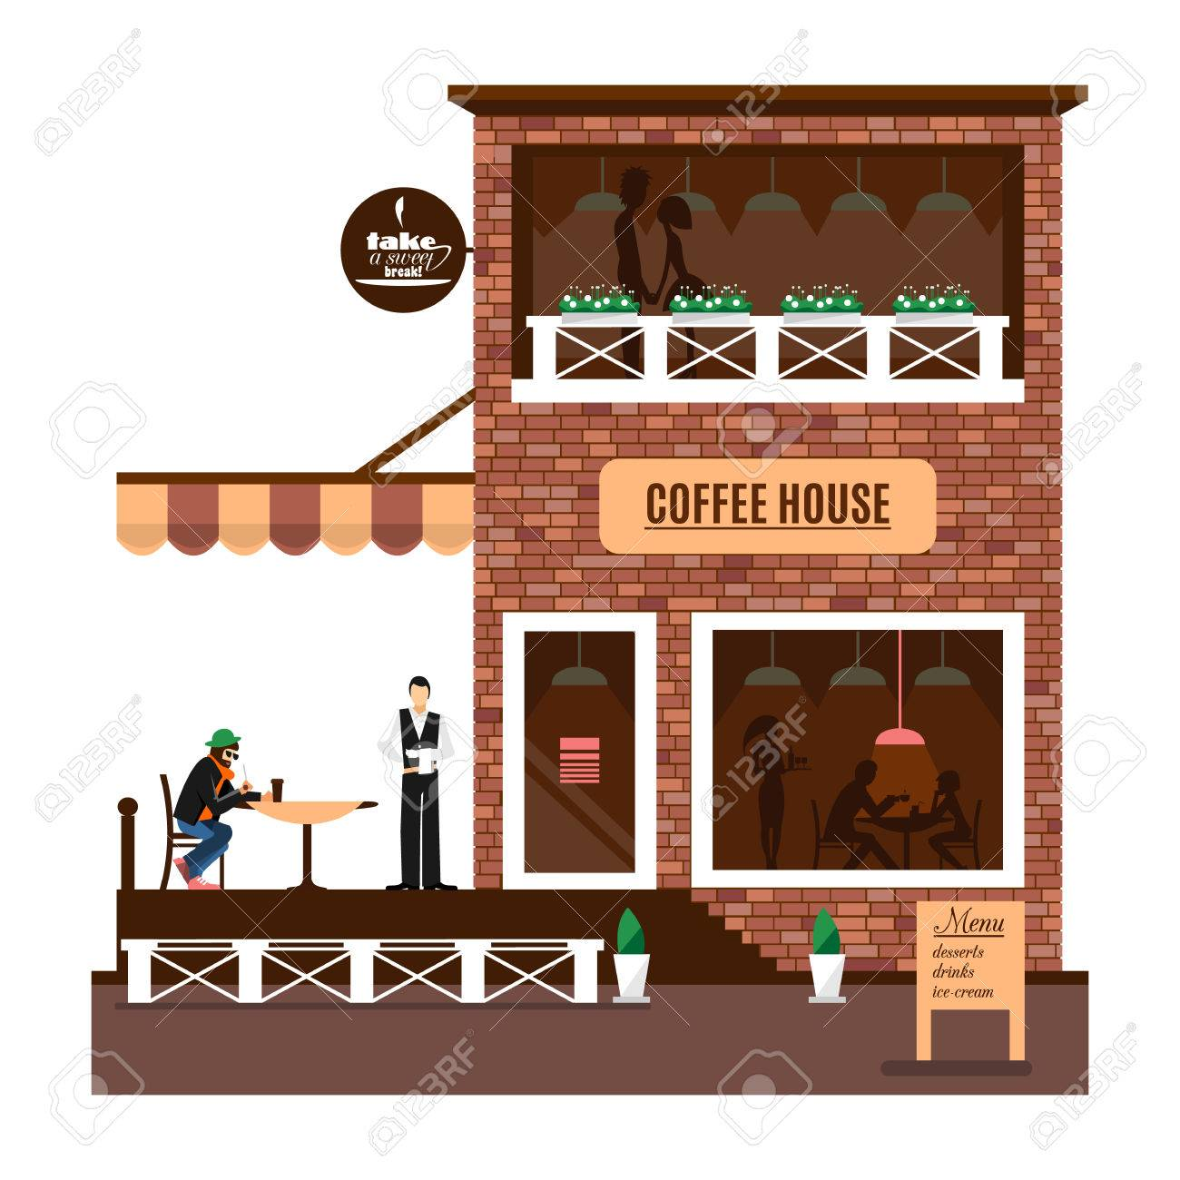
Project Description
We are exploring two visualization tools – Power BI and Qliksense.
We used Yelp API to determine which restaurants are most popular near University of Toronto.
We would like to know where the UofT campus community gets their sustenance and visualize the data in Power BI and Qliksense and draw a comparison between the two.

Slide 3
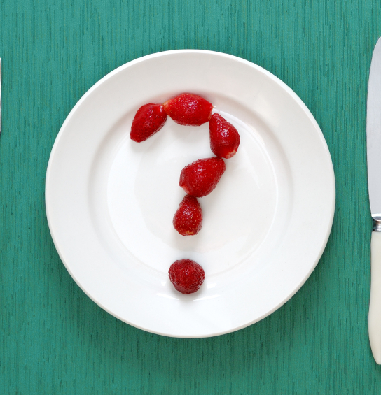
Research Questions
Which restaurants are closest to our location?
Which restaurants are most affordable?
Which restaurants are the most popular by rating among the community?
What is the overall sentiments for the restaurants by the community?
Which restaurant had the most reviews?
What are the differences between PowerBI and Qliksense?

Slide 4
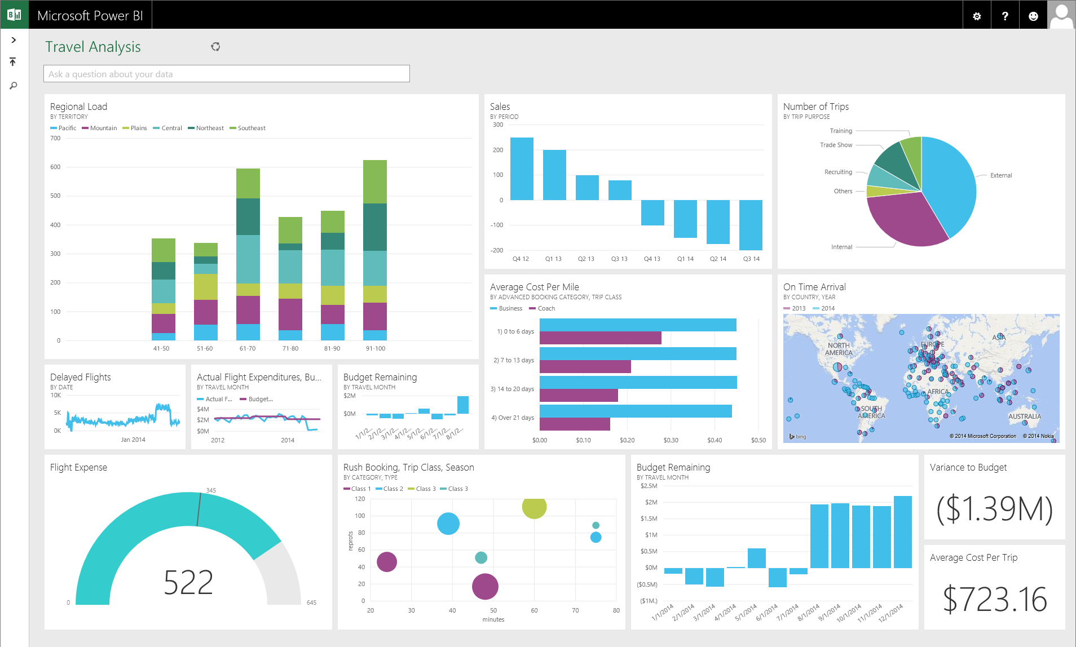
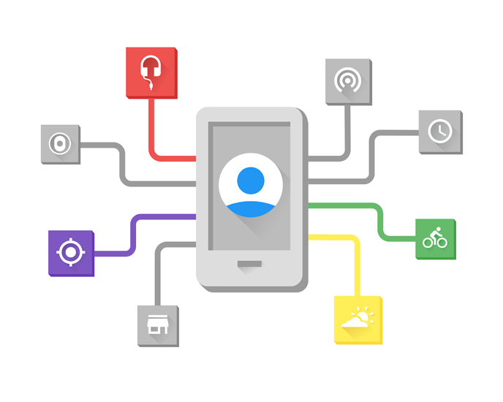

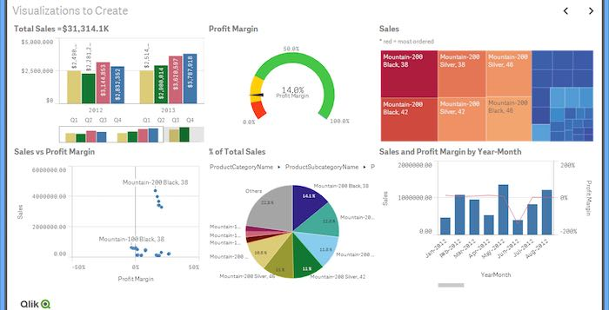
Methods
Power BI
Jupyter Notebook
YELP API
Qliksense Dashboard

Slide 5
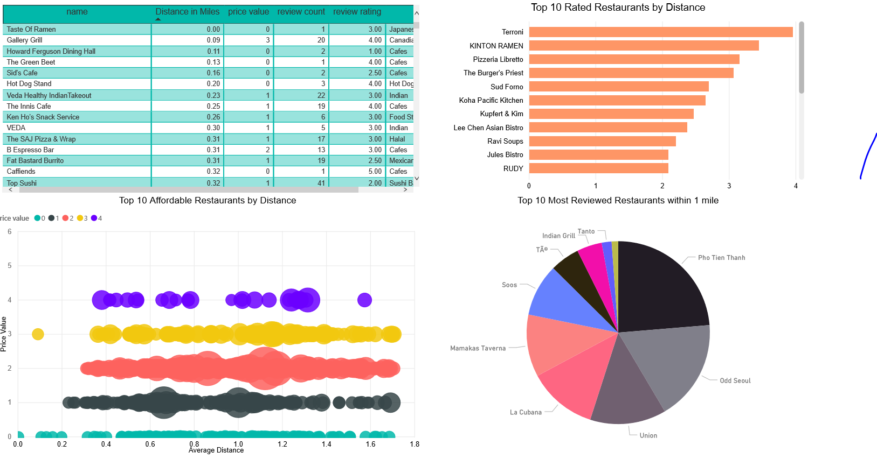
POWER BI DASHBOARD (1/2)

Slide 6
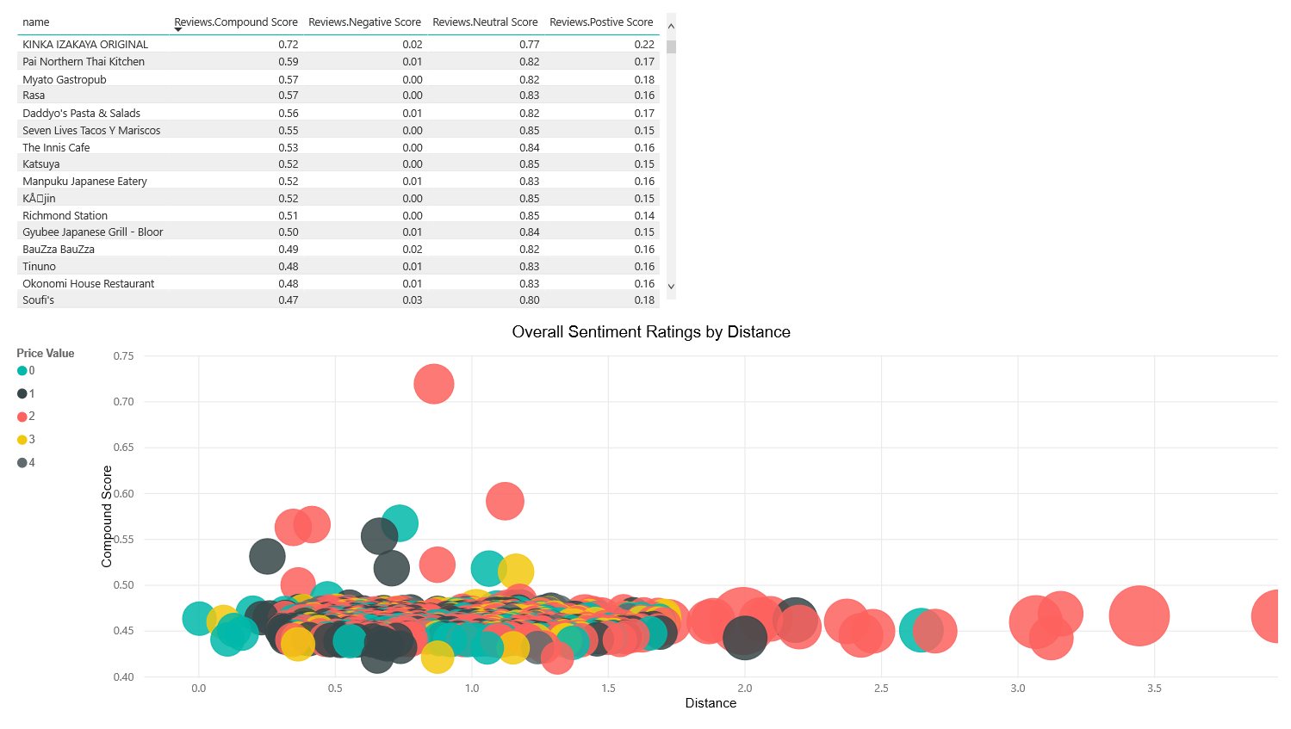
POWER BI DASHBOARD (2/2)

Slide 7
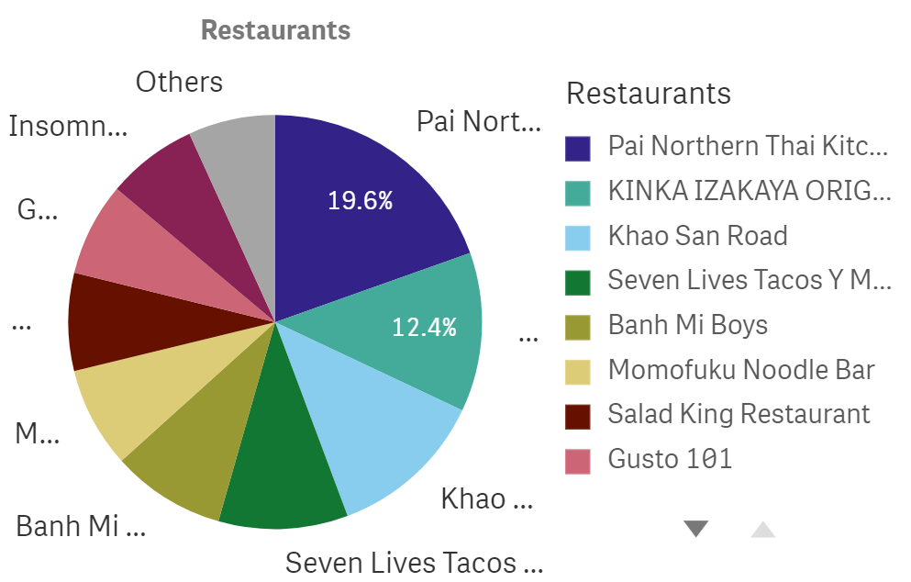
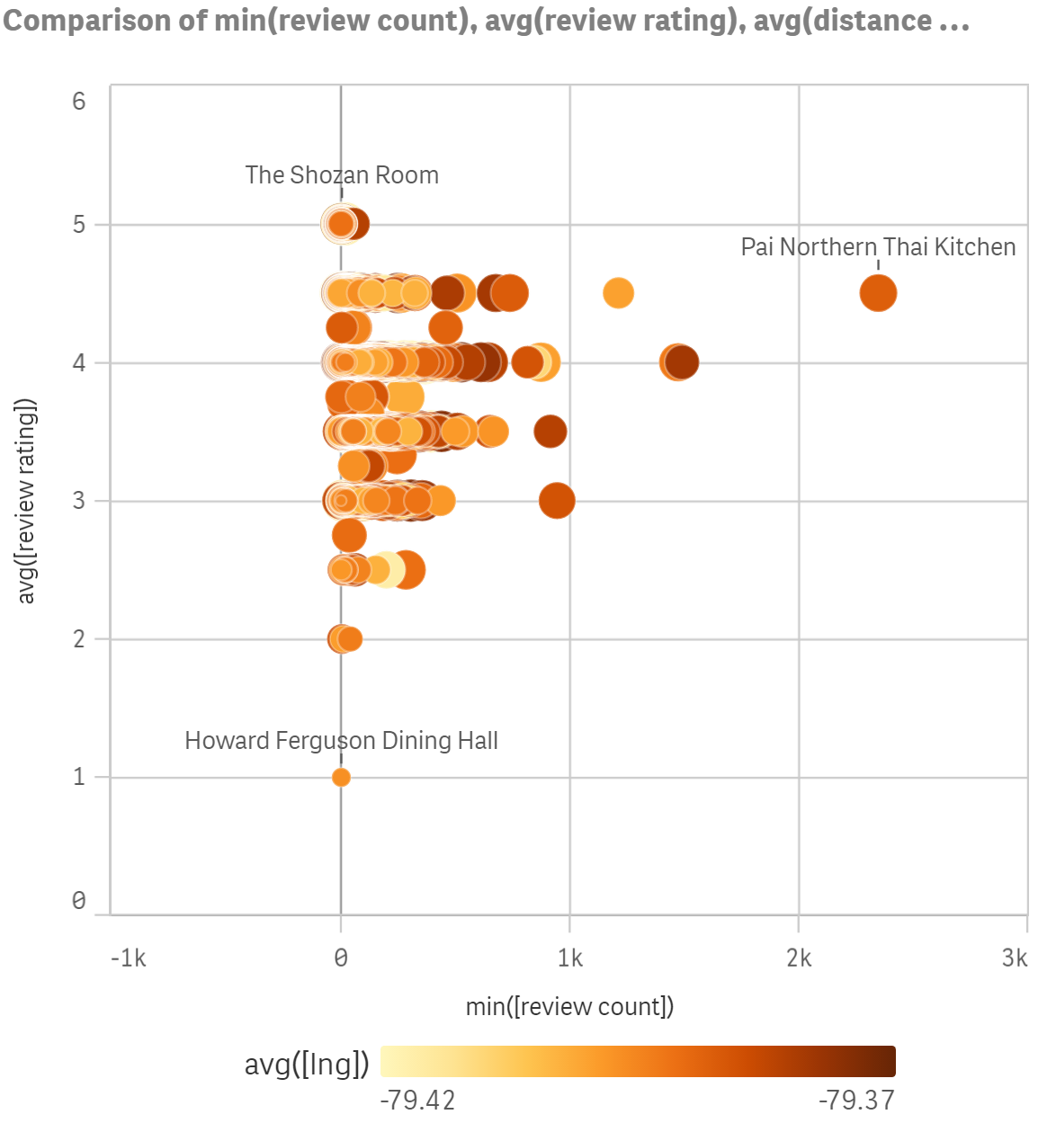
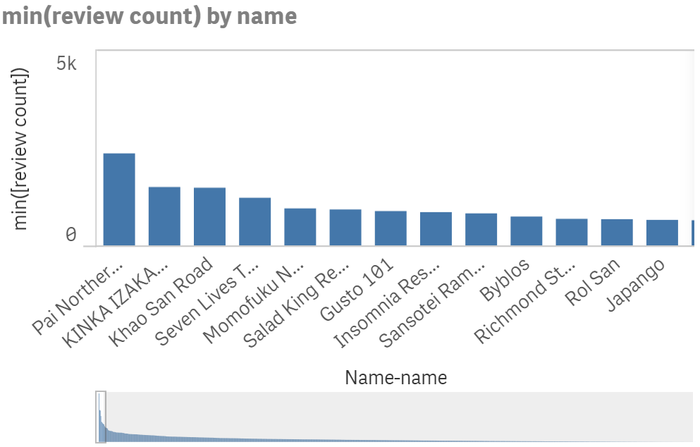
QLIKSENSE DASHBOARD (1/2) https://us.qlikcloud.com/hub/personal

Slide 8
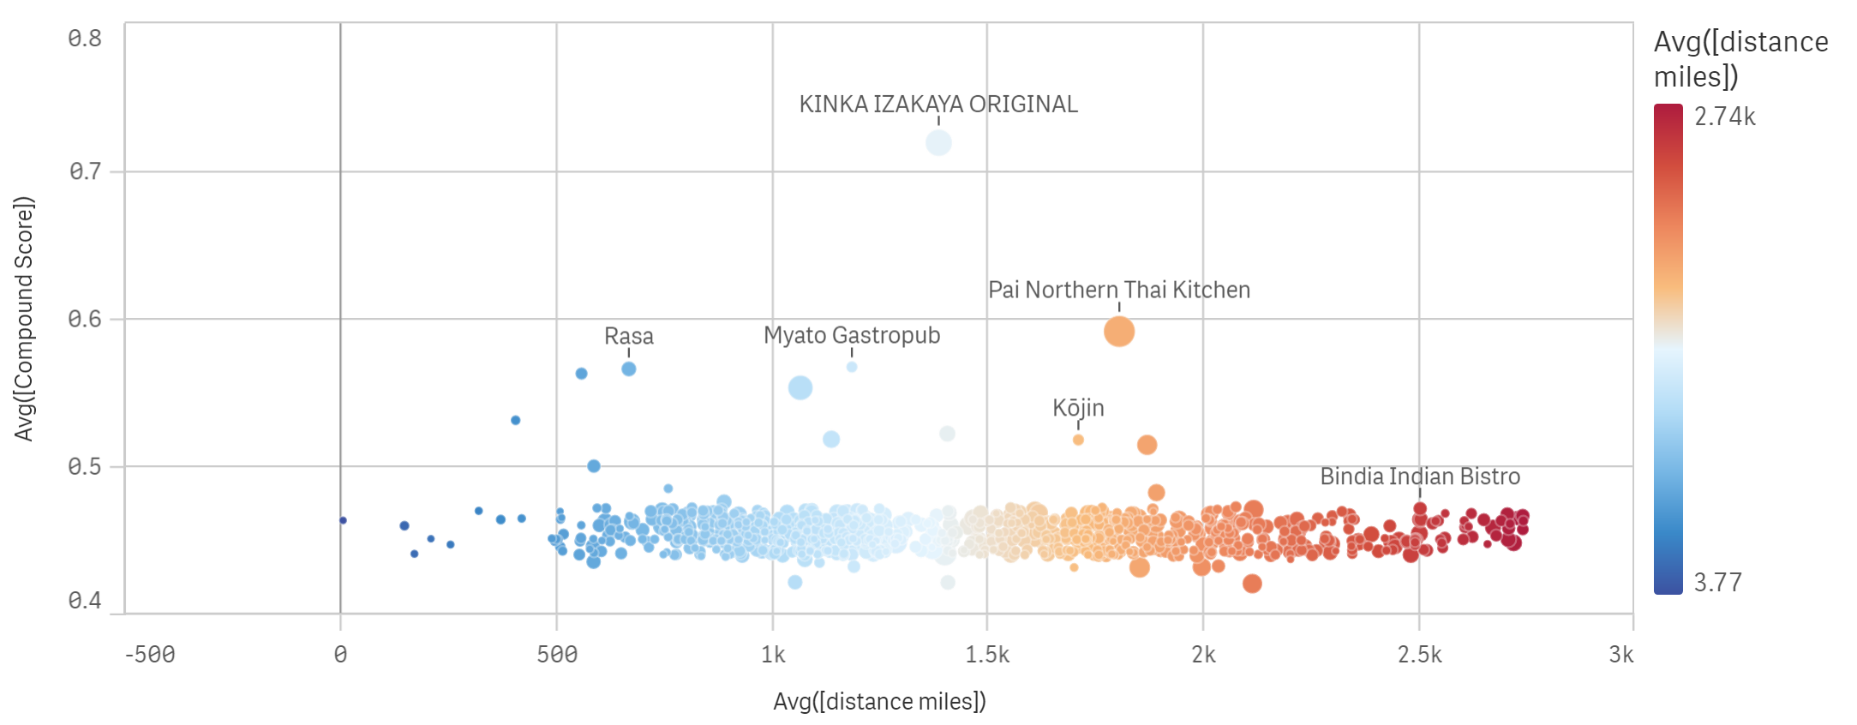
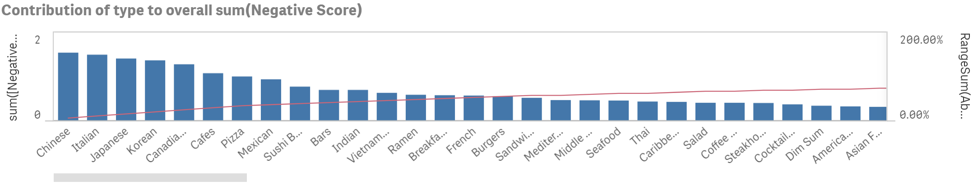
QLIKSENSE DASHBOARD (2/2)

Slide 9


vs.
FEATURES | POWER BI | QLIKSENSE
DATA LOAD TRANSFORMATION | VERY GOOD | EXCELLENT
MEASURES | VERY GOOD | EXCELLENT
SEARCHING | ADEQUATE | EXCELLENT
CLOUD FREE | YES FOR 1 | YES SHARE 5
ADJUSTING DIFF SCREEN SIZE | GOOD | EXCELLENT
DATA LOAD TIME | BIT SLOW | VERY FAST
PRINT EXPORT | ADEQUATE | GOOD
NULL HANDLING | GOOD | DIFFICULT
PIVOT TABLES | GOOD | VERY GOOD
DRILL DOWN | GOOD | GOOD

Slide 10
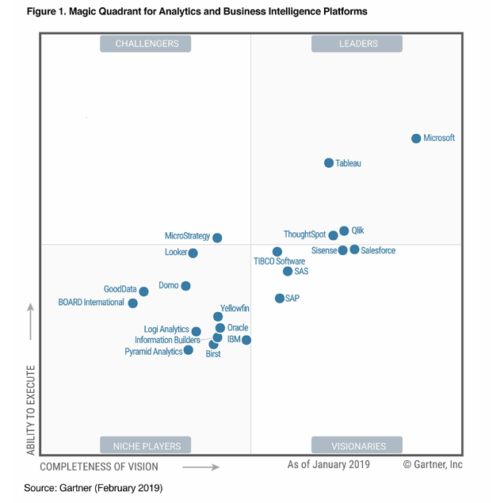
GARTNER MAGIC QUADRANT

Slide 11
THANKYOU

