Slide 1

PRESEMTED BY:- PURNIMA SOLANKI

Slide 2
What is Culture?
CULTURE, is a design for Living: The values, beliefs, behavior practices and material objects that organize people way of life and living.
It is a bridge to the past as well as a guide to the Future

Slide 3
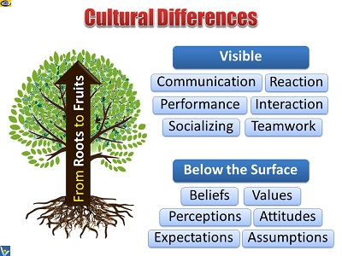

Slide 4

Type of Culture
Material
Non-Material

Slide 5
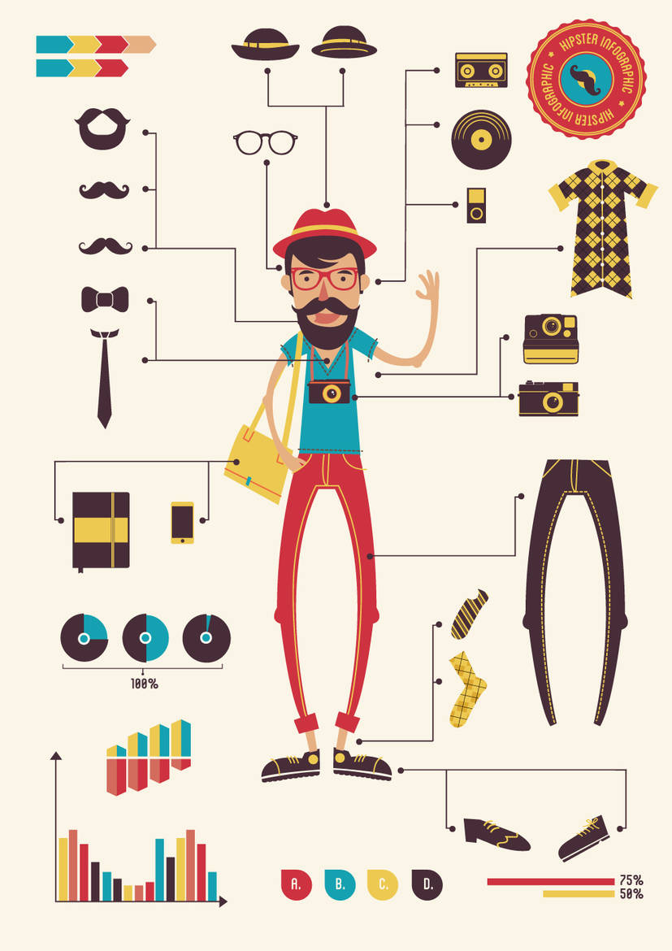
Material Culture
The physical or Tangible (See To Touch) that me mbers of society makes, use and share
Ex: Mobile Phone, Raw Materials etc..

Slide 6
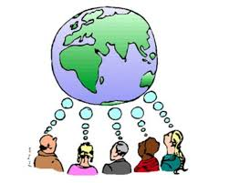
Non Material Culture
The abstract or intangible human creations of so ciety that influences people behavior
Ex: Language, beliefs, values, rules of behavior, family patterns & Political system

Slide 7

What is Corporate Culture?
"Culture is not about perks and parties. It's about what you believe and how you behave."
A set of shared beliefs, values and practices….

Slide 8

Why Corporate Culture is Important?
The culture refers to the values and attitudes of employees in the business or organization…...
A healthy corporate culture values each employee in the organization regardless of his job duties, which results in employees working as a team to meet the company's and their own personal needs.

Slide 9
Development and Purpose of Culture
Provides sense of organizational identity
Two critical purposes in organizations:
1. To integrate members so they know how to relate to one another
2. To help organization adapt to external environment
Collective identity and know how to work
Internal Integration
together
How the organization meets goals and deals
External Adaption
with outsiders

Slide 10
THANKYOU

