Slide 2
Data Wrangling
Explore data
Data Cleaning
Data Modelling / Machine Learning
Model Deployment
Interpret results
Data Visualization
Data Science / Machine Learning Pipeline

Slide 3
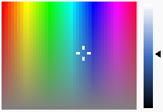


Visual Cue | Rank (smaller is better) | Example
Position along a common Scale | 1
Position along a identical but non-aligned scale | 2
Length | 3
Angle / Slope | 4
Area | 5
Volume / Density / Saturation | 6
Color Hue | 7
Elements of a bar chart
Elements of a pie chart
Framework to Help Decide which Visual Cue to Use for Quantitative Visualizations

