Slide 1



LUNCH AND LEARN
1 Hour of HTML

Slide 2

Lesson Objectives
Learn the origin of the web HTML
Understand the basics of HTML
Learn how to Create the following in HTML
Headings
Paragraphs
Links to other pages
Embedded Images

Slide 3
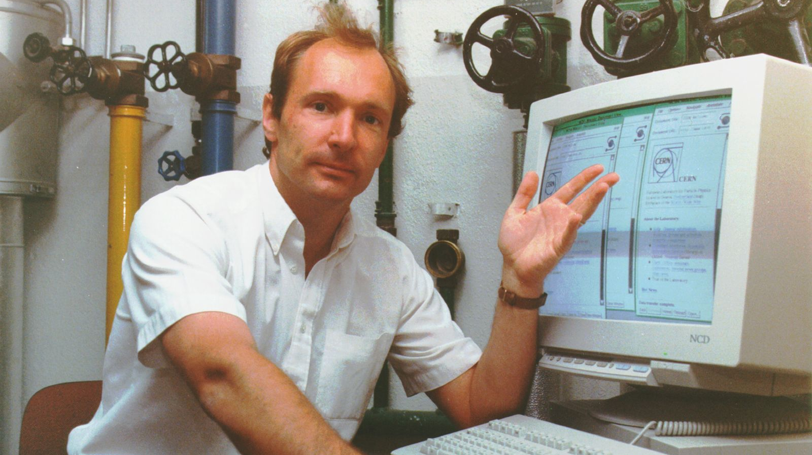
HTML History
Tim was working in a computing services section of CERN when he came up with the concept; at the time he had no idea that it would be implemented on such an enormous scale. ...

Slide 4
HTML History
Tim had the idea of enabling researchers from remote sites in the world to organize and pool together information. But far from simply making available a large number of research documents as files that could be downloaded to individual computers, he suggested that you could actually link the text in the files themselves.

Slide 5
HTML History
In other words, there could be cross-references from one research paper to another. This would mean that while reading one research paper, you could quickly display part of another paper that holds directly relevant text or diagrams. Documentation of a scientific and mathematical nature would thus be represented as a `web' of information held in electronic form on computers across the world.

Slide 6
HTML History
This, Tim thought, could be done by using some form of hypertext, some way of linking documents together by using buttons on the screen, which you simply clicked on to jump from one paper to another. Before coming to CERN, Tim had already worked on document production and text processing, and had developed his first hypertext system, `Enquire', in 1980 for his own personal use.

Slide 7
HTML History
Tim's prototype Web browser on the NeXT computer, a company by Steve Jobs, came out in 1990.
This was the start of the journey to the web we see today and use ubiquitously every day.

Slide 8
HTML History Summary
HTML has grown from its conception in the early 1990s
HTML was invented by Tim Berners-Lee in 1989 at CERN

Slide 9
Outline of the Web Today
The World Wide Web has undergone a remarkable transformation since its inception in 1990.
Today, the web has exploded with websites and users and has become more complex and dynamic, with advanced web development technologies like HTML5, CSS3, JavaScript, and AJAX.
The web today offers advanced functionality like e-commerce, social networking and online streaming among others. The web has had a profound impact on society and the economy and continues to evolve and innovate at a rapid pace.

Slide 10
Resources for Students
HTML
W3 Schools
MDN Docs
Head Tag
W3 Schools
MDN Docs
Body Tag
W3 Schools
MDN Docs
Heading
W3 Schools
MDN Docs
Paragraph
W3 Schools
MDN Docs
Anchor
W3 Schools
MDN Docs
Images
W3 Schools
MDN Docs

