Slide 1

Learning Curve to Implementing a Just Culture
Joshua Hamm
Mod 9.2
7.14.24

Slide 2
What is a Just Culture in DevOps?
A just culture in DevOps encourages open reporting of mistakes and learning from them, while maintaining accountability. It focuses on improving processes and systems rather than blaming individuals, thus fostering a culture of safety, trust, and continuous improvement.

Slide 3
Importance of a Just Culture in DevOps
Enhances Team Collaboration: Promotes open communication and trust.
Improves Incident Management: Encourages reporting and learning from failures.
Drives Continuous Improvement: Focuses on process and system improvements.
Reduces Downtime: Proactive identification and mitigation of risks.

Slide 4
Phases of Implementing a Just Culture
Awareness
Understanding
Implementation
Sustainment

Slide 5
Awareness
Key Activities:
Conducting initial training sessions to introduce the concept.
Launching awareness campaigns to emphasize the importance of a just culture.
Securing leadership buy-in to support the cultural shift. Challenges:
Overcoming resistance to change.
Ensuring initial understanding among all team members.

Slide 6

Understanding
Key Activities:
Organizing in-depth workshops to delve deeper into just culture principles.
Developing clear policies that align with just culture values.
Identifying key behaviors that exemplify a just culture. Challenges:
Achieving comprehensive understanding across all teams.
Aligning organizational policies with just culture principles.

Slide 7

Implementation
Key Activities:
Rolling out policies and integrating them into daily operations.
Providing continuous training to reinforce just culture principles.
Setting up monitoring and feedback mechanisms to track progress. Challenges:
Integrating just culture into existing workflows.
Handling initial pushback from team members.

Slide 8

Sustainment
Key Activities:
Conducting regular audits to ensure adherence to just culture principles.
Offering ongoing training and refresher courses.
Promoting continuous improvement through feedback loops and learning. Challenges:
Maintaining momentum and avoiding complacency.
Ensuring long-term commitment from leadership and teams.

Slide 9
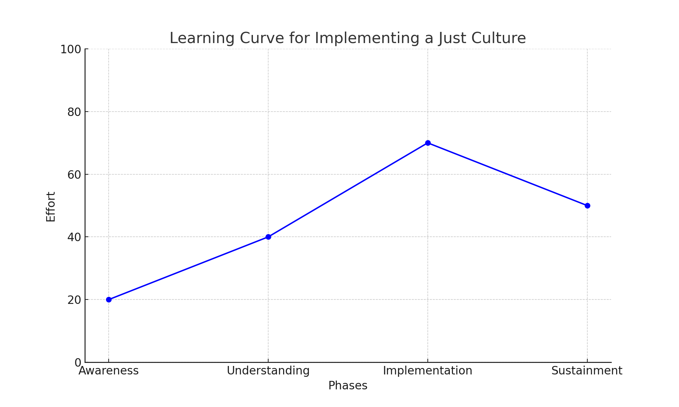
Learning Curve

Slide 10

Conclusion
Implementing a just culture in DevOps is a multi-phase effort that requires commitment and perseverance. Each phase presents unique challenges but also opportunities for growth and improvement. A successful just culture leads to a safer, more transparent, and resilient DevOps environment.

Slide 11

References
Reason, J. (1997). Managing the Risks of Organizational Accidents. Ashgate.
Marx, D. (2001). Patient Safety and the "Just Culture": A Primer for Health Care Executives.
Dekker, S. (2012). Just Culture: Balancing Safety and Accountability. Ashgate.
Stahnke, M. (2021, January 22). Change management is broken: Here’s how to fix it. DZone. Retrieved from https://dzone.com/articles/change-management-is-broken-heres-how-to-fix-it
Prosci. (2022, January 19). The costs and risks of poorly managed change. Prosci. Retrieved from https://www.prosci.com/resources/articles/the-costs-and-risks-of-poorly-managed-change

