Slide 1
Large Language Model Embeddings
Youzhi Yu
University of Chicago

Slide 2
Agenda
The current landscape of large language models (LLMs)
The transformer
Architecture
Encoder, Decoder
Self-attention mechanism
Tokens
Embeddings
GPU computing
Scaling laws
LLM embeddings and their use cases
Hands-on exercise

Slide 3
Large language models
Large: Refers to the size of the model, typically measured by the number of parameters (usually referred to as weights in deep learning).
Language: Focuses on human languages, encompassing tasks like understanding, generating, translating, and analyzing text.
Model: Refers to a mathematical framework or neural network trained to recognize patterns in data.
All models are wrong, but some are useful. (George Box)

Slide 4
Large language models
Large language models (LLMs) are advanced neural network models trained on vast amounts of text data to understand, generate, and analyze human language. The model is a Transformer architecture, which excels in processing sequential data like text.
Key Features
Scalability: Billions of parameters (e.g., GPT-3 with 175 billion).
Versatility: Capable of tasks like text generation, summarization, translation, and question-answering.

Slide 5
NLP evolution
Pre-Transformer Era:
RNNs and LSTMs: Struggled with long-term dependencies.
Seq2Seq with Attention: A precursor to modern LLMs.
Transformer Revolution (2017):
Introduction of self-attention in Attention is All You Need.
Efficient parallel processing and context understanding.
Notable Milestones:
BERT (2018): Bidirectional context understanding.
GPT-3 (2020): Breakthrough in zero-shot learning.
Recent Advances: GPT-o1, o3-mini, deepseek-R1, Llama3.3-70b
Future: GPT-4.5, GPT-5

Slide 6
LLM pre-training & inference
Pretraining
• Objective: Learn language structure and knowledge from vast amounts of raw text (self-supervised learning).
• Outcome: Produces a general-purpose model with internal representations that capture linguistic patterns and facts.
Inference
• Objective: Generate responses or perform tasks in real time using the pretrained model.
• Outcome: Delivers cost-effective, low-latency responses to user queries while leveraging the pretrained knowledge.

Slide 7
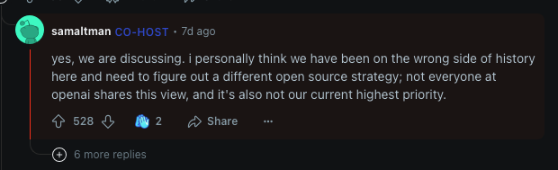
Open-source VS Closed-source
Open-source LLMs
• Transparency & Collaboration
• Customizability
• Accessibility
E.g., Llama, Qwen, MistralAI, Deepseek
Closed-source LLMs
• Proprietary Excellence
• Controlled Usage
• Commercial Focus
E.g., OpenAI, Anthropic

Slide 8
Training LLM costs
Llama 2: Training costs are estimated to be over $20 million, encompassing compute resources, development, and safety measures.
Llama 3.1: Estimates suggest that training the 405B parameter model required up to 16,000 Nvidia H100 GPUs, with each GPU costing between $25,000 to $40,000. This places the total training cost at approximately $640 million.
Why So Costly?
Trained on trillions of tokens
Tens of thousands of GPUs running for weeks/months during the pre-training phase
Data center cooling
Source: medium.com, techtarget.com

Slide 9
Tokens
The smallest textual units that a language model processes. A token could be:
A whole word
A part of a word (subword)
A punctuation mark
A special symbol (e.g., <EOS>, <CLS>, etc.)
Example:
"the student learns from the teacher"
Word-Level: ["the", "student", "learns", "from", "the", "teacher"]
Subword (e.g., BPE): ["the", "stu", "##dent", "learn", "##s", "from", "the", "teach", "##er"]
Character-Level: ["t", "h", "e", " ", "s", "t", "u", "d", "e", "n", "t", " ", "l", "e", "a", "r", "n", "s", " ", "f", "r", "o", "m", " ", "t", "h", "e", " ", "t", "e", "a", "c", "h", "e", "r"]

Slide 10
Tokenizer
1. Purpose
Definition: A tokenizer splits raw text into smaller units (tokens) for models to process.
Why It Matters: Preprocessing step that impacts model performance, vocabulary management, and handling of rare or unknown words.
2. Key Considerations
Vocabulary Size: Larger vocab → fewer tokens per sentence, but more memory overhead.
Handling Punctuation & Special Tokens: Retaining or separating punctuation affects downstream tasks (e.g., sentiment, NER).
Performance Impact: Tokenization can affect model perplexity, throughput, and accuracy.

Slide 11
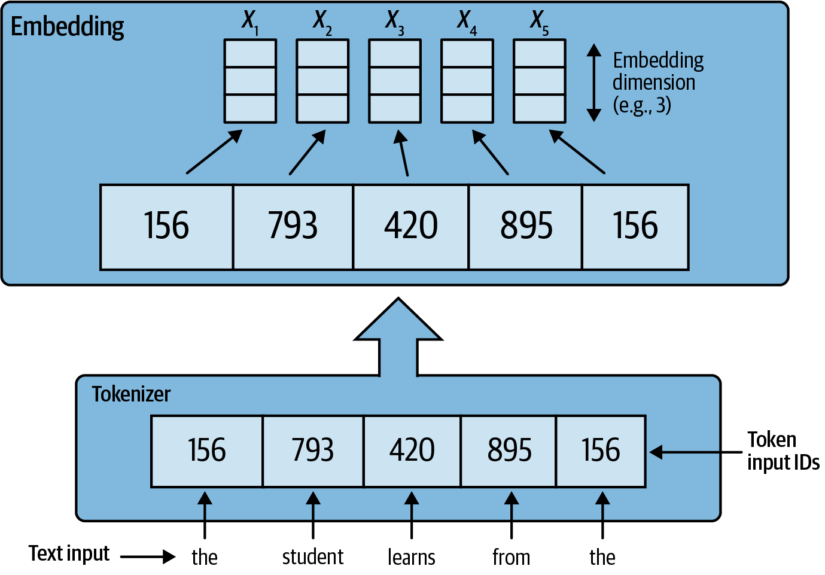
Tokenizer
Source: Fregly, C., Barth, A., & Eigenbrode, S. (2023). Generative AI on AWS: Building Context-Aware Multimodal Reasoning Applications. O'Reilly Media.

Slide 12
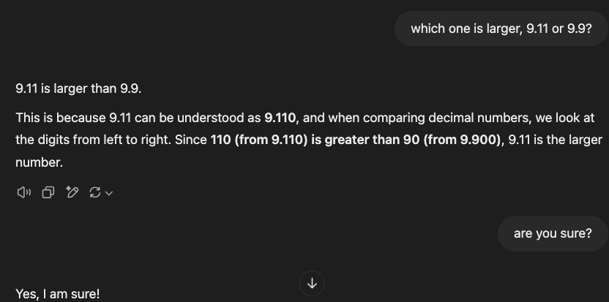
Tokenizer

Slide 13
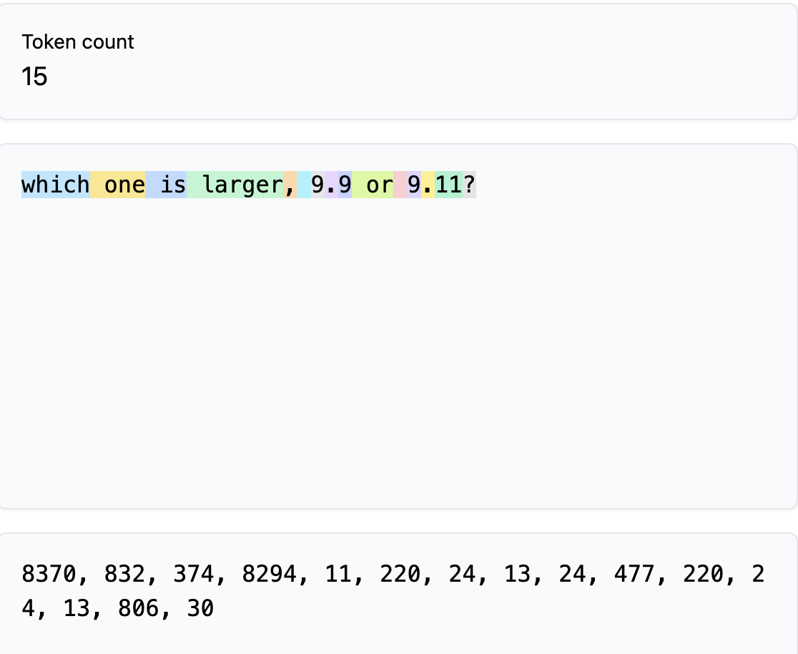
Tokenizer
Tiktokenizer: https://tiktokenizer.vercel.app/?model=cl100k_base

Slide 14
Autoregressive models
The Engine Behind Generative AI: An autoregressive model generates output one token (word, character, or image patch) at a time, where each new token is predicted based on all previously generated tokens.
Next Token Prediction: The model is trained to predict the next token given a sequence. For example, with the prompt “The student learns from the”, the model calculates probabilities for every possible next word and selects “ teacher” as the most likely.
Iterative Generation: Once the next token is chosen, it is appended to the input, and the process repeats. This chain‐rule method allows the model to generate long, coherent sequences.

Slide 15
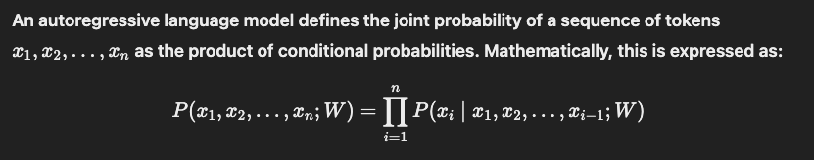
Autoregressive models
Example:
Input: “The student learns from the”
Prediction: The model predicts “ teacher” as the next token.
Output: “The student learns from the teacher”
Output: “The student learns from the teacher.”
Output: “The student learns from the teacher.<EOS>”

Slide 16
Transformer key components
Encoder & Decoder: The encoder processes the input sequence; the decoder generates the output one token at a time.
Positional Encodings: Added to input embeddings to retain the order of tokens
(“the student learns from the teacher” & “the teacher learns from the student are different”).
Feed-Forward Networks: Process each token’s representation independently after self-attention.
Residual Connections: Help preserve the original input by adding it back to the processed output.
Layer Normalization: Stabilizes training and ensures consistent scaling across layers.

Slide 17
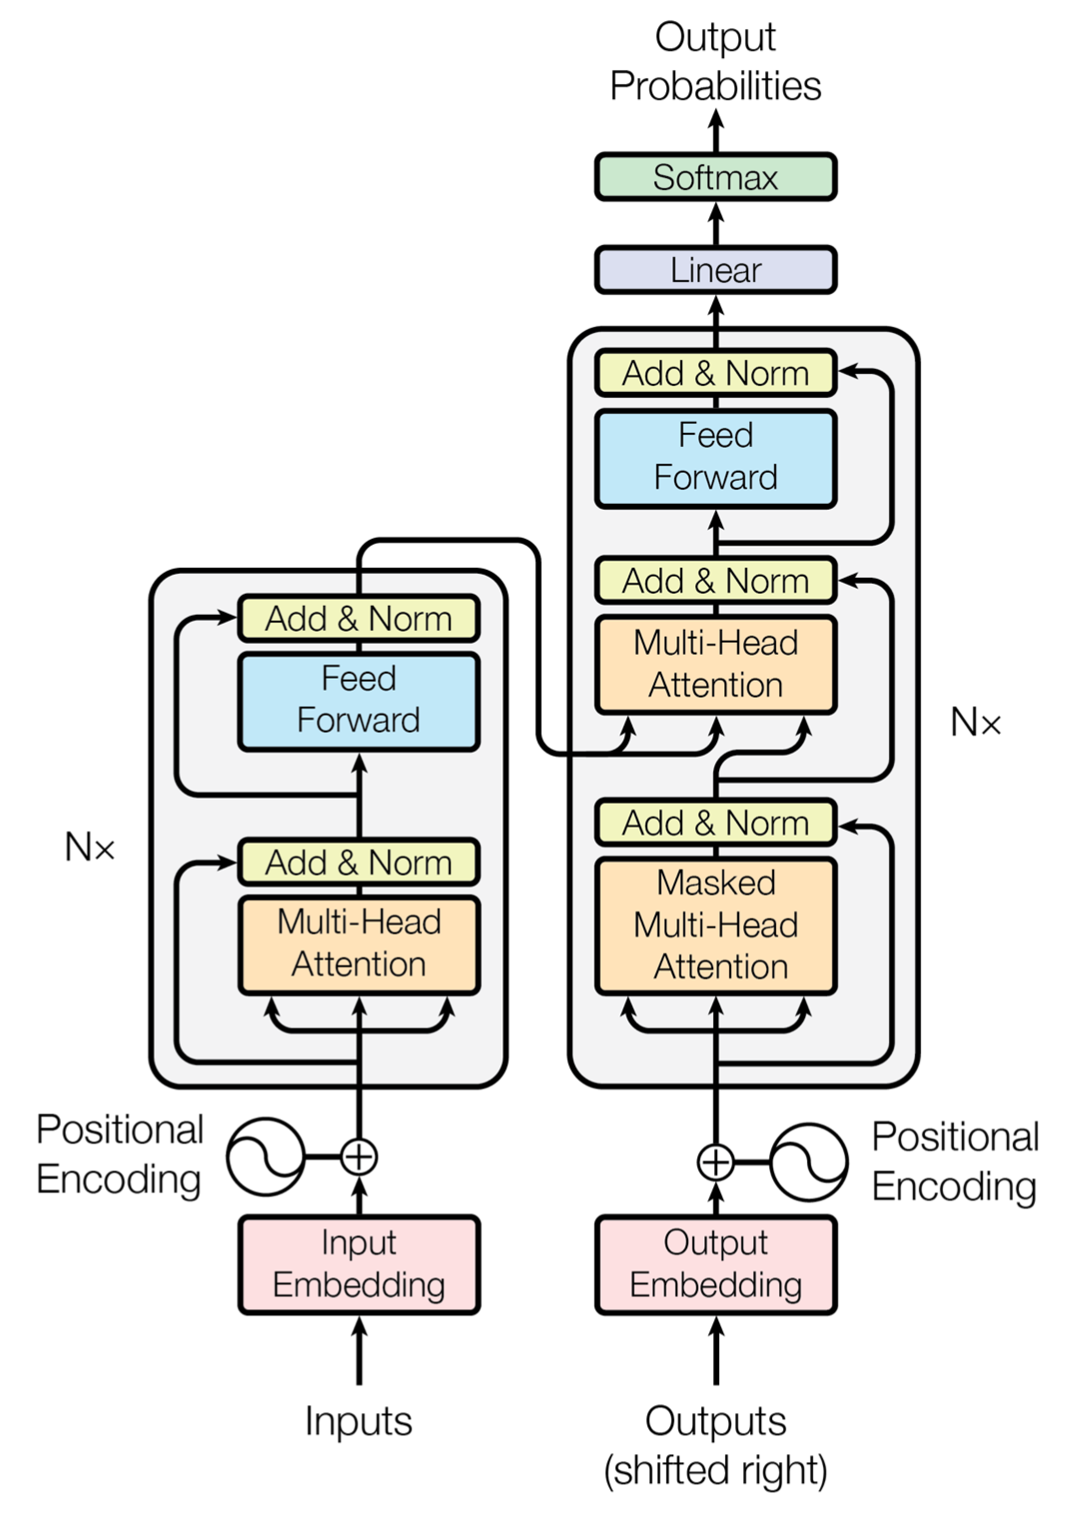
Encoder-decoder
Encoder on the left and decoder on the right
The only difference between them: “Masked” in decoder.
Source: Vaswani, A., et al. (2017). Attention Is All You Need. In Advances in Neural Information Processing Systems (Vol. 30).

Slide 18
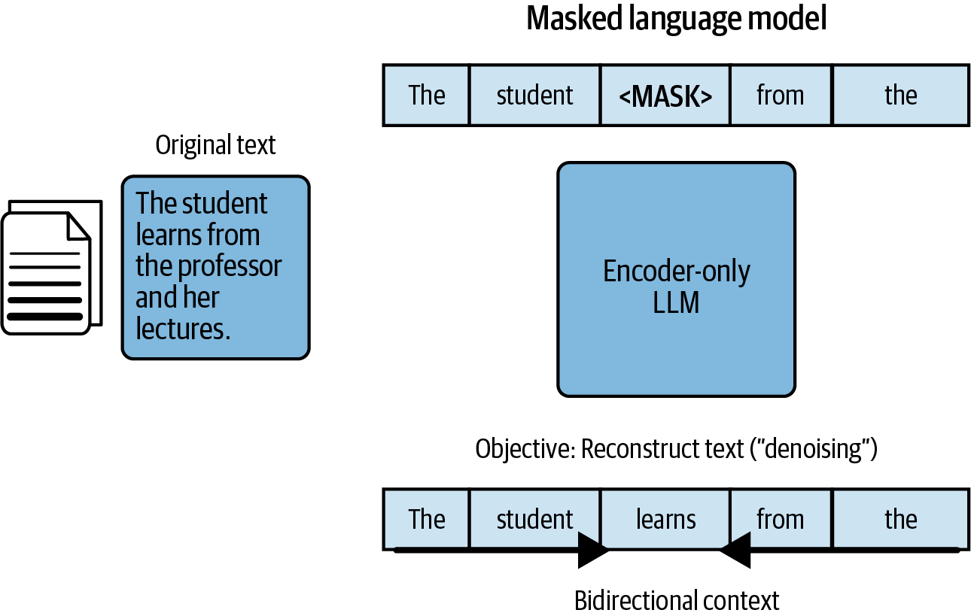
Encoder
The encoder can “see” all the tokens in a given sequence, making it suitable for extracting contextual embeddings.
Source: Fregly, C., Barth, A., & Eigenbrode, S. (2023). Generative AI on AWS: Building Context-Aware Multimodal Reasoning Applications. O'Reilly Media.

Slide 19
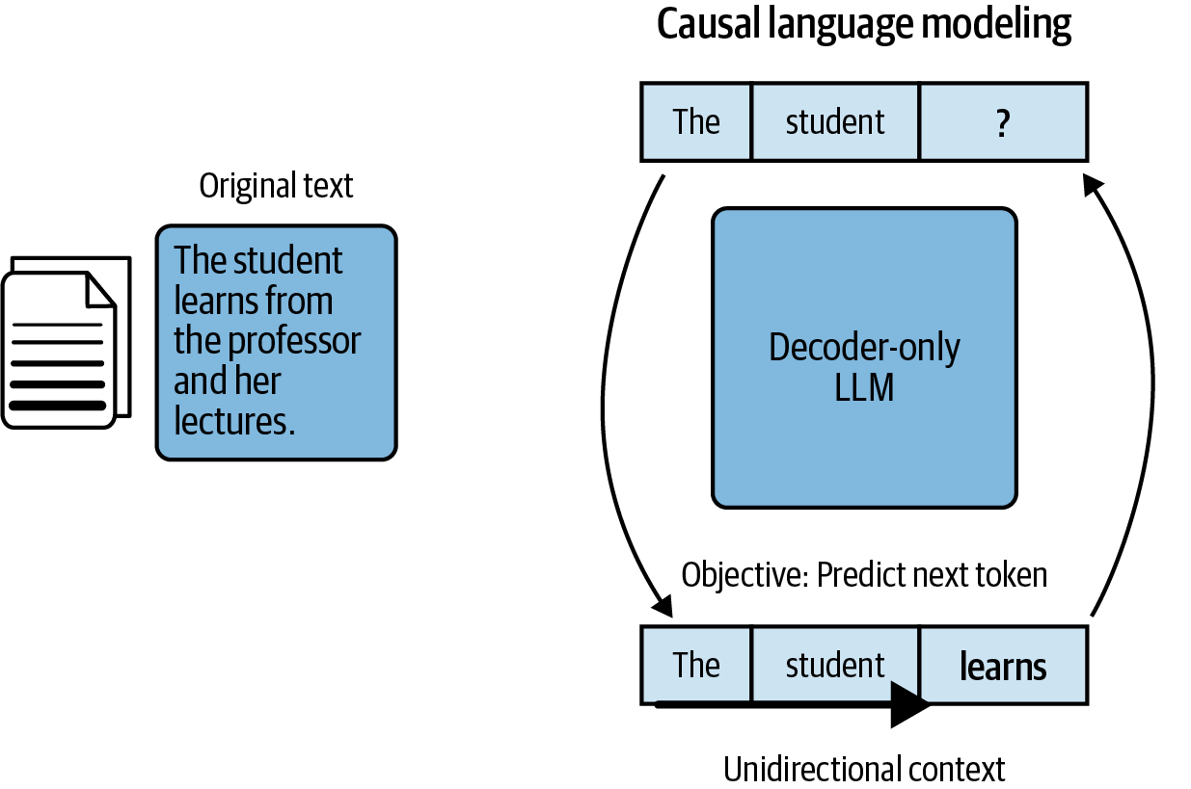
Decoder
The decoder can “see” all the tokens that come before the given token/position, making it good for ?
Source: Fregly, C., Barth, A., & Eigenbrode, S. (2023). Generative AI on AWS: Building Context-Aware Multimodal Reasoning Applications. O'Reilly Media.

Slide 20


Self-attention mechanism
Purpose: Enables each token in a sequence to “pay attention” to every other token.
Captures relationships and dependencies regardless of their position.
Core Components:
Queries (Q), Keys (K), and Values (V):
Each token is transformed into these three vectors using learned weight matrices.

Slide 21
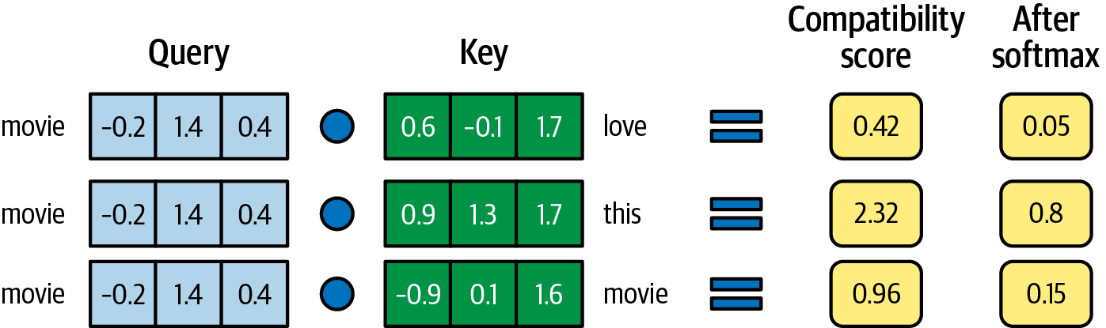
Self-attention mechanism
Source: Fregly, C., Barth, A., & Eigenbrode, S. (2023). Generative AI on AWS: Building Context-Aware Multimodal Reasoning Applications. O'Reilly Media.

Slide 22
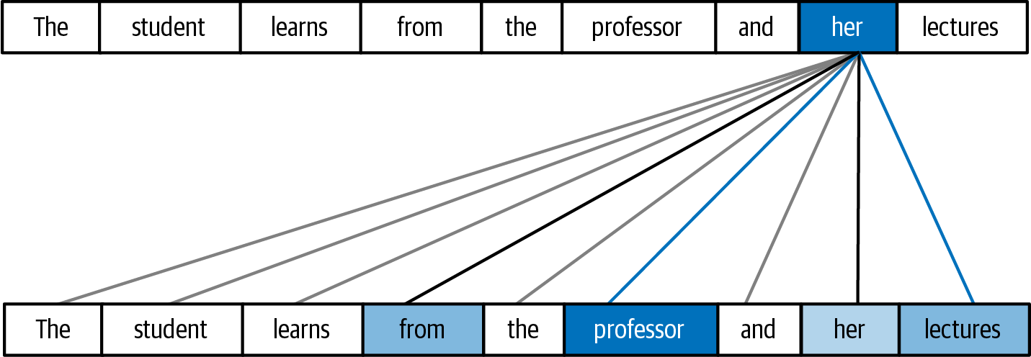
Self-attention mechanism
Source: Fregly, C., Barth, A., & Eigenbrode, S. (2023). Generative AI on AWS: Building Context-Aware Multimodal Reasoning Applications. O'Reilly Media.

Slide 23
Memory needed for LLM inference
Using a 7b model for illustration
1. Baseline memory usage
FP32 weight precision: 4 * 7 = 28GB of memory
FP16 Precision ~14 GB of memory
INT8 Quantization ~7 GB
2. Key influencers
Sequence Length (Context Window)
Longer contexts require more memory to store intermediate states.
Batch Size

Slide 24
GPU Computing
1. Definition & Key Idea
General-Purpose Graphics Processing Units (GPGPUs)
Use the massively parallel hardware of GPUs to accelerate non-graphics tasks.
2. Why GPUs?
Parallel Architecture
Thousands of cores excel at highly parallel operations (e.g., matrix multiply).
High Throughput
Ideal for AI/ML training, scientific simulations, and model inference.
3. Common Applications
Deep Learning: Training/inference on large neural networks such as LLMs.
HPC & Scientific: Simulations in physics, genomics, fluid dynamics, etc.

Slide 25
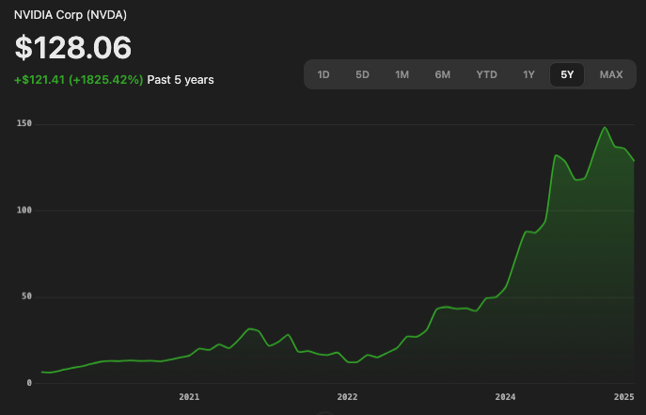
GPU Computing
An investment of $1,000 in NVIDIA stock a decade ago would be worth approximately $267,000 today, reflecting a return of 26,600%.
Source: Nasdaq.com, Google Finance

Slide 26
Scaling laws
Scaling laws describe how model performance (e.g., loss, perplexity) improves predictably as we increase:
Model size (parameters)
Training data (tokens)
Compute (FLOPs)
Kaplan et al. (OpenAI 2020) showed near power-law relationships for NLP models.
Bigger Model → Better Performance (until diminishing returns).
Balanced Data & Compute: Optimal ratio of data to parameters (Chinchilla analysis).
Performance Forecasting: Guides resource planning (GPU hours, dataset size).

Slide 27
Embeddings
1. Embeddings
A numerical (vector) representation of entities (words, sentences, images, etc.) in a continuous space.
2. Common embedding examples
One‑Hot Encoding
Dense Word Embeddings (e.g., Word2Vec)
Sentence/Article Embeddings
Image Embeddings

Slide 28
What makes good embeddings good?
Semantic Expressiveness
Meaningful Representation: Captures context and relationships (e.g., synonyms, hypernyms, similarities).
Context Sensitivity: Reflects differences in meaning when context changes (e.g., “bank” in finance vs. river bank).
Discriminative Power
Separability: Distinguishes between dissimilar items (e.g., different topics, classes).
Cluster Formation: Similar items naturally form tight clusters in the embedding space.

Slide 29
LLM embeddings
1. Definition
Dense vector representations produced by LLMs for words, sentences, or entire documents.
Capture meaning based on surrounding context, unlike older, static embeddings (e.g., Word2Vec).
2. Embedding Generation
Transformer Layers: Hidden states (especially the last hidden state) from encoder-based LLMs (e.g., BERT) serve as rich embeddings.
Every token is corresponding to an LLM embedding. How can we aggregate these embeddings on the document level?

Slide 30
Pooling
Definition: Reducing the sequence of token-level outputs (hidden states) into a single, fixed-size vector (e.g., token embeddings → article embedding).
Goal: Summarize or aggregate meaning from an entire sequence (sentence/paragraph) for downstream tasks.
Dimensionality Reduction
Converts variable-length sequences into a single fixed-size vector.
Semantic Summarization
Captures the overall meaning/context without storing every token output.
Efficiency
Simplifies downstream tasks like classification, retrieval, or clustering.

Slide 31
Pooling
Common Pooling Strategies:
[CLS] Token Pooling
Take the hidden state of the special [CLS] (or equivalent) token.
Used by encoders like BERT for sentence/article embedding.
Mean Pooling: Compute the average of all token embeddings.
Offers a balanced view of the entire sequence.
Max Pooling
Take the maximum value across tokens for each dimension.
Highlights the most prominent features in the sequence.

Slide 32
Use cases for LLM embeddings
Next token prediction
Implicit
Semantic Search & Information Retrieval
Compute similarity (e.g., cosine similarity) to match queries with relevant documents
Enables more intuitive, meaning-based search over keyword-based methods
Recommendation Systems
Represent users, products, or content as vectors
Recommend similar items based on proximity in the embedding space
Clustering & Topic Modeling
Group similar texts together automatically
Identify underlying topics and trends across large datasets
Text Classification & Sentiment Analysis
Use embeddings as features in machine learning classifiers
Capture nuanced relationships between similar concepts for improved accuracy

Slide 33
Hugging Face 🤗
A leading open-source AI startup focused on NLP and beyond
Community-driven platform hosting ML models, datasets, and demo apps
Key Offerings
The Transformers library in Python: Pretrained models for text, vision, audio, etc.
Model Hub: Central repository to share and discover state-of-the-art models
Datasets Library: Curated and community-contributed datasets for quick experimentation

Slide 34
Hands-on exercise
https://github.com/PursuitOfDataScience/uchicago-workshops/tree/main/llm-embeddings
Follow the instructions on the README

Slide 35
Recap
Generative AI and LLMs
The transformer architecture
Encoder and decoder
Self-attention mechanism
GPU computing
The transformers library
LLM embedding generation
ML tasks using embeddings

Slide 36
Thank you!
Youzhi.Yu@ChicagoBooth.edu

