Slide 1
RCC WORKSHOP · UNIVERSITY OF CHICAGO
Claude Code on Midway3
An AI coding agent for everyday research computing.
Youzhi Yu · Research Computing Center

Slide 2
Agenda
1
AI agents from language models that answer, to systems that act.
2
Claude Code an AI agent for coding and research tasks.
3
Everyday applications the range of tasks it handles.
4
Model, effort, and context configuring the model's behavior.
5
Commands and interaction directing and constraining a session.
6
Customization and extensibility CLAUDE.md, skills, and external tools.
7
Claude Code on the cluster everyday Slurm and Midway3 work.
8
Hands-on exercise applying Claude Code on Midway3.
2

Slide 3
PART 1 OF 8
AI agents
From language models that answer, to systems that act.
3

Slide 4
At the core is a language model
Every AI agent is built on one.
• Prediction, at heart. Given some text, a large language model (an LLM) continues it — enough to answer a question, summarize a document, or draft prose.
• The engine behind chatbots. Tools such as ChatGPT and Claude are chatbots wrapped around a language model, presented as a conversation: the user types, the model replies.
• Words, and only words. On its own the model can describe a procedure, but cannot run a program, open a file, or verify a result.
4

Slide 5
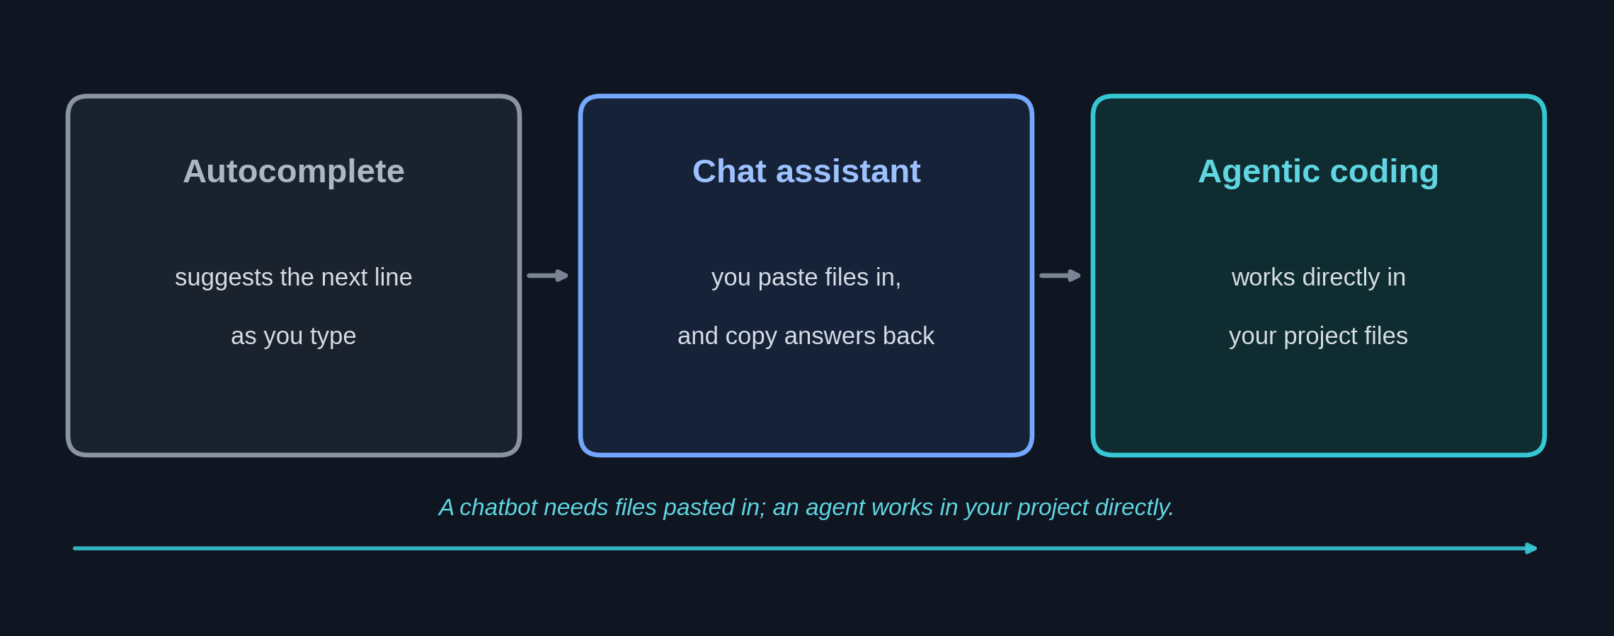
From autocomplete to agent
The key difference: an agent works directly in your project files, instead of you pasting code into a chat and copying answers back.
5

Slide 6
An agent adds tools and a loop
Wrap the model in a program that gives it tools and runs it repeatedly, and it can act.
• Tools, first. The model is given the means to run commands, read and edit files, search, and call other software — actions, not just descriptions.
• A loop, not one reply. The model chooses an action, a tool carries it out, and the result is fed back; this repeats, step by step, toward the goal.
• A goal to reach. The user states the desired outcome; the agent works out the sequence of steps and continues until the task is complete.
6

Slide 7
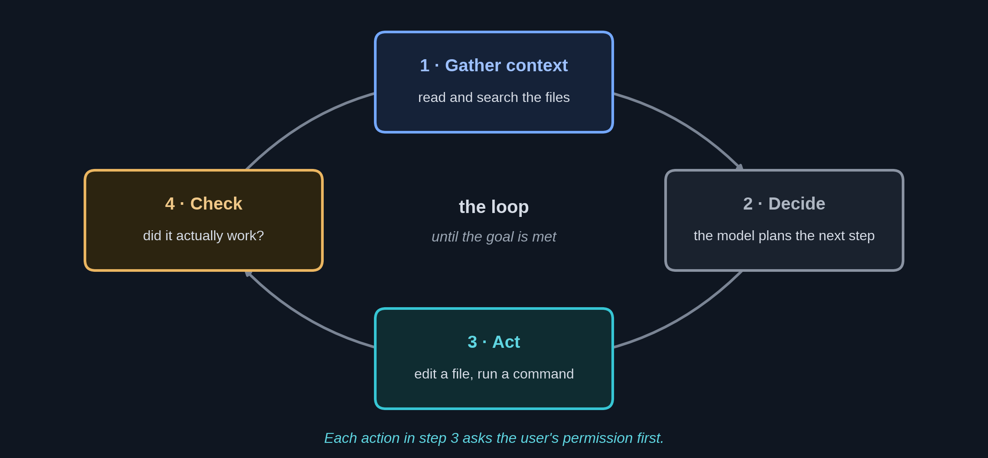
The loop it runs in
Gather context, act, check the result, and repeat. The settings covered later in this talk act on the stages of this loop.
Loop framing: Anthropic, "Building effective agents" (2024).
7

Slide 8
An agent checks its own work
• Concrete feedback guides it. Test results, error messages, and exit codes show whether a step actually succeeded.
• Failure prompts a retry. When a step fails, the agent adjusts its approach and tries again rather than stopping at the first error.
• Verification closes the loop. This self-checking is what distinguishes an agent from a single model response — though the user remains responsible for confirming the final result.
8

Slide 9
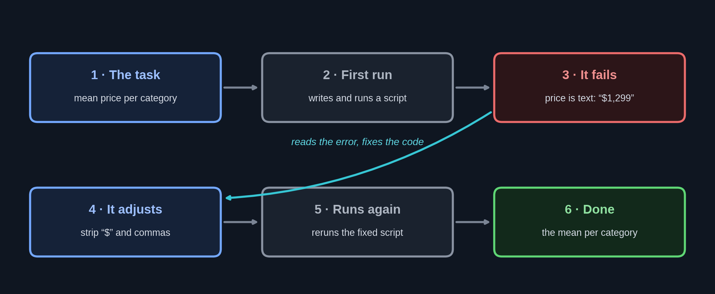
An agent corrects itself and finishes the job
One small task: the first attempt fails, the agent reads the error, fixes the code, and succeeds — unprompted.
9

Slide 10
PART 2 OF 8
Claude Code
An AI agent for coding and research tasks.
10

Slide 11
Claude Code is an agent for the terminal
One such agent, from Anthropic — the maker of the Claude models.
• An agent for practical work, not only code. It reads files, runs commands, and edits them in a loop to carry out a task described in plain language.
• Directed in ordinary language. The user states an objective; the tool determines and carries out the necessary steps.
• No programming expertise required. Familiarity with a terminal is sufficient; it is available in the terminal, common editors, and the desktop and web applications.
11

Slide 12
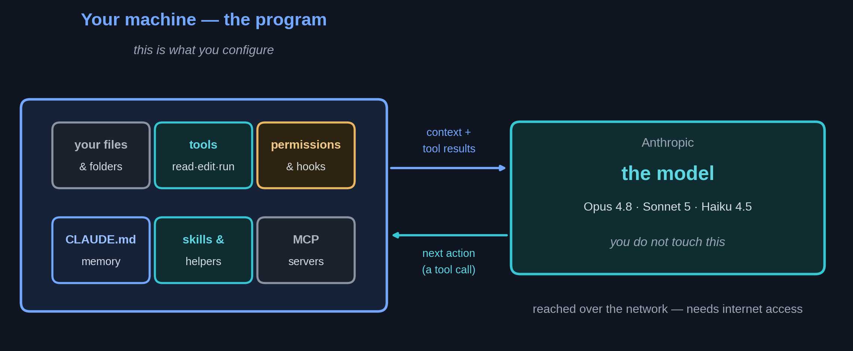
A program and a model
The program runs on the local machine and is configurable; the model (Claude) supplies the reasoning.
12

Slide 13
Instructions in plain language
The user names files with @; the tool works out and runs the steps.
• “Summarize what changed between @run_a.csv and @run_b.csv.” Reads both files, and reports the substantive differences.
• “Load @results.csv and plot accuracy against epoch.” Writes a short script, runs it, and saves the figure.
• “Explain why @train.py exits with an error.” Reproduces the error, then pinpoints the cause in the code.
13

Slide 14
PART 3 OF 8
Everyday applications
The range of tasks it handles.
14

Slide 15
Applications extend beyond code
• Data and analysis. Cleaning datasets, computing summaries, running statistical tests, and generating figures.
• Text and documentation. Drafting a methods section, summarizing logs, or organizing literature notes.
• Software tasks. Writing, refactoring, and debugging analysis code and pipelines.
15

Slide 16
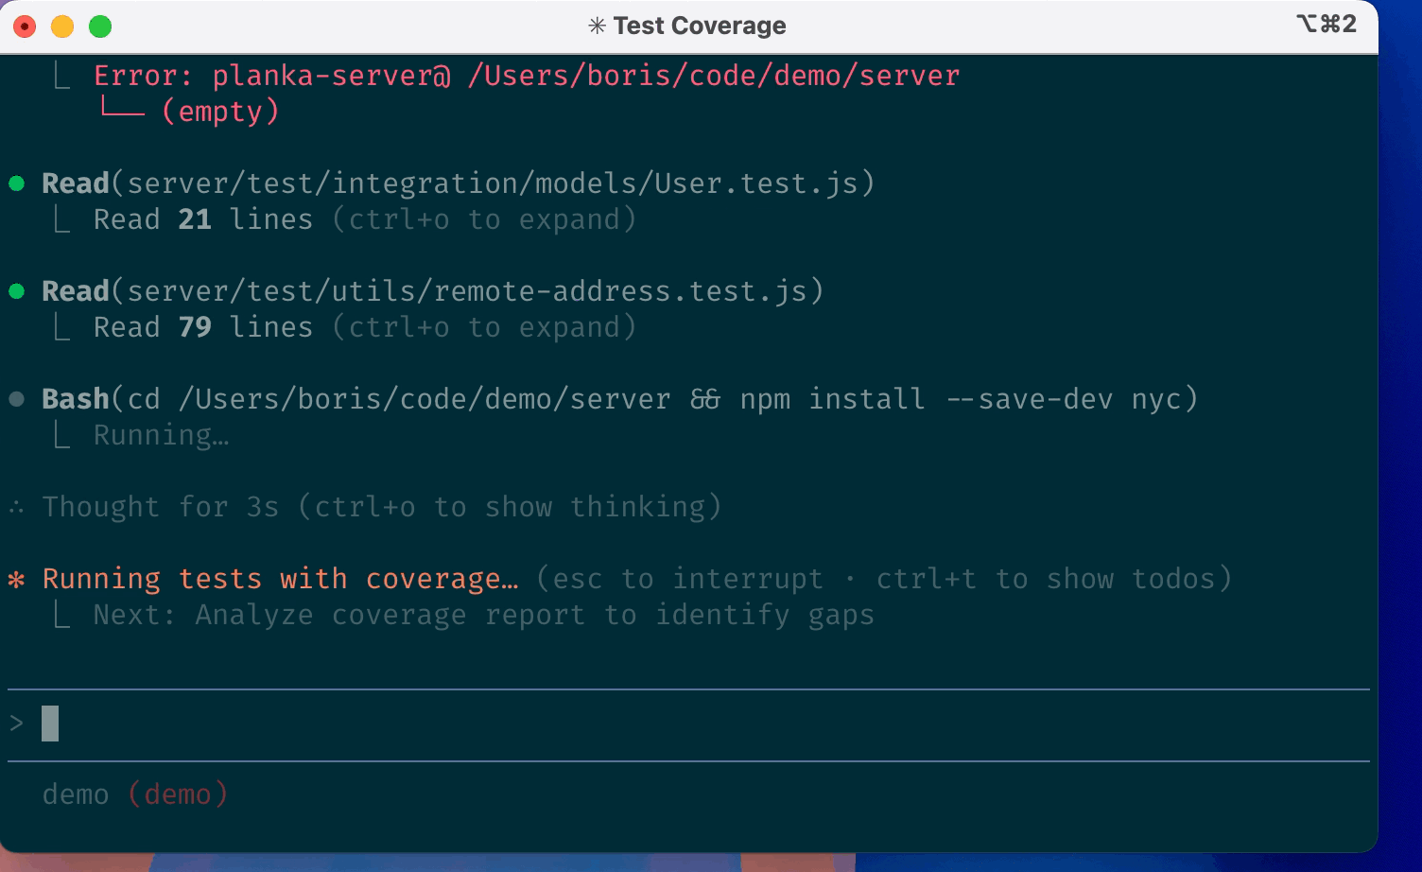
A representative session
It reads files, runs commands, and reports back — and the user reviews each step.
Screenshot: Anthropic's Claude Code demo (github.com/anthropics/claude-code).
16

Slide 17
PART 4 OF 8
Model, effort, and context
Configuring the model's behavior for the task.
17

Slide 18
Model selection
The model is chosen with /model, a command entered with a leading slash. A more capable model is slower and uses more of the allocation.
Model | Best suited for | Relative cost
Opus 4.8 | Complex reasoning and multi-step tasks | $$$
Sonnet 5 | General day-to-day work | $$
Haiku 4.5 | Simple, high-volume, or time-sensitive tasks | $
A frontier model (Fable 5) is also available for the most demanding tasks. The default is set by the institution.
18

Slide 19
Reasoning effort
/effort sets how hard the model thinks before it acts. Current models default to high.
Level | Best suited for
low | Quick, routine edits
medium | Cost-sensitive work
high · default | Everyday balance of speed and depth
xhigh | Hard reasoning; involved agentic coding
max | The most demanding problems
Claude Code adds ultracode: it raises the effort and, beyond a single agent, coordinates a team of agents working in parallel — for the largest, hardest tasks.
19

Slide 20
Subagents: a coordinated team
That parallel work is done by subagents — helpers the main agent runs, set up with /agents.
• Each has its own context. The main agent hands off a sub-task; the subagent works in a separate context window and returns only a short summary, so the main conversation stays lean.
• One coordinator splits and merges. It divides a large task across several subagents running at once, then combines their results into a single answer.
• Not the same as separate sessions. Independent claude windows run blind to one another — you would stitch their output together by hand; subagents share one goal and one coordinator that does the stitching.
20

Slide 21
The context window
The model reads its entire context at every step, and that context grows as a session continues.
• A large context is slower and more costly. Every open file and prior message is reprocessed on each step.
• Manage it deliberately. /context reports what is loaded, /compact condenses the conversation, and /clear begins a new one.
• Earlier states can be restored. /rewind returns the files and the conversation to a previous checkpoint.
21

Slide 22
PART 5 OF 8
Commands and interaction
Directing and constraining a session.
22

Slide 23
Common slash commands
Enter / to list every command; /help provides a full reference.
Session
Configuration
• /model — select the model
• /effort — set reasoning effort
• /context — inspect the context window
• /compact — condense the conversation
• /clear — begin a new conversation
• /rewind — restore an earlier state
• /init — create a CLAUDE.md file
• /agents — set up task-specific helpers
• /mcp — connect external tools
• /permissions — set allow / ask / deny rules
• /config — adjust settings
• /help — list every command
23

Slide 24
Permission modes
The user sets the level of autonomy with Shift+Tab; the model cannot change it.
Mode | Behavior
Manual (default) | Reads freely; requests approval for each edit or command
Accept edits | Applies its own edits within the working directory
Plan | Read-only; proposes changes without applying them
Auto | Operates autonomously, subject to a safety check (opt-in)
A further mode bypasses all checks and is appropriate only in an isolated, disposable environment.
24

Slide 25
Actions are confirmed before execution
Before it edits a file or runs a command, Claude Code stops and asks.
• Three choices, every time. Permit the action once, permit the whole category from now on, or decline and tell it what to do instead.
• Nothing runs until you choose. Reads are free, but an edit or a command waits for approval — the mode you set (Manual, Accept edits, Plan) decides how often it asks.
• You stay the reviewer. The command it wants to run is shown in full before it runs, so nothing happens behind your back.
25

Slide 26
PART 6 OF 8
Customization and extensibility
Adapting the tool to a project.
26

Slide 27
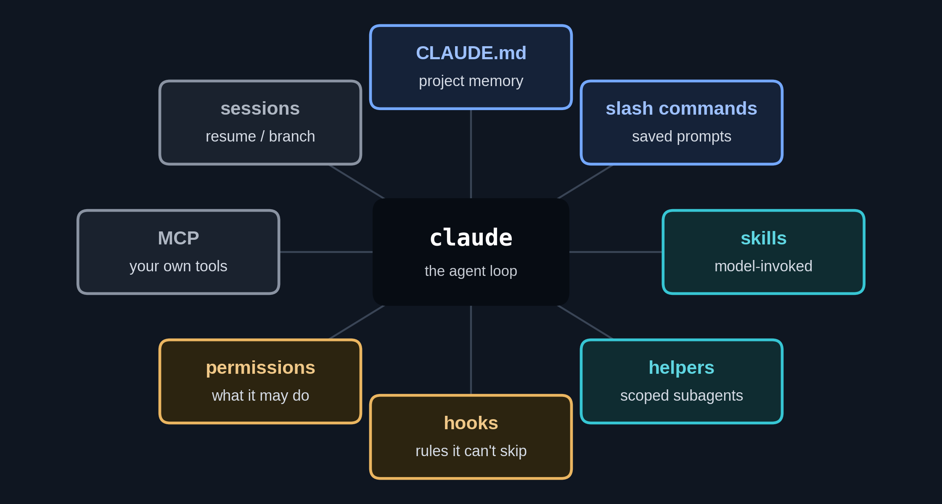
Configurable components
The model is fixed; the surrounding program is configurable.
27

Slide 28
Project memory: CLAUDE.md
A Markdown file loaded automatically at the start of every session in a directory.
• A place for project conventions. For example, the location of the tests, the environment to activate, or which data are read-only.
• /init drafts an initial file. Keep it concise — roughly 200 lines or fewer. It is guidance, not an enforced constraint.
• Two levels, personal and shared. A personal file that applies to all your work, and a project file shared with collaborators.
Memory hierarchy and /init: Anthropic documentation.
28

Slide 29
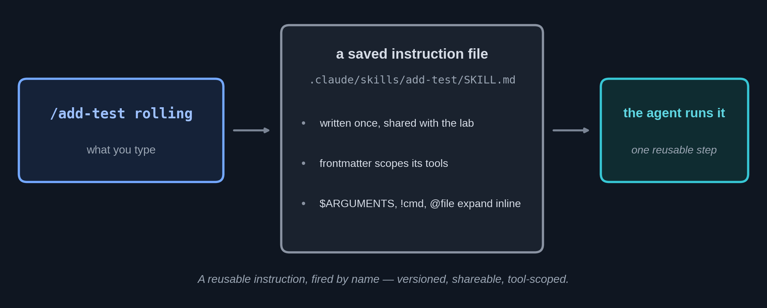
Reusable instructions
A frequently used instruction can be saved and invoked by name. Such saved instructions are one kind of skill.
29

Slide 30
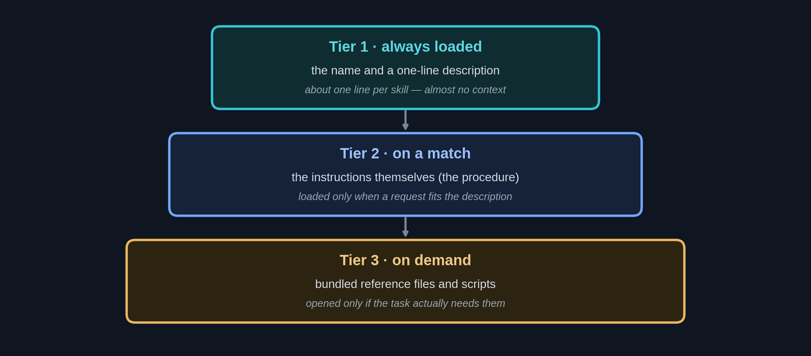
Skills: automatically invoked capabilities
More generally, the model invokes a relevant skill on its own when a request matches the skill's description — without being asked by name.
Agent Skills: Anthropic, "Equipping agents for the real world with Agent Skills" (2025).
30

Slide 31
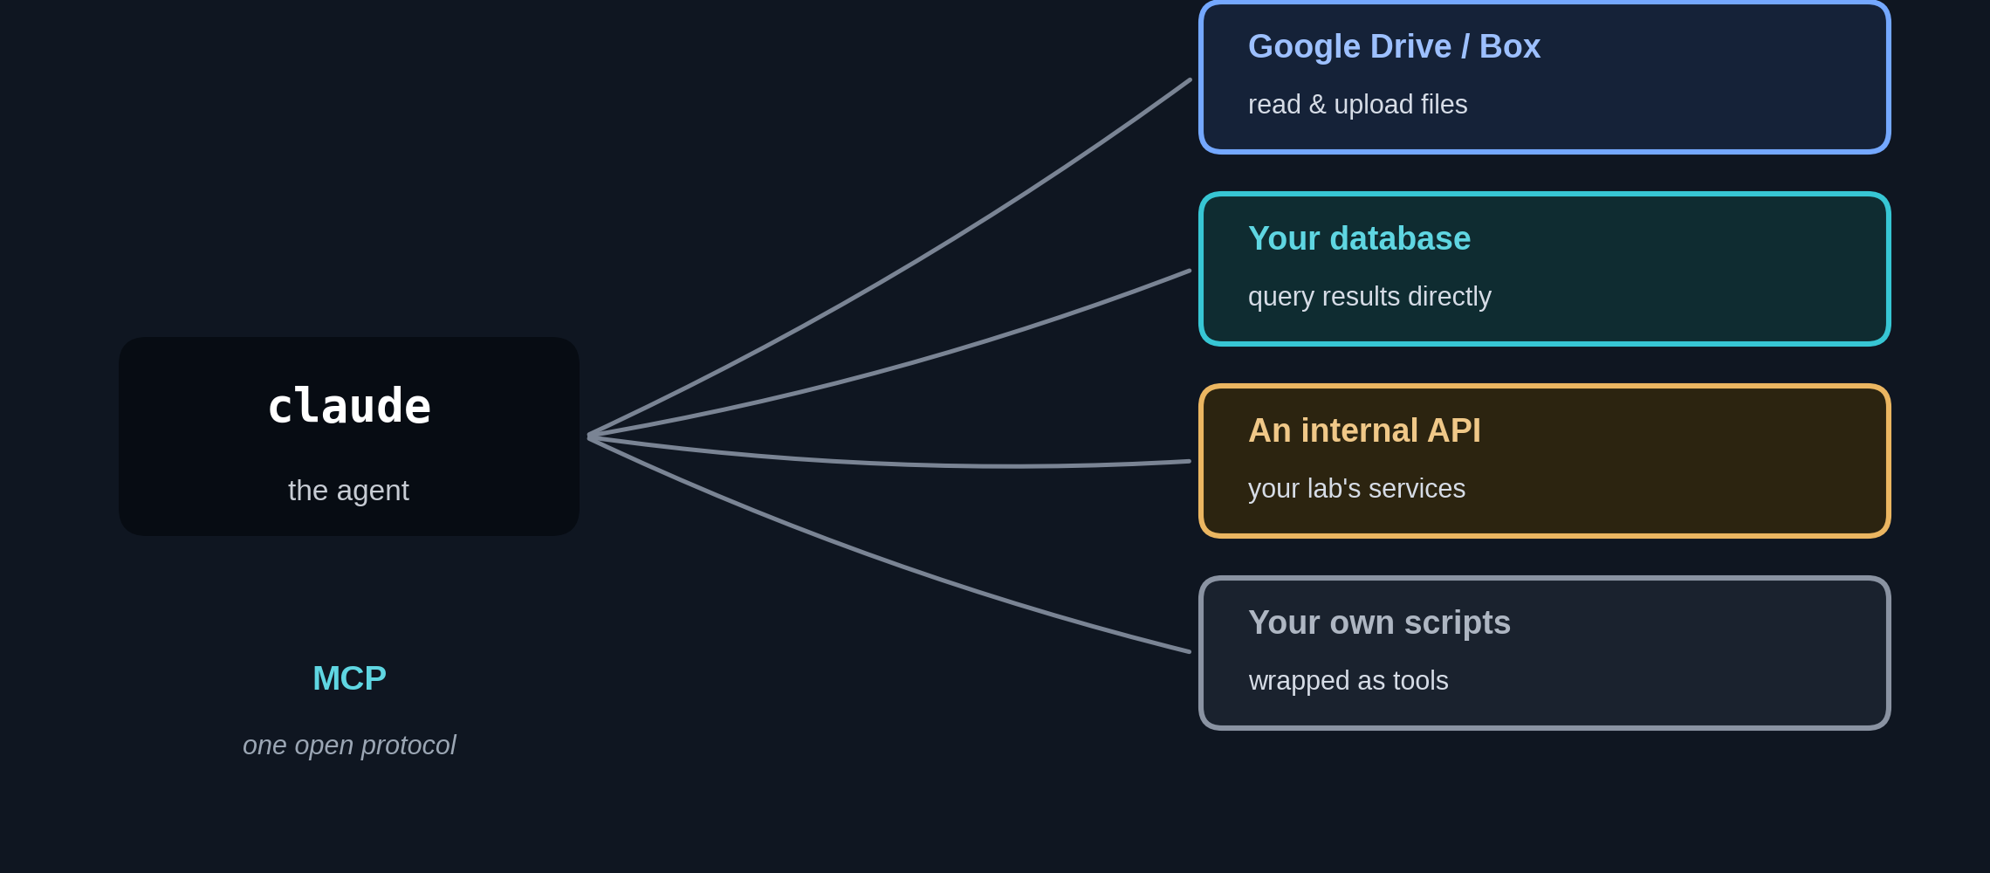
External tools and data: MCP
The Model Context Protocol is an open standard that connects the tool to outside services — for example, a Google Drive or Box server, to read your files and write results back.
MCP: Anthropic, "Introducing the Model Context Protocol" (2024); modelcontextprotocol.io.
31

Slide 32
Hooks: rules the harness enforces
A hook is a small command the program runs automatically at a set point — no prompt, no reminder.
• For example: protect the raw data. Register a hook that runs before every command; if one would write inside data/raw/, the hook exits with an error and the command is blocked — before it runs.
• Or: format on every edit. A hook that runs after each edit can auto-format the file, so the code stays tidy on its own.
• Enforced, unlike CLAUDE.md. CLAUDE.md is advice the model usually follows; a hook is a rule the program applies every time.
32

Slide 33
PART 7 OF 8
Claude Code on the cluster
Everyday Slurm and Midway3 work, in plain language.
33

Slide 34
The cluster chores it handles
• Batch scripts. Describe the job — cores, memory, time, a GPU — and it writes and explains the sbatch script.
• Job triage. When a job is stuck or fails, it checks squeue and your allocation and explains why, in plain terms.
• Getting oriented. Disk quota, allocations, partitions, and the right module load line — it runs the RCC commands and reads the answer back.
34

Slide 35
On the cluster, you might ask
• “Write an sbatch script for @train.py: 1 GPU, 2 hours, 16 GB.” It drafts the script; you review it before submitting.
• “Why is my job stuck in PENDING?” It reads the queue and your allocation and explains the hold-up.
• “How much of my allocation is left this month?” It runs the account command and reports the balance.
35

Slide 36
PART 8 OF 8
Hands-on exercise
Applying Claude Code on the Midway3 cluster.
36

Slide 37
The exercise
A set of short, plain-language tasks with a reference solution. No setup or downloads needed.
• Each task is stated in plain language. The user pastes a task; Claude Code runs the commands, produces the analysis, and reports the result.
• The exercise has two parts. First, examining the Midway3 environment; then, analyzing a dataset read directly from a URL.
• The user reviews each result. Each step is approved, and its output is checked against the reference solution.
37

Slide 38
The two parts of the exercise
Claude Code is run in the exercise directory; it executes the commands and reports back for review.
Part 1 · The Midway3 environment
Part 2 · Data analysis
• Account, allocation, and disk quota
• Cluster and partition status
• Interactive sessions and batch scripts
• Job status and available software
• Read-only inspection of the cluster.
• Loading and summarizing a dataset
• Comparisons across groups
• A correlation and a data-quality check
• A generated figure and a written summary
• Results checked against a reference solution.
38

Slide 39
The exercise on GitHub
Everything is in the README.
• github.com/PursuitOfDataScience/uchicago-workshops
39

Slide 40
Summary
• Claude Code is an agent that completes tasks. It reads files, runs commands, and edits them in a verified loop, directed in plain language.
• The user stays in control. The model, effort, context, permissions, and project memory (CLAUDE.md) determine how it behaves.
• The same tool runs anywhere. Today's exercise uses Midway3, but Claude Code works the same on a laptop, another cluster, or inside an automated pipeline.
• Always verify the output. The tool is a capable assistant, not an authority; the researcher remains responsible for the result.
40

Slide 41
References
1. Claude Code: Overview — Anthropic. code.claude.com/docs/en/overview
2. Model configuration — Anthropic. code.claude.com/docs/en/model-config
3. Memory (CLAUDE.md) — Anthropic. code.claude.com/docs/en/memory
4. Slash commands — Anthropic. code.claude.com/docs/en/commands
5. Permission modes — Anthropic. code.claude.com/docs/en/permission-modes
6. Custom subagents — Anthropic. code.claude.com/docs/en/sub-agents
7. Extend Claude with Skills — Anthropic. code.claude.com/docs/en/skills
8. Connect tools via MCP — Anthropic. code.claude.com/docs/en/mcp
9. Models overview — Anthropic. platform.claude.com/docs/en/about-claude/models/overview
10. Building effective agents (2024) — Anthropic. anthropic.com/engineering/building-effective-agents
11. Running jobs with Slurm — UChicago RCC. docs.rcc.uchicago.edu/slurm
12. UChicago RCC user guide — docs.rcc.uchicago.edu
41

Slide 42
Thank you
42

