Slide 1

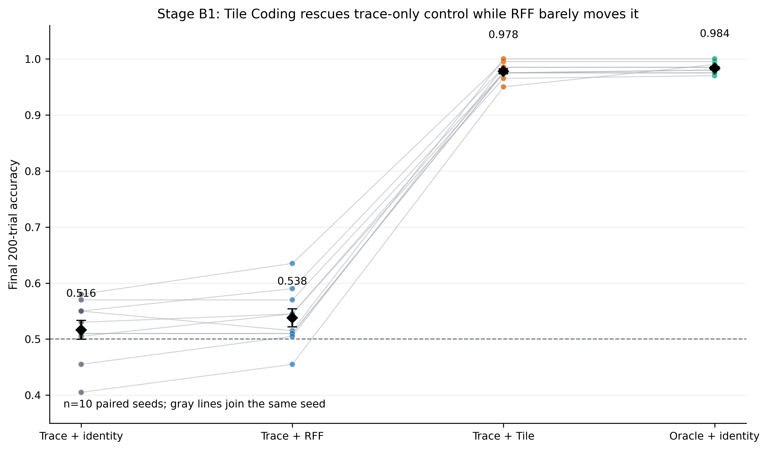
Exploring Useful Predictive Representations for Streaming RL
under Partial Observability and Non-Stationarity
Mingzhu Li · Xinwei Song · Yuqi Wei · Peng Yu
PROBLEM STATEMENT
When does predictive knowledge become a useful state representation for replay-free streaming control?
We test a three-stage bottleneck: useful predictive state must preserve action-relevant distinctions, expose them to the learner, and remain compact and complementary under drift.
WHY THIS PROBLEM?
RESULTS
Accurate prediction ≠ useful control state
Three questions, three bounded answers
The Alberta Plan proposes predictions as agent state. In a partially observable Markov
decision process (POMDP), retained hidden information may still be unusable by the
online controller. We therefore separate three failure modes—preservation,
accessibility, and adaptation under drift—rather than rank predictions alone.
RQ1 · Does reshaping predictive features reliably improve control?
Environment
Within-task evidence
What it rules out
PRESERVE
→
EXPOSE
→
ADAPT
T-maze
non-oracle ≈ 0.50 (chance)
feature shape alone does not recover memory control
retain the hidden
action distinction
make it learnable by
the online controller
keep a compact basis
as the world drifts
Two-loop
moment 0.797±0.068
raw 0.495±0.004
a positive effect can be environment-specific
RUNNING EXAMPLE
Hidden velocity
raw −0.063±0.018
highest mean
regularization and priors can reduce control utility
Continuing delayed-cue T-maze
Answer: no. Effects reverse across hidden structures; feature geometry is diagnostic, not a universal
selection rule. With n=3/condition, the evidence supports counterexamples—not a general ranking.
cue L/R
?
?
?
?
?
J
turn L
Cue appears once.
Corridor observations repeat.
The junction requires the past cue.
RQ2 · Is decodable information accessible to online control?
aliased corridor
turn R
The past cue is perfectly decodable at the junction (1.00); same gₜ and learner, only f changes.
RL task: cue → aliased corridor → junction turn; correct / incorrect feedback
Goal: continuing accuracy · Drift: cue corruption · distractors · timing · remapping
HOW WE TEST THE CLAIM
xₜ = [ oₜ , f(gₜ) , 1 ]
gₜ: learned forecasts from general value functions (GVFs)—cue, timing, regime
f: identity, residual random Fourier features (RFF), tile coding, or bank interface
RQ1
Representation geometry
4 POMDPs · 10 conditions · 3 seeds; compare transforms within environment.
Accuracy and reward differ across tasks, so results are never pooled.
RQ2
Control accessibility
Trace-only T-maze · 10 paired seeds; hold gₜ and the learner fixed,
then vary only the controller adapter: identity, RFF, or tile coding.
RQ3
Bank structure under drift
Big-world T-maze · 4 seeds; vary bank k, diversity, and novelty,
then compare against raw observations and a single cue-GVF baseline.
ONLINE GVF BANK UNDER DRIFT
Identity 0.5165 · RFF 0.5380 · Tile 0.9780 · Oracle / direct cue 0.9835
A compact predictive division of labor, updated online
Tile − identity = +0.4615 ± 0.0144 SEM · 10/10 paired improvements
1 GENERATE
2 SCORE
3 RETAIN + EXPOSE
Answer: not necessarily. Tile coding adds no cue information; local, sparse features expose the retained
cue to the fixed linear learner, moving control near oracle—an accessibility, not prediction, gain.
memory · timing
control · regime
+ sparse mixtures
→
decision / decode gains
+ uncertainty reduction
− TD error / redundancy
→
keep k complementary GVFs
[oₜ, bank, 1]
→ streaming linear policy
Mutate horizon / step size; retain candidates that fill missing roles and replenish online.
RQ3 · What bank structure converts predictions into control under drift?
EXPERIMENTAL CONTROLS
Raw 0.5073 · Cue GVF 0.5246 · four-seed means; uncertainty not supplied
• One-pass online learning; no replay, offline fitting, or recurrent memory.
• Held-out probes are diagnostic only; budgets and seeds are matched within comparisons.
• Environment-specific metrics; n=3/4 summaries are descriptive, not significance tests.
Bank variant
Cue decodability
Post-switch control
k=2 full
0.6483
0.4950
k=3 full
0.7294
0.5565
k=4 full
0.7386
0.5408
READOUTS Decoding → preservation · post-switch → control · recovery → adaptation
k=3, no diversity
0.6951
0.5196
WHY THE SEQUENCE MATTERS
k=3, no novelty
0.7294
0.5565
RQ1 tests whether feature reshaping generalizes across hidden structures.
RQ2 fixes predictions to isolate controller accessibility. RQ3 asks how
to compose predictions as relevance drifts. Together, the sequence moves
from diagnosis to intervention to adaptive construction.
• Remove diversity: −3.69 percentage points (0.5565 → 0.5196).
• k=4 decodes more (0.7386 > 0.7294) but controls worse (0.5408 < 0.5565).
• Remove novelty: no observed mean change (0.5565).
Answer: supplied means favor a compact, diversity-aware bank over increasing size or novelty alone.
The k=4 counterexample shows that more decodable predictions can still add redundancy or interference.
CONCLUSION
In these streaming POMDPs, usefulness depends on the representation–learner interface—not on the predictive feature alone.
Same cue information, better access: tile coding moves control 0.5165 → 0.9780. More decodability, worse control: k=4 underperforms k=3—two counterexamples to selection by decoding alone.
Scope: controlled POMDPs · linear control · hand-structured GVF roles · n=3/4/10 by study. Next: jointly adapt bank composition and controller coupling.
REFERENCE
REPRODUCIBILITY
SOURCE VERSIONS
Sutton et al. · The Alberta Plan for AI Research · 2022
Streaming · replay-free · CPU-scale
Held-out probes are diagnostic only
Geometry 2940182f · Adapters a88813c
GVF bank: supplied 4-seed summaries
Commands/results accompany the course package

