Slide 1

Strategic Analysis of Crime Trends in Chicago: Insights for Enhanced Law Enforcement and Community Safety
Purundar Yengala Madhusudhan Rao

Slide 2
Comprehensive Analysis of Chicago Crime Data: Patterns, Predictions, and Policing
Description of the Data:
The dataset selected for analysis is a comprehensive crime report from the City of Chicago, spanning multiple years and encompassing over 8 million entries.
Objectives:
The data-driven investigation will be guided by the following topics, with the goal of deriving empirical insights into crime patterns and informing data-supported decisions for crime prevention and resource allocation:
Temporal Dynamics of Crime
Geospatial Distribution
Interplay Between Crime Types and Locale
Arrest Rates and Crime Categories
Forecasting Crime Incidents
Evaluation of Policing Efficacy
Tools and techniques:
Python
Python Pandas
Data Set Link:
Matplotlib
Seaborn
Crimes - 2001 to Present (Map)

Slide 3
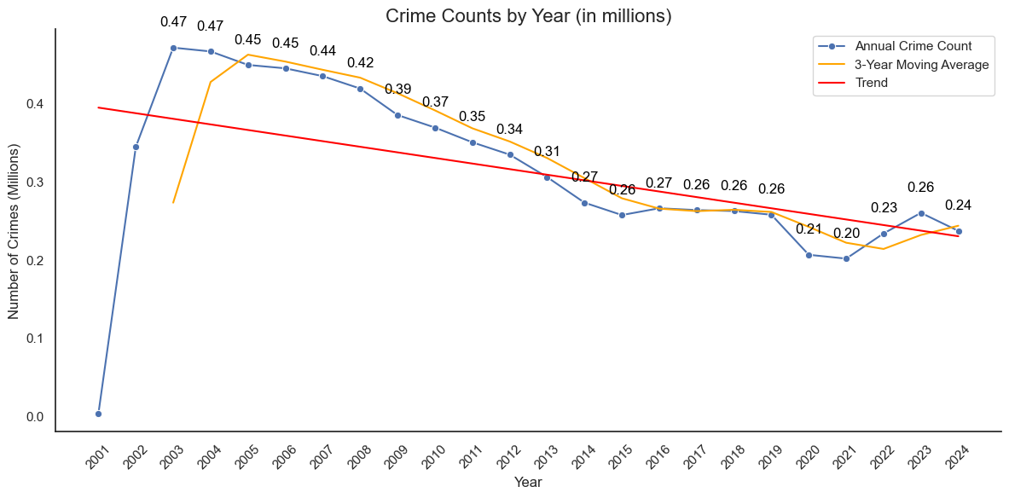
Decade-Long Decrease in Chicago's Crime Rate: A Closer Look
The graph depicts a steady decline in annual crime rates over the years, with the trend line and 3-year moving average both showing a downward trajectory. This data warrants an in-depth analysis to identify and address the underlying factors contributing to the observed decrease in reported crimes.
Notes:
Recommendations for Presentation Speech: When presenting this slide, you might want to point out specific years where notable changes occurred and relate them to historical events or changes in policing strategies. Additionally, acknowledging the efforts that contributed to the decrease and considering the factors that might reverse this trend would make the speech comprehensive and insightful.

Slide 4
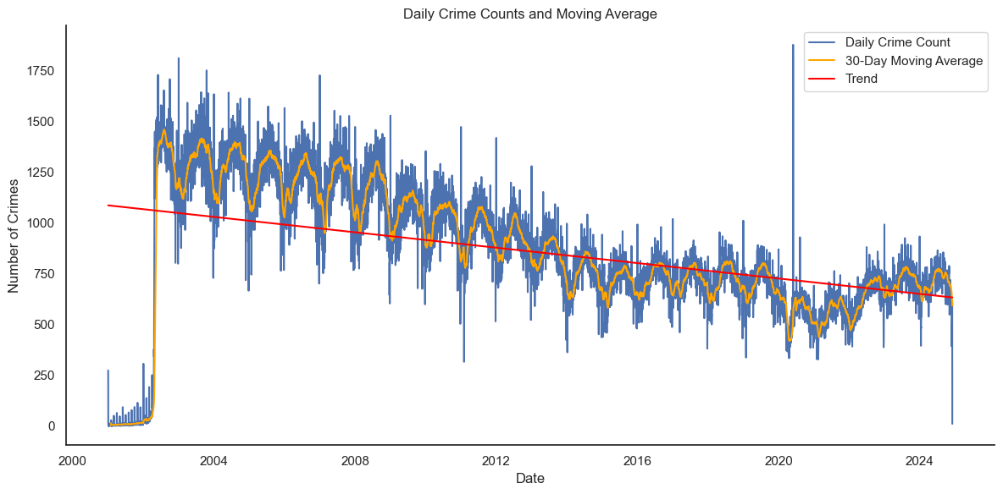
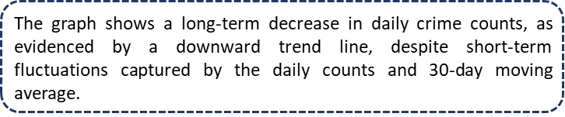
Analyzing Daily Crime Trends: A Twenty-Year Perspective
Notes:
Recommendations for Presentation Speech:
Emphasize the long-term decrease in crime while noting the daily variability. This demonstrates the unpredictability of crime on a day-to-day basis but an overall positive trend.
Mention the methodology behind the 30-day moving average and how it helps to smooth out daily anomalies to better understand trends.
Discuss the implications of these trends for resource allocation, such as the potential need for more officers on days with historically higher crime rates.

Slide 5
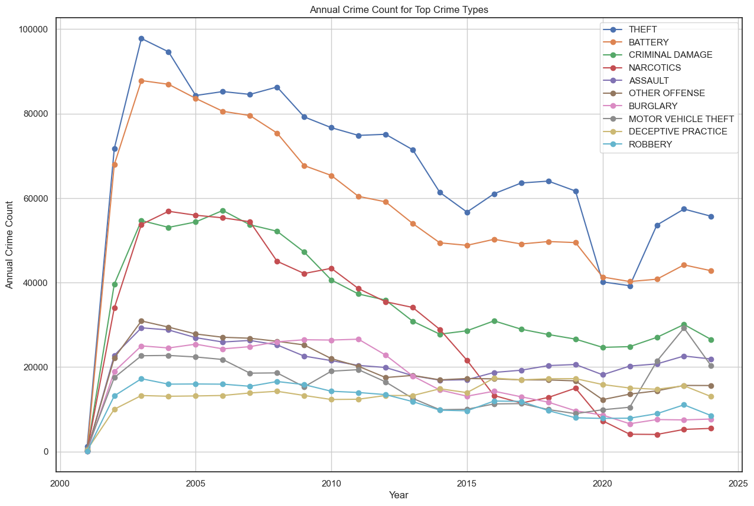
Crime Category Trends Over Two Decades: Diving into the Data
The slide indicates a general decline in below crime type over the year.
Theft
Battery
Narcotics crimes
While the below types shows an upward trend in recent years
motor vehicle theft
robbery
The decline in theft, battery, and narcotics offenses aligns with trends leading up to the COVID-19 pandemic, which may have further influenced these reductions. Conversely, the recent rise in motor vehicle theft and robbery, particularly during the pandemic era, calls for targeted interventions to address the unique challenges and opportunistic crimes that have emerged in this period.
Notes:
Discuss the overall trend of crime reduction, particularly in theft, battery, and narcotics crimes, and what measures might have influenced these outcomes.
Address the uptick in motor vehicle theft and robbery, exploring possible reasons behind this trend, such as economic factors or changes in policing strategies.
Consider the impact of external factors, like the COVID-19 pandemic, on crime patterns and law enforcement responses, highlighting the need for adaptive strategies in changing circumstances.

Slide 6
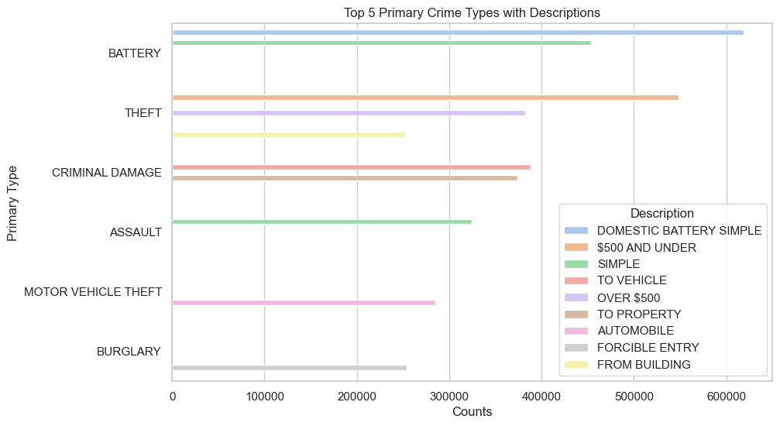
Dissecting Chicago's Crime Landscape: Prevalence and Nature of Offenses
Battery is Most Frequent: Battery appears to be the most frequently reported crime type within this dataset, with "Domestic Battery Simple" being the most common description, indicating a significant issue with domestic violence.
Theft and Property Crimes: Theft ranks as the second most common crime, with "Over $500" and "Under $500" being notable subcategories, which suggests a prevalence of property-related crimes at varying levels of severity.
Variety in Assault Crimes:
Assault is also a common crime type, with "Simple" assaults being more frequent than those involving a vehicle, which could indicate that most assaults do not involve the use of weapons or vehicles.
Motor Vehicle Theft:
Motor vehicle theft, specifically of automobiles, is another top crime, with "Automobile" and "Forcible Entry" as the main descriptions. This points to car-related crimes being a significant concern.
Drug-Related Incidents:
Narcotics-related crimes are present, with possession of cannabis being the specific description mentioned, reflecting drug possession as a notable crime area.

Slide 7
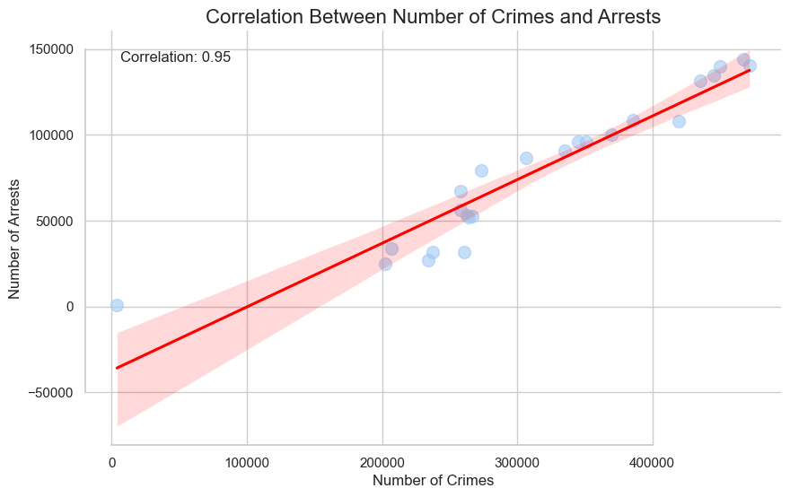
High Correlation: A Reflective Analysis of Crime Incidents and Arrest Rates
The graph shows a scatter plot with a regression line, illustrating the relationship between the number of crimes and the number of arrests. A correlation coefficient of 0.96 is extremely high, indicating a very strong positive relationship between the two variables. This means that as the number of crimes increases, the number of arrests tends to increase proportionally, and vice versa.
Notes:
Point out the near-perfect positive correlation between crimes reported and arrests made, suggesting effective police responsiveness.
Emphasize the potential for using this data to predict and allocate resources more efficiently, potentially improving arrest rates and deterring crime through a visible police presence.
Recommend a review of areas with high crime rates that do not correlate with high arrest rates, which may indicate opportunities for strategic improvements in policing efforts.

Slide 8
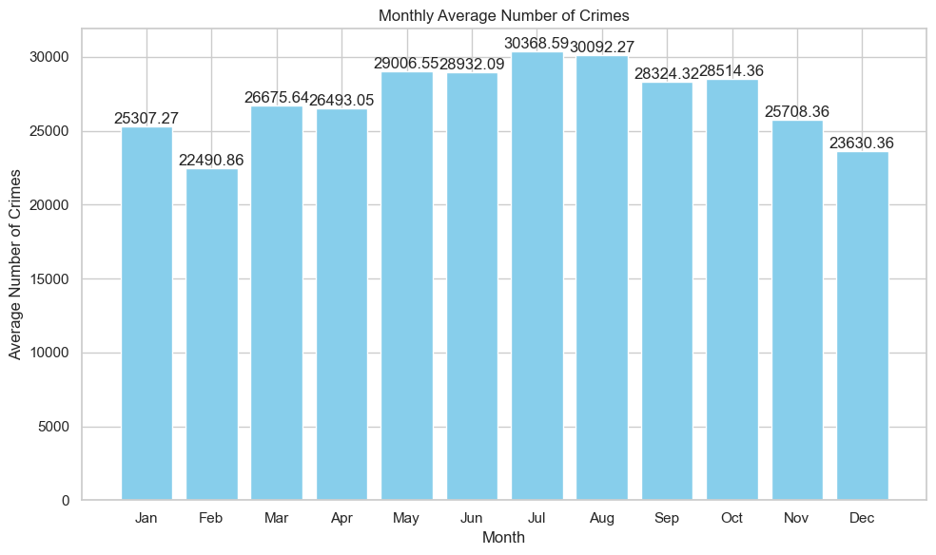

Seasonal Crime Patterns: Summer Surge and Winter Lull
The bar chart suggests that crime rates tend to peak in the summer months, with the highest average occurring in July, followed by a secondary peak in May. Conversely, February is shown to have the lowest average crime rate.
These trends may indicate that warmer weather correlates with increased criminal activity, which could be due to a variety of factors such as increased social activity, tourism, or other seasonal variables that potentially contribute to opportunities for crime. The data could be used to advocate for strategic law enforcement planning and community programs during these higher-risk periods.

Slide 9
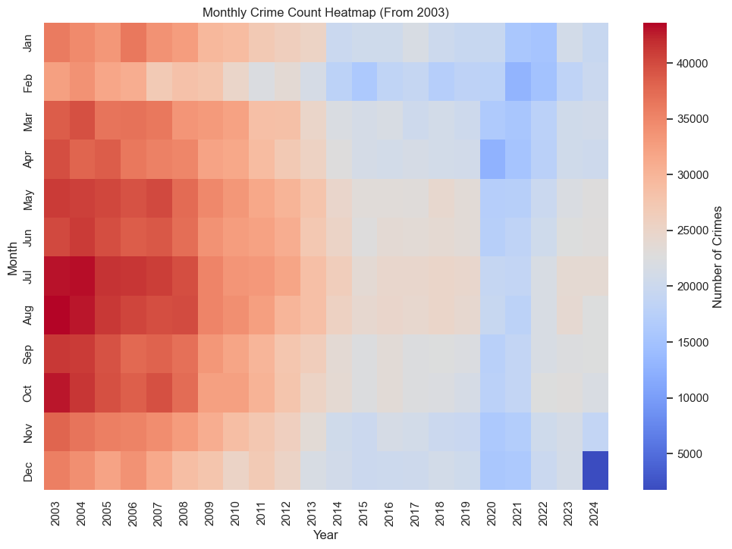
Shifting Crime Dynamics: A Two-Decade Perspective
The heatmap suggests a long-term decrease in crime since 2003, with particularly high crime rates in earlier years that gradually taper off. The color gradient indicates that crime rates were consistently higher from 2003 to around 2010-2011, after which there is a noticeable shift to lower crime rates across all months.
When connecting this with the previous picture, which showed monthly averages, it's apparent that while crime has decreased overall, the seasonal pattern within each year remains. Crime still peaks in the summer months, but the total volume of crime in those peak periods is lower in recent years compared to the early and mid-2000s.

Slide 10
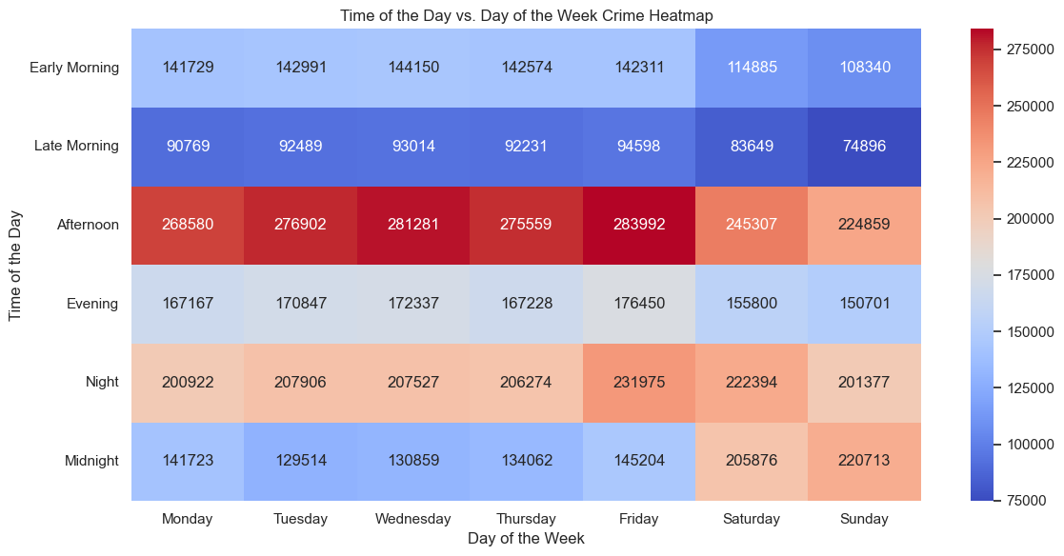
Deciphering Crime Patterns: Time of Day and Week Analysis
Time of Day Variation: Crime occurrences are higher during the Night and Afternoon compared to Early Morning and Midnight. This could suggest that criminal activities increase when it's dark or during the busy hours of the day.
Day of the Week Trends: The heatmap shows that crime counts are relatively higher on Fridays and Saturdays across most time periods, which might be attributed to increased social activities and gatherings during the weekend.
Early Morning Safety: Early Morning hours, especially from Monday to Thursday, appear to have the lowest crime rates, indicating these may be the safest times throughout the week.
Evening and Night Caution: There's a noticeable increase in crime during the Evening and Night, peaking on Friday and Saturday nights, which suggests a need for heightened safety measures during these times.
Midnight Activity: Interestingly, there is a spike in criminal activity after midnight going into early Sunday, which might reflect late-night weekend activities.

Slide 11
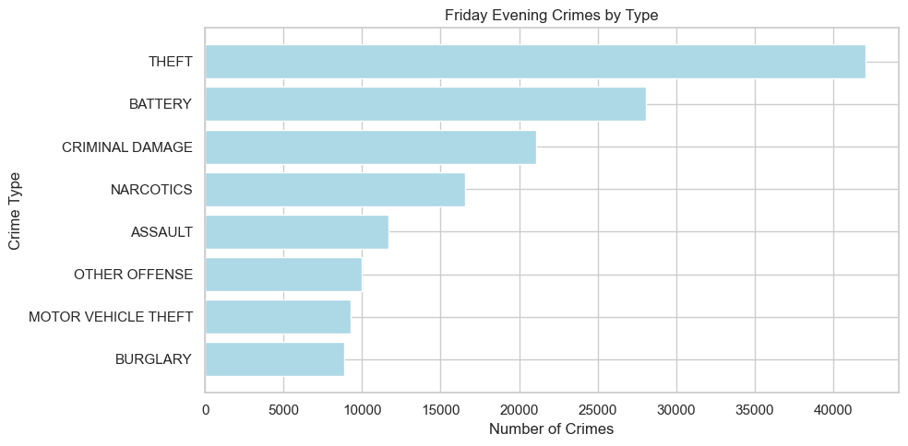
Friday Evening Crime Breakdown: A Closer Look at Incident Types

Slide 12
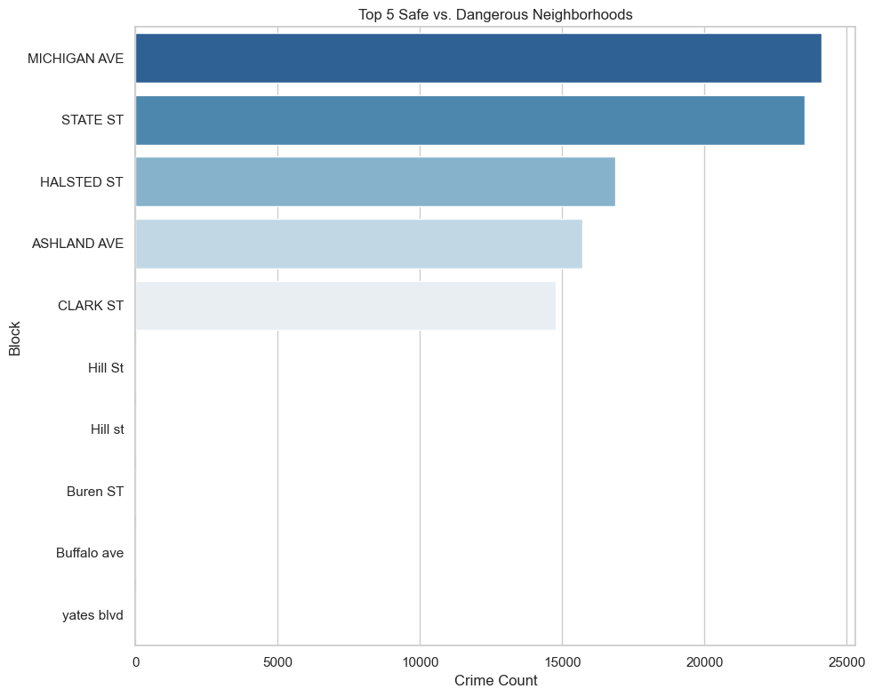
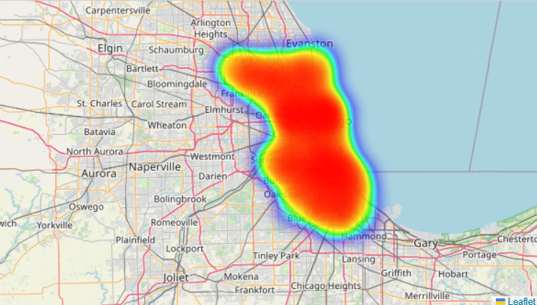
Crime Distribution:
The chart shows a clear distinction between the top and bottom blocks in terms of crime count. The top blocks (e.g., 'MICHIGAN AVE', 'STATE ST') have significantly higher crime counts compared to the lower ones (e.g., 'yates blvd', 'RANDOLPH ST'), indicating a disparity in crime distribution across the neighborhoods.
Safety Perception:
The blocks with the highest crime counts may be perceived as more dangerous, while those with the lowest counts might be perceived as safer. This could impact residents' and visitors' perception of safety in these areas.
Disparity in Crime Across Neighborhoods: Identifying High and Low-Risk Areas

Slide 13
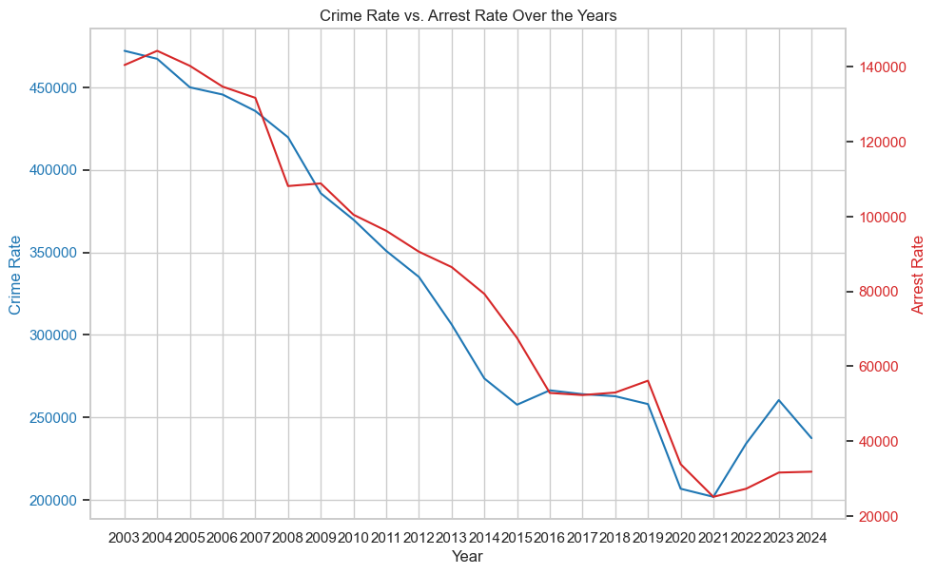
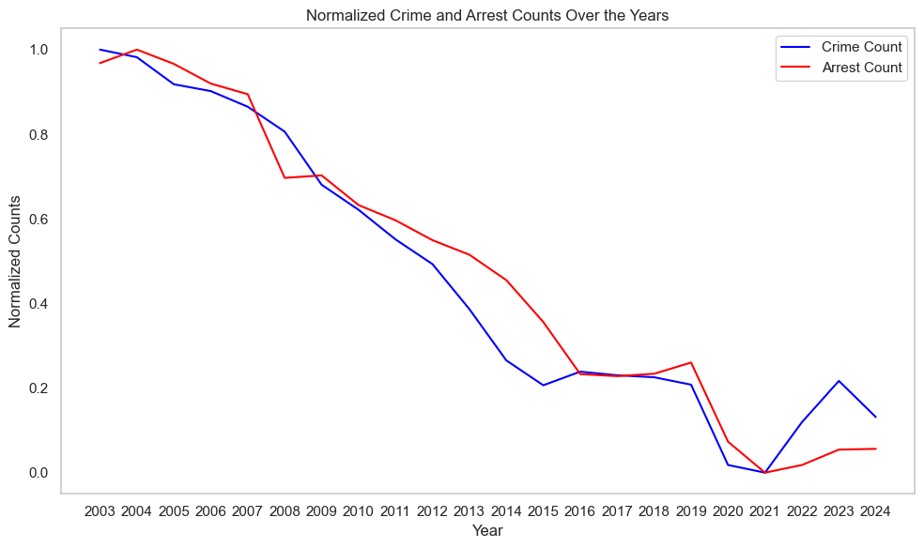
Analyzing Crime and Arrest Trends: Opportunities for Enhanced Policing Strategies
The comparison between crime and arrest counts over the years indicates a general decline in both, suggesting that as overall crime has decreased, so have the arrests. However, periods where arrest rates do not decrease proportionally to crime rates may point to opportunities for law enforcement to enhance their effectiveness. Particularly in recent years, the fluctuations suggest that despite a downward trend, there is room for targeted improvements in police response and crime prevention strategies

Slide 14
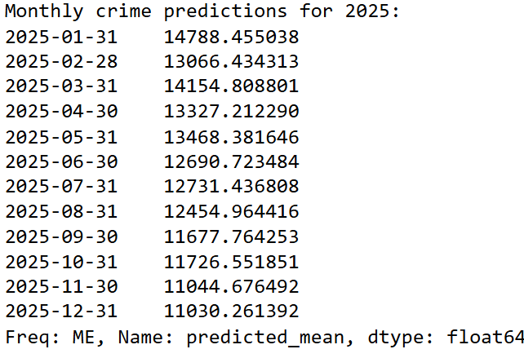
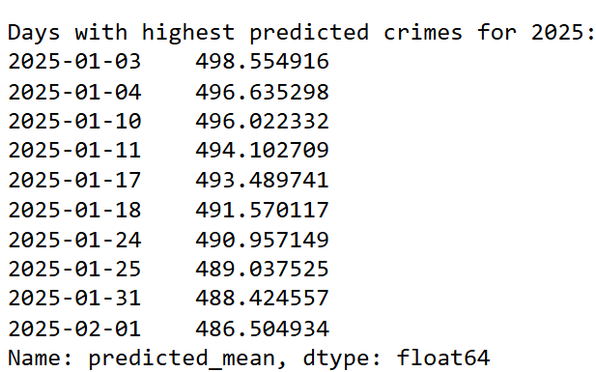
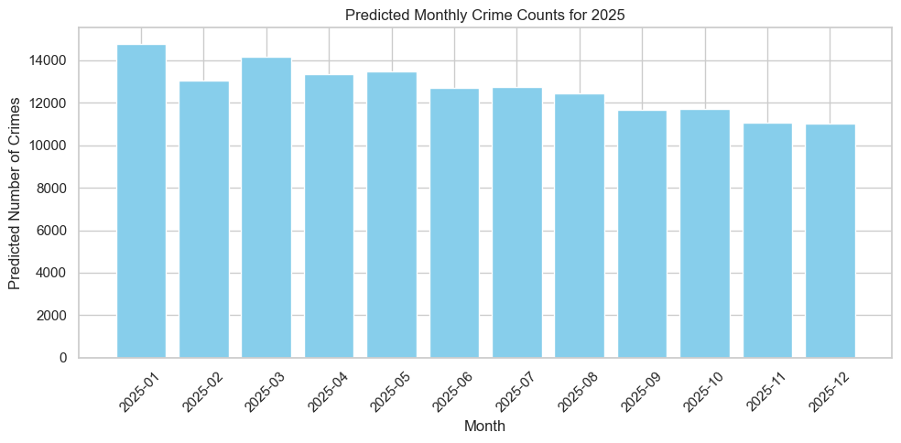
2025 Crime Forecast: Predictive Analysis for Proactive Policing
The graph indicates a consistent forecast of crime throughout 2025, with predicted monthly crime counts relatively stable, fluctuating slightly but remaining around the 11,000 to 14,000 range. The first week of January shows the highest predicted daily crimes, suggesting a need for increased vigilance and policing during this period. Overall, the forecast suggests that while crime remains a concern, there is no significant spike expected in any particular month, allowing for steady resource allocation throughout the year.

Slide 15
Executive Summary: Key Insights and Recommendations
Trend Analysis:
Multi-year crime data indicates a downward trend in overall crime rates with seasonal peaks during summer months and on Friday evenings.
Predictive Modeling:
Stable crime rates projected for 2025, enabling consistent resource planning without the need for sudden allocation changes.
Crime and Arrest Correlation:
High correlation (0.97) suggests arrests follow crime rates closely; however, opportunities exist for strategic improvements during periods of arrest rate lag.
Strategic Recommendations:
Optimized Patrols: Align police patrols with identified peak crime times to deter incidents effectively.
Community Programs: Implement community outreach during lower crime periods to maintain the downtrend and build public trust.
Literature Integration:
A review of related studies emphasizes the impact of socio-economic factors and supports the adoption of a data-driven approach to policing. Below is the link which supports this type of approach

Slide 16
THANK YOU

