Slide 1
RAJA BALWANT SINGH ENGINEERING TECHNICAL CAMPUS,BICHPURI,AGRA
TOPIC: File Encryption and Decryption
PRESENTED BY:
Purusharth Pachauri(70)
Sanju Mahour(76)
Saransh Agarwal(77)

Slide 2
Contents :
Introduction
Encryption
Decryption
Methodology
Technology used
Purpose
Importance of Encryption and Decryption
Real-world Application
Conclusion

Slide 3

Introduction
Title– File Encryption and Decryption
Encryption is the process of converting
plaintext (readable text) into
ciphertext (unreadable text) to protect
it from unauthorized access.
Decryption
is the process of converting ciphertext back
into plaintext.

Slide 4
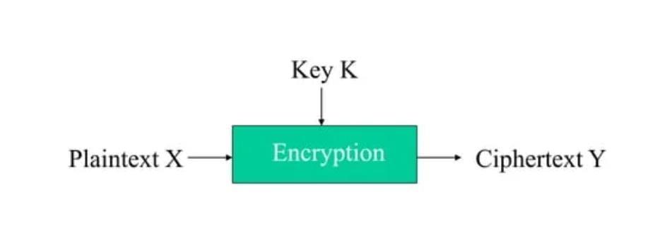
Encryption :-
Encryption is the process of converting plaintext (readable text) into ciphertext (unreadable text) to protect it from unauthorized access.
Encryption Process :
Plaintext: The original readable text.
Encryption Algorithm: The algorithm used to encrypt the plaintext.
Key: The secret key used for encryption.
Ciphertext: The resulting unreadable text.

Slide 5

Decryption :-
Decryption is the process of converting ciphertext back into plaintext.
Decryption Process :
Ciphertext:- The unreadable text to be decrypted.
Decryption Algorithm:- The algorithm used to decrypt the ciphertext.
Key:- The secret key used for decryption.
Plaintext:- The resulting readable text.

Slide 6
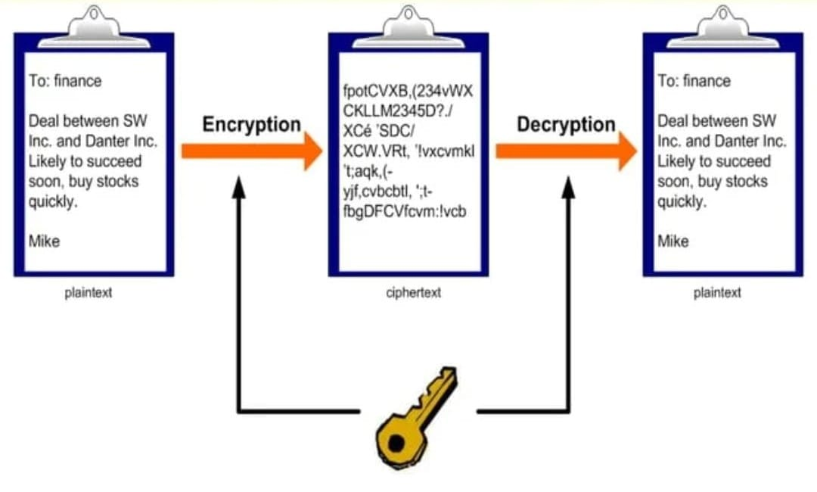
Methodology :-

Slide 7

Technology :- 1. Python Programing-

Slide 8
Purpose :- 1. Provides Security, 2. File encryption, 3. Communication encryption, 4. Network traffic encryption, 5. Password manager, 6. Single sign-on.

Slide 9
Importance of Encryption and Decryption: Protects sensitive data from unauthorized access. • Ensures confidentiality, integrity, and authenticity of data. • Used in various applications, such as online transactions, communication networks, and data storage.

Slide 10
Real-world Application:-
Online banking and transactions.
Secure communication networks (HTTPS, VPN).
Data storage and cloud computing.
Password protection and authentication.

Slide 11
Conclusion :- 1. File encryption and decryption are crucial for protecting sensitive data. 2.Understanding the basics of encryption and decryption is essential for ensuring data security. 3. Encryption and decryption have numerous real-world applications.

