Slide 1
Hybrid Optical/Radio Frequency Communication Channel Model
YimengLi
a1874845

Slide 2
What is Hybrid Optical/Radio Frequency Communication Channel Model
Location 0
Location 1
TSS
RSS
RFL
Channel
RFL
RSS
TSS
Radio Frequency Link
Free Space Optical
73.5 & 83.5 GHz
TSS
RSS
FSO
Channel
FSO
RSS
TSS
193.4 THz
Wind Direction
Wind Speed
Temperature
Humidity
Visibility
Particle Count
Rain Intensity
SYNOP Code
TSS:
RSS:
Transmit Signal Strength
Receive Signal Strength
Weather

Slide 3
Background
Multiple advantage of Hybrid Radio Frequency Channel/Free Space Optical(RF/FSO) system
Faster
Better link availability
More robust
Hybrid system will be widely used for multiple area
Australian space agency
NASA
Limits for hybrid system
Easily be infected by different weathers

Slide 4
Introduction
Use model to predict attenuation of RF channel and FSO channel under different weather conditions
Help us to switch channel automatically under different situations

Slide 5
Dataset
Shape:91379 Rows, 27 columns
7 Different weathers
 | Clear | Dust Storm | Fog | Drizzle | Rain | Snow | Showers
SYNOP Code | 0 | 3 | 4 | 5 | 6 | 7 | 8
Amount | 56964 | 191 | 466 | 6605 | 25018 | 419 | 1716

Slide 6
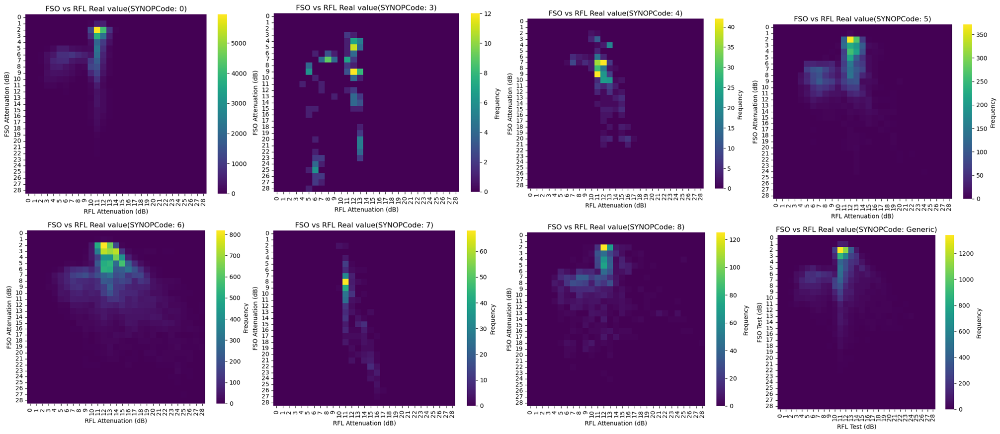
Dataset
Heat map of the dataset divided by weather conditions(SYNOPCode)

Slide 7
Base model
Random forest
Good at handle complex dataset
Can used for feature selection
Steps of model build：
Average Rain Intensity
> 10?
Node
Leaf
Average Temp.
> 25?
Prepare data
Average Rain Intensity
> 0?
Feature selection
Generate correlation
Feature selection with correlationship
Train final model and test

Slide 8
Base Model
2 different method to build model
Specific model for different weather conditions:
Generic model for all dataset:
SYNOP = 0
Data Set 0
Build Model
Random Forest 0
(Clear Weather)
Training
Data Set
SYNOP = 3
Data Set 3
Build Model
Random Forest 3
(Dust Storm)
…
…
SYNOP = 8
Data Set 8
Build Model
Random Forest 8
(Showers)
Training
Data Set
Build Model
Generic random forest
(All weather conditions)

Slide 9
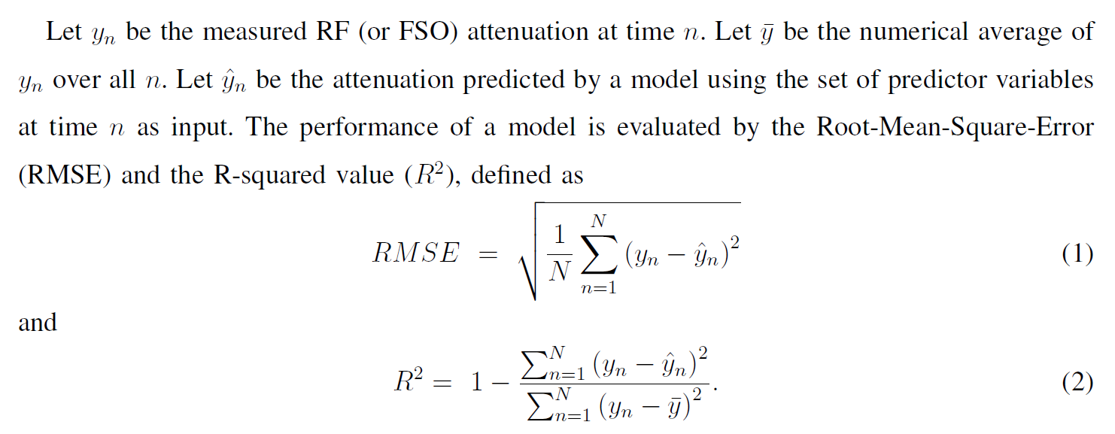
Evaluation method
RMSE and R²:

Slide 10
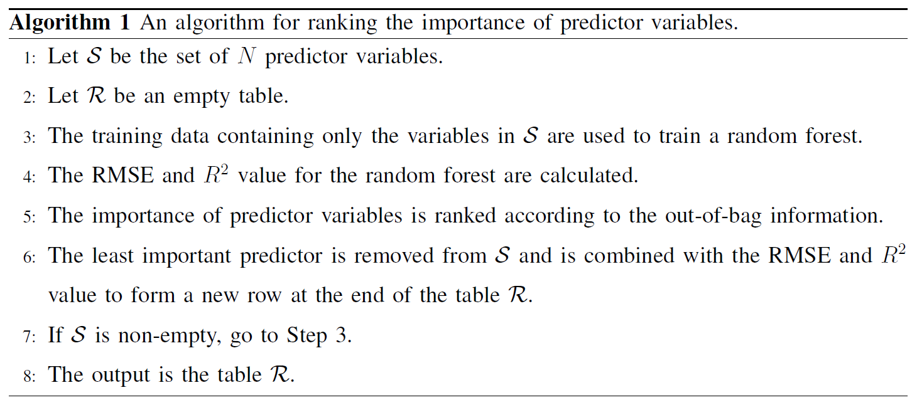
Feature selection

Slide 11
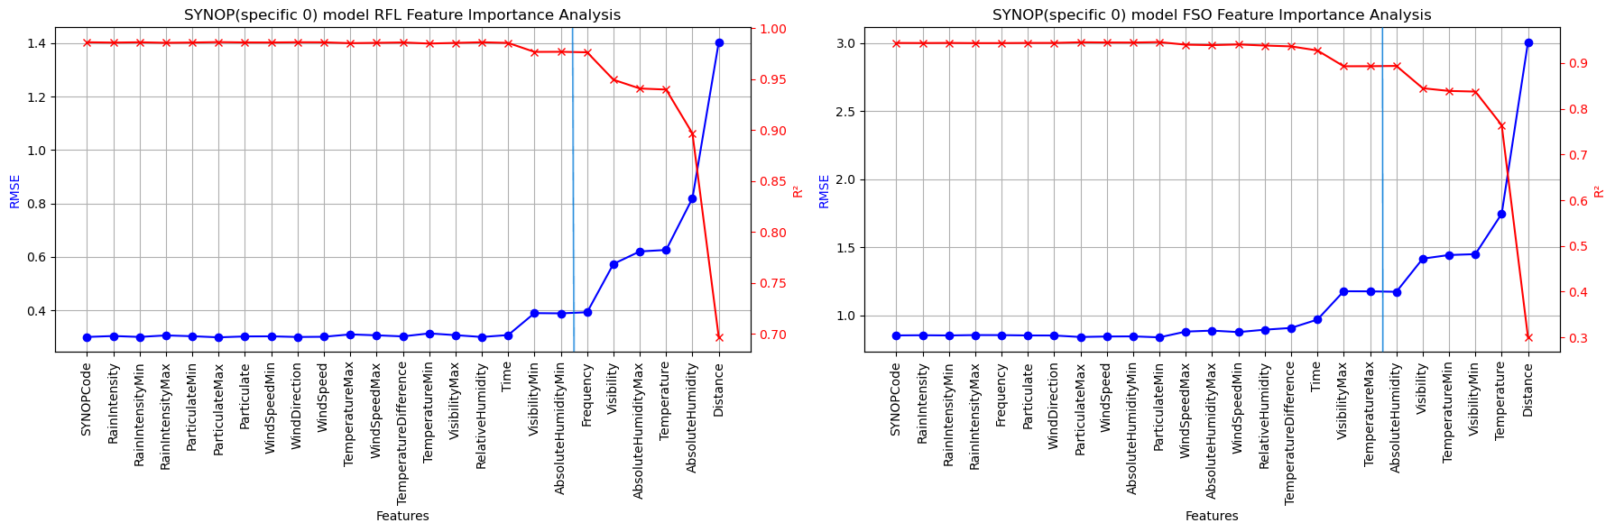
Feature selection result

Slide 12
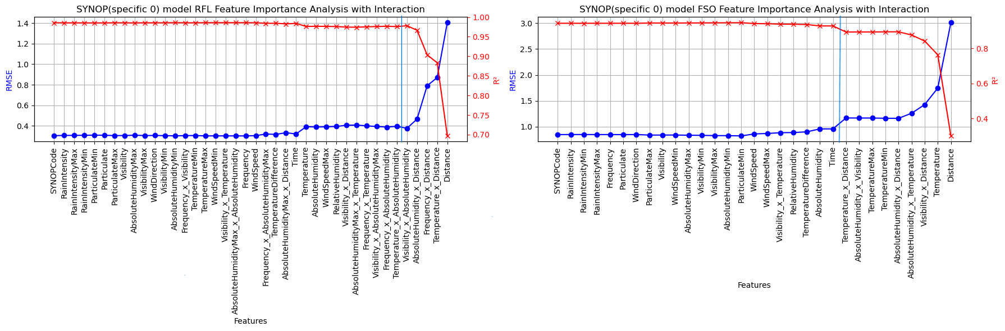
Feature selection with correlationship

Slide 13
Base model result
Model type |  | Clear | Duststorm | Fog | Drizzle | Rain | Snow | Showers
Specified | RF Att RMSE(dB) | 0.375 | 0.475 | 0.744 | 1.011 | 0.917 | 0.361 | 0.832
Specified | RF Att R² | 0.978 | 0.976 | 0.803 | 0.876 | 0.952 | 0.944 | 0.928
Specified | FSO RMSE(dB) | 0.956 | 1.209 | 0.717 | 1.008 | 1.308 | 0.949 | 1.141
Specified | FSO Att R² | 0.929 | 0.979 | 0.971 | 0.921 | 0.909 | 0.965 | 0.929
Generic | RF Att RMSE(dB) | 0.384 | 0.367 | 0.330 | 0.534 | 0.790 | 0.467 | 0.783
Generic | RF Att R² | 0.977 | 0.986 | 0.961 | 0.965 | 0.964 | 0.906 | 0.937
Generic | FSO RMSE(dB) | 0.833 | 2.614 | 0.841 | 0.765 | 0.790 | 0.962 | 0.768
Generic | FSO Att R² | 0.946 | 0.901 | 0.960 | 0.955 | 0.967 | 0.964 | 0.968

Slide 14
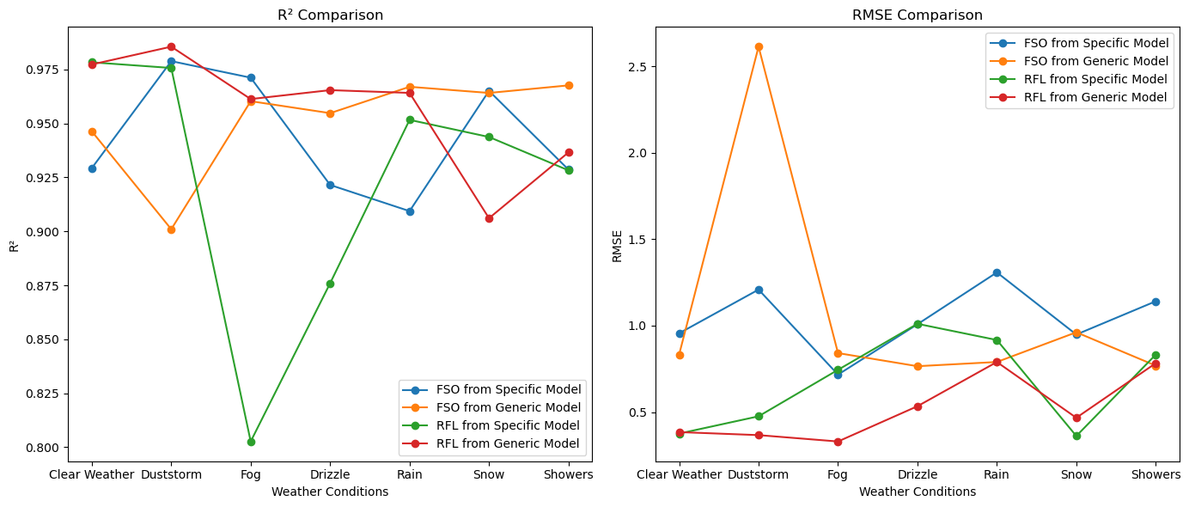
Base model result
Generic model has produce better result on most weather conditions.

Slide 15
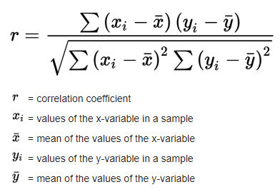
Relationship between RF attenuation and FSO attenuation
2 Indicators to test relationship
Pearson Correlation Coefficient
-1<r<1
r=0 means no linear relationship
R close to 1 or -1 means strong linear relationship
Mutual Information
Can quantify both linear and non-linear relationship
Mutual Information value>=0
use it to divide joint entropy to get correlationship value
close to 1 means highly correlated
close to 0 means independent

Slide 16
Relationship between RF attenuation and FSO attenuation
Pearson correlation coefficient for whole dataset
SYNOP Code | 0 | 3 | 4 | 5 | 6 | 7 | 8 | All
Pearson value | -0.268 | -0.424 | 0.578 | -0.156 | 0.348 | 0.804 | -0.170 | 0.090

Slide 17
2 method to preserve RFL-FSO relationship
Temp
Freq
Humidity
RFL-FSO Hybrid model
FSO-RFL Hybrid model
Random
Forest 1
RF Att
(RF Att)’
Temp
Freq
Humidity
Random
Forest 2
FSO Att
Temp
Freq
Humidity
(FSO Att)’
Temp
Freq
Humidity
Random
Forest 2
Random
Forest 1
RF Att
FSO Att

Slide 18
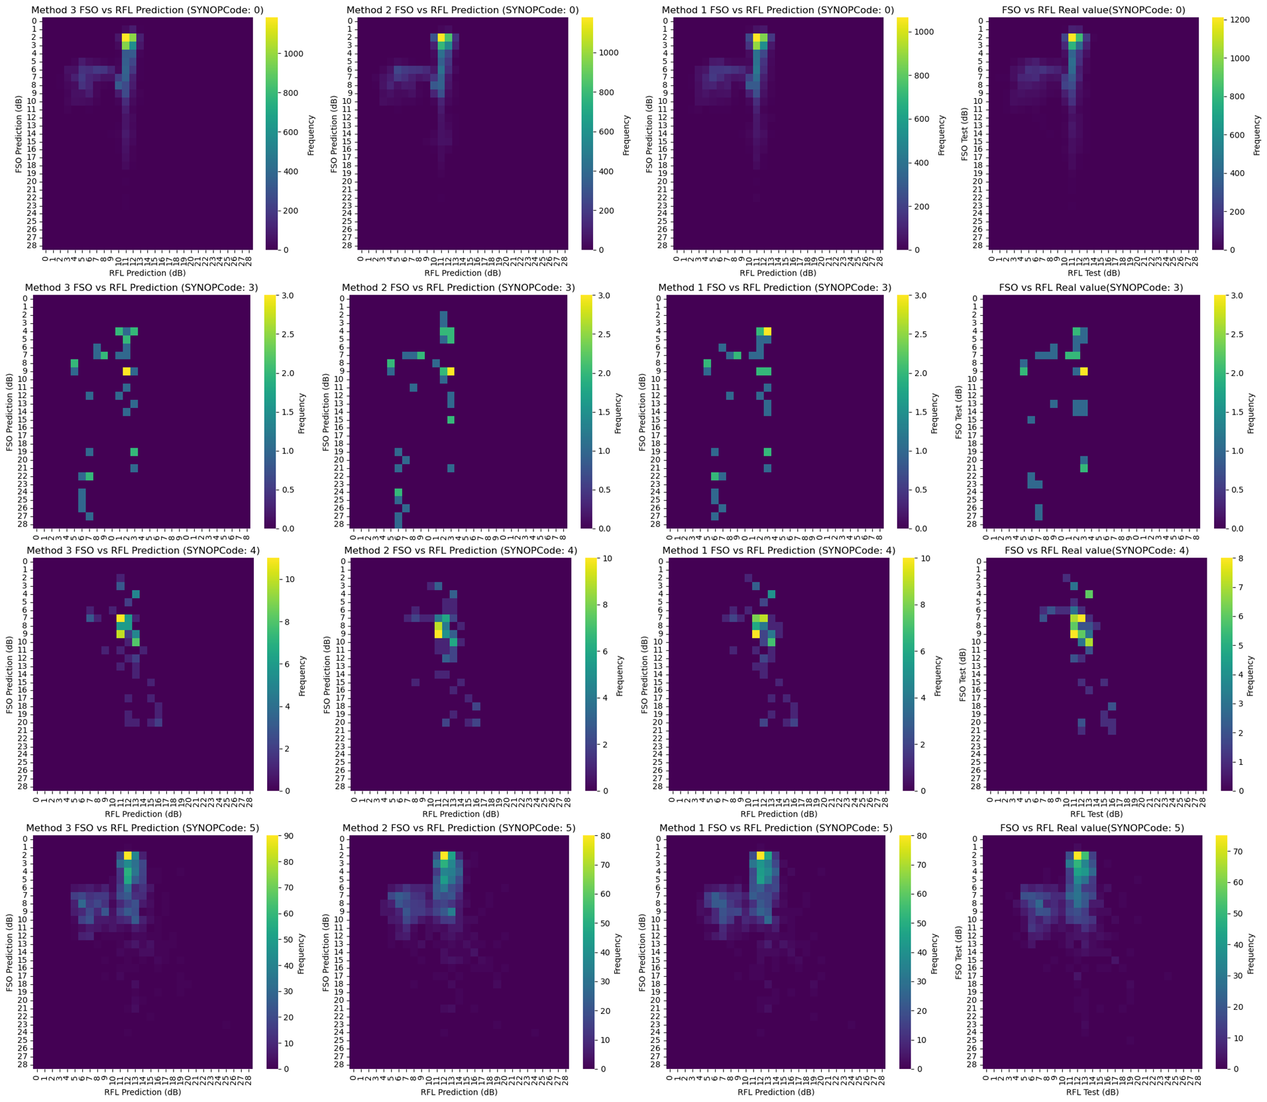
Results
 | Data source
SYNOP | FSO-RFL model | RFL-FSO model | Base model | Test set
0
3
4
5
Heat map:

Slide 19
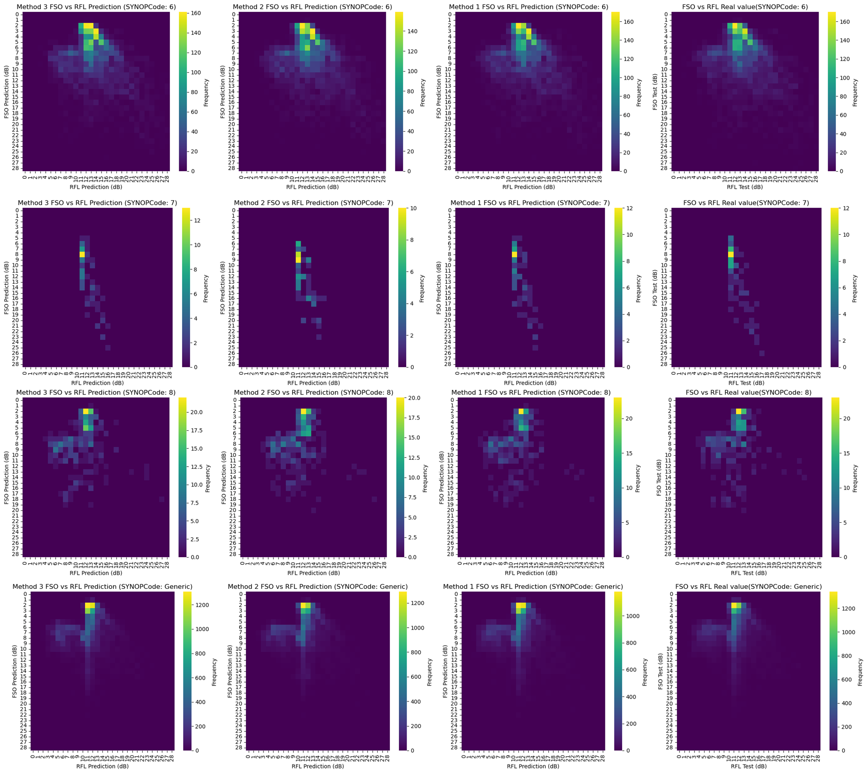
Results
 | Data source
SYNOP | FSO-RFL model | RFL-FSO model | Base model | Test set
6
7
8
ALL

Slide 20
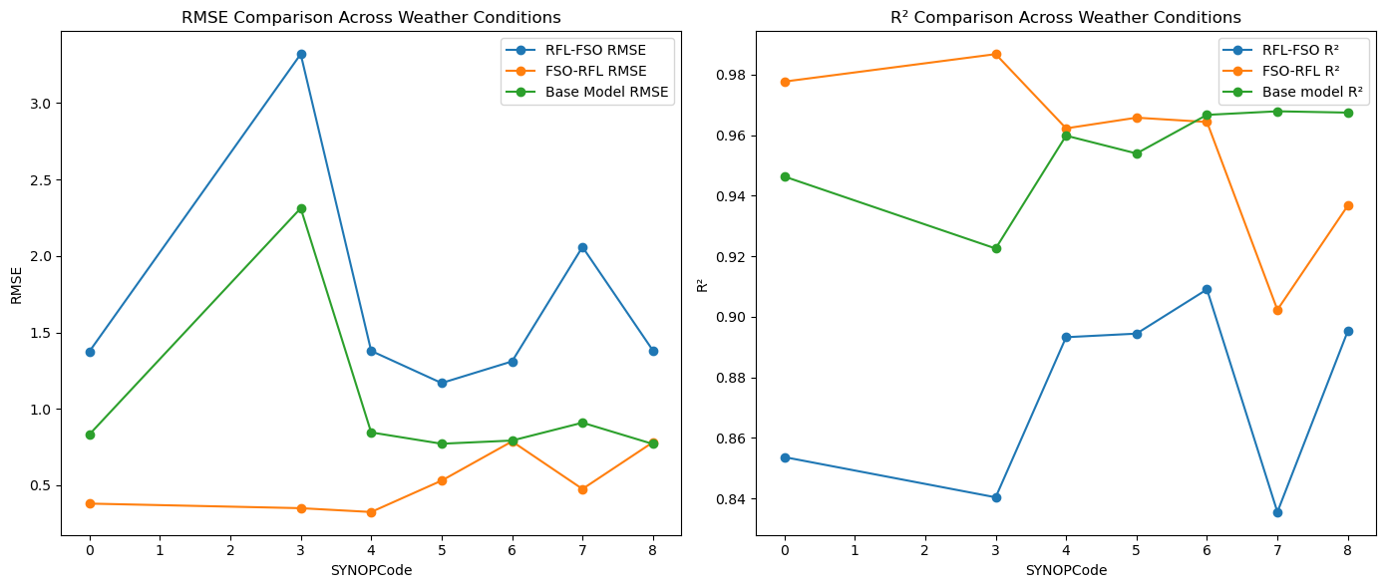
Results

Slide 21
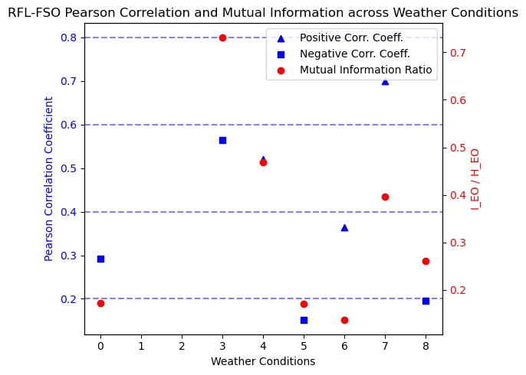
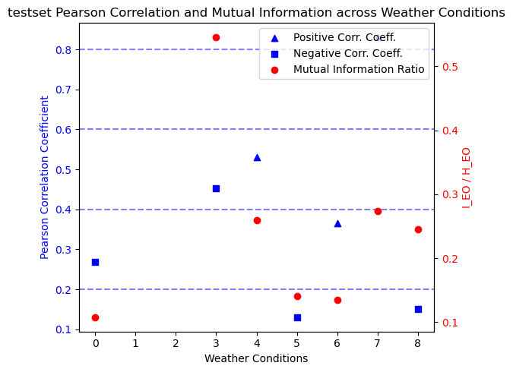
Correlationship Comparison

Slide 22
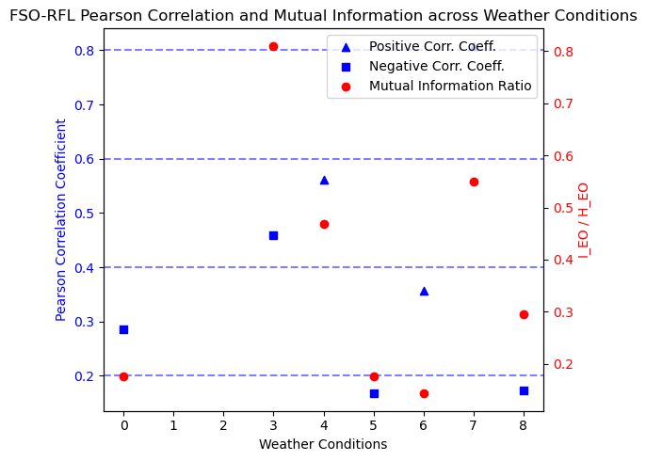
Correlationship Comparison

Slide 23
Future work
Use neural network to train model
Tune model with more hyper parameters

