Slide 1
DSA 5900 Professional Practicum Predicting Business Owners Response on Social Media Using Data Science Approach Supervisor: Dr. Naveen Kumar Assistant Professor of Management Information Systems, University of Oklahoma.
Purushotham Vadde(113459984)
May 4, 2021

Slide 2
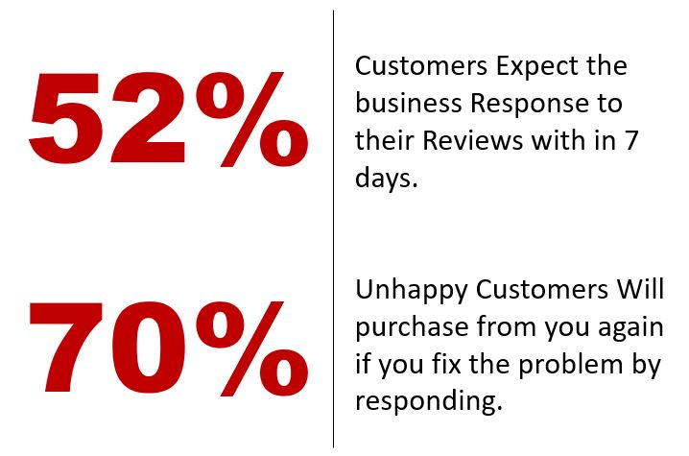
Project Definition
The aim of this project is to develop a machine learning model that can classify the types of business reviews that are likely to get a response from the business owner.
Dr. Naveen Kumar, Assistant Professor of Management Information Systems, guided me through this project.

Slide 3
Data Ingestion
As part of this Project, we collected Data from Yelp Website.
To collect data from the Yelp website, we used the web scraping technique.
Challenges:
Yelp API provides only 3 Reviews in Response.
Web Scraping is challenging due to the way website designed.
We can't get the webpage content in response using Python packages like urllib and requests.
HTML tags are dynamic in nature.
Yelp will restrict scraping by duplicating business results and displays maximum 240 business for search.

Slide 4
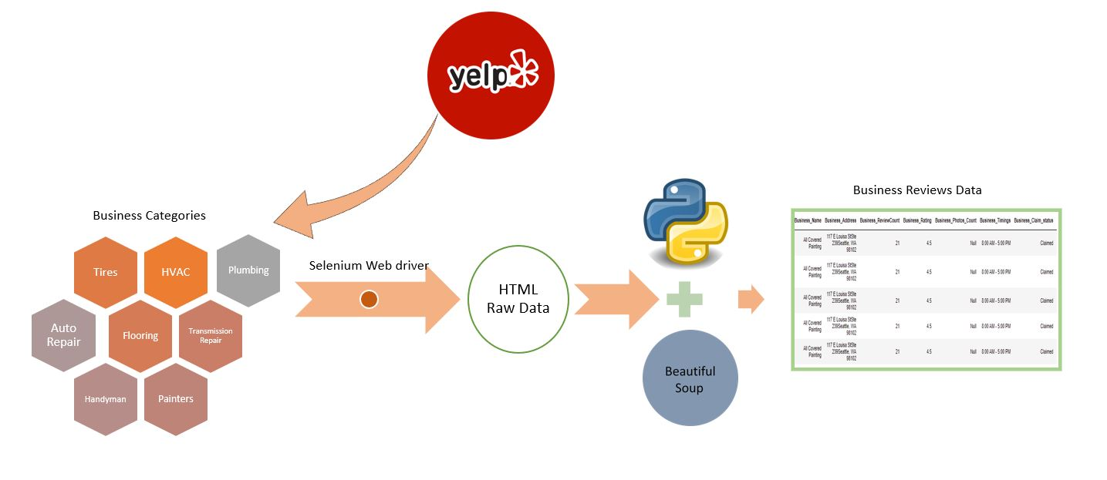
Data Ingestion
Data Collection Architecture

Slide 5
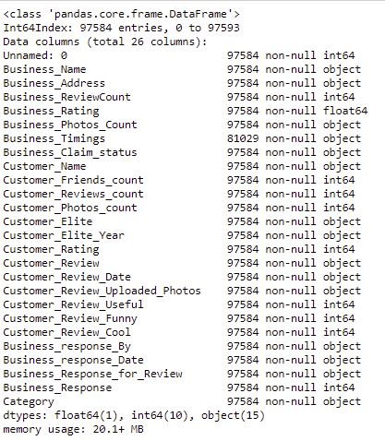
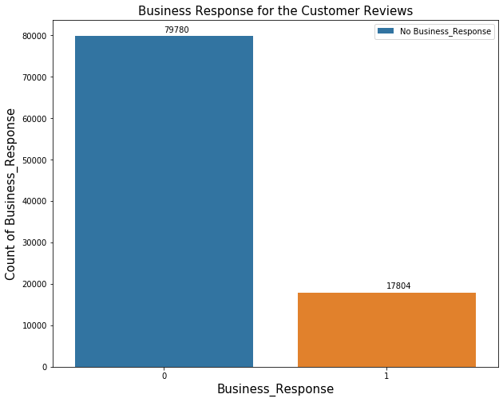
Data Understanding
Data Frame
Business Response By Class
We have collected the Business Review Data in 3 levels
Business Level
Customer Level
Business Response Level
We collected total of 97584 Reviews in 8 categories and the business Response rate is 18%

Slide 6
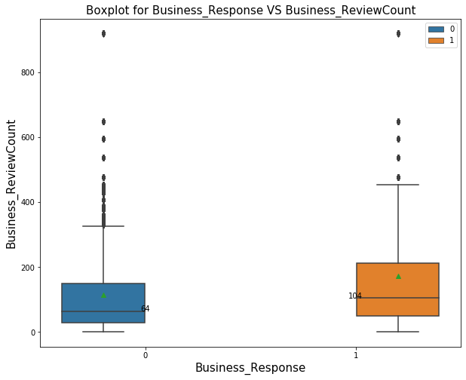
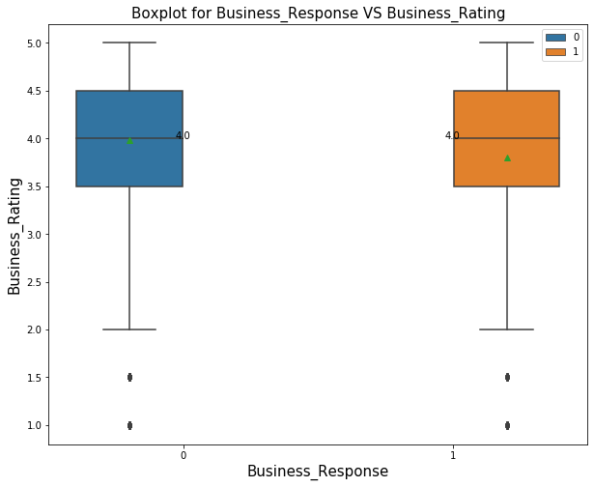
Data Understanding
Insights from Features:
Business Reviews Count: Business response rate is high for the businesses with large review count.
Business Rating: Businesses with low rating are likely to respond more for Customer review.
Customer Rating: Business Response rate is high for the low customer rating, As the Customer Rating increases the business response rate decreases.

Slide 7
Data Preparation
Customer Review Sentiment Analysis :
Text Blob: A simple python library that supports complex analysis on Text Data.
Polarity: The polarity value lies between the [-1,1], -1 defines the strong Negative sentiment, and 1 defines the strong Positive sentiment.
Subjectivity: Subjectivity refers to the amount of personal opinion, emotion, or judgment
Sentiment Score:
Other Features: Operational Hours, Review Day, Review Statistics.
Sentiment Score | Class 0 | Class 1 | Business Response Rate
Negative | 8775 | 2512 | 22.25
Neutral | 653 | 171 | 20.75
Positive | 70352 | 15121 | 17.69

Slide 8
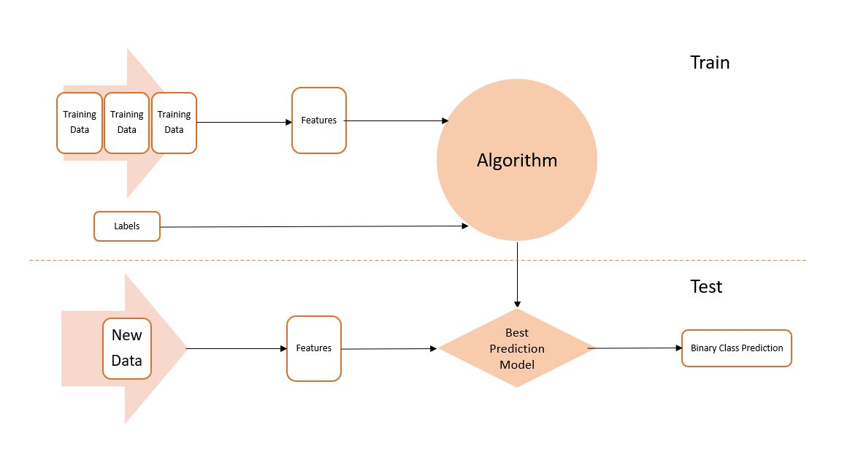
Model Design and Validation
To Build the Binary Classification Model we used the below Algorithms.
Random Forest
Gradient Boosting
XGBoost.
Used GridsearchCV for finding the optimal Tuning parameters.
Used Cross fold validation technique to validate the model.
Classification Model Architecture

Slide 9
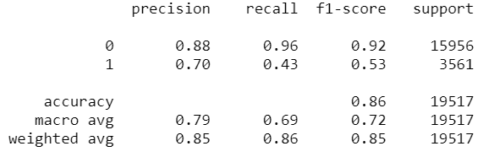
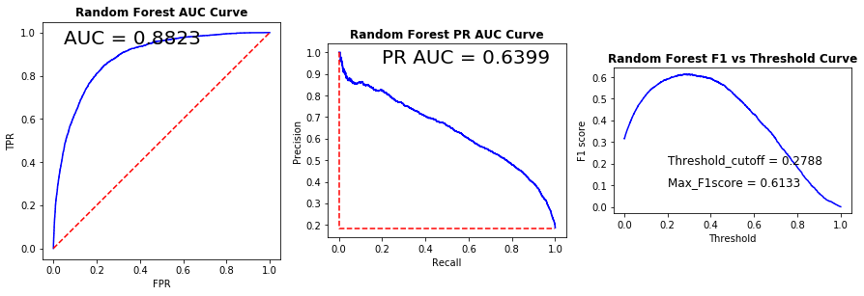
Model – Random Forest
GridsearchCV with cv = 10 folds.
Final Tuning Params: {max_depth = 30, max_features = 'auto', min_samples_leaf = 2, min_samples_split = 10, n_estimators = 500}
Model Accuracy = 0.86
Random Forest model Performance
Performance metrics for Random Forest

Slide 10
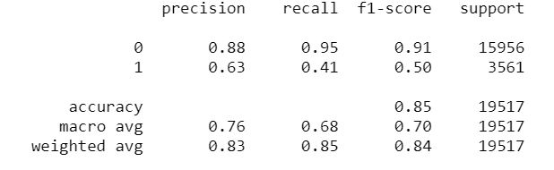
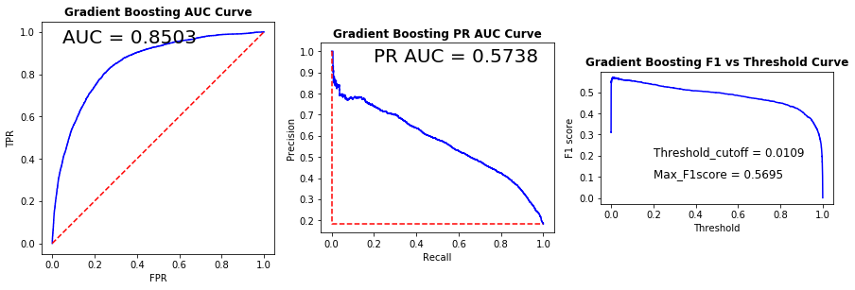
Model – Gradient Boosting
GridsearchCV with cv = 10 folds.
Final Tuning Params: {learning_rate = 0.5, max_depth = 20, n_estimators = 25 }
Model Accuracy = 0.85
Gradient Boosting Model performance
Gradient boosting Performance metric plots

Slide 11
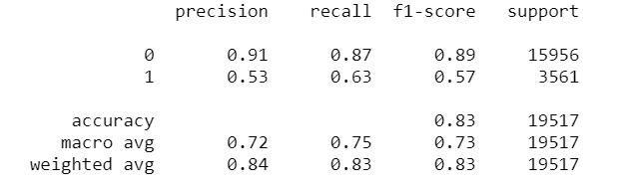
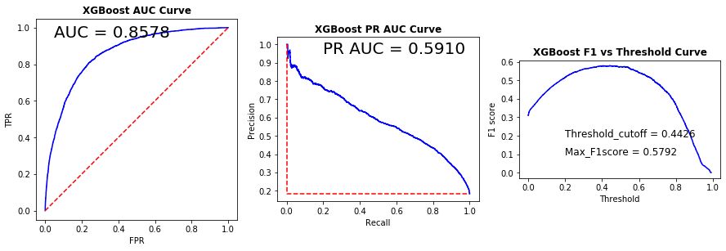
Model – XGBoost
GridsearchCV with cv = 10 folds.
Final Tuning Params: {max_depth = 10, learning_rate =0.3, reg_lambda = 1.5, scale_pos_weight= 3, gamma = 0}
Model Accuracy = 0.83
XGBoost Model Performance
Performance metrics plots for XGBoost

Slide 12
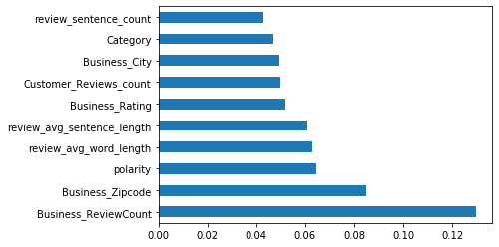
Model – Important Features
Important Features in the model
Business Reviews Count
Customer Review Sentiment
Business Rating
Business Zip code
Important features in the model

Slide 13
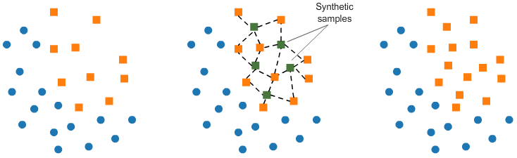
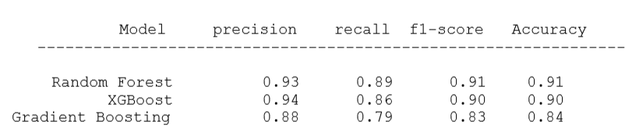
Model – Oversampling with SMOTE
SMOTE is an Oversampling Technique.
Creates Synthetic data points for minority class with KNN Method.
Models Performance on Oversampling Data.
Over Sampling with SMOTE
Models Performance on Over Sampled Data

Slide 14
Evaluation
Model Precision Recall F1-Score Accuracy AU PRC
--------------------------------------------------------------------------------------------------------------
Random Forest 0.70 0.43 0.61 0.86 0.63
Gradient Boosting 0.63 0.41 0.57 0.85 0.57
XGBoost 0.53 0.63 0.58 0.83 0.59
Models Performance comparison 1
Model Precision Recall F1-Score Accuracy AU ROC
--------------------------------------------------------------------------------------------------------------
RandomForest_SMOTE 0.97 0.84 0.90 0.91 0.96
Gradient_Boosting_SMOTE 0.98 0.78 0.87 0.88 0.94
XGBoost_SMOTE 0.96 0.85 0.90 0.91 0.94
Models Performance comparison 2

Slide 15
Conclusion
By our model, We can provide new review data and determine whether the business owner will respond to the review.
This model can be used by company owners or consumers who want to engage in future interactions.
Future Work: We can improve the model by training with more Reviews data from other cities and categories.

Slide 16
Data Understanding - Backup
From the Dataset we observed that the Businesses with More reviews are actively responding compare to the business with low reviews.
The Mean and Median of Business review count for Business Response class is High.
Business Review Count:

Slide 17
Data Understanding – Back up
Null= Two mean are equal
Alternate = Two mean Not equal
Class 0: n1 = 79780, u1= 4, s1 =0.8757
Class 1: n2 = 17804, u2=3.8, s2=0.7637
T0= 30.7253
At 95% confidence P-Value = 0.00001.
So, we rejected Null Hypothesis and we can say that two means are not equal with 95 % confidence.
Business Rating:

Slide 18
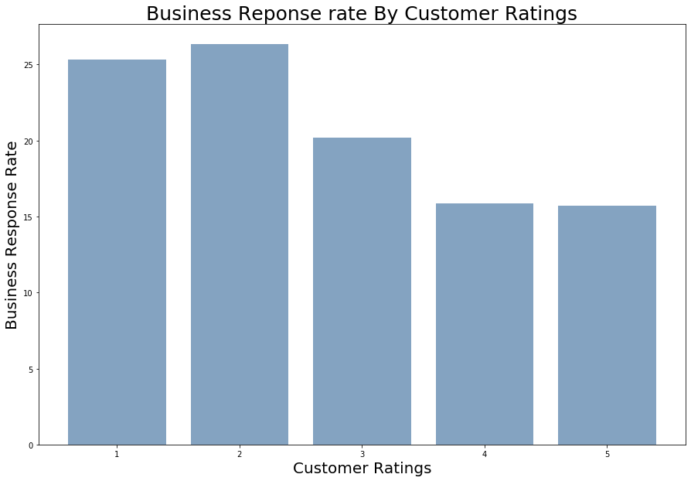
Data Understanding – Back Up
We observe that the Business response rate for customer review is more for low customer Ratings.
As the Customer ratings increases the Business Response Rate reduces.
Customer Rating:

