Slide 1
Yelp Website
Selenium Web driver
HTML Raw Data
Beautiful Soup
Business Reviews

Slide 2
Beautiful
Soup

Slide 3

Selenium Web driver
HVAC
Auto Repair
Flooring
Handyman
Painters
Plumbing
Tires
Transmission Repair

Slide 4


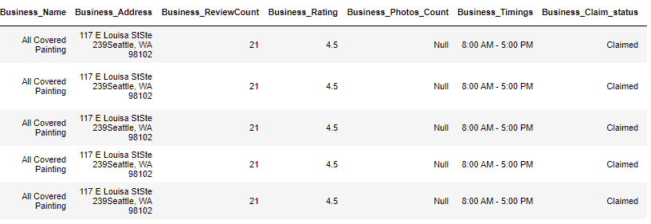

Yelp
Business Reviews Data
Business Categories
Selenium Web driver
HVAC
Tires
Painters
Handyman
Auto Repair
Plumbing
Flooring
Transmission Repair
HTML Raw Data

Slide 5
Training
Data
Training
Data
Training
Data
Train
Features
Algorithm
Labels
New
Data
Test
Features
Best Prediction Model
Binary Class Prediction

Slide 6
52%
Customers Expect the business Response to their Reviews with in 7 days.
Unhappy Customers Will purchase from you again if you fix the problem by responding.
70%

