Slide 1
UE24CS352A : Machine Learning
Training a Playlist Curator Based on User Taste
Machine Learning-Based Playlist Classification and Content-Based Song Recommendation
Purushothama K C Raghav G Uddihal
SRN: PES1UG25AM810 SRN: PES1UG24AM215
Notes:
Introduce yourself and the project: an ML application that classifies songs into playlists from audio features and recommends acoustically similar songs. The subtitle follows the title of the Stanford paper by Awadelkarim and Coelho (2018) that inspired the idea.

Slide 2
Problem Statement
1
Manual playlisting does not scale
Organizing a large music collection into playlists by hand is slow and tedious.
2
Similar-sounding songs are hard to find
Listeners struggle to discover songs with similar audio characteristics.
3
Titles and genres are not enough
Listening taste is not fully captured by song titles or genre labels. Measurable audio features offer a systematic alternative.
Notes:
Frame the problem: manual playlisting does not scale, and titles or genres alone do not describe how a song sounds. The research question is the central question the project tries to answer.

Slide 3
Project Objectives
01
Preprocess the dataset
Clean the music data and prepare the audio features for modelling.
02
Train and compare ML models
Train five classifiers on the same data and evaluate them with standard metrics.
03
Predict the playlist category
Given a song's audio features, predict which playlist it belongs to.
04
Recommend similar songs
Rank songs by cosine similarity of their audio features.
05
Build a web application
Interactive React + FastAPI app, with music previews where available.
Notes:
Five objectives, from data preparation through model comparison to the web application and music previews.

Slide 4
Dataset and Audio Features
5,721
songs
Key feature | What it describes
Danceability | How suitable the track is for dancing (0–1)
Energy | Intensity and activity of the track (0–1)
Valence | Musical positivity, from sad to happy (0–1)
Tempo | Speed of the track in beats per minute (BPM)
Loudness | Overall volume in decibels (dB)
12
playlist categories
11
audio features
Also used: speechiness, acousticness, instrumentalness, liveness, key and mode.
Target label: playlist (1 of 12 classes)
Song, playlist and feature counts are as shown in the application dashboard.
Notes:
5,721 songs, 12 playlists and 11 audio features are shown in the application dashboard. The target variable is the playlist label. These are the same family of audio features as the Spotify features used in the Stanford paper.

Slide 5
System Architecture
BRANCH A · PLAYLIST CLASSIFICATION
Classification model
Predicted playlist + confidence
Music dataset
Cleaning and preprocessing
Feature scaling
BRANCH B · SONG RECOMMENDATION
Cosine similarity
Ranked similar songs
Both branches are exposed through the FastAPI backend and shown in the React dashboard.
Jamendo API (optional licensed previews)
React frontend dashboard
FastAPI backend (REST API)
Notes:
Walk left to right. After scaling, the data splits into two branches: a classifier that predicts the playlist with a confidence value, and a cosine-similarity engine that ranks similar songs. Both are exposed by the FastAPI backend and shown in the React dashboard. Jamendo is an optional source of licensed preview audio.

Slide 6
Data Preprocessing
1
2
3
4
5
6
Inspect and clean
Handle bad values
Select features
Encode labels
Standardize
Train/test split
Check for errors and duplicates
Fix missing or invalid values
Keep numerical audio features
Playlist names → class labels
StandardScaler puts features on one scale
Hold out data for testing
Why is scaling necessary?
z = (x − μ) / σ
Features sit on very different scales. If they are left as they are, large-range features such as tempo dominate distance calculations. KNN and cosine similarity are the most affected.
x: raw value μ: feature mean σ: standard deviation
Example song: danceability 0.72 · loudness −5.2 dB · tempo 128 BPM
Notes:
Explain each step briefly, then the z-score formula. Loudness is in negative decibels and tempo is in BPM, while danceability and energy are between 0 and 1, so unscaled distance calculations would be dominated by the large-range features. The example values are the ones shown in the Playlist Prediction screenshot.

Slide 7
Machine Learning Models
No single classifier is best for every dataset. All five are trained on the same scaled features, and the final choice is based on measured test-set results.
Model | Core idea | Strength
Logistic Regression | Linear classification baseline | Simple, fast, interpretable
K-Nearest Neighbors | Labels a song by its closest samples | No training step; intuitive
Random Forest | Ensemble of decision trees | Handles non-linear patterns
SVM (RBF kernel) | Non-linear, margin-based classifier | Strong with scaled features
Neural Network (MLP) | Layers learn non-linear feature relations | Flexible function approximator
Notes:
These are the five models considered. Do not claim one is best on this slide; the evaluation slide and your measured results decide.

Slide 8
Evaluation and Results
Accuracy
Share of all predictions that are correct
Test-set accuracy by model
(TP + TN) / Total
Model | Accuracy
Logistic Regression | to be added
K-Nearest Neighbors | to be added
Random Forest | to be added
SVM (RBF kernel) | 87.4%*
Neural Network (MLP) | to be added
Precision
Of the songs predicted for a playlist, how many are right
TP / (TP + FP)
Recall
Of the songs that belong to a playlist, how many are found
TP / (TP + FN)
F1-score
Balance between precision and recall
2 · P · R / (P + R)
*SVM (RBF) accuracy as shown in the application dashboard. Values for the other models will be filled in from the final evaluation output; none are estimated here.
Notes:
The only measured figure currently available is the 87.4% accuracy for SVM (RBF) shown in the application dashboard. Verify it against your notebook or results file, and replace the 'to be added' cells with real test-set results for the other models before presenting. The Stanford paper's own numbers belong to that paper, not to this project.

Slide 9
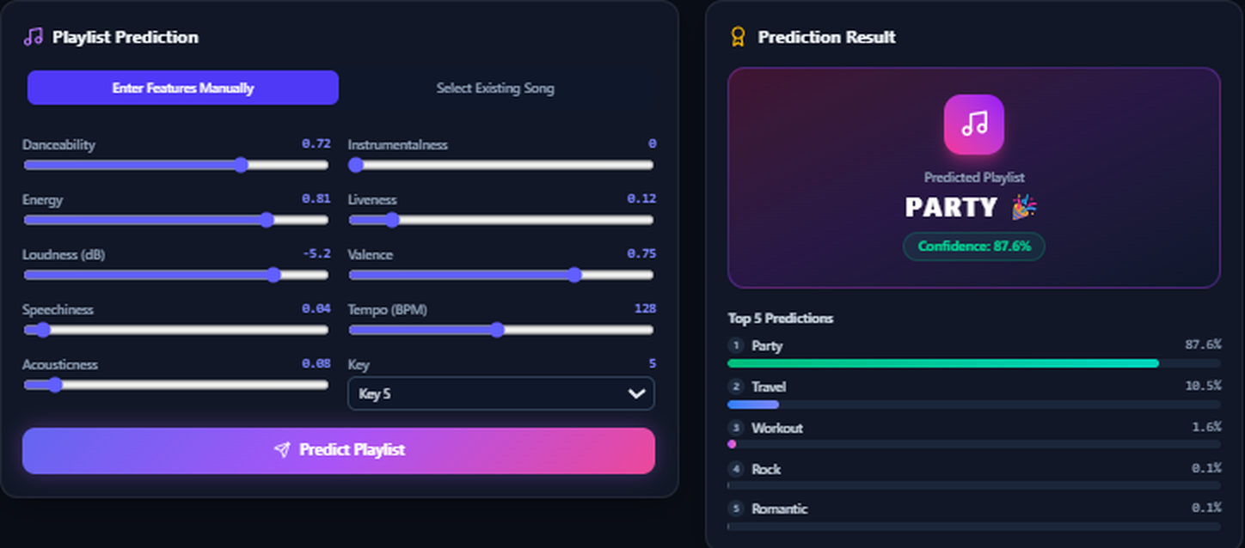
Playlist Prediction
In this example
Predicted playlist: Party
Confidence: 87.6%
Next most likely: Travel (10.5%)
Playlist Prediction page of the application: feature sliders, predicted playlist and top-5 probabilities.
Enter or select a song's features
Apply the trained scaler
Pass to the selected classifier
Show the predicted playlist
Show confidence for top-5
Notes:
The screenshot is from the running application. It shows manual sliders for each audio feature, the predicted playlist (Party), its confidence (87.6%), and the top-5 predictions. The same pipeline is applied to any song: the features are scaled with the trained scaler, passed to the classifier, and the class probabilities are displayed.

Slide 10
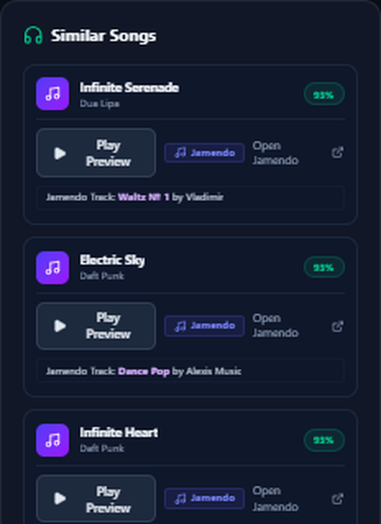
Similar-Song Recommendation
Similarity(A, B) = (A · B) / (‖A‖ × ‖B‖)
1
Select a reference song
A
2
Take its scaled audio features
B
3
Compare with every candidate song
θ
4
Rank by score and return the top N
Smaller angle θ = higher similarity (illustration with two features)
Similar Songs panel with a similarity badge per song.
Notes:
Explain cosine similarity as the angle between two feature vectors: songs whose feature vectors point in a similar direction get a higher score. The vector drawing is only an illustration with two features; the real system uses all scaled audio features. The right-hand screenshot is the Similar Songs panel from the application, with a similarity badge for each recommendation. A high score does not guarantee that a listener will like the song.

Slide 11
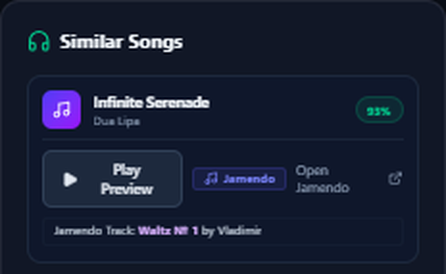
Technology Stack and Music Preview
Frontend
React, Vite, Tailwind CSS, Recharts, Lucide
Backend
Python, FastAPI, Uvicorn
ML and data
scikit-learn, Pandas, NumPy, Joblib
Preview is a different track. The Jamendo preview is a licensed track and may not be the recommended song. Here, “Infinite Serenade” (Dua Lipa) is recommended, but the preview is “Waltz N° 1” by Vladimir. The app labels both.
Music preview
Jamendo API, where available
Notes:
Technologies are the ones listed in the project brief; check them against package.json and requirements.txt. The key honesty point: the audio you hear is a licensed Jamendo track and may differ from the recommended commercial song. The screenshot shows exactly this, with the Jamendo label and the track name under the card.

Slide 12

Conclusion and Future Scope
What was built
Future scope
Dataset preprocessing and feature analysis
Personalized recommendations from listening history
Hybrid content-based and collaborative filtering
User feedback and preference adaptation
Mood-based playlists
Training and comparison of five classifiers
Playlist prediction with confidence
Cosine-similarity song recommendation
React + FastAPI web application
Music previews through Jamendo, where available
Purushothama K C | PES1UG25AM810
github.com/Purushothama449
Notes:
Summarise what is implemented, mention the future scope briefly, and invite questions.

Slide 13
Thank You

