Slide 1
A Fully Serverless Web Application on AWS Using Amplify, API Gateway, Lambda, and DynamoDB
Submitted by:
Purushothaman S (G24AI1042) Swatantra Yadav (G24AI1065) Nalin Bhatt (G24AI1070)
Submitted to:
Dr. Sumit Karla (Assistant Professor)
School of Artificial Intelligence and Data Engineering. IIT-JODHPUR
Institute: Indian Institute of Technology – Jodhpur
Date: 15th April 2025.

Slide 2
Abstract
This project demonstrates the design and implementation of a fully serverless web application on Amazon Web Services (AWS), built to perform exponential calculations through a browser-based interface.
The application stack includes AWS Amplify for static site hosting, HTML and JavaScript for the client interface,
AWS API Gateway for RESTful communication,
AWS Lambda for backend logic processing,
and AWS DynamoDB for persistent data storage.
A streamlined architecture ensures high scalability, zero server management, and minimal operational overhead.
With secure IAM policies and automated deployment, this application exemplifies modern cloud-native development practices, providing a practical solution for lightweight, real-time computational tasks.

Slide 3
Introduction
Project Overview: Demonstrates a fully serverless web application using AWS.
Objective: To show how AWS services can be integrated to build a scalable and efficient application.
Frontend:
AWS Amplify: Used for front-end hosting.
Technologies: HTML and JavaScript for the user interface.
Backend:
AWS API Gateway: Facilitates RESTful communication.
AWS Lambda: Handles backend logic in a serverless manner.
AWS DynamoDB: Provides persistent data storage.

Slide 4
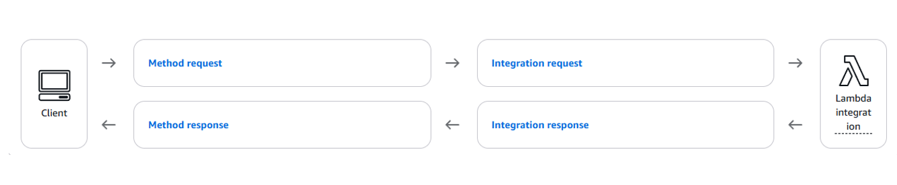
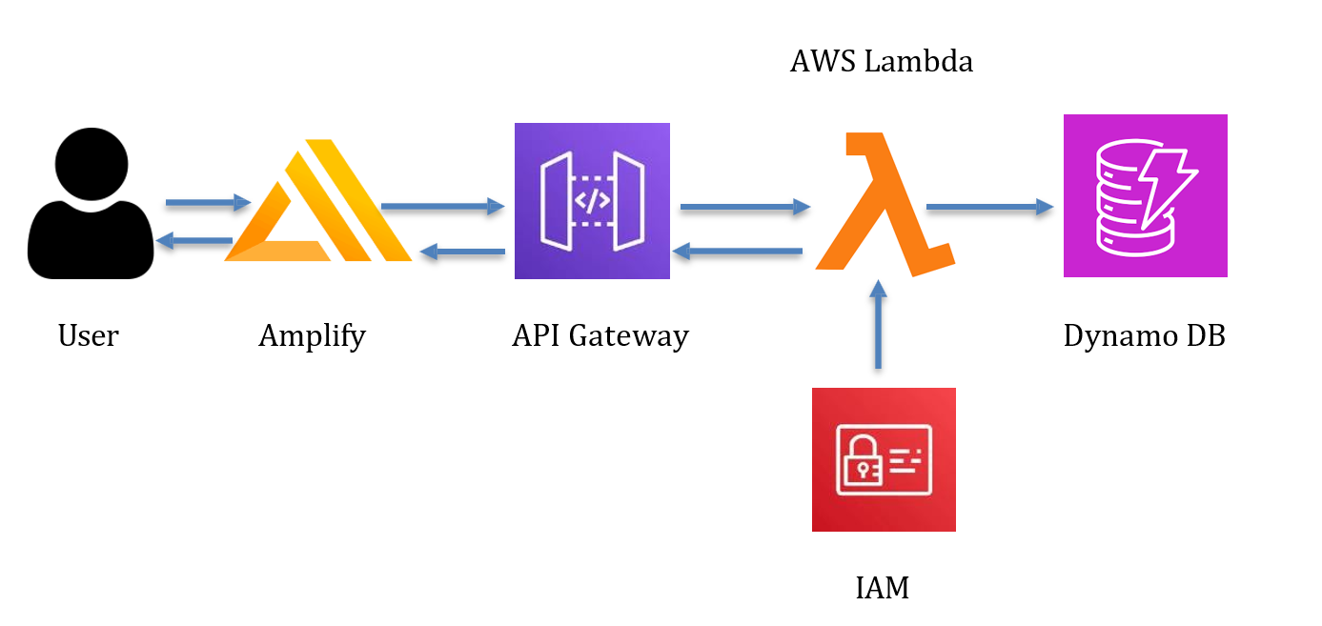
Architecting and Building an End-to-End AWS Web Application and System Architecture

Slide 5
Front-End Development and Hosting
Frontend Technologies: Developed using basic HTML, CSS, and JavaScript.
Functionality:
Includes a form to input a base and exponent.
Calculates the power expression on submission.
User Interaction:
'CALCULATE' button triggers a JavaScript function.
Sends a POST request with input data to an API Gateway endpoint.
Deployment:
HTML and JavaScript files deployed to AWS Amplify.
Amplify offers secure and scalable hosting.
Provides a globally accessible HTTPS URL.
Supports CI/CD pipelines for automated updates.

Slide 6
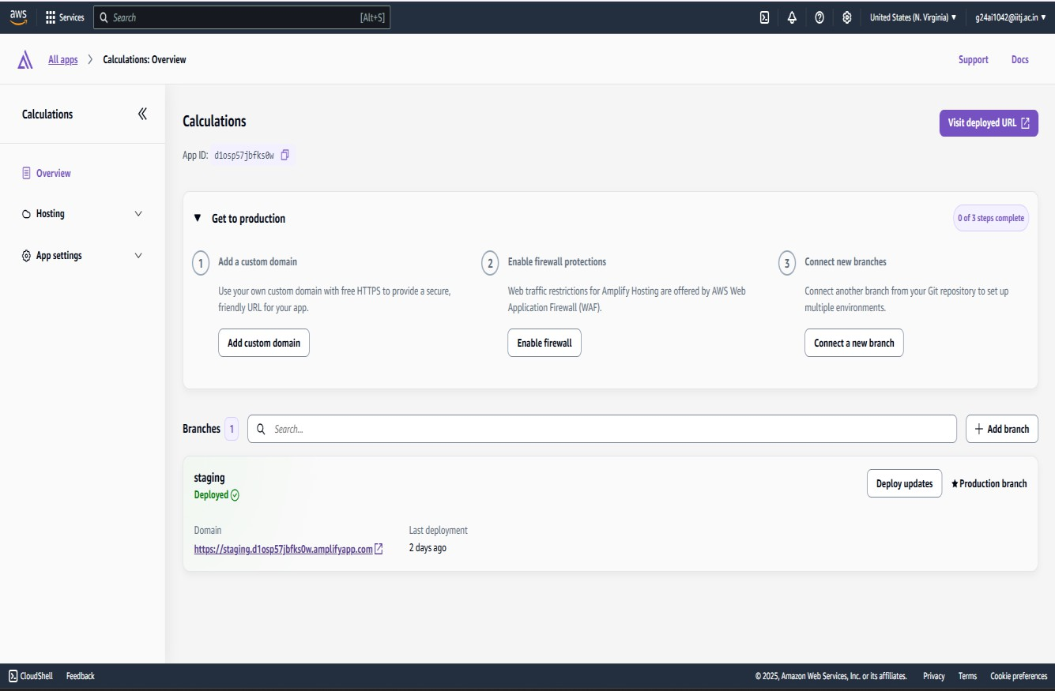
Deployment and Sample Output for Front End:

Slide 7
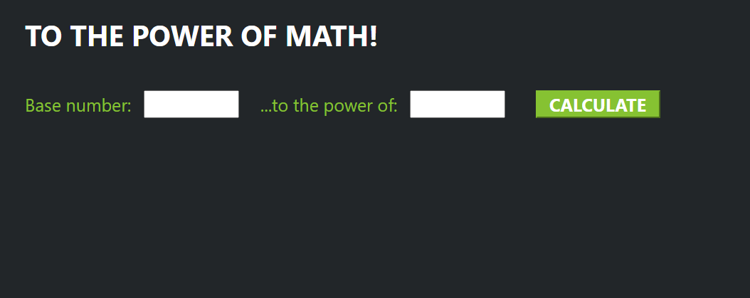

Slide 8
API Gateway Configuration
API Integration: A REST API was created using AWS API Gateway to connect the frontend and backend.
Endpoint Configuration: Defines a single route — POST / — to handle user requests.
CORS Enabled: Cross-Origin Resource Sharing was enabled to allow requests from the Amplify-hosted domain.
Functionality:
API Gateway serves as the traffic controller.
It forwards valid requests to the linked AWS Lambda function for processing.

Slide 10
Serverless Logic with AWS Lambda
Backend Logic: Implemented in Python and deployed as an AWS Lambda function.
Request Handling:
Triggered by requests from API Gateway.
Extracts 'base' and 'exponent' from the incoming JSON payload.
Computation: Uses math.pow() to compute the power expression.
Data Logging:
Generates a timestamp using the time module.
Stores the result and timestamp in a DynamoDB table named 'mathsCalculation'.
Response: Returns a JSON response containing the calculation result.

Slide 11
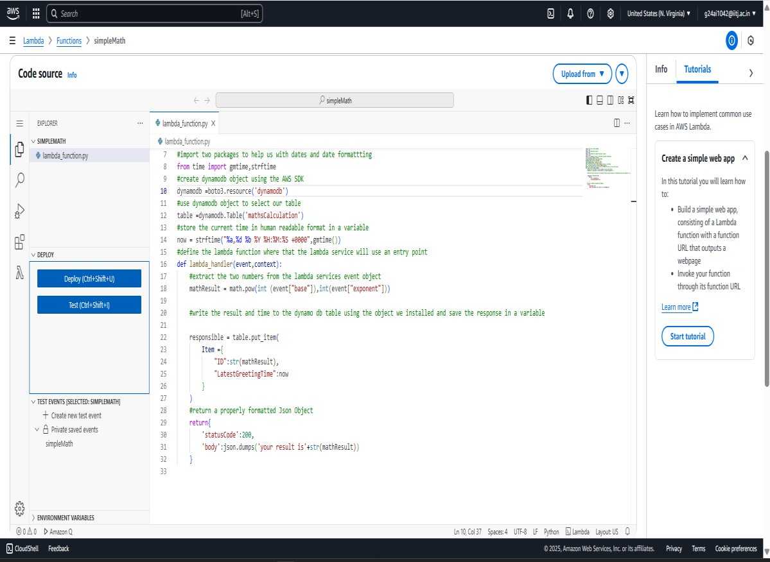

Slide 12
Data Persistence with DynamoDB
Database Used: Amazon DynamoDB stores the results of each computation.
Table Name: 'mathsCalculation’.
Key Fields:
ID': Stores the calculated result as a string.
'LatestGreetingTime': Stores the timestamp of the computation.
Database Interaction: Utilizes AWS’s boto3 SDK within the Lambda function.
Scalability: DynamoDB’s auto-scaling handles varying workloads efficiently without performance issues.

Slide 13
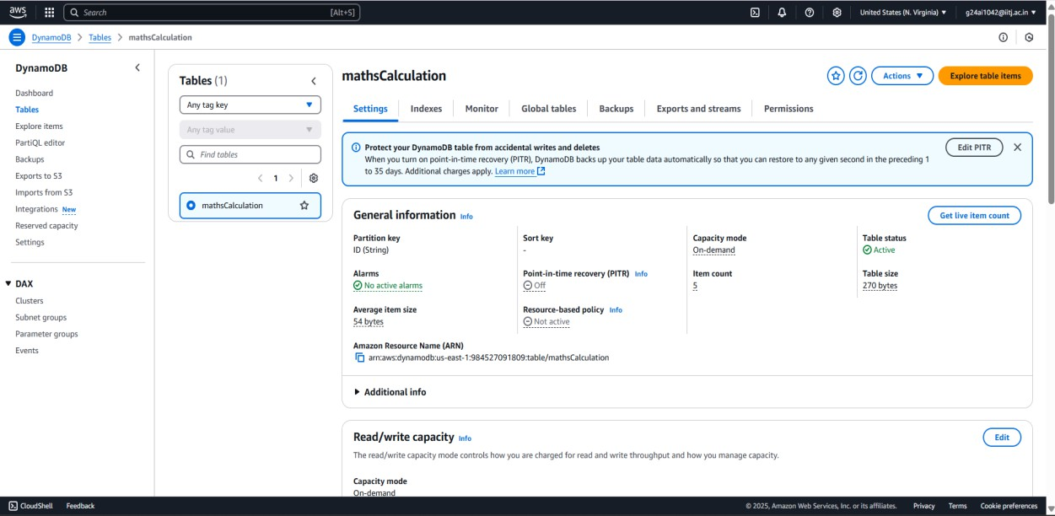

Slide 14
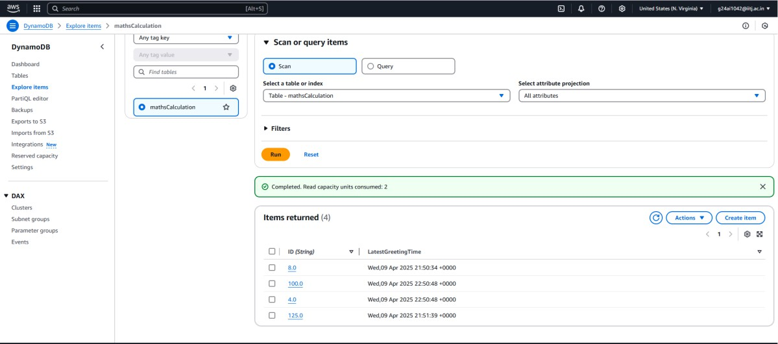

Slide 15
IAM Policy for Secure Access
Security Configuration: An IAM policy was defined and attached to the Lambda execution role.
Granted Permissions:
Includes PutItem, GetItem, UpdateItem, DeleteItem, Scan, and Query operations.
Resource Scope: Access is restricted to the specific DynamoDB table using the
ARN:arn:aws:dynamodb:us-east-1:984527091809:table/mathsCalculation.
Security Principle:
Follows the principle of least privilege while maintaining full application functionality.

Slide 16
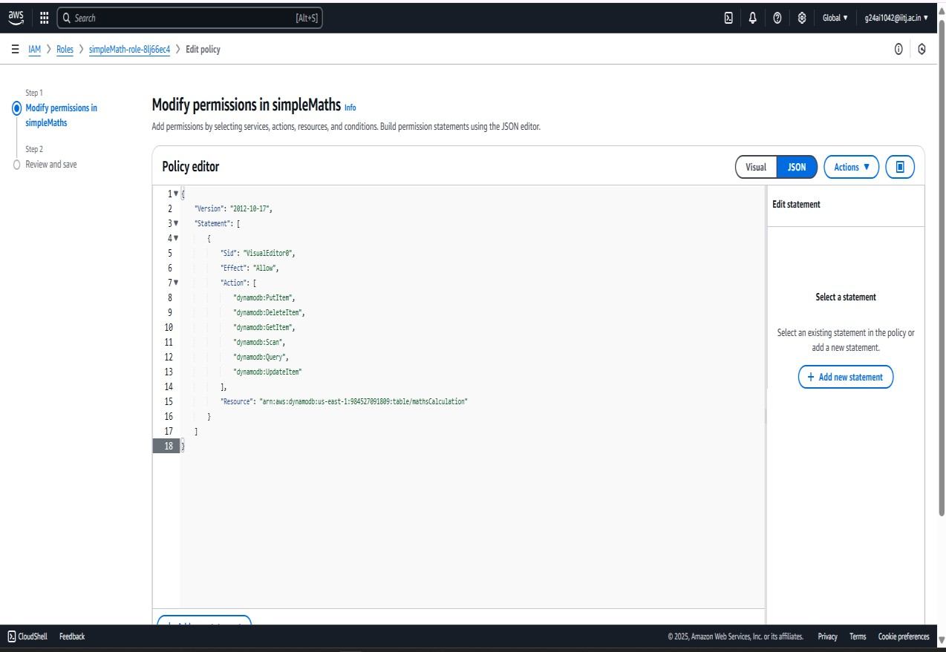

Slide 17
Deployment Process
Deployment Approach: Followed a methodical and structured process.
Steps Involved:
Frontend developed and deployed using AWS Amplify.
API Gateway configured to create a REST API routing requests to Lambda.
Lambda function written in Python, tested, and deployed.
Lambda function integrated with API Gateway.
DynamoDB table (mathsCalculation) was created.
IAM policy assigned to Lambda for secure database access.

Slide 18
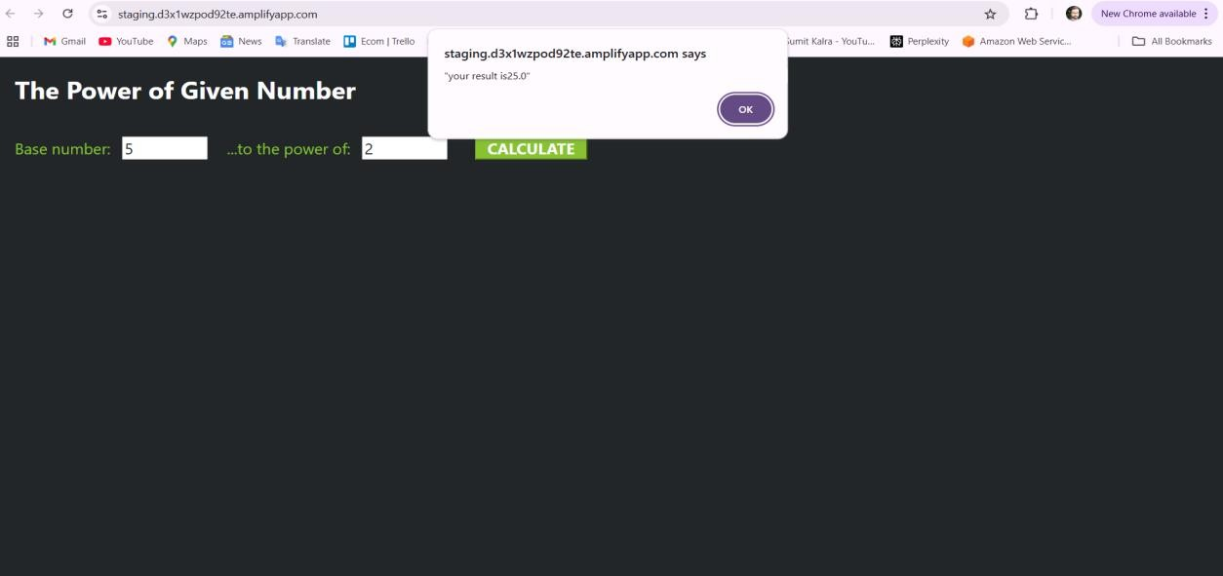

Slide 19
Advantages of This Architecture
The serverless architecture offers numerous benefits.
It automatically scales with user demand and eliminates the need to provision or manage servers.
It is also highly cost-effective, as users are only charged for the compute and storage resources they consume. Moreover, AWS’s extensive suite of tools allows for fast development, secure deployment, and seamless integration across services.
Conclusion
This project showcases the power and simplicity of building serverless web applications on AWS. By using AWS Amplify, API Gateway, Lambda, and DynamoDB in conjunction, developers can rapidly prototype and deploy fully functional applications. This architecture not only simplifies development but also ensures reliability, scalability, and minimal operational overhead.

Slide 20


