Slide 1

Advance DRIVING SCHOOL MANAGEMENT SYSTEM
GROUP-1

Slide 2
TEAM MEMBERS
ID | NAME
2490128 | Cheerla Purushotham(Team Lead)
2491703 | Ashwin Suresh Borale(Back-end Lead)
2491138 | Bhadriraju Lalitha Priyanka (Front-end Lead)
2490775 | Beeram Prasanna
2491114 | Bodasani Balaji Reddy
2490171 | Bonagiri Abhishek
2490927 | C Charan Sai
2490998 | Chaduvu Prathyusha
2490990 | Chakali Rama Lingamaiah
2491204 | Annaa Praveen

Slide 3
INDEX
Introduction
Project Scope
Tools & Technologies
ER Diagram
Schema
Admin Module
Student Module
Output
Conclusion

Slide 4
INTRODUCTION
This Advanced Driving School Management system can reduce the efforts of human power and wealth very much and ensure driving-training school’s information resource to be utilized effectively.
It is a web-based application for maintaining records of car and training school. It will maintain the record of entire students at driving school.
This application automates manual tasks by managing all records of student’s admission, Attendance,vehicles,and trainers.

Slide 5
PROJECT SCOPE
This Advanced Driving School Management system can reduce the efforts of human power.
It will maintain the record of entire students at driving school.
This application automates manual tasks by managing all records.
It is a web-based application for maintaining records.

Slide 6





TECHNOLOGIES
Front end: Angular
Server Side: Spring Boot
Back-end: Hibernate , MY SQL
Server: Tomcat 9.0

Slide 7

Register into portal
Login into portal
Manage Records
Admin
Maintain Records
Student
view the portal
select trainers

Slide 8
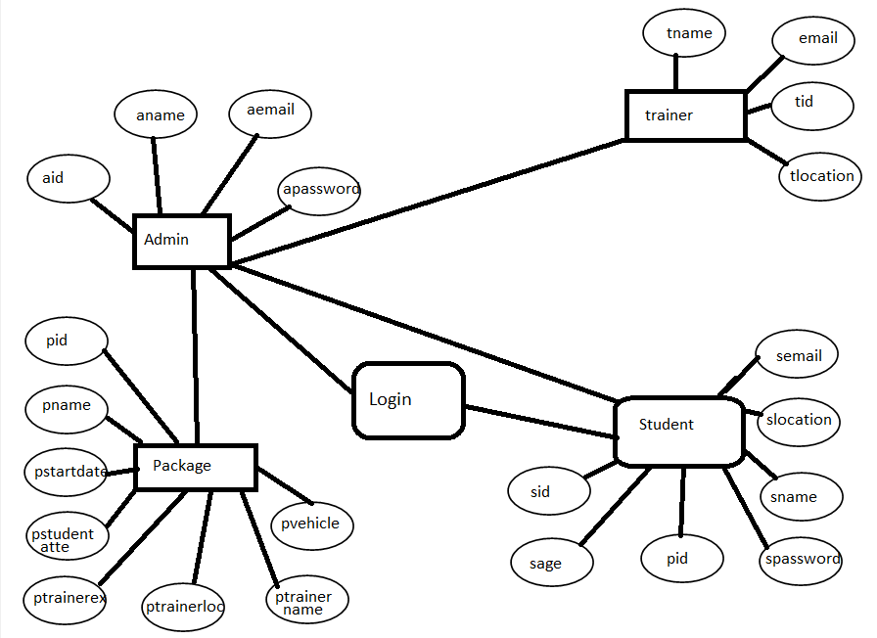
ER DIAGRAM

Slide 9
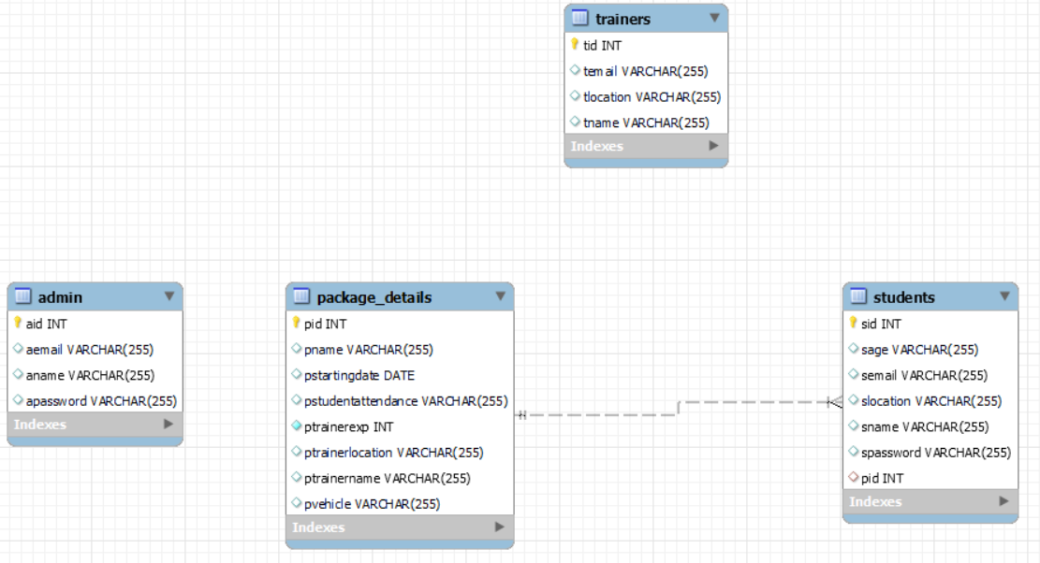
SCHEMA

Slide 10


MODULES
ADMIN
STUDENT

Slide 11
ADMIN MODULE
Login to the portal.
Manage the records of student’s admission, attendance, vehicles,and trainers.
Maintain the record of entire students at driving school
Two admins are assigned for the work in the absence one, another can handle the process.

Slide 12
STUDENT MODULE
Register and Login to the portal.
Once Login see basic training tutorials accessible on the portal.
Students are also divided into two types, local students,and remote student.
Local students can register and select the package and timing, for remote student they can check for the nearby remote trainer.

Slide 13
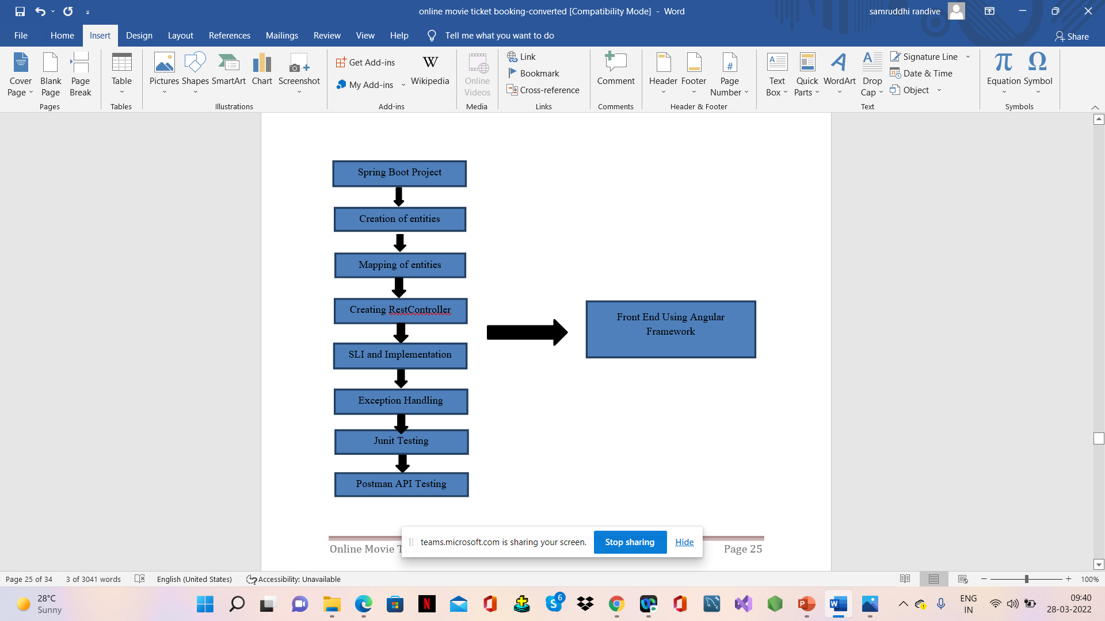
FLOW DIAGRAM:

Slide 14
SYSTEM OVERVIEW
The “Driving School Management” should support basic functionalities for all below listed users.
Administrator
Students
Authentication & Authorization:-
Authentication: Any end-user should be authenticated using a unique user-id and password.
Authorization: The operations supported and allowed would be based on the user type.

Slide 15
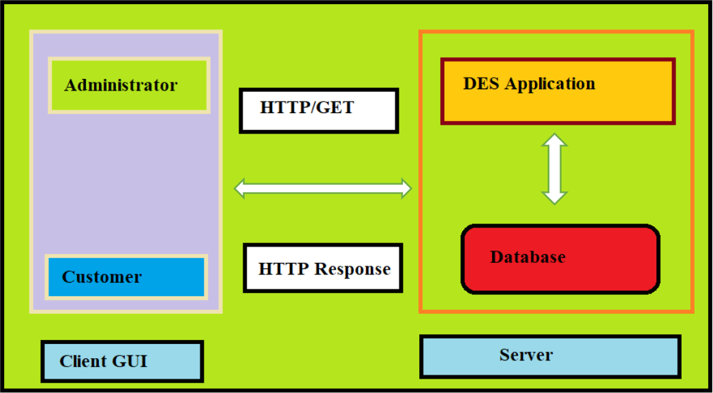
FUNCTIONAL FLOW
The functional flow of the messages across different application components is shown below. Ex. - Web Application.
Application
Student

Slide 16
ANNOTATIONS
Request Mapping
Auto Wired
Post Mapping
Get Mapping
Delete Mapping
Put Mapping

Slide 17
FUNCTIONAL SPECIFICATIONS
Login | Logout:-
[Web Application - MySQL, Spring-boot, Angular]
Go to Registration screen when you click on Register link.
Go to Success screen when you login successfully after entering valid username & password fetched from the database.
Redirect back to same login screen if username & password are not matching.
Implement Session tracking for all logged in users before allowing access to application features. Anonymous users should be checked, unless explicitly mentioned.

Slide 18
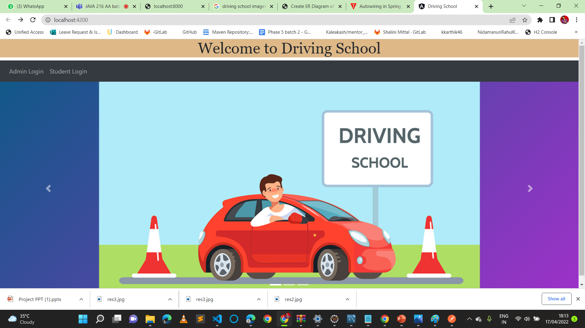
OUTPUTS

Slide 19
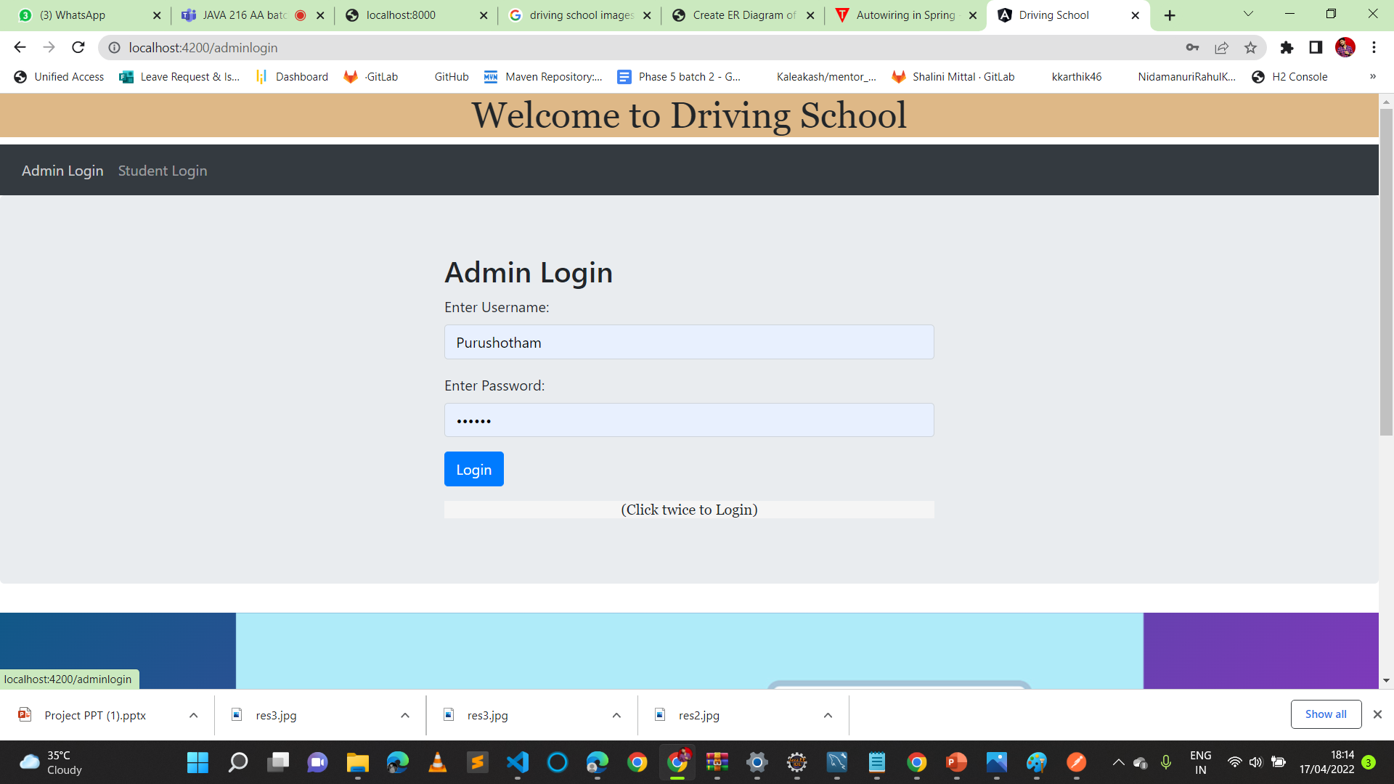
Admin Login Page

Slide 20
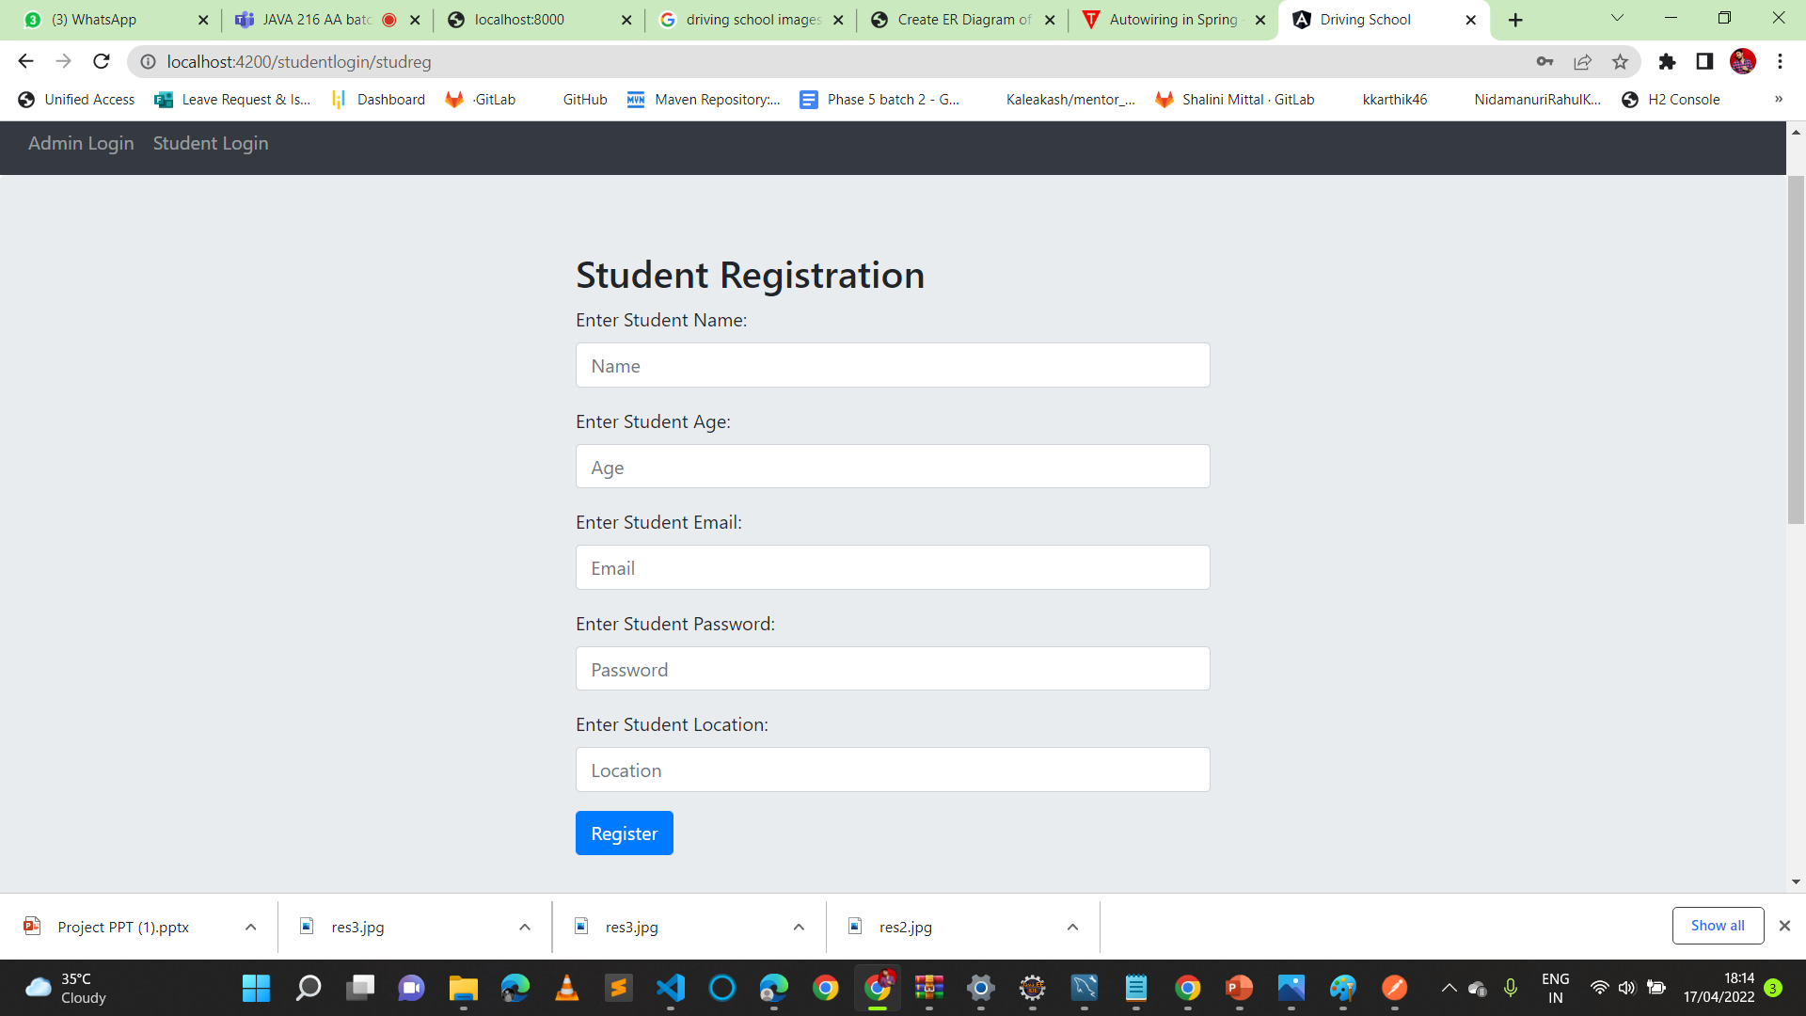
Student ReGISTRATION Page

Slide 21
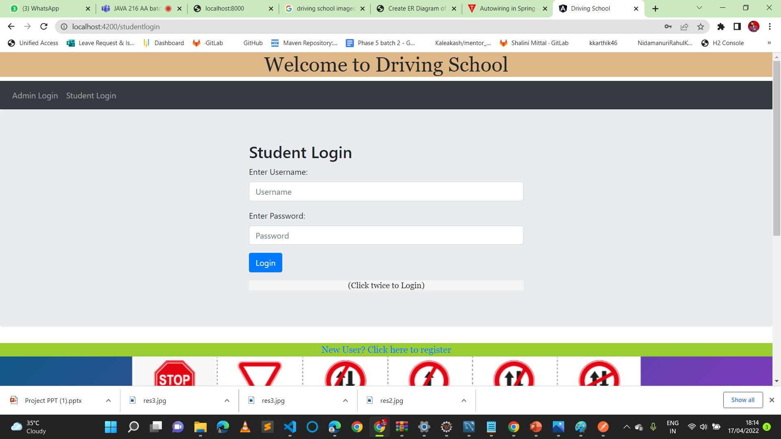
Student LOgin Page

Slide 22
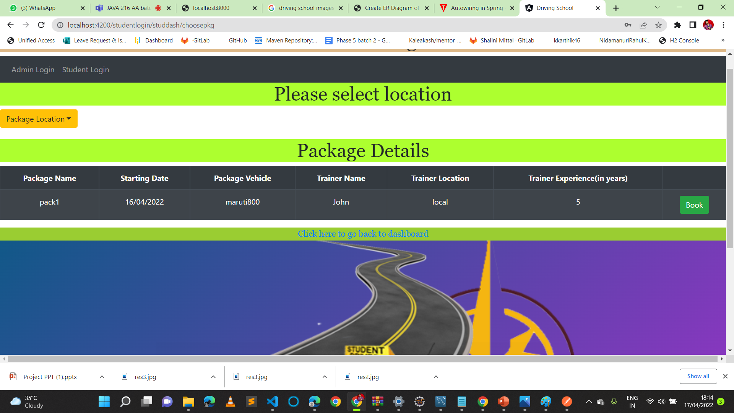

Slide 23
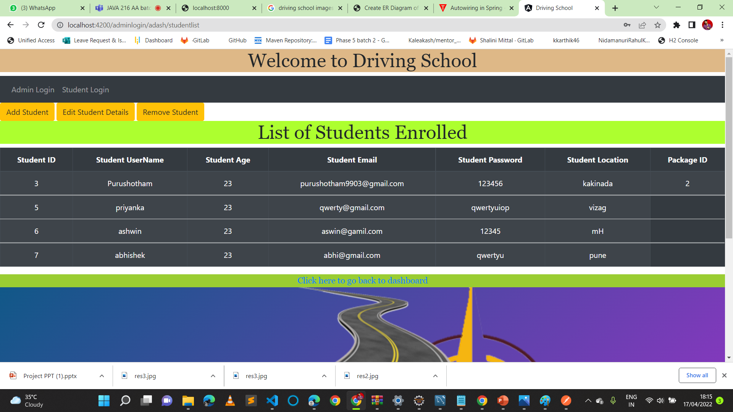

Slide 24
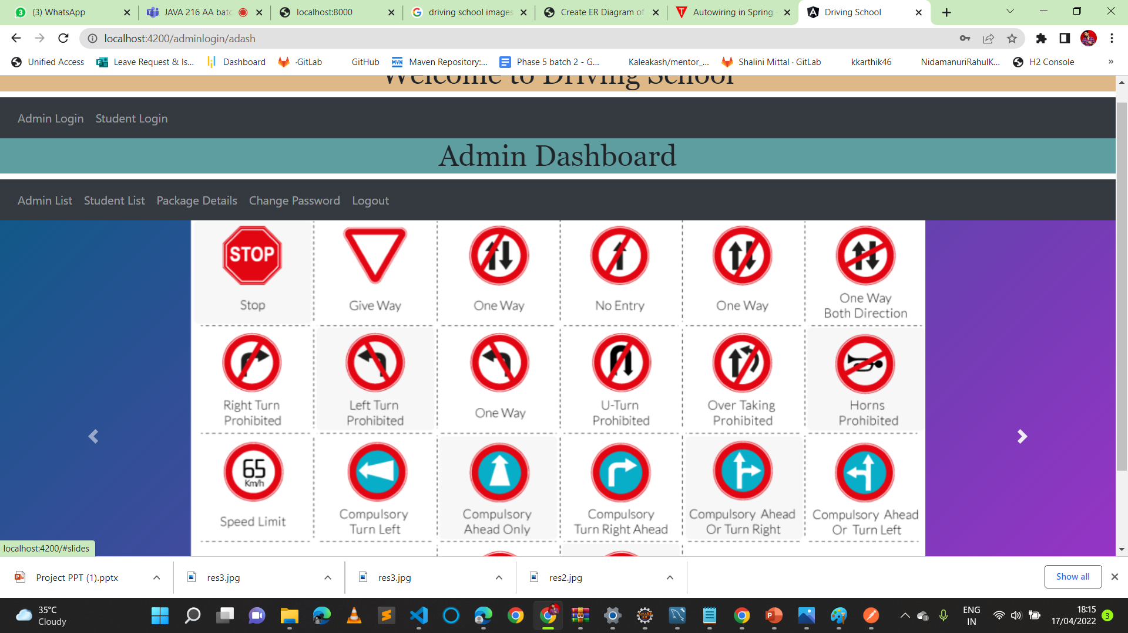

Slide 25
CONCLUSION
This application automates manual tasks by managing all records of student’s admission, Attendance, vehicles,and trainers.
This Advanced Driving School Management system can reduce the efforts of human power.
This helps to increase business.

Slide 26
THANK YOU

