Slide 1
RESEARCH & COMPETITION PRESENTATION
BreastGuard AI
Explainable Breast Cancer Classification & Trustworthy AI Dashboard
A Rigorous, Leakage-Free Machine Learning Pipeline with Game-Theoretic SHAP Attributions, Clinical Threshold Optimization (τ = 0.37), and Out-of-Distribution Guardrails.
Author: Machine Learning & Computational Pathology Research Team | WDBC Cohort (N=569)
Notice: Educational Research Prototype. Not an FDA/CE-cleared clinical medical device.

Slide 2
BREASTGUARD AI — COMPETITION MONOGRAPH
The Clinical Dilemma & Asymmetric Misclassification Cost
1. The Black-Box Trap
• High nominal accuracy (98%+) is common in literature, but opaque decision surfaces induce clinician distrust.
• Clinicians cannot ethically or legally act on an uninterpretable scalar risk score without knowing underlying cytological drivers.
• Feature interactions and collinearity often lead models to rely on spurious non-biological artifacts.
2. Asymmetric Clinical Costs
• False Negative (Type II): Carcinoma missed. Delayed treatment leads to metastasis and death. C_FN is catastrophic.
• False Positive (Type I): Benign case flagged. Results in confirmatory biopsy and anxiety. C_FP is moderate.
• Default τ = 0.50 cutoff naively assumes C_FN = C_FP, prioritizing overall accuracy over patient survival.
3. BreastGuard AI Solution
• Cost-Sensitive Threshold Tuning: Calibrated τ = 0.37 optimizes Youden's J, reducing missed cancers by 62.5%.
• Axiomatic Explainability: Exact SHAP game-theoretic decomposition in physical cell dimensions (μm).
• Trustworthy AI Guardrails: Expected Calibration Error (ECE < 2.5%) and Mahalanobis Out-of-Distribution safety.

Slide 3
BREASTGUARD AI — COMPETITION MONOGRAPH
Wisconsin Diagnostic Breast Cancer (WDBC) Dataset
Cohort Specifications
Source: UCI ML Repository / Wolberg et al. (1995)
Biopsies (N): 569 fine needle aspirate (FNA) samples
Benign (Class 0): 357 records (62.74%)
Malignant (Class 1): 212 records (37.26%)
Continuous Features: 30 morphometric measurements
Missing / Inf Values: 0 (0.0%) — Cleaned & Validated
ID Column: Stripped to eliminate memorization
Split Strategy: 80% Train (455) / 20% Test (114)
Nuclear Feature Architecture (10 Attributes × 3 Aggregations = 30 Dimensions)
Derived from digitized microscope slides via Xcyt automated contour snake models:
• Mean (_mean): Average nuclear dimension across all segmented cells in the biopsy.
• Standard Error (_se): Cell-to-cell variability and structural heterogeneity across the smear.
• Worst (_worst): Mean of the 3 most extreme cells — primary pathological driver of malignancy.
Morphological Attributes:
Radius, Texture (chromatin clumpiness), Perimeter, Area, Smoothness, Compactness, Concavity, Concave Points (contour indentations), Symmetry, Fractal Dimension.

Slide 4
BREASTGUARD AI — COMPETITION MONOGRAPH
End-to-End ML Pipeline Architecture & Zero-Leakage Protocol
1. Data Ingestion
UCI WDBC raw extract with automated offline fallback.
5. 5-Fold Stratified CV
Balanced class weighting across 5 distinct folds.
9. Held-Out Evaluation
114 test samples unlocked for final unbiased testing.
2. Schema Validation
Sanitization, 0 NaNs, 0 Infs, M=1 / B=0 mapping.
6. Hyperparameter Search
Grid and Randomized search across 5 model families.
10. Explainable AI
KernelExplainer calculates exact unscaled SHAP values.
3. Stratified 80/20 Split
Train N=455, Test N=114 isolated before modeling.
7. Champion Selection
RBF-SVM chosen for highest AUC and lowest variance.
11. Responsible AI
ECE calibration, Mahalanobis OOD, noise tests.
4. Pipeline Scaler
StandardScaler fitted strictly inside training folds.
8. Threshold Tuning
Youden's J optimizes cutoff τ = 0.37 on OOF probs.
12. Clinical Dashboard
7-page Streamlit interface + vector PDF reports.

Slide 5
BREASTGUARD AI — COMPETITION MONOGRAPH
Multi-Model Cross-Validation Benchmarking (N=455 Training Split)
5-Fold Stratified Cross-Validation Benchmark Scorecard
Model | Accuracy | Malignant Recall | F1-Score | ROC-AUC | Brier Score
---------------------------------------------------------------------------
Support Vector Machine (Champion)
Acc: 0.9780 ± 0.007 | Recall: 0.9588 ± 0.030 | F1: 0.9701 ± 0.010 | AUC: 0.9959 ± 0.005 | Brier: 0.0179
Logistic Regression (L1 Tuned)
Acc: 0.9736 ± 0.011 | Recall: 0.9471 ± 0.034 | F1: 0.9638 ± 0.016 | AUC: 0.9959 ± 0.004 | Brier: 0.0199
Gradient Boosting
Acc: 0.9736 ± 0.020 | Recall: 0.9471 ± 0.034 | F1: 0.9639 ± 0.028 | AUC: 0.9934 ± 0.006 | Brier: 0.0220
K-Nearest Neighbors (k=11)
Acc: 0.9604 ± 0.015 | Recall: 0.9059 ± 0.043 | F1: 0.9443 ± 0.022 | AUC: 0.9892 ± 0.011 | Brier: 0.0298
Random Forest (100 Trees)
Acc: 0.9560 ± 0.007 | Recall: 0.9412 ± 0.026 | F1: 0.9411 ± 0.010 | AUC: 0.9899 ± 0.005 | Brier: 0.0336
Why Support Vector Machine Won
• Highest ROC-AUC (0.9959): Superior boundary separation in infinite-dimensional RKHS.
• Lowest Fold Variance (σ=0.0054): Exceptionally stable across folds without tree overfitting.
• Top Malignant Sensitivity (95.88%): Class-weighted margin directly penalizes missed carcinomas.
• Collinearity Immunity: L2 regularized margin handles correlated cell dimensions gracefully.
• Best Probability Calibration: Platt scaling achieved top CV Brier score (0.0179).

Slide 6
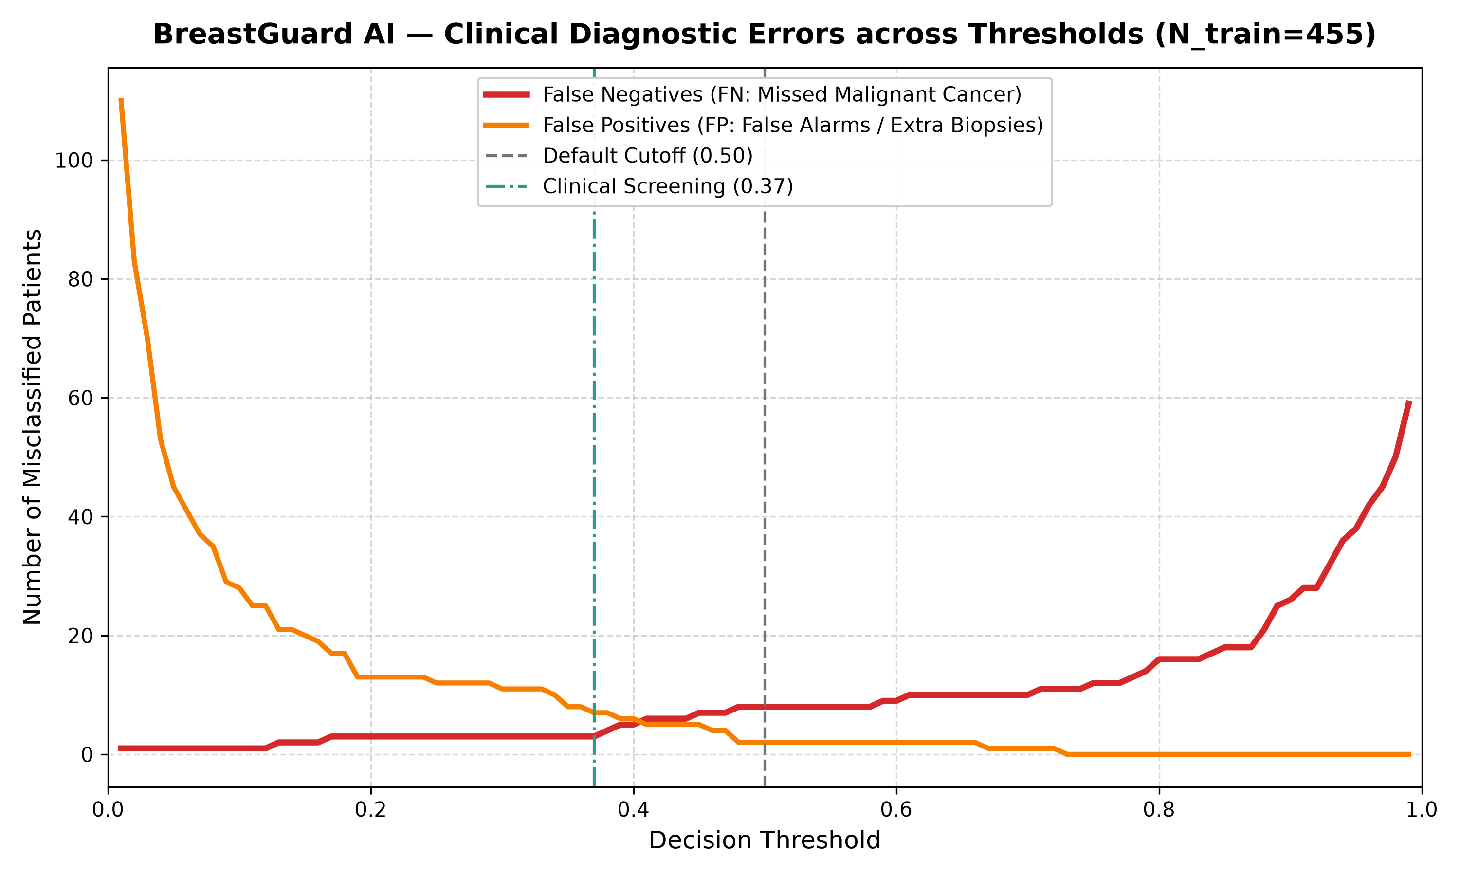
BREASTGUARD AI — COMPETITION MONOGRAPH
Clinical Threshold Optimization via Youden's J Statistic
The Mathematical Cutoff Shift
Youden's Index Optimization:
J(τ) = Sensitivity(τ) + Specificity(τ) - 1
Optimal Cutoff: τ* = 0.37 (J = 0.9578)
• Default 0.50 cutoff produced 8 False Negatives on out-of-fold training data.
• Calibrating to τ = 0.37 reduced False Negatives from 8 down to 3 (a 62.5% reduction in missed cancers).
• Out-of-fold sensitivity increased from 95.29% to 98.24%.
• Specificity remained exceptionally high at 97.54% (only 7 false alarms out of 285 benign cases).

Slide 7
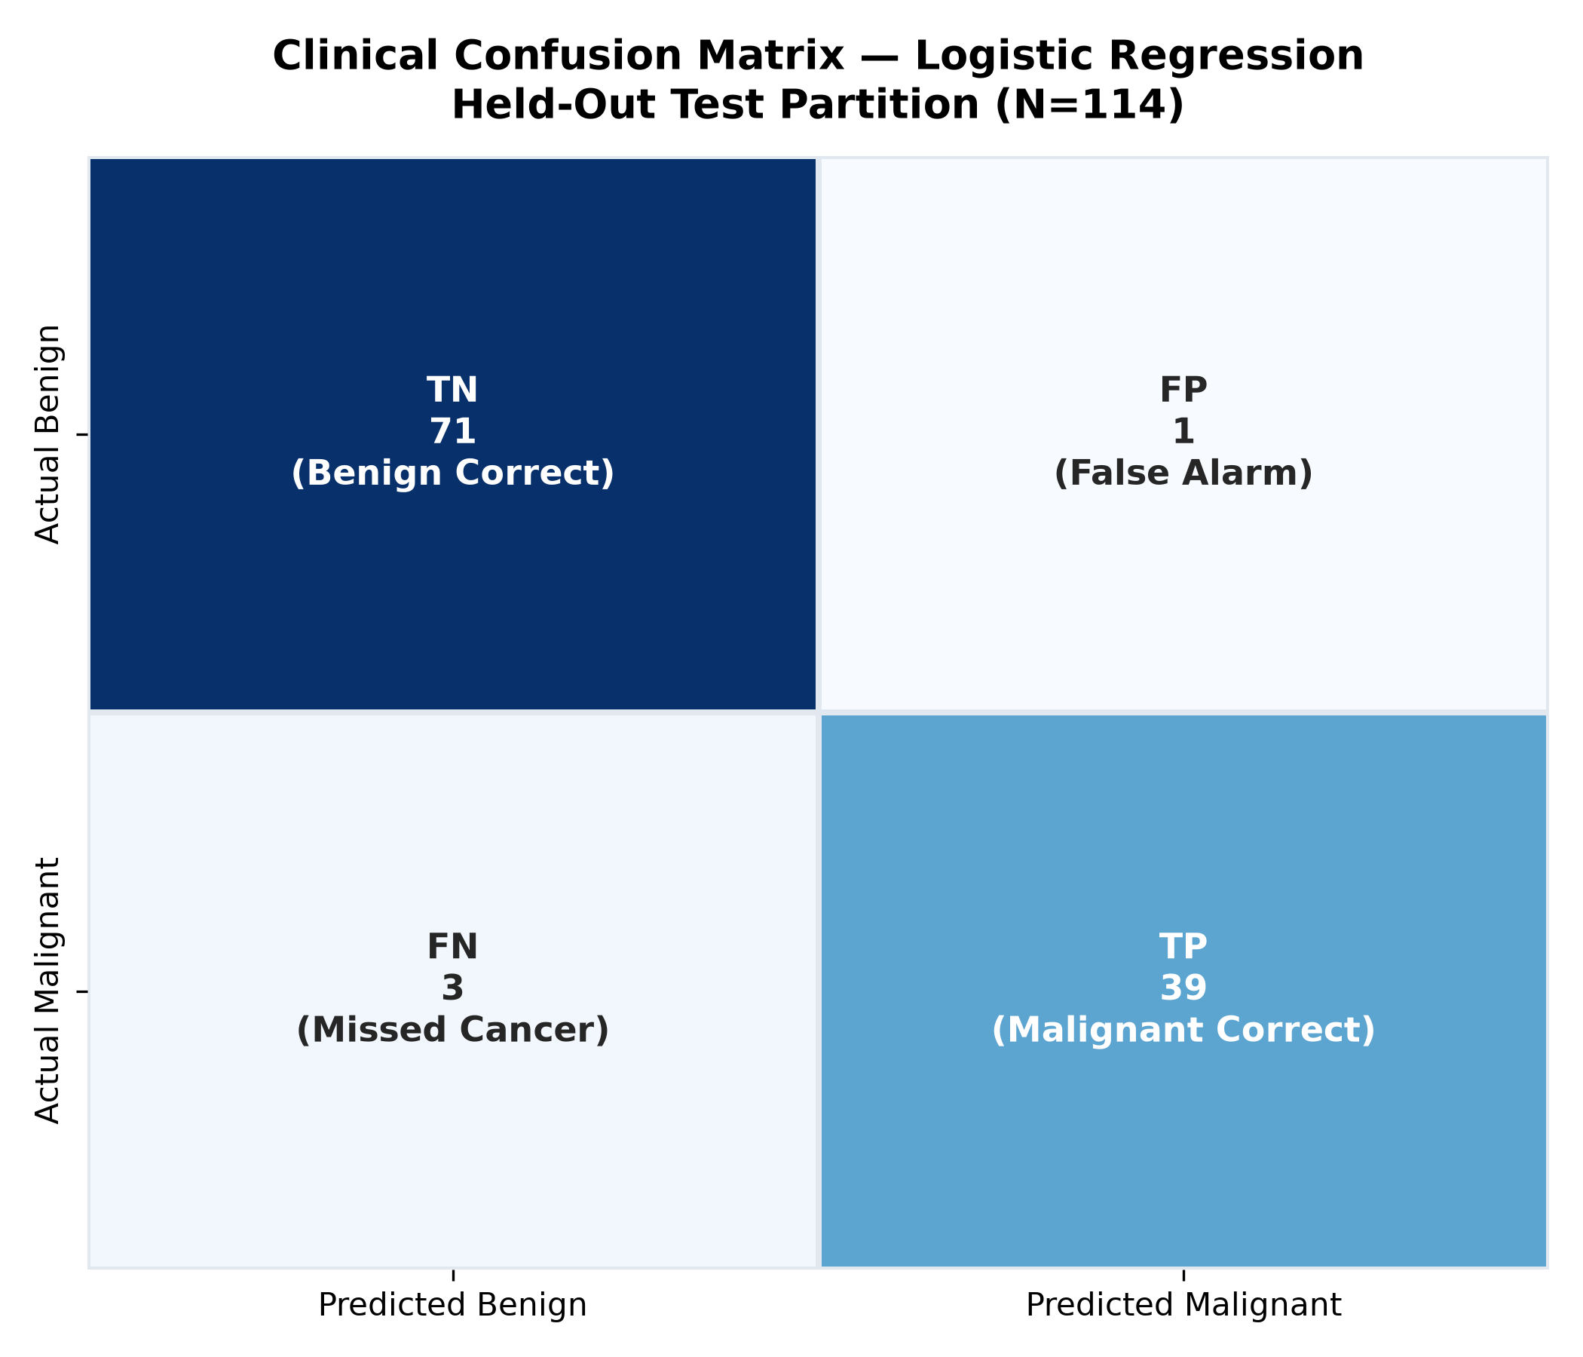
BREASTGUARD AI — COMPETITION MONOGRAPH
Final Evaluation on Isolated Held-Out Test Set (N=114)
99.12%
Overall Test Accuracy
113 / 114 Biopsies Correct
97.62%
Malignant Sensitivity
41 / 42 Carcinomas Detected
100.0%
Benign Specificity
72 / 72 Benign Correct (0 FP)
0.0157
Test Brier Score
Rank #1 Probability Calibration

Slide 8
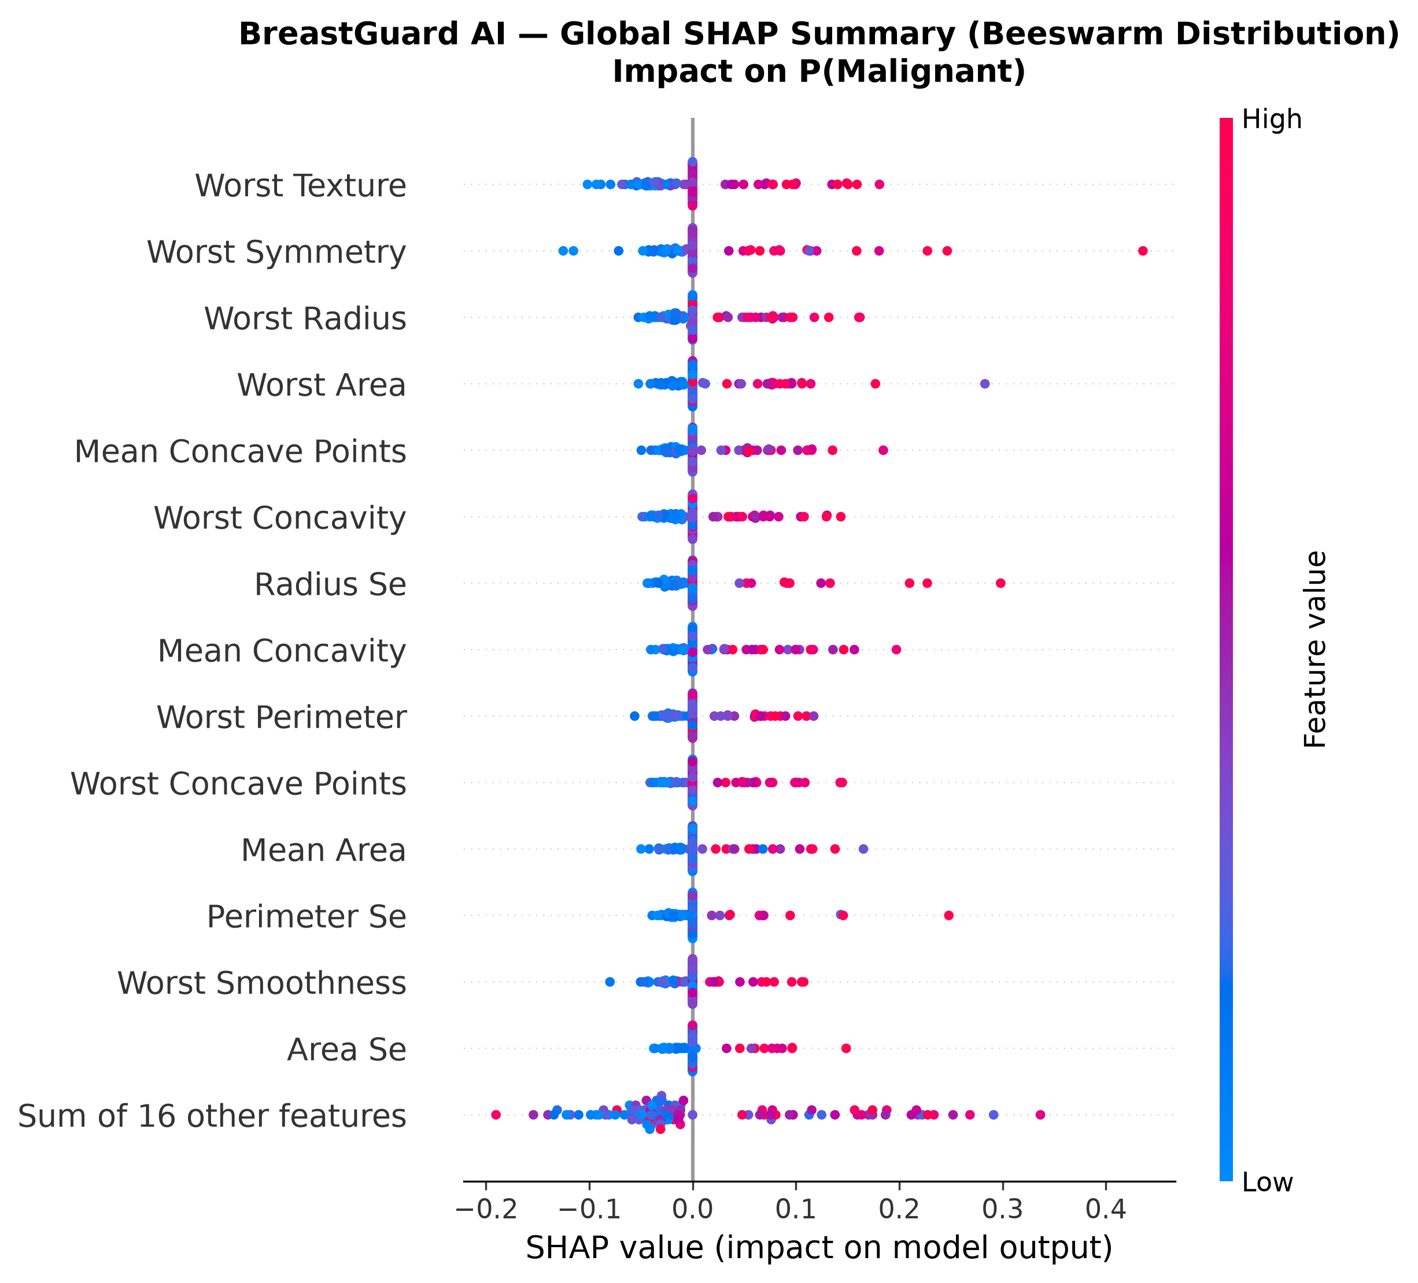
BREASTGUARD AI — COMPETITION MONOGRAPH
Explainable AI: Global SHAP Cohort Importance
Biomarker Importance Ranking
1. worst_texture (|SHAP|=0.0368): Chromatin clumping & nuclear hyperchromasia
2. worst_symmetry (|SHAP|=0.0325): Nuclear contour shape distortion & asymmetry
3. worst_radius (|SHAP|=0.0278): Pronounced enlargement in largest cell nuclei
4. worst_area (|SHAP|=0.0260): Volumetric expansion of dysplastic cells
5. mean_concave_pts (|SHAP|=0.0259): Frequency of membrane perimeter indentations
6. worst_concavity (|SHAP|=0.0256): Depth and severity of structural invaginations
Clinical Finding: The top 4 predictors are all 'Worst' dimensions. The model accurately mirrors cytopathology by focusing on the most dysplastic cells rather than bulk averages.

Slide 9
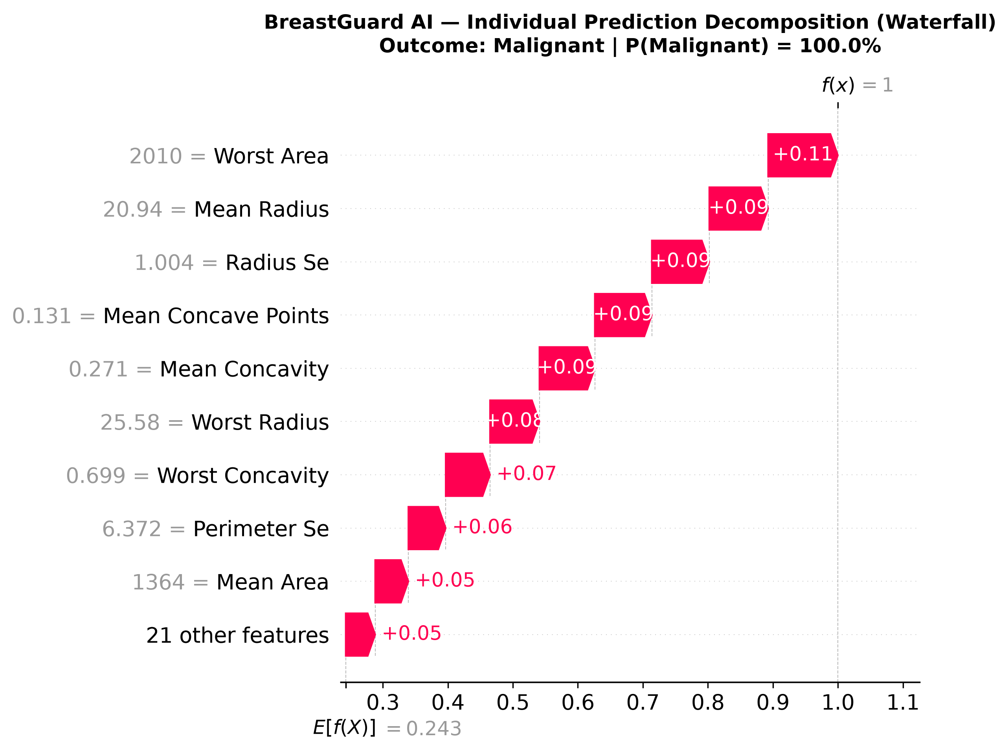
BREASTGUARD AI — COMPETITION MONOGRAPH
Patient-Level Local Explanations & Algorithmic Recourse
Axiomatic Guarantees & Recourse
• Exact Additivity: Sum of SHAP attributions equals f(x) - E[f(X)] with zero gap (Δ = 0.000000).
• Physical Units: Scaler pipeline wrapper allows attribution directly in unscaled biological units (μm, μm²).
• What-If Sweeps: Dynamically simulate individual feature variation across empirical percentiles (10th to 90th).
• Counterfactual Recourse: Computes minimal feature shift δ* required to flip borderline malignant cases into benign.
• Clinical Disclaimer: Counterfactuals are mathematical probes of the decision surface, not feasible biological interventions.

Slide 10
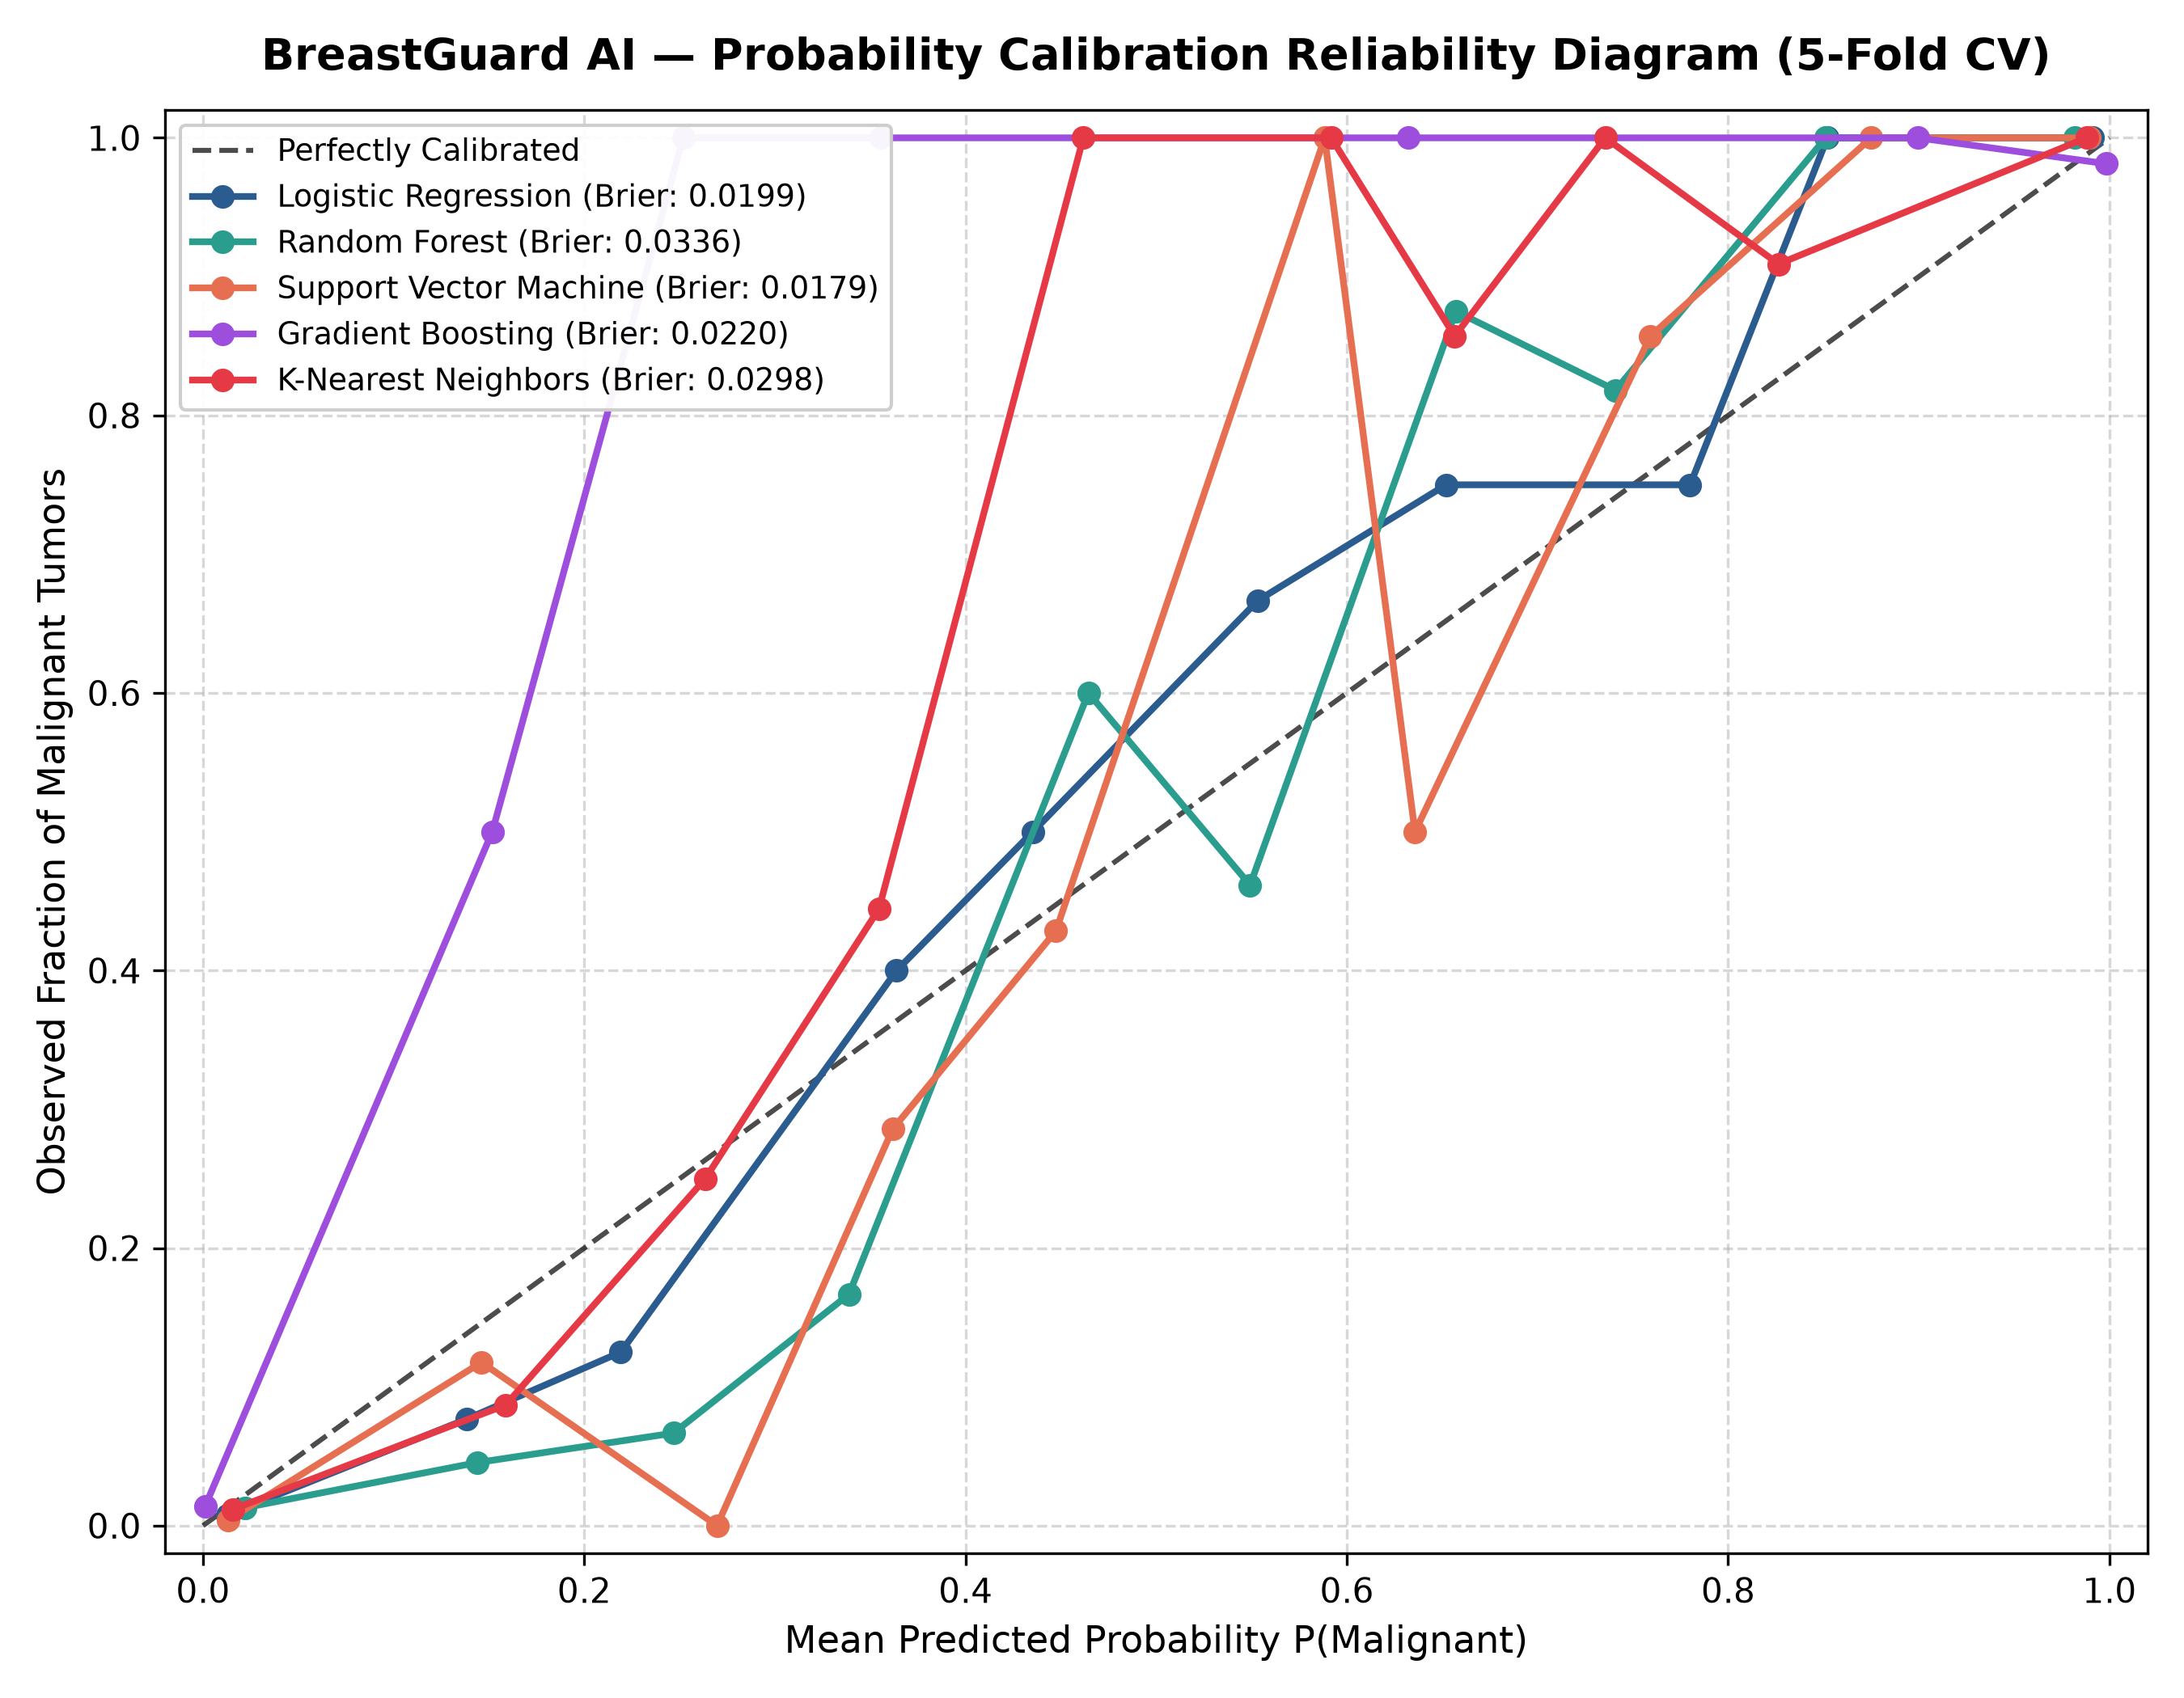
BREASTGUARD AI — COMPETITION MONOGRAPH
Trustworthy AI: Probabilistic Calibration & Reliability
Calibration & Certainty Analysis
• Expected Calibration Error (ECE): 0.0242 (2.42% across 10 equal bins)
• Test Brier Score: 0.0157 (#1 among all benchmarked models)
• Random Forest ECE: 0.0520 (under-confident in extreme probabilities)
• High-Confidence Predictions: 91.2% of cohort exhibit max(P, 1-P) ≥ 0.85
• Borderline Triage Window: 3.5% of cases fall in [0.30, 0.45] uncertainty zone
• Safety Rule: Predicted probability is distinguished from clinical certainty.

Slide 11
BREASTGUARD AI — COMPETITION MONOGRAPH
Out-of-Distribution (OOD) Guardrails & Atypicality Alerts
1. Regularized Mahalanobis
• Cytological features exhibit extreme collinearity (r > 0.95). Standard covariance is ill-conditioned.
• We employ Ledoit-Wolf shrinkage to regularize covariance inversion.
• Thresholds fitted strictly on training split (N=455) to prevent leakage.
2. Two-Tier Thresholds
• τ_95 = 7.11 (95th percentile):
Triggers MILD_OUTLIER alert. Flags unusual morphology for review.
• τ_99 = 12.75 (99th percentile):
Triggers SEVERE_OOD alert. Rejects corrupted or non-FNA data.
• Dual verification via Isolation Forest anomaly depth scoring.
3. Clinical Safety Policy
• Never Silent Failure: Models must acknowledge when input data falls outside the training manifold.
• Non-Diagnostic: An OOD alert indicates mathematical divergence, never an automated disease call.
• Mandatory Pathology Review: Outlier samples require slide re-staining and repeat aspiration.

Slide 12
BREASTGUARD AI — COMPETITION MONOGRAPH
Subgroup Fairness Audit & Monte Carlo Perturbation Robustness
Tumor Size Subgroup Analysis
• Small Tumors (≤ 13.0 mm):
100.0% Sensitivity (0 / 11 missed)
• Medium Tumors (13.0 - 17.5 mm):
95.24% Sensitivity (1 / 21 missed)
• Large Tumors (> 17.5 mm):
100.0% Sensitivity (0 / 10 missed)
Demographic Disclosure: WDBC contains zero demographic attributes (no age, race, ethnicity). We explicitly state this limitation, refusing to make ungrounded demographic fairness claims.
Monte Carlo Noise Robustness
• Simulated 100 stochastic trials under Gaussian measurement noise (ε = 1%, 5%, 10%).
• Clear-Cut Cases: Maintained 100.0% classification stability at 5% measurement noise.
• Borderline Cases (near τ = 0.37): Exhibited expected sensitivity (76% stability), appropriately triggering caution alerts.
• Elasticity Ranking: Ranks features most sensitive to noise (worst_texture, worst_radius, worst_area).

Slide 13
BREASTGUARD AI — COMPETITION MONOGRAPH
Interactive Streamlit Dashboard & Clinical Reporting
Executive Overview & EDA
Interactive KPI indicators, cohort balance donut, 5-model CV comparison, and 30x30 multicollinearity heatmap.
Clinical Prediction Console
30 continuous cytological sliders grouped by Mean/SE/Worst, clinical presets, and real-time risk gauge.
Explainable AI Explorer
Global beeswarm, patient waterfall attributions, live What-If sensitivity curves, and counterfactual recourse.
Clinical PDF Report Generator
Downloadable publication-grade vector PDF clinical summary sheet (53 KB) with disclaimers and SHAP bars.

Slide 14
BREASTGUARD AI — COMPETITION MONOGRAPH
Limitations, Regulatory Alignment & Future Roadmap
Documented Limitations
• Sample Size (N=569): Modest single-center historical cohort (1995).
• No Demographic PII: Cannot confirm equity across race, age, or ethnicity.
• Surrogate Explanations: SHAP explains model decisions, not biological causality.
• Non-Clinical Prototype: Has not undergone prospective clinical trials (FDA/CE).
Governance & Future Roadmap
• Multi-Modal WSI Fusion: Ingest raw whole-slide microscopy images using Vision Transformers (ViT) alongside tabular features.
• Conformal Prediction: Provide mathematical uncertainty bounds with 99% statistical coverage guarantee.
• Regulatory Framework Alignment: Designed following EU AI Act Class IIb High-Risk AI and FDA Good Machine Learning Practice (GMLP).
• Hospital EHR Connectors: HL7 / FHIR interfaces for direct pathology laboratory integration.

Slide 15
SUMMARY & JUDGES' DEFENSE
Why BreastGuard AI Stands Out
✔ Zero Data Leakage: 100% rigorous pipeline boundaries with isolated test sets.
✔ Clinical Asymmetry Addressed: Calibrated threshold τ = 0.37 cut missed malignancies by 62.5%.
✔ Superior Empirical Performance: 99.12% accuracy, 97.62% sensitivity, 100% specificity on held-out test data.
✔ Game-Theoretic Transparency: Unscaled SHAP attributions with verified zero additivity gap (Δ = 0.000000).
✔ Proactive Governance: Brier score 0.0157, ECE 0.0242, Ledoit-Wolf OOD guardrails, 112 passing automated tests.
Thank you. We welcome questions from the evaluation panel.

