Slide 1
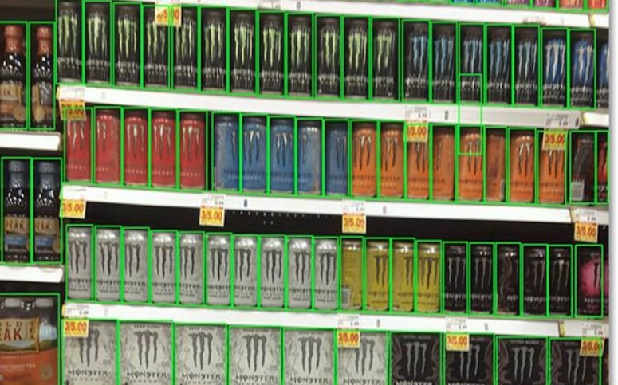
E-Cell IIT Bombay x Everseen | Computer Vision AI Hackathon 2026
ShelfTwin
Real-time shelf auditing with trustworthy restock and displacement alerts
Track 1: Shelf Auditing and Real-Time Stockouts. Submission: idea and prototype.
At a glance
Problem | About 1 in 12 products is missing from the shelf at any moment. Most gaps start inside the store and are found too late.
Solution | A per-slot shelf record ('twin') built from cameras. A temporal engine decides when to act, wait, or report that it cannot see.
Techniques | Dense detection (YOLO), catalogue retrieval (DINOv2 + FAISS), OCR tie-breaks, planogram alignment, Bayesian evidence over frames.
Prototype | Working prototype; code and trained models are public. In simulation: 0.12 false alerts per camera-hour vs 966 for a single-frame detector, at full recall.
Deployment | One edge GPU box per store; existing CCTV, shelf cameras or phones; alerts on web, Telegram or WhatsApp.
Team ShelfTwin, SVNIT Surat | github.com/Purv-Kabaria/shelftwin

Slide 2
Problem statement and requirements
PROBLEM STATEMENT (TRACK 1)
# | Requirement | What it means in practice | How ShelfTwin meets it
R1 | Real-time imagery | Read shelf cameras, CCTV or phone video continuously | Edge pipeline at 0.5-2 frames/s per camera; change-triggered analysis
R2 | Planogram comparison | Know which product belongs in each slot | Approved layout; per-row sequence alignment of detections to slots
R3 | Threshold alerts | Warn when a slot runs low, not only when empty | Per-slot coverage states; adaptive low-stock threshold; time-to-empty
R4 | Displacement alerts | Detect a product in the wrong slot | Catalogue match with abstention; identity kept separate from location
R5 | Immediate staff alerts | The right person gets a clear task fast | Ranked tasks with photos, stock location, reason, and camera verification
R6 | Trust (our addition) | False alarms waste time and teach staff to ignore alerts | Temporal evidence engine with an explicit 'cannot see' state
“Design and build an automated computer vision solution that processes real-time imagery from shelf-scanning cameras, compares it against a digital planogram, and automatically triggers immediate re-stock or displacement alerts the moment inventory thresholds drop or items are misplaced.”
Context given by the organisers
Human-led shelf audits are slow and error-prone.
They cannot catch stockouts or misplaced items in real time.
Smart camera networks or roaming robots scan aisles continuously.
The scan is compared with the store planogram to raise alerts for backroom staff.

Slide 3
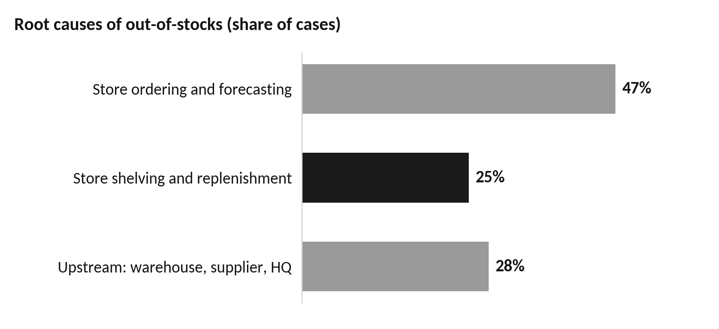
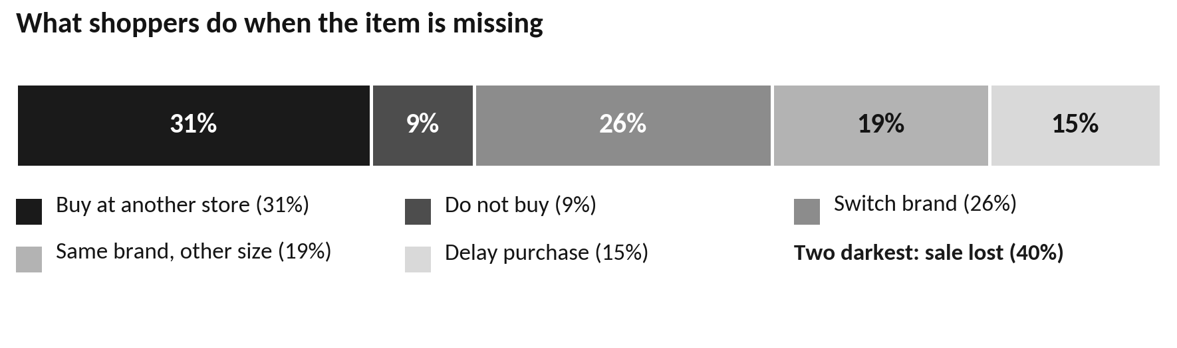
The facts: shelf gaps are frequent, costly, and mostly caused in-store
Figure | What it means
8.3% | Average out-of-stock rate across 661 outlets in a worldwide study
Above 10% | Out-of-stock rate for fast-moving and promoted items, which earn the most
70-75% | Share of out-of-stocks caused by store practice: ordering, forecasting, shelving
About 25% | Cases where the product is in the store but not on the shelf; a camera sees this
31% / 9% | Shoppers who buy at another store / do not buy at all when the item is missing
Up to 4% | Share of yearly revenue lost by grocery retailers to out-of-stocks
Daily or weekly | Typical manual audit cycle; a fast mover can empty within an hour
Why this is harder in Indian retail
Few stores keep a maintained digital planogram.
Frequent pack redesigns, regional variants and look-alike multipacks.
Patchy internet; tight hardware budgets; high staff turnover.
Both charts: worldwide averages across 661 outlets. Responses vary by category.
Main implication: the store can fix most gaps itself, if it learns about them early and trusts the signal.

Slide 4
Problem breakdown: pain points and our response
# | Pain point | Who is affected | Consequence | ShelfTwin response | Req.
1 | Gaps are found hours late | Shoppers, store | Lost sales for the full gap | Continuous, change-triggered analysis; alert within seconds of confirmed evidence | R1
2 | Only 'empty' is detected | Floor staff | Shelf empties during peak hours | Low-stock state, adaptive threshold, time-to-empty estimate | R3
3 | False alarms from shoppers, staff, glare | Floor staff | Alerts are ignored | Visibility-weighted evidence across frames; 'cannot see' state | R6
4 | No maintained digital planogram | Most Indian stores | Compliance systems cannot start | Layout drafted from shelf tags and stable views; manager approval | R2
5 | New, seasonal and look-alike packs | Recognition model | Wrong product, wrong alert | Catalogue retrieval with abstention; add a product with 3-5 photos | R4
6 | Stock in backroom, not on shelf | Backroom staff | Avoidable empty shelf | Backroom rack camera; pick location in every task | R5
7 | Misplaced and abandoned items | Shoppers, cold chain | Lost sale; spoiled chilled food | Slot alignment; displacement and cold-chain alerts | R4
8 | No proof that the shelf was fixed | Store managers | Same gap stays open | Task closes only on camera or photo verification | R5
9 | Costly hardware, weak internet | Small and mid-size chains | System cannot be deployed | Reuse CCTV and phones; all inference runs offline in the store | R1
10 | No record of availability over time | Category managers | Root causes stay hidden | Per-slot history: time empty, time to fix, repeat offenders | R2

Slide 5
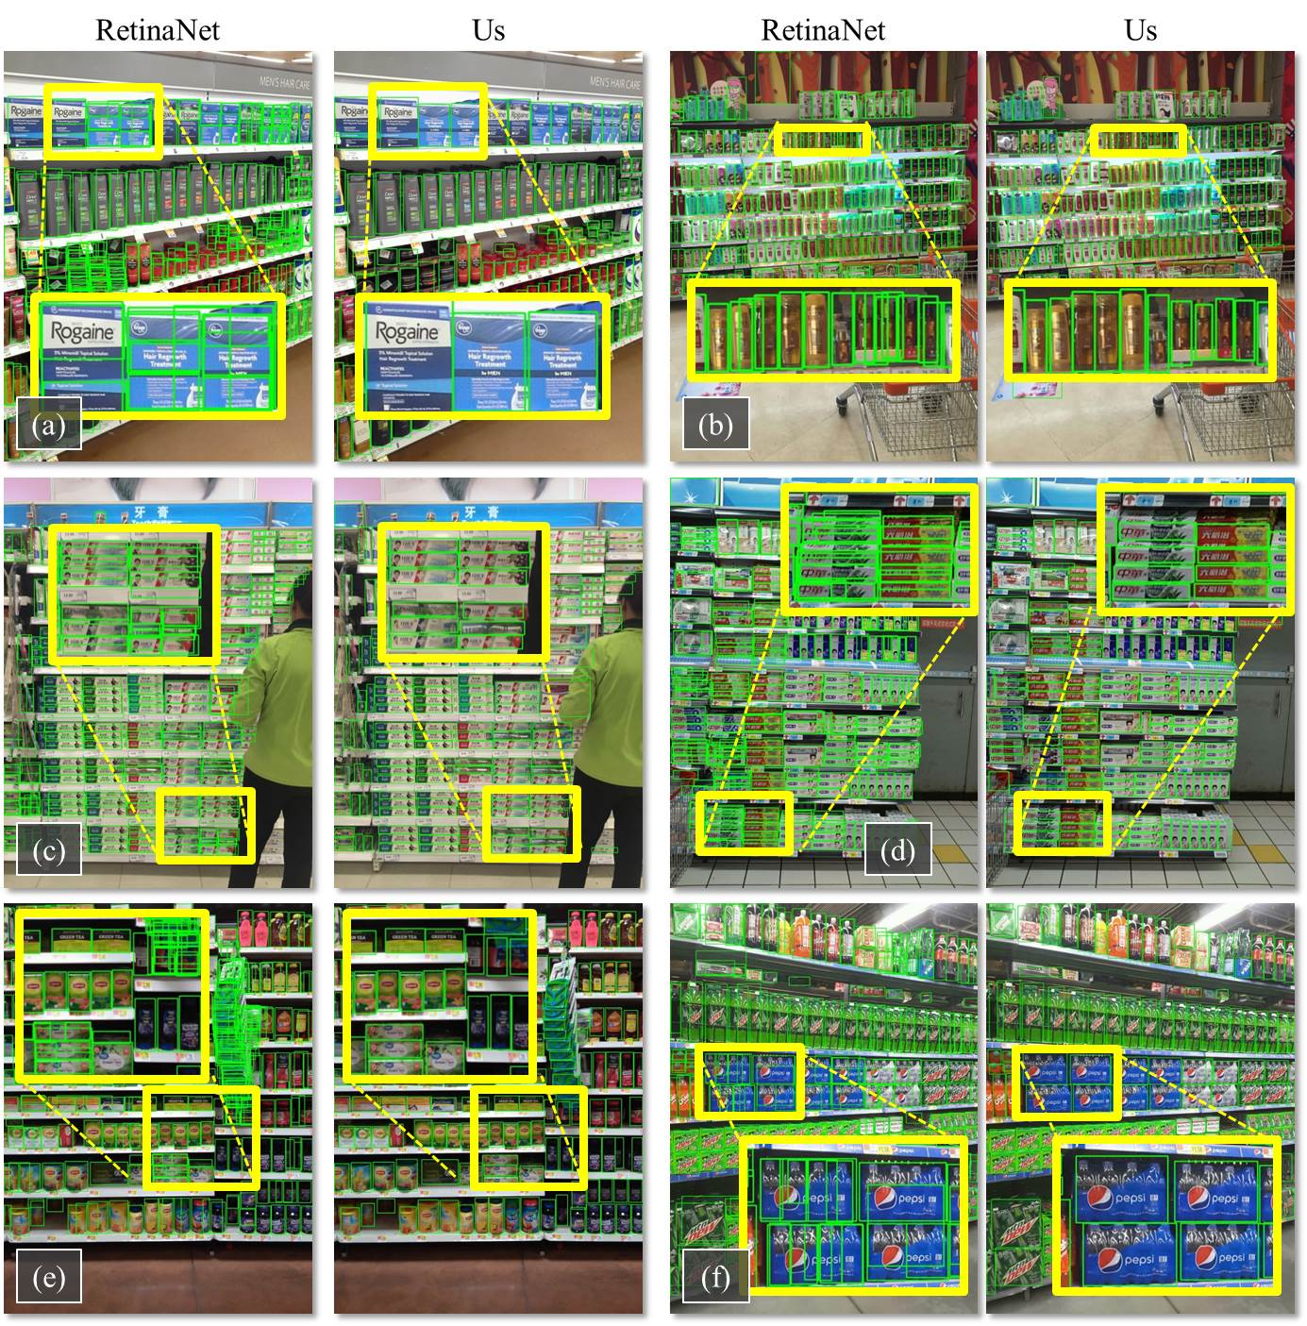
Existing approaches and the gap we address
Approach / work | What it does well | Limitation for this problem
Manual audits | No hardware; staff know the store | Slow, infrequent, error-prone; no time record
Shelf-scanning robots (e.g. Simbe Tally) | Whole-store scans several times a day | High cost; periodic, not continuous
Dense detection: SKU-110K | Finds every pack in crowded shelves | No product identity; single image
Counting: Locount | Localises and counts product groups | Single image; no expected layout
Text matching: Unitail | Reads pack text to match products | Recognition only; no alerts
Planogram compliance (YOLOv8) | YOLOv8 compliance in 7,000+ 7-Eleven stores | Needs a digital planogram; 471 fixed classes
Retail vision platforms (e.g. Everseen) | Store-wide cameras; shelf and loss products | ShelfTwin adds a trusted, verified slot layer
The gap ShelfTwin addresses
Decisions over time, with explicit uncertainty, instead of per-frame alerts.
Works from an approved layout when no digital planogram exists.
Open product catalogue that abstains, and a task loop closed by camera proof.
Dense detection results on real shelves, including a shopper blocking the shelf (panel c).
Detection quality is no longer the bottleneck. Turning detections into trusted actions is.

Slide 6
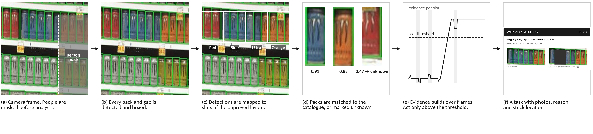
Proposed solution: ShelfTwin pipeline
1. See and clean
2. Detect and map
3. Identify
4. Decide
5. Act and verify
Frames from shelf cameras, CCTV or phone video.
Blur, glare and exposure checks reject bad frames.
A person/cart segmenter builds a visibility mask.
Class-agnostic detector finds packs and gaps.
Shelf edges give a homography to shelf coordinates.
Each detection is assigned to a planogram slot.
Pack crops are embedded (DINOv2, metric-tuned).
k-nearest neighbours in the store catalogue (FAISS).
Low margin between top matches gives 'unknown'.
Per-slot log-odds evidence, weighted by visibility.
Evidence decays; contradicting views subtract.
Outputs: ACT, WAIT or CANNOT SEE.
Ranked task: product, slot, quantity, stock location.
Shown with before/after crops and the reason.
Closes only when clean views show the slot full.
The twin: for every slot we store location, expected product (approved layout version), last trusted observation, state (HEALTHY, LOW, EMPTY, MISPLACED, CANNOT SEE), separate detection / identity / visibility / event confidences, and the full history of state changes linked to the frames that caused them. Any alert can be replayed.

Slide 7
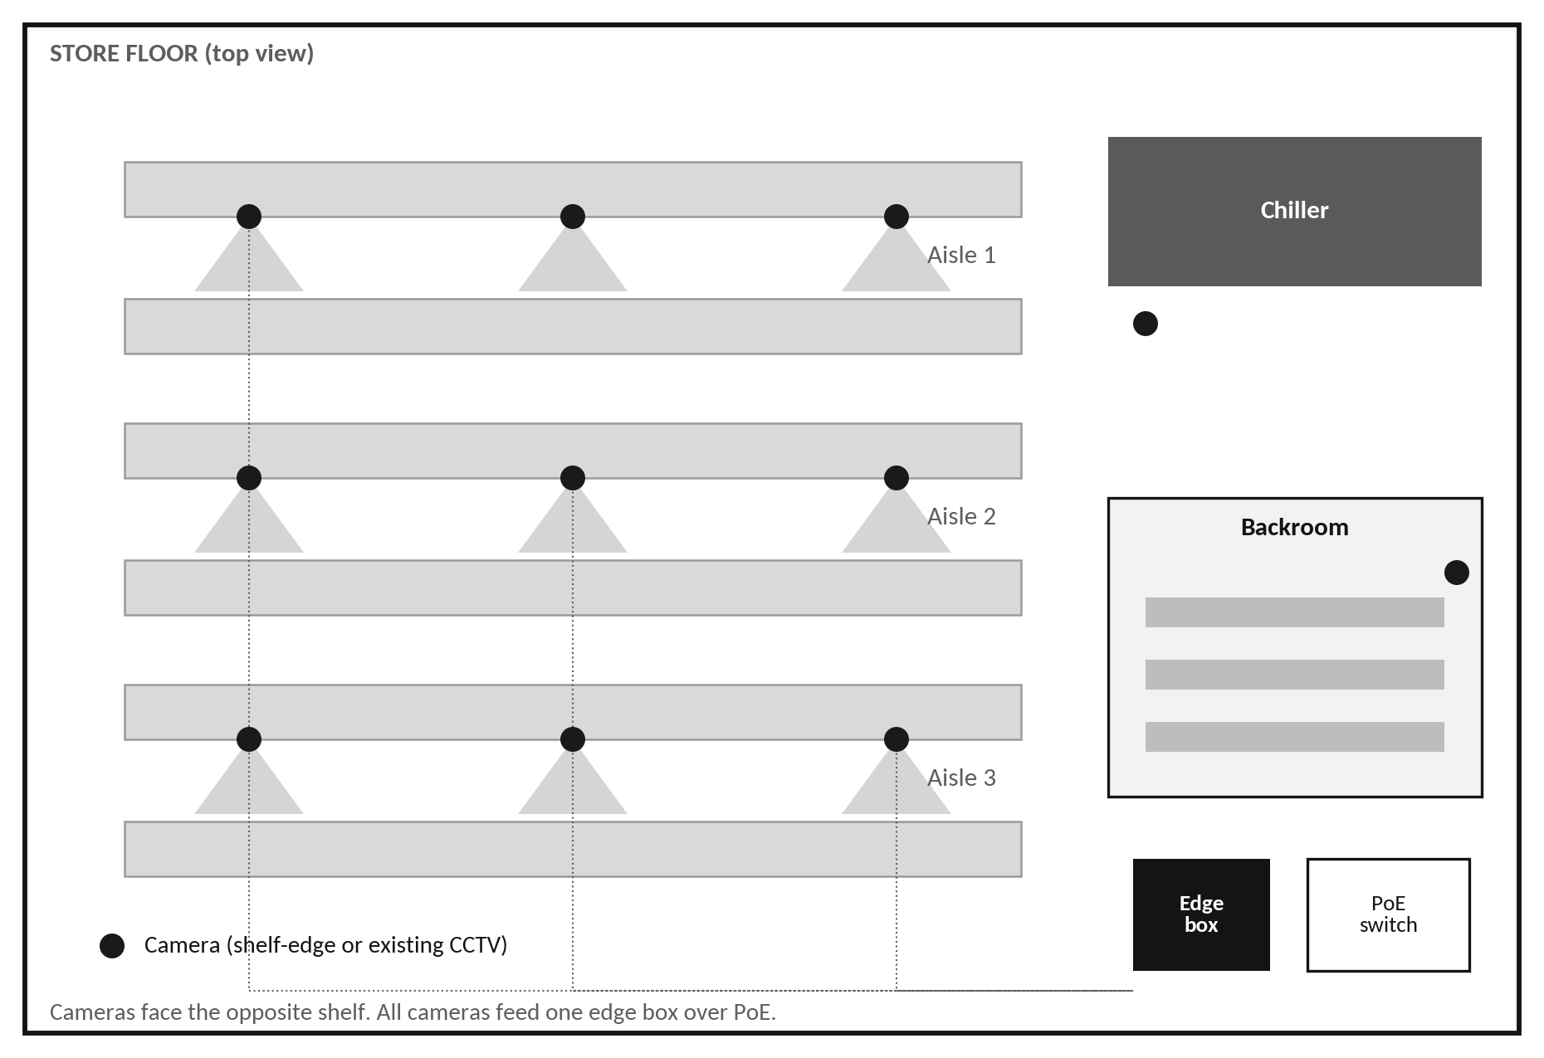
System architecture: components and deployment
Component | Technique / model | Runs on | Rate
Frame capture | RTSP/USB readers; hardware video decode (GStreamer) | Edge box | 0.5-2 fps per camera
Quality and change gate | Laplacian blur, glare ratio, frame differencing per bay | Edge box | Every frame
Visibility mask | Person/cart instance segmentation (YOLO-seg, small) | Edge box | Changed bays
Pack and gap detector | YOLO (n/s), two classes, 2 tiles per 1080p frame | Edge box | Changed bays
Shelf geometry | Shelf-edge lines, homography to shelf cm, slot assignment | Edge box | On camera move
Product identity | DINOv2 ViT-S/14 + ArcFace head; FAISS k-NN; margin test | Edge box | Changed slots
Pack and tag text | PaddleOCR (mobile); barcode reader for shelf tags | Edge box | Ambiguous only
Planogram matcher | Needleman-Wunsch alignment with position cost | Edge box | Per row update
Temporal state engine | Visibility-weighted log-odds, decay, hysteresis | Edge box | Every observation
Task service | Priority ranking, routing, verification, escalation | Edge + cloud | Event-driven
Twin store and replay | PostgreSQL + object store for masked crops | Edge + cloud | Event-driven
Interfaces | Next.js dashboard; staff web app; Telegram/WhatsApp | Cloud + LAN | Real time
Data flow
Cameras stream to one in-store edge box over PoE.
The edge box runs the full pipeline and keeps a local task queue.
Events sync to the cloud twin when the internet is available.
Staff receive tasks on the store Wi-Fi web app or messaging apps.
Models, catalogue and rules are versioned and updated in stages.
Edge box: NVIDIA Jetson Orin-class (Orin Nano Super, 67 sparse INT8 TOPS), models exported to ONNX/TensorRT (FP16/INT8). Video stays in the store; only events and masked crops are sent out.

Slide 8
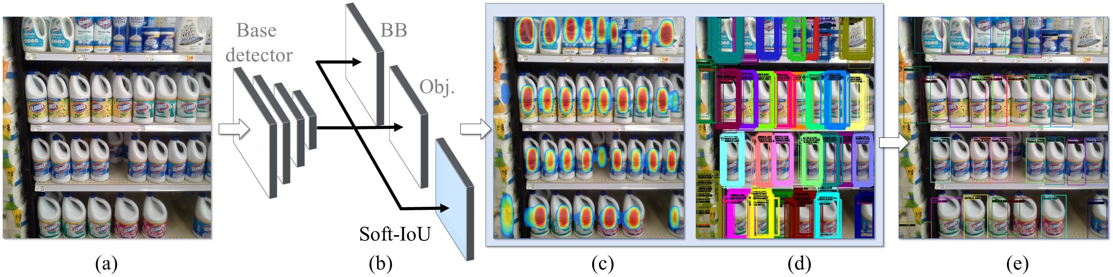
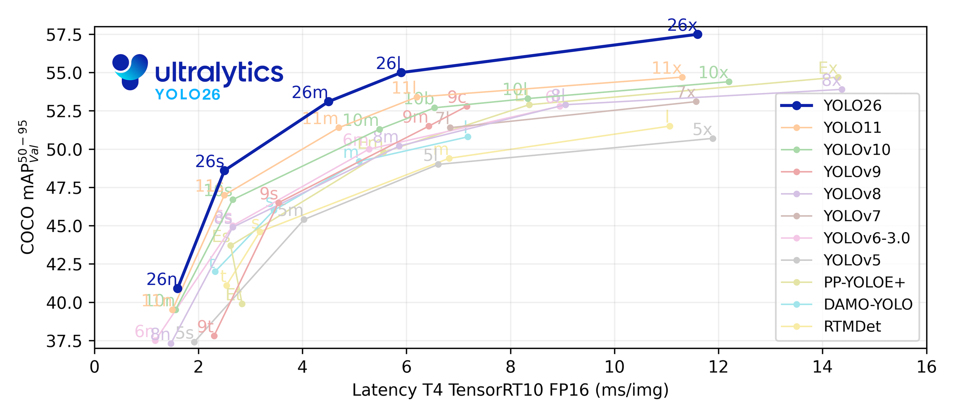
Technique 1: dense pack and gap detection, mapped to shelf slots
Detector design
Class-agnostic 'pack' class plus an explicit 'gap' class (visible shelf back).
Pre-trained on SKU-110K (11,762 images, 147 objects per image on average).
Fine-tuned on our own store footage and rendered shelves.
1080p frames are split into two 640 px tiles so small packs stay detectable.
Soft-NMS / box merging handles tightly packed, overlapping facings.
Dense detection with a Soft-IoU layer and EM-merger to resolve overlapping boxes.
From pixels to slots
Shelf-edge lines are detected per bay.
A homography maps image points to shelf coordinates in centimetres.
Each pack is assigned to a slot by its centre and width.
Slot coverage = share of the slot face covered by packs.
Camera drift is detected by feature matching to a reference frame; alerts pause until recalibration.
Accuracy vs latency of recent YOLO versions (COCO, T4 GPU, TensorRT). We choose small variants for the edge.
Small YOLO models reach 45-48 COCO mAP at about 2-3 ms on a T4 GPU, which leaves headroom for many cameras per edge box.
Occlusion: a person/cart mask gives each slot a visibility score (0-1). Hidden slots are never marked empty; their evidence is down-weighted instead.

Slide 9
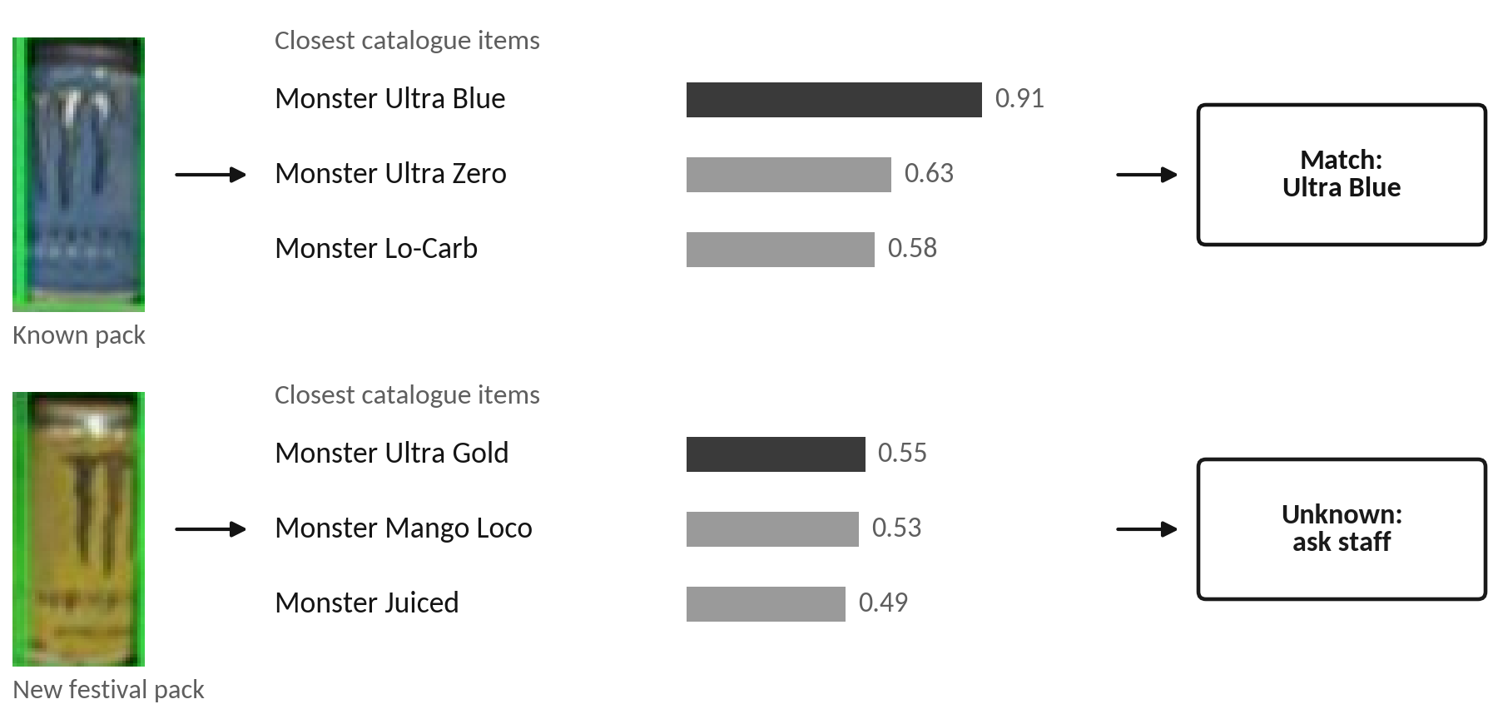
Technique 2: product identity by catalogue retrieval, with abstention
Why retrieval instead of a fixed classifier
Stores add and change products every week. A fixed classifier must be retrained each time.
With retrieval, a new product is one catalogue entry: 3-5 photos and its barcode. No retraining.
Training uses hard negatives from the same brand, so variants are pushed apart in feature space.
Both studio pack shots and shelf crops are used, so the catalogue matches real shelf views.
Real pack crops. Product names and similarity scores are illustrative.
Identity is kept separate from location
Step | Method | Why
Embed | DINOv2 ViT-S/14 backbone + ArcFace metric head | Strong features for fine-grained packs
Search | FAISS inner-product index over the store catalogue | Millisecond k-NN for thousands of SKUs
Decide | Accept if top score ≥ 0.75 and margin to runner-up ≥ 0.15 | Abstain instead of guessing
Tie-break | OCR text overlap: brand, flavour, weight | Separates look-alike variants
Learn | Unknown crops go to an inbox; staff label once | Catalogue grows with use
The expected product of a slot never boosts the match score.
Location consistency is a separate signal used only by the decision step.
Result: a misplaced pack is not 'corrected' into the expected product, so displacement stays visible.
Onboarding a new product: the unknown crop appears in the manager inbox; staff scan the barcode and take 3-5 photos; embeddings are computed and pushed to every store index within a minute.

Slide 10
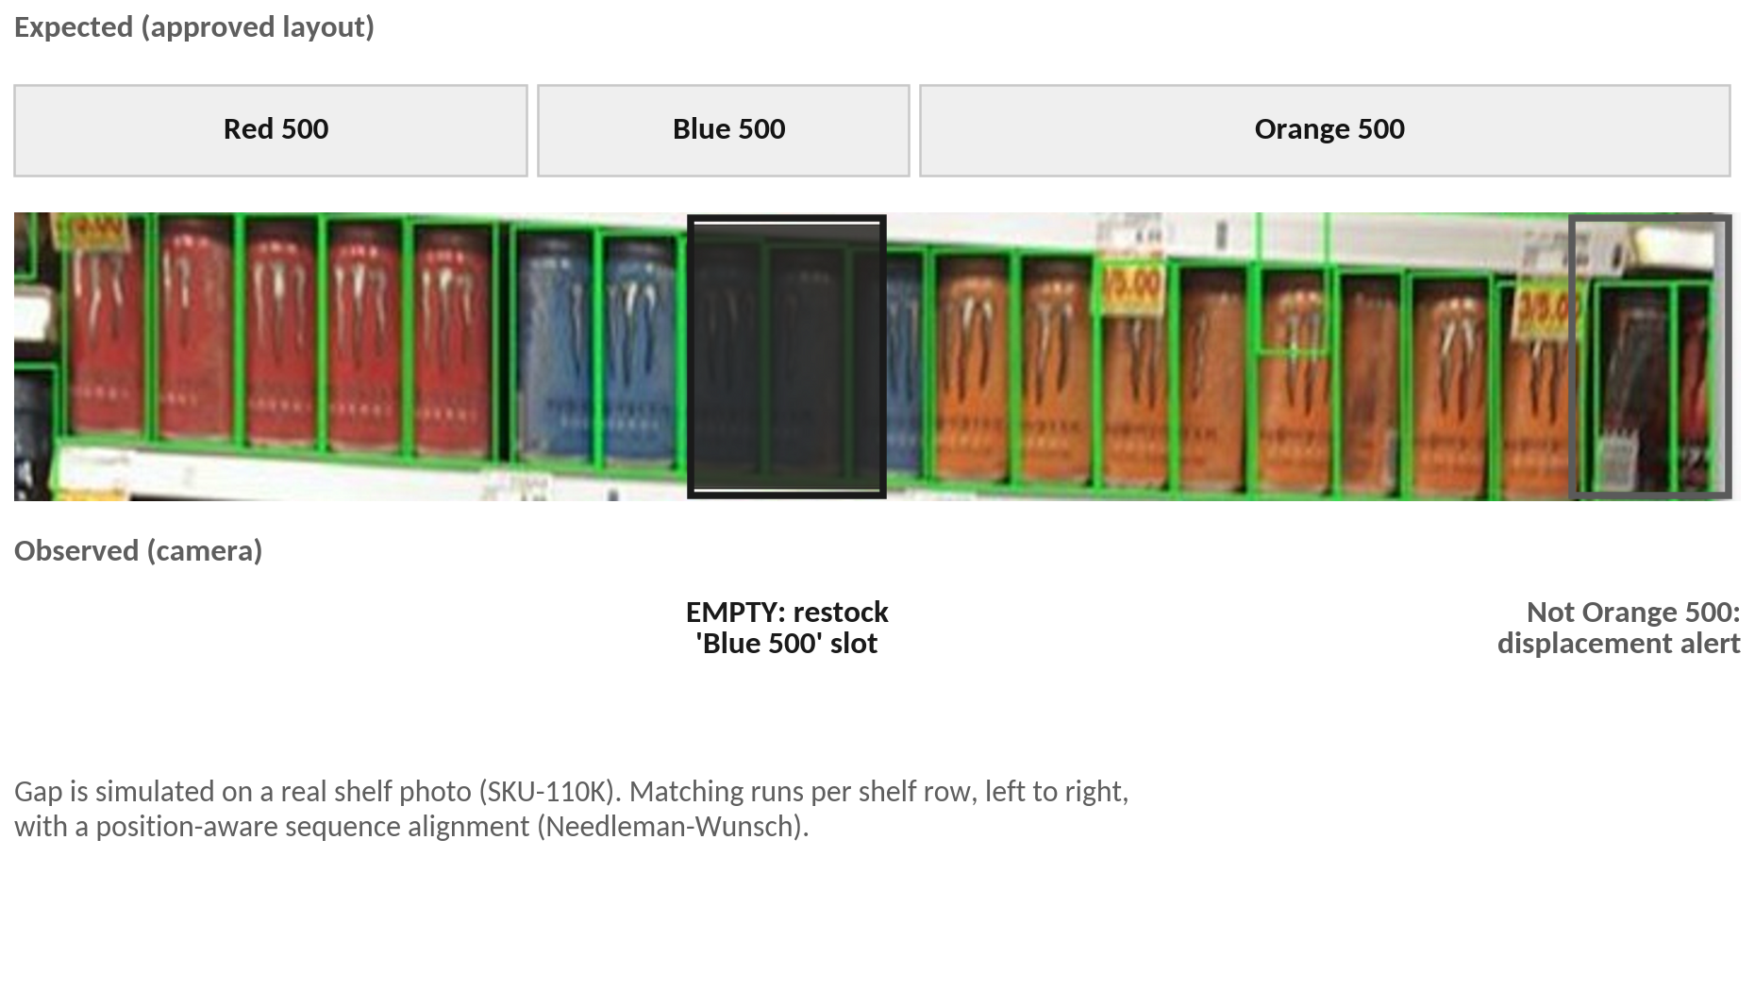
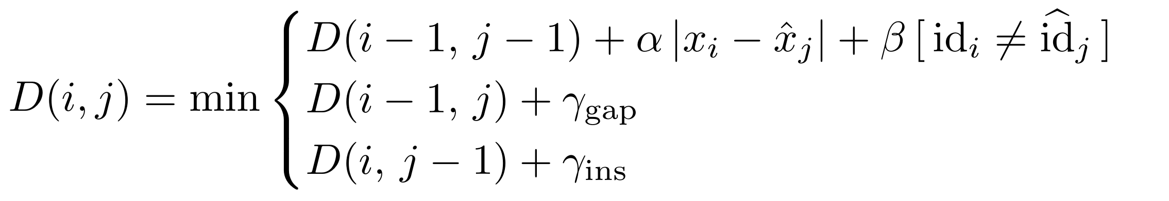
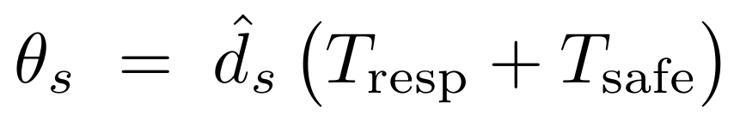
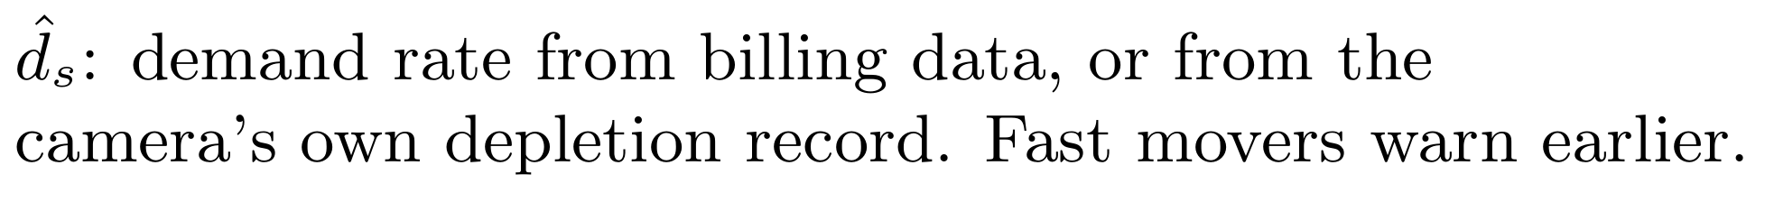
Technique 3: planogram comparison, restock and displacement alerts
Row alignment
Expected slots and observed packs per row are aligned (Needleman-Wunsch).
Each step is a match, gap (restock), substitution (displacement) or insertion (foreign item).
Alert | Trigger | Routed to
Restock: low | Coverage below the slot's threshold | Floor staff, batched per aisle
Restock: empty | No product in the slot | Backroom staff, immediately
Displacement | Product sits in another product's slot | Floor staff
Cold chain | Chilled item seen on an ambient shelf | Floor staff, top priority
Record check | Empty for hours while stock system shows units | Inventory team
Where the expected layout comes from
Imported: the store's planogram file (CSV/JSON: bay, shelf, x, width, SKU, facings).
Drafted: shelf-tag barcodes/OCR plus stable observations over the first days.
Approved: a manager confirms per bay; only approved versions drive alerts.
Observed, draft and approved layouts stay separate, so a messy shelf is never learned as correct.
Many simultaneous mismatches in one bay trigger a single 'layout changed?' question, not dozens of alerts.
Adaptive low-stock threshold

Slide 11
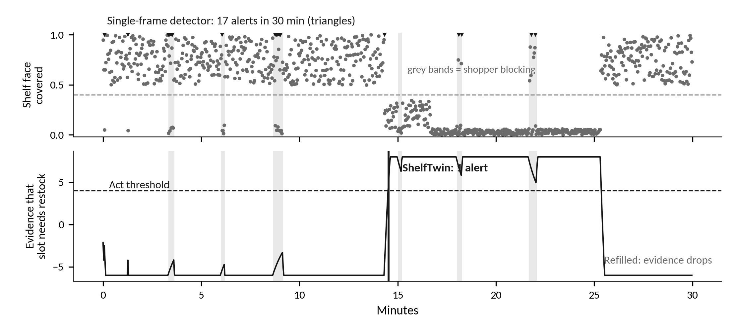
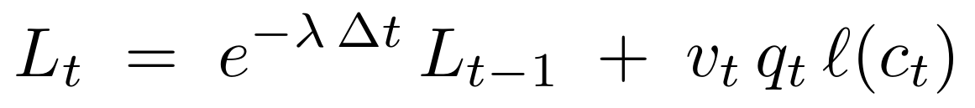
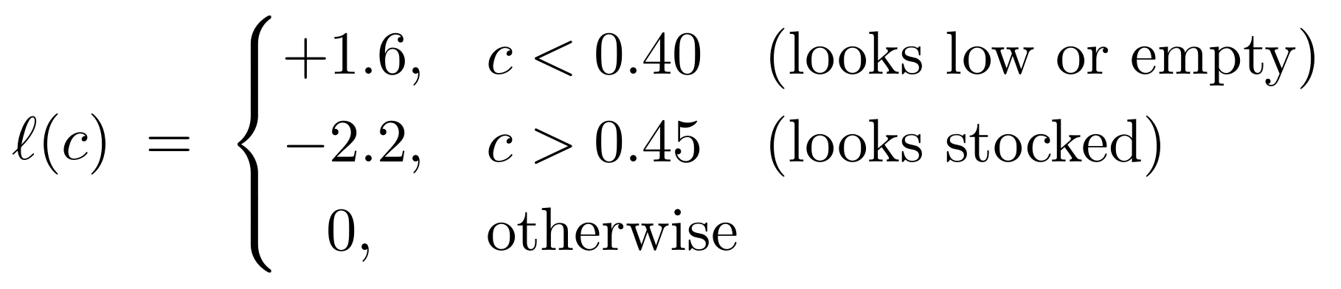
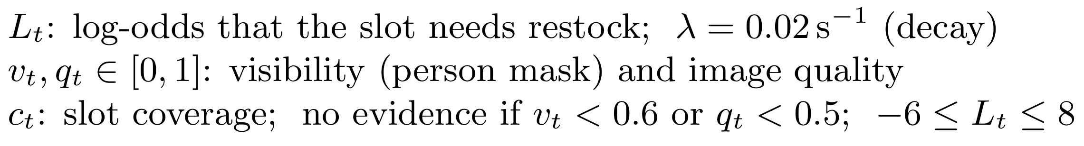
Technique 4: temporal state engine (core contribution)
We treat each slot like a cell in an occupancy grid: every observation adds or removes evidence, weighted by how well the slot was seen.
Rule | Value (starting default)
ACT (open a task) | L ≥ 4.0, about 3 clean confirming views
CLEAR (verify a refill) | L ≤ −1.0 after the task is in progress
Hysteresis | Different enter and exit thresholds stop flicker
CANNOT SEE shown in UI | No clean view for more than 20 s
Evidence cap | −6 ≤ L ≤ 8, so old states can be overturned
Prototype output for one slot over 30 minutes. Top: per-frame coverage; grey bands show a shopper blocking. Bottom: evidence L(t). The single-frame detector alerts 17 times; the engine alerts once, when stock really runs low, and clears after the refill.
Engine output | Meaning | Staff see
ACT | Evidence is solid | A task with photos and reason
WAIT | Change seen, evidence still weak | Nothing yet
CANNOT SEE | Slot blocked or frame unusable | Last trusted state and its age
CLEAR | Slot verified full again | Task marked verified
One confident frame can never trigger a task alone.
Every decision is logged with its inputs, so any alert can be replayed and audited.
Thresholds are tuned per store on recorded footage, not fixed by hand.

Slide 12
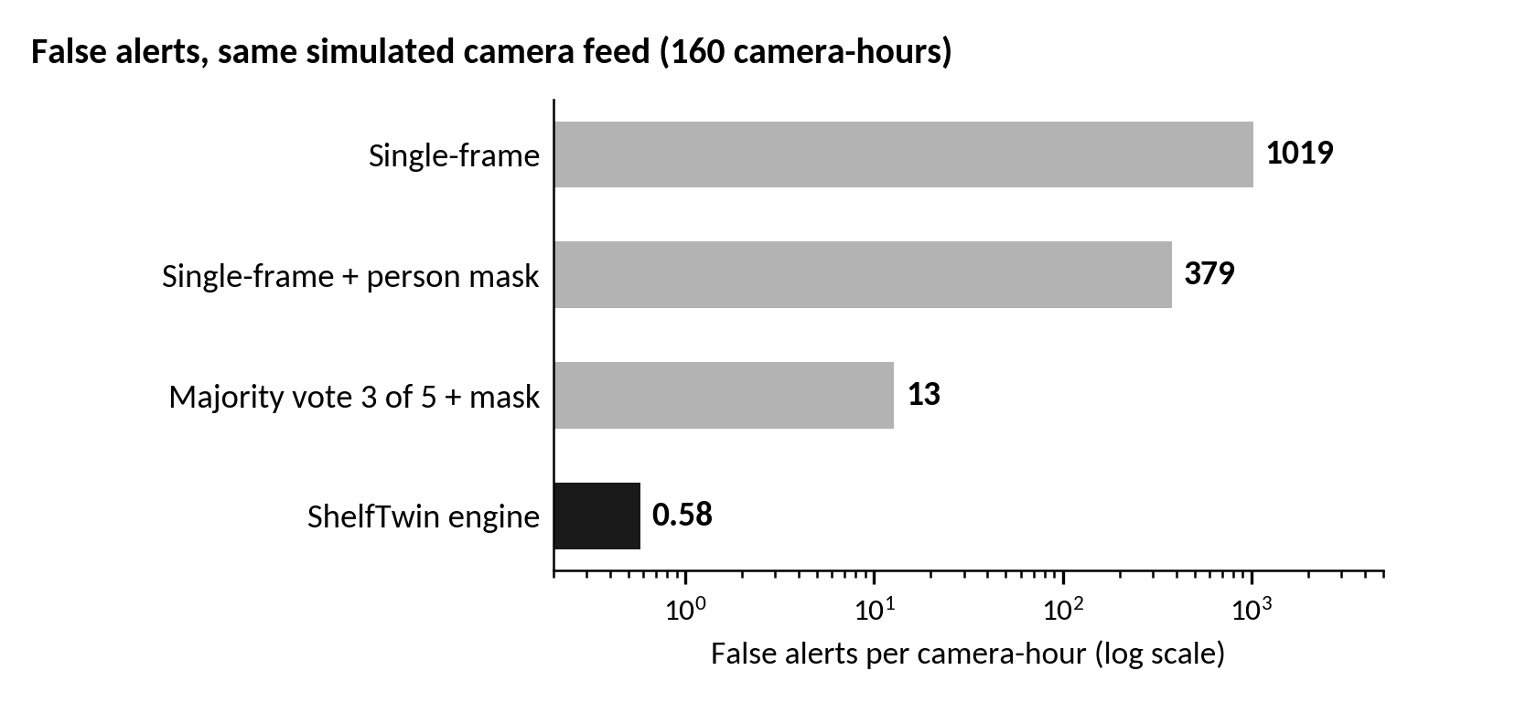
Prototype: temporal engine evaluated against baselines
Decision method | False alerts / camera-hour | Precision | Recall | Median delay | 95th pct delay
Single-frame | 965.86 | 5.2% | 97.5% | 0 s | 0 s
Single-frame + person mask | 376.43 | 12.3% | 99.6% | 0 s | 2 s
Majority vote 3 of 5 + mask | 11.17 | 45.5% | 99.9% | 4 s | 8 s
ShelfTwin engine (spec defaults) | 0.82 | 91.7% | 100% | 12 s | 18 s
ShelfTwin engine (tuned) | 0.12 | 98.6% | 100% | 18 s | 26 s
Same simulated observations for every method: 20 runs x 8 hours, 24 slots per camera, 1,452 true restock events. 'Tuned': parameters chosen on separate simulator seeds (100-109), reported on these seeds.
Prototype code (built)
shelftwin/engine + sim/simulate.py: temporal engine, three baselines and the shelf simulator.
Full pipeline in code: quality gate, YOLO11 pack+gap detector, geometry, DINOv2+ArcFace identity, planogram alignment, tasks, dashboard.
56 automated tests; one Kaggle notebook trains, evaluates and error-analyses every model.
Simulation assumptions
One frame every 2 s; shoppers take 0.5-6 units per slot per hour (Poisson).
Shoppers block each slot about 25 times per hour for 2-30 s; the detector sees a 'gap' 70% of that time.
The person mask misses 5% of blocking events entirely; 1% of clean frames read a false gap (glare).
Staff refill 10-40 minutes after a slot needs restock, identically for every method.
REPOSITORY
github.com/Purv-Kabaria/shelftwin
Scope: these numbers test the decision logic on simulated detector outputs. Trained models on real held-out data: next two slides.
Run: pytest -q · python sim/simulate.py 20. Training logs: kaggle.com/code/purv2k2/notebook77852dc329

Slide 13
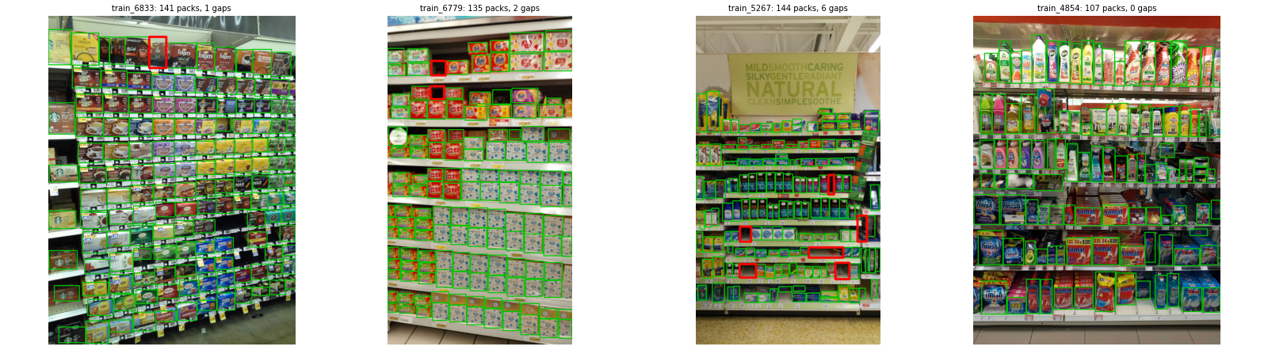
Real data: what the data told us before training
Finding | Measured | Decision it drove
Packs per shelf photo | mean 147, max 718 | Keep up to 1000 detections; YOLO11 with NMS (YOLO26 stops at 300)
Packs under 16 px at the training size | 640 px: 40.7% 896 px: 17.7% 1024 px: 11.7% | Drop 640 px; compare 896 and 1024 px
Photos with a real shelf gap | 88% (5.4 per photo) | Train and test the gap class on real gaps
RP2K product photos | 2,233 SKUs, 381k photos | Open-set split by SKU; cap 40 photos per SKU
Engine false alerts (simulation) | 19 of 19 involve a missed person mask | Improve the person/cart mask first
Real SKU-110K photos (Kaggle run). Green: annotated packs. Red: gaps found by our shelf-row rule; most are real empty spaces, some are structural (shelf ends).
EDA on all 11,689 SKU-110K photos and 381,303 RP2K photos; engine sweep on 4 x 4 h of simulation.
Notes:
Sources: results/kaggle/eda/eda_sku110k.json, eda_rp2k.json, engine_analysis.json in the repo; produced by the public Kaggle notebook https://www.kaggle.com/code/purv2k2/notebook77852dc329.

Slide 14
Trained models: results on held-out real data
pending
pending
pending
pending
Pack detection mAP50
SKU-110K test split (2,920 photos)
Gap recall at 90% precision
real gaps on unseen shelf photos
Product identity Recall@1
SKUs never seen in training (open set)
False alerts: ShelfTwin vs single-frame
end-to-end demo on a real shelf photo
Experiment (subset, short schedule) | Options compared | Winner
Detector: model x resolution x mosaic | YOLO11 n/s; 896 vs 1024 px; mosaic on/off | pending
Gap labels | real gaps only vs + synthetic erasing vs shelf-back fill | pending
Identity: fine-tuning depth | zero-shot vs head only vs last 2 / 4 blocks | pending
End-to-end demo
Every frame runs the full pipeline: quality gate, person mask, trained pack+gap detector, identity, planogram alignment, temporal engine, tasks.
Scripted episode on a real shelf photo: a product runs out, shoppers block the view, glare, two products are swapped, a refill is verified.
Trace and video: results pending (training run in progress).
Each experiment ran on a small subset with a short schedule; winners were picked automatically (decision_*.json) and used for the final training on the full data.
Error analysis per model: misses by pack size and shelf density, counting error, confused SKU pairs, precision vs coverage.
All numbers reproducible from the public Kaggle notebook and the repository.
Notes:
Sources: results/kaggle/final_report.json, exp_detector.json, exp_gap.json, exp_embed.json, embedder/embedder_report.json, e2e_summary.json. Training log: https://www.kaggle.com/code/purv2k2/notebook77852dc329

Slide 15
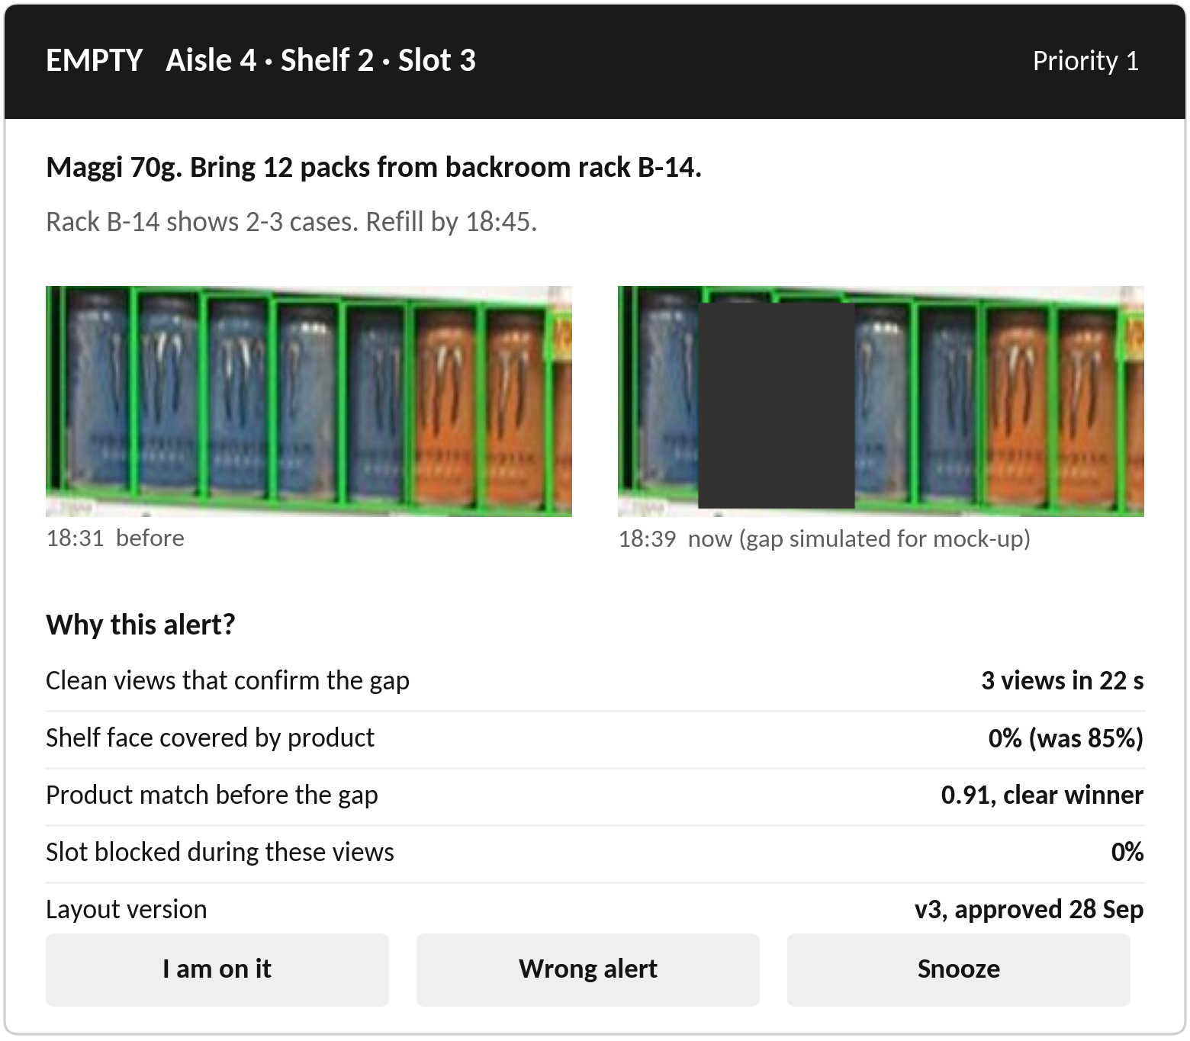
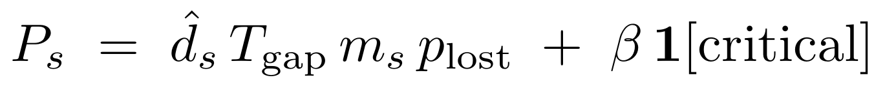
Staff workflow: every alert says what, where, why, and is verified
Task state | Entered when | Leaves when
Open | Engine outputs ACT | Staff tap 'I am on it'
Acknowledged | Staff accept the task | Staff check in at the bay
In progress | Person at bay + app check-in | Staff mark done
Verifying | Staff mark done | Clean views show slot full (CLEAR)
Verified | Camera or photo confirms | Final state; time-to-fix recorded
Reopened | Slot still empty after time limit | Returns to Open with a note
Priority score
Alert-fatigue controls
Design of the staff alert. Real shelf crops; the gap is simulated.
Empty and cold-chain tasks go at once; low-stock tasks batch every 15 minutes per aisle.
Each team has a cap on open tasks; extra tasks queue nearest-first.
'Snooze with reason' (e.g. delivery due at 16:00); unanswered tasks escalate after 10 minutes.
Channels: web app on store Wi-Fi (works offline), Telegram, WhatsApp.
Languages: English, Hindi and Gujarati in the final build.
Feedback: 'Wrong alert' taps become labelled training data.

Slide 16
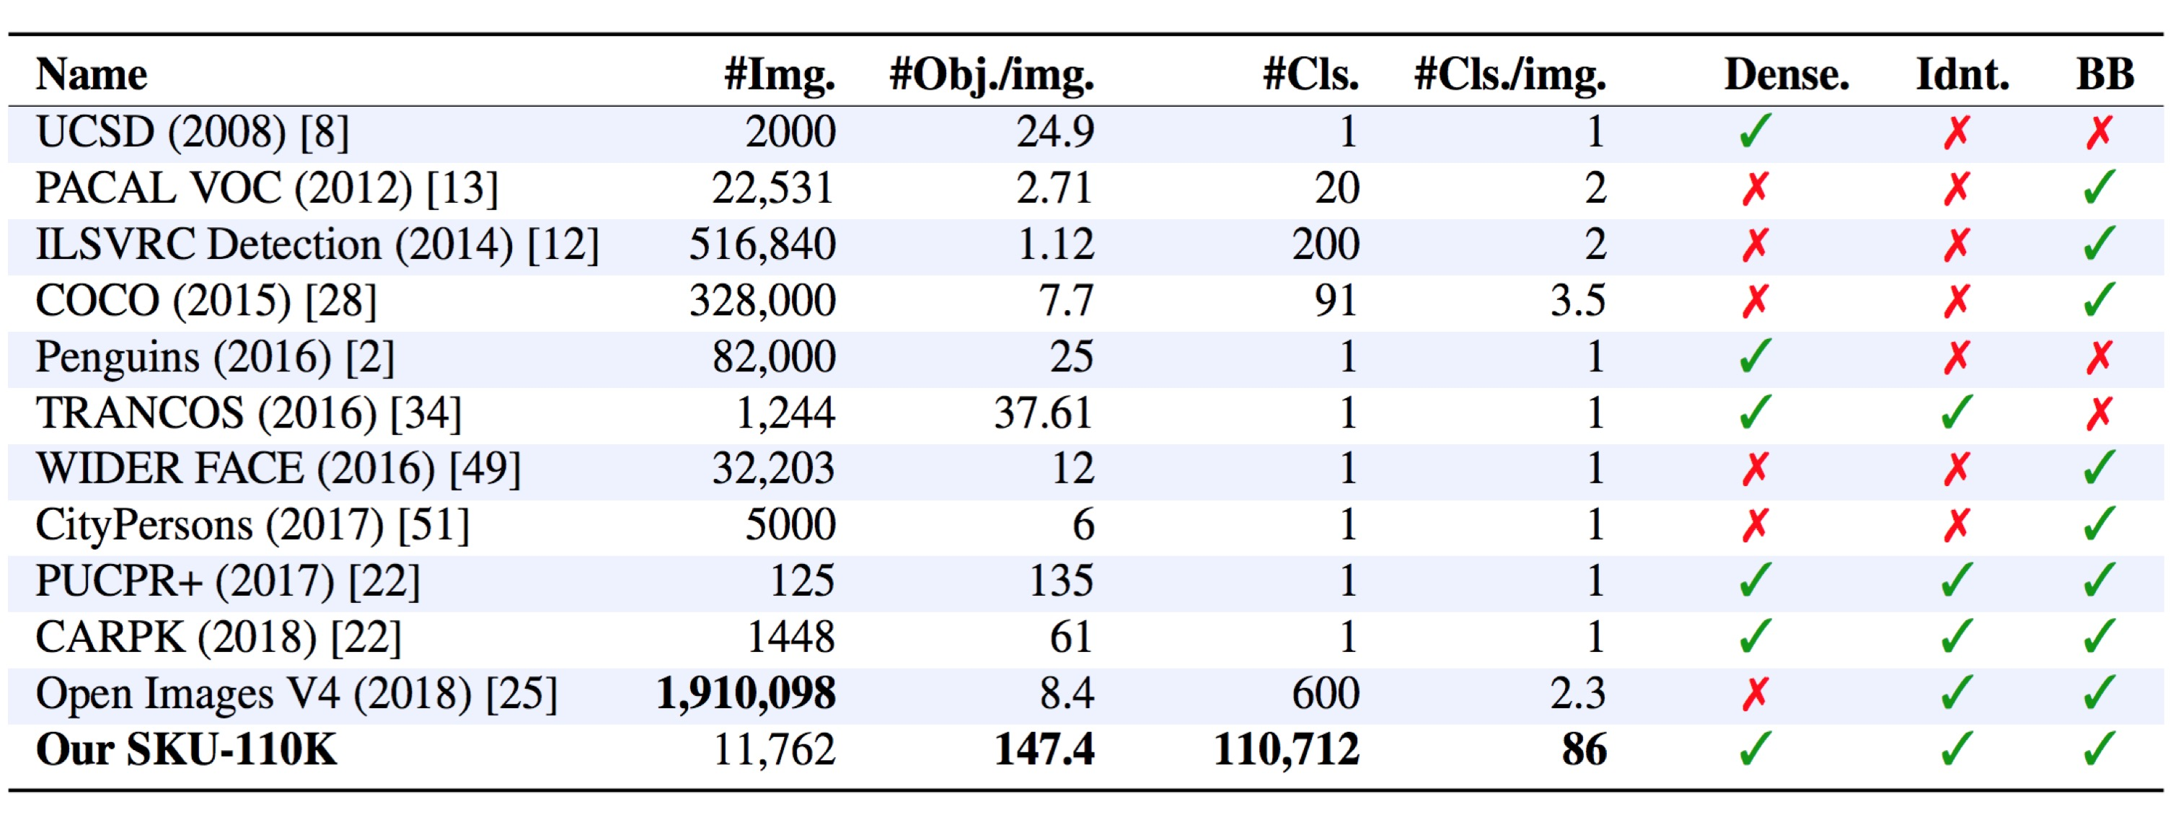
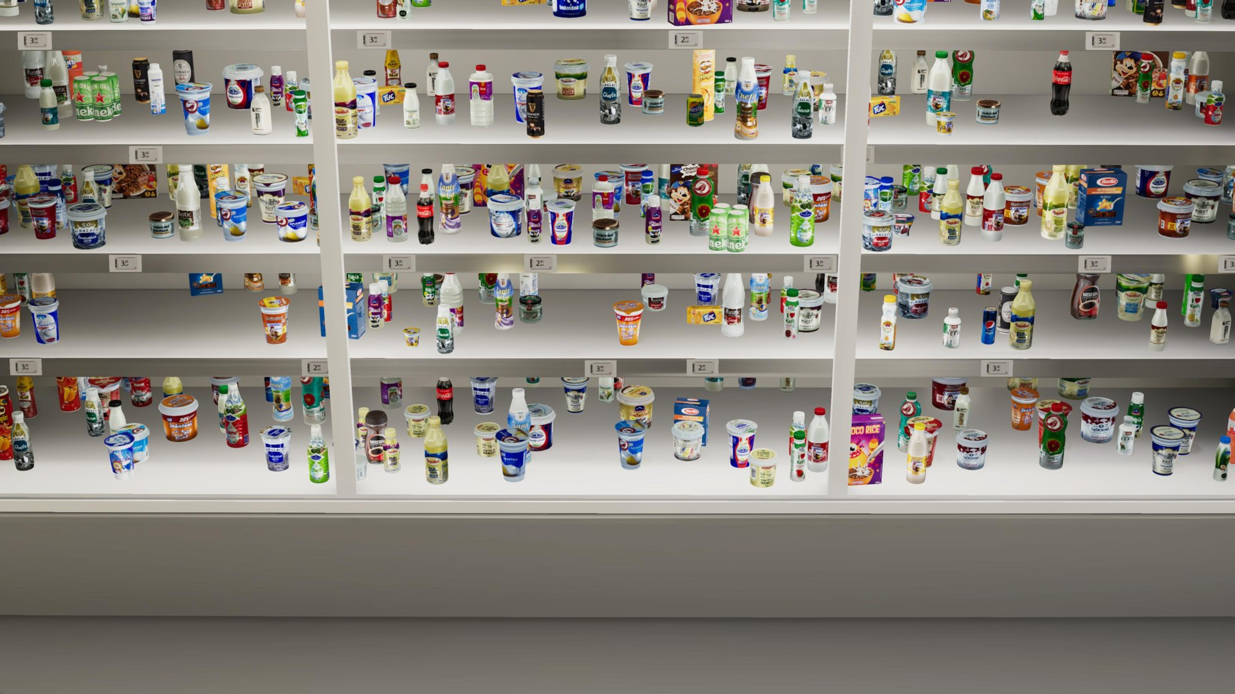
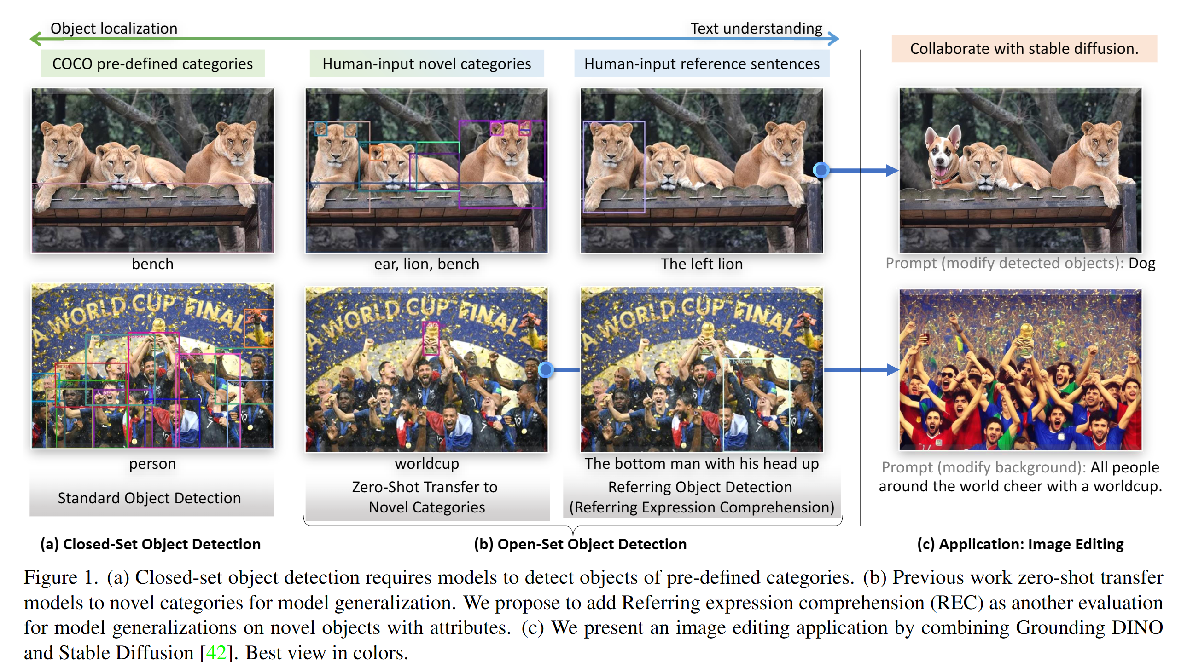
Data strategy: no dependence on organiser-provided data
Source | Content | Used for
SKU-110K | 11,762 dense shelf images, 1.73M boxes | Pack detector pre-training
Locount | 50,394 images, 1.9M instances, 140 classes | Counting and robustness tests
RP2K | 2,388 SKUs, about 500k product crops | Metric learning for identity
Retail-786k | 786k images, 3,298 product groups | Look-alike training pairs
Unitail-OCR | 1,454 products, 30k text regions | Pack text reading
Own store capture | Phone and camera video of local stores, with permission | Fine-tuning, catalogue, test sets
Rendered shelves | Shelves rendered from our pack photos | Rare events: gaps, misplacement, glare
SKU-110K has about 147 objects per image, far denser than COCO (7.7).
Labelling without hand-drawing every box
Left: rendered synthetic shelf. Right: open-set detection by Grounding DINO.
Open-vocabulary teachers (Grounding DINO, SAM 2) propose boxes and masks.
Labels are kept only where two teachers agree; a sample is checked by hand.
Staff feedback ('wrong alert', unknown-pack labels) becomes new training data.
Rendered and edited images are used for training only, never for testing.
Test splits that prevent over-optimism
Seen sessions; unseen days and lighting; unseen stores.
Hard cases: look-alikes, multipacks, old vs new packs, half-hidden packs.

Slide 17
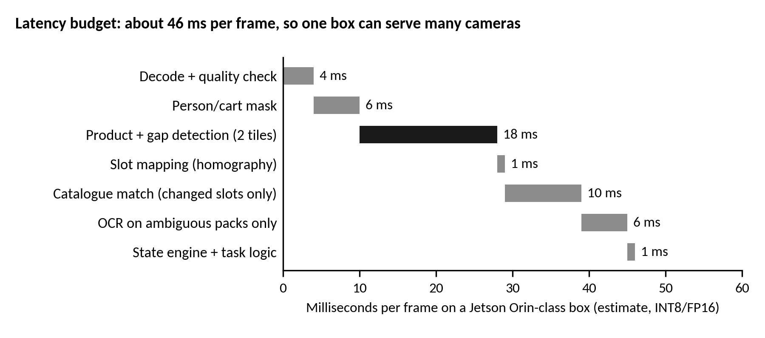
Compute, feasibility and scalability
Feasibility
All models are open-source and proven on edge GPUs (YOLO, DINOv2-S, PaddleOCR mobile).
Works with three camera types; existing CCTV gives bay-level alerts at zero hardware cost.
No planogram, no inventory system and no internet are required to start.
Store set-up: mount cameras, walk each aisle once, approve the drafted layout.
Scalability
Planning estimates for the final build; to be measured on hardware.
Compute scales per store, so head-office cost grows slowly.
One shared product catalogue; each store loads only its own range.
Models, catalogue, layouts and rules are versioned separately, rolled out to 1%, 10%, then all stores, with automatic rollback.
Multi-tenant cloud (row-level security) or private deployment for large chains.
The same twin extends to pharmacies, dark stores and warehouses.
Sizing item | Estimate | Basis
Analysis per frame | about 46 ms | Latency budget above
Box capacity | about 20 frames/s | 1000 ms / 46 ms, with headroom
Cameras per box | 12-20 | 0.5-1 frame/s per camera, change-gated
Upload per store | under 200 MB/day | Events + masked crops only
Local storage | about 1 TB SSD | 72 h replay buffer + crops
Camera type | Detail level | Cost
Existing CCTV | Bay-level gaps | None
Shelf-edge camera | Product-level, real time | Per bay
Phone walk-through | Product-level snapshots | None
Change gating: heavy models run only on bays whose pixels changed, so quiet aisles cost almost nothing.

Slide 18
Costs and return on investment (mid-size Indian supermarket)
Item | Quantity | Unit cost (Rs) | Total (Rs)
Edge GPU box, installed (Jetson Orin class, case, SSD, UPS) | 1 | 45,000-70,000 | 45,000-70,000
Shelf-edge camera, installed (incl. cabling, mount) | 20 | 6,000-12,000 | 1.2-2.4 lakh
PoE switch and network work | 1 | 20,000-35,000 | 20,000-35,000
Existing CCTV reuse | - | 0 | 0
One-time hardware |  |  | about 1.9-3.5 lakh
Cloud twin, storage, messaging | per year |  | 15,000-30,000
Software subscription and support | per year |  | 1-2 lakh
Maintenance (10-15% of hardware) | per year |  | 20,000-50,000
Worked example
 | Value
Store revenue | Rs 10 crore / year
Lost to out-of-stocks (3-4%) | Rs 30-40 lakh / year
Recovered (assume 25-50%) | Rs 7.5-20 lakh / year
Gross margin 20-25% | Rs 1.5-5 lakh profit / year
Plus staff hours saved | Audits replaced by tasks
Payback | about 6-24 months
Recovery share is an assumption. Vendor case studies report on-shelf availability gains of 25-60%, which a pilot must confirm for Indian stores.
Planning estimates; to be confirmed with supplier quotes. Phone-only and CCTV-only modes need no new hardware.
Cost levers
Other value
Shelf cameras only on the 20-30% of bays that carry most sales; CCTV or phones elsewhere.
Change gating lets one box serve more cameras.
Hardware can be leased inside the subscription to remove upfront cost.
Accurate shelf data improves ordering.
Fewer price and placement errors.
Brand compliance data with consent.

Slide 19
Privacy, security and limitations
Privacy by design
Security
What version 1 does not claim
Continuous video never leaves the store.
People, hands, phones and badges are masked in every saved crop.
No face recognition, no re-identification, no tracking of people.
Crops kept 30 days by default; replay frames 72 hours.
Staff metrics are team-level, not individual.
Each deployment is reviewed under India's DPDP Act 2023 and Rules 2025.
Edge box makes outbound connections only; no open ports.
Mutual TLS between store and cloud; per-device certificates.
Signed model and software updates; secure boot.
Encrypted disks; role-based access; every crop view logged.
Camera network isolated on its own VLAN.
Exact unit counts or store-wide inventory.
Automatic planogram changes or ordering.
Perfect separation of near-identical packs (it abstains).
Product-level identity from wide ceiling CCTV.
Camera depletion is not called 'sales' without billing data.
Data | Leaves the store? | Retention | Who can see it
Live video | No | Seconds (memory only) | Nobody
Replay frames (people masked) | No | 72 hours | Store admin, on request
Slot crops (people masked) | Yes, with events | 30 days | Store and HQ roles
Event and task records | Yes | Configurable | Store and HQ roles
Model and system telemetry | Yes | 90 days | Operations team

Slide 20
Prototype status and the planned final build
Module | In the prototype now | Planned for the final build
Temporal state engine | Built and tested; tuned on held-out simulator seeds | Tuned on real footage; per-store thresholds
Baselines and simulator | Built, with false-alert error analysis | Extended with recorded real detections
Pack and gap detector | Built: YOLO11 training on SKU-110K (Kaggle); gap labels from shelf geometry | Fine-tune on Indian-store footage; TensorRT on edge
Visibility mask | Built with a pretrained person segmenter | Fine-tune for carts and baskets
Product identity | Built: DINOv2 + ArcFace training on RP2K; FAISS; abstention | Indian pack catalogue (3-5 photos per SKU); OCR tie-break
Planogram matcher | Built and tested (row alignment, layout guard) | Layout drafting from shelf tags; approval flow
Alerts and tasks | Built: priority, batching, escalation, camera verification; Telegram; en/hi/gu | Staff mobile app, WhatsApp channel
Twin dashboard | Built: live slot view, tasks, alert replay | Store-wide, multi-camera view
Backroom routing | Rack location carried in every task | Rack camera; pick location from stock
Time-to-empty | Built: Gamma-Poisson estimate with a range | Use billing data when connected
Final build: what it will show
A shelf with 60-80 real Indian SKUs and 3-4 cameras.
Shoppers block views; the baseline raises false alerts while ShelfTwin waits.
A real low-stock alert in Hindi names the backroom rack.
A refill is verified by the camera and the task closes.
An unseen pack is flagged 'unknown' and added in a minute.
Measures we will report
Alert precision and recall per episode.
False alerts per camera-hour.
Detection and notification delay.
Correct 'unknown' rate on new packs.
Cameras per box at full speed.
Main risks and mitigation
Look-alike packs: abstain and ask staff.
Low-resolution CCTV: bay-level alerts only.
Camera moved: drift check pauses alerts.

Slide 21
References
[1] T. W. Gruen, D. S. Corsten, S. Bharadwaj. Retail Out-of-Stocks: A Worldwide Examination of Extent, Causes and Consumer Responses. Grocery Manufacturers of America, 2002.
[2] D. Corsten, T. Gruen. Desperately seeking shelf availability: an examination of the extent, the causes, and the efforts to address retail out-of-stocks. IJRDM 31(12), 2003.
[3] E. Goldman, R. Herzig, A. Eisenschtat, J. Goldberger, T. Hassner. Precise Detection in Densely Packed Scenes (SKU-110K). CVPR 2019.
[4] Y. Cai et al. Rethinking Object Detection in Retail Stores (Locount). AAAI 2021.
[5] F. Chen et al. Unitail: Detecting, Reading, and Matching in Retail Scene. ECCV 2022.
[6] J. Peng, C. Xiao, Y. Li. RP2K: A Large-Scale Retail Product Dataset for Fine-Grained Image Classification. arXiv:2006.12634, 2020.
[7] B. Lamm, J. Keuper. Retail-786k: a Large-Scale Dataset for Visual Entity Matching. arXiv:2309.17164, 2023.
[8] T.-Y. Ou, A. Ponce, C. Lee, A. Wu. Real-time retail planogram compliance application using computer vision and virtual shelves. Scientific Reports 15, 43898, 2025.
[9] M. Oquab et al. DINOv2: Learning Robust Visual Features without Supervision. TMLR, 2024.
[10] G. Jocher et al. Ultralytics YOLO (YOLOv8, YOLO11, YOLO26). Software and benchmarks, github.com/ultralytics/ultralytics.
[11] J. Deng, J. Guo, N. Xue, S. Zafeiriou. ArcFace: Additive Angular Margin Loss for Deep Face Recognition. CVPR 2019.
[12] J. Johnson, M. Douze, H. Jegou. Billion-scale similarity search with GPUs (FAISS). IEEE Trans. Big Data, 2019.
[13] S. B. Needleman, C. D. Wunsch. A general method applicable to the search for similarities in the amino acid sequence of two proteins. J. Mol. Biol. 48(3), 1970.
[14] H. Moravec, A. Elfes. High resolution maps from wide angle sonar. IEEE ICRA, 1985.
[15] S. Liu et al. Grounding DINO: Marrying DINO with Grounded Pre-Training for Open-Set Object Detection. ECCV 2024.
[16] Y. Du et al. PP-OCR: A Practical Ultra Lightweight OCR System. arXiv:2009.09941, 2020 (PaddleOCR).
[17] Neurolabs. CPGDet-129: Synthetic Dataset for Object Detection in Retail. github.com/neurolaboratories/reshelf-detection, 2022.
[18] M. Denninger et al. BlenderProc2: A Procedural Pipeline for Photorealistic Rendering. JOSS 8(82), 2023.
[19] NVIDIA. Jetson Orin Nano Developer Kit Gets a Super Boost. NVIDIA Technical Blog, December 2024.
[20] N. Ravi et al. SAM 2: Segment Anything in Images and Videos. arXiv:2408.00714, 2024.
[21] Simbe Robotics. Wakefern Food Corp. customer story (on-shelf availability results). simberobotics.com, accessed 2026.
[22] Everseen. Evershelf product page; Everseen expanded product suite incl. Everstock (press release, Jan 2023).
[23] Ministry of Electronics and IT, Government of India. Digital Personal Data Protection Rules, 2025 (notified November 2025).

