Slide 1
BOBATHON · HACKATHON PROJECT
TrialGuard
Clinical Trial Risk Monitor &
Protocol Deviation Detector
Team: Trial Guardians
Members: Devarsh Patel , Yug Joshi , Tirtha Parsana , jia Parikh
HIGH
MEDIUM
LOW
Demo only — synthetic data. Not for clinical decision-making. Not FDA/EMA approved.
Notes:
TrialGuard is a hackathon proof-of-concept that detects protocol deviations in clinical-trial visit records, scores site risk, raises early warnings and drafts rule-based CAPA reports. Replace [TEAM NAME] and [TEAM MEMBERS]. Everything shown uses synthetic data.

Slide 2
01 · PROBLEM
The Problem
1
Deviations happen at trial sites
Individual deviations
Missed or late visits, wrong doses, prohibited medications.
One late visit, one wrong dose
2
Individual deviations are hard to prioritise
They arrive as a long list of separate errors.
Repeated patterns
Same issue across several patients
3
Repeats point to site-level problems
The same issue across patients suggests a process gap.
Site-level risk
4
Rising deviations are an early warning
The site needs attention
A worsening trend can be caught before risk becomes severe.
5
Monitors need a simple focus
Early warning
Which sites need attention first — and why?
Act before it becomes severe
TrialGuard · Hackathon proof-of-concept · Synthetic data only
2 / 7
Notes:
Problem framing is qualitative — the repository contains no verified real-world statistics, so none are shown. The key idea: single deviations are hard to prioritise; repeated patterns and rising trends are what reveal a site-level problem.

Slide 3
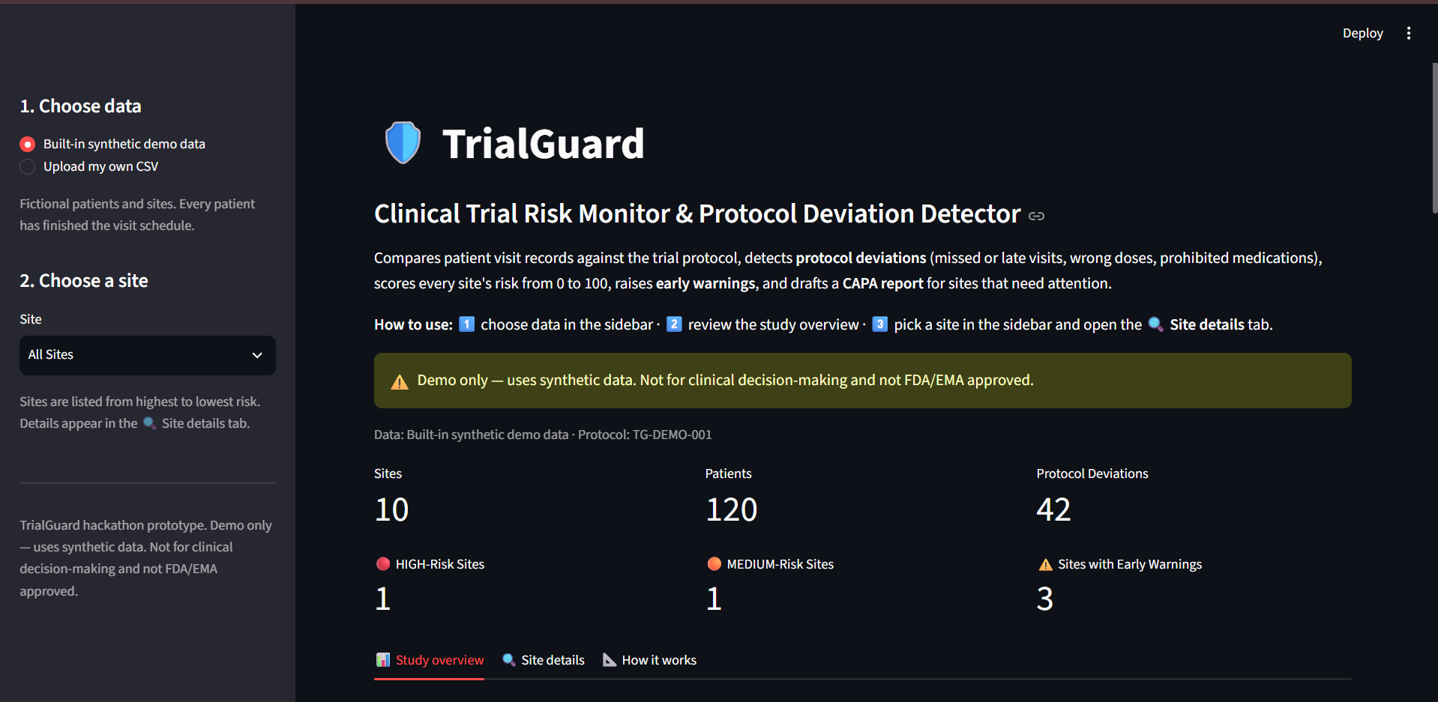
02 · SOLUTION
Our Solution — TrialGuard
Prototype uses synthetic clinical-trial data
CSV / Trial Data
Deviation Detection
Severity
Risk Score
Early Warnings
CAPA
Dashboard
demo or uploaded CSV
5 rule types
Major · Minor · Admin
0–100 per site
patterns & trends
rule-based actions
Streamlit + Plotly
TrialGuard combines
1
Protocol deviation detection
SCREENSHOT PLACEHOLDER
2
Severity classification
Insert a real screenshot of the running TrialGuard dashboard here
(for example, the Study overview tab) and delete this box.
3
Site-level risk scoring
4
Early-warning detection
5
Rule-based CAPA recommendations
TrialGuard · Hackathon proof-of-concept · Synthetic data only
3 / 7
Notes:
TrialGuard is one transparent pipeline: validated CSV input, five deviation rules, severity, a 0–100 site risk score, early warnings and rule-based CAPA recommendations, shown in a Streamlit + Plotly dashboard. Replace the dashed placeholder with a real screenshot of the running app.

Slide 4
03 · HOW IT WORKS
How TrialGuard Works
User
Streamlit Dashboard
Data Loader & Validation
Deviation Detector
Severity Classifier
web browser
src/app.py
utils/data_loader.py
core/deviation_detector.py
core/severity.py
Rule-based
Transparent
Explainable
Dashboard / Markdown Report
CAPA Generator
Early Warning Engine
Risk Scoring
app.py + charts.py
core/capa_generator.py
core/early_warning.py
core/risk_scoring.py
Deviation types detected
Missed visits
Out-of-window visits
Wrong dose
Prohibited medications
Missing documentation
No record, or a blank visit day
Outside the day window; severity by days
Dose differs from the 10 mg protocol dose
DrugB or DrugC recorded
Blank dose or medication
Major
Admin → Minor → Major
Major
Major
Administrative
TrialGuard · Hackathon proof-of-concept · Synthetic data only
4 / 7
Notes:
Each box is a separate Python module. app.py only displays results; all rules live in src/core and thresholds in config.py. The dashboard passes the selected site's results to the CAPA generator, which returns a Markdown report.

Slide 5
04 · RESULTS
From Deviations to Site Risk
Actual results on synthetic demo data
SITE-104
HIGH
SITE-107
MEDIUM
68 / 100
52 / 100
14 deviations
15 deviations
SITE-105
LOW
SITE-110
LOW
0 / 100
0 / 100
0 deviations
0 deviations
Risk levels
HIGH 61–100
MEDIUM 31–60
LOW 0–30
Score = risk points per patient ÷ 25 × 100 (max 100)
TrialGuard · Hackathon proof-of-concept · Synthetic data only
5 / 7
Notes:
Actual output on the synthetic demo data (10 sites, 120 patients, 42 deviations). SITE-104 and SITE-107 were deliberately planted problem sites; SITE-105 and SITE-110 have no deviations. Across all sites: 1 HIGH, 1 MEDIUM, 8 LOW. These results show the planted problems are found; they are not real-world accuracy results.

Slide 6
05 · ACTION
From Detection to Action
SITE-104
14 deviations · 11 of 12 patients affected · CAPA items abridged from the generated report
HIGH · 68/100
Early warnings
C
Corrective
P
Preventive
Repeated dosing errors
Verify recent dosing records
Review dose calculation procedures
Review medication reconciliation
Retrain relevant site staff if required
Add second-person dosing verification
Add automated dose validation
Periodic medication review
Periodic site-level deviation review
!
!
Repeated prohibited medications
!
Increasing deviation trend
Unusually high deviation rate
Monitoring: Prompt enhanced monitoring/review
!
Prototype recommendations, not regulatory advice.
Demo only — synthetic data.
TrialGuard · Hackathon proof-of-concept · Synthetic data only
6 / 7
Notes:
SITE-104's four early warnings come from the early-warning module. The CAPA items are abridged from the report the app generates for SITE-104, using fixed, editable lookup tables — no AI model writes them. They are prototype recommendations, not regulatory advice.

Slide 7
06 · WRAP-UP
Technology, Impact & Future Scope
Technology
IBM Bob integration
Python
pandas
Streamlit
Plotly
CSV / JSON
pytest · 334 tests
Not used in this implementation.
Impact
Limitations
Future scope
Helps prioritise sites for monitoring
Highlights emerging trends
Makes deviation patterns easier to understand
Turns detected risk into actionable prototype recommendations
Reproducible proof-of-concept on synthetic data
Synthetic data only
Not clinically validated
Not FDA/EMA approved
Rule-based recommendations
No real patient data
Local prototype deployment
Real clinical data integrations
More sophisticated trend detection
Production authentication and database
Validated clinical / regulatory workflows
Optional AI-assisted analysis
TrialGuard · Hackathon proof-of-concept · Synthetic data only
7 / 7
Notes:
Built with Python, pandas, Streamlit, Plotly, CSV/JSON data and pytest (334 automated tests). IBM Bob is not used in this implementation — stated plainly. Future scope items are ideas, not implemented features.

