Slide 1
EDSR
Enhanced Deep Residual Networks for Single Image Super-Resolution
-PURVA CHINIYA
EED,IIT Roorkee

Slide 2
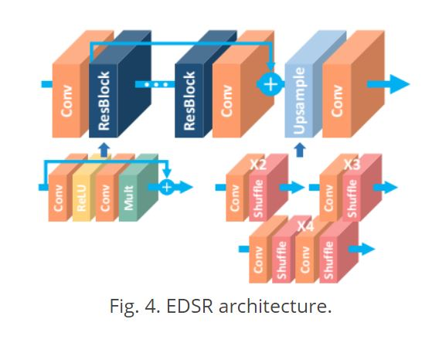
EDSR ARCHITECTURE

Slide 3
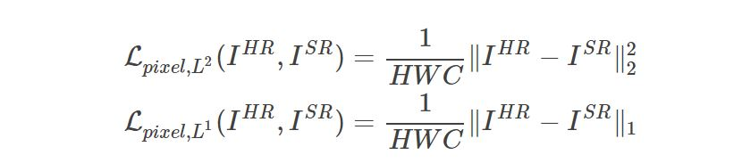
PIXEL LOSS

Slide 4
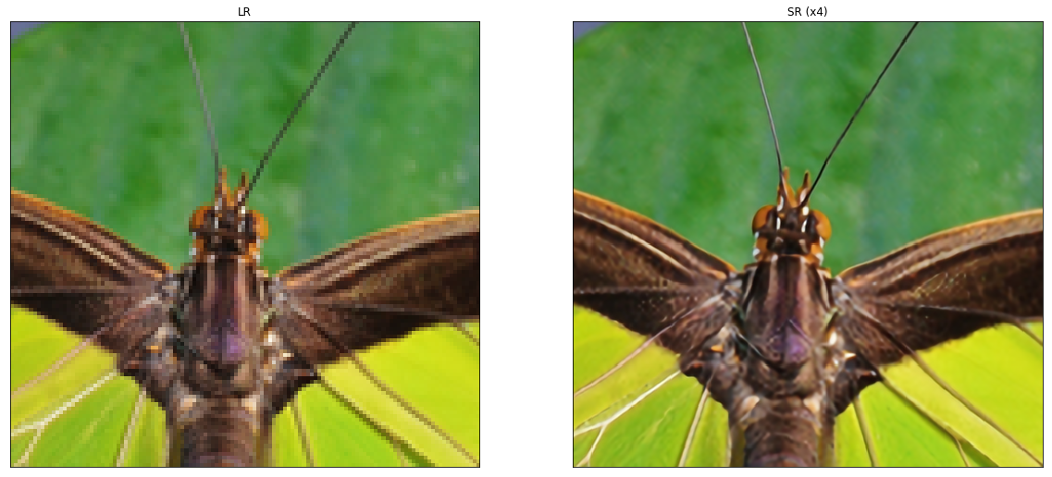
RESULTS

Slide 5
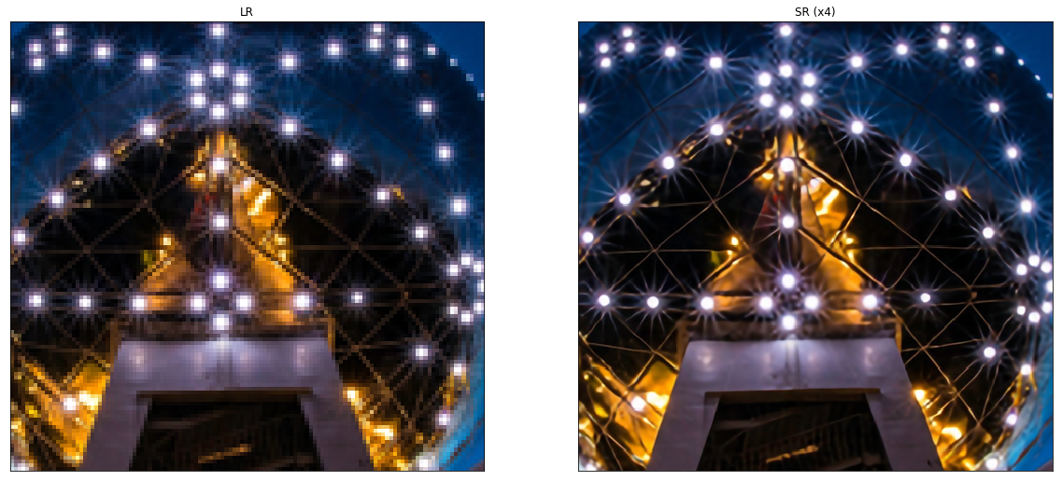

Slide 6
