Slide 1
Generative Adversarial Networks
^{To}
^{Prof. Sithu Aung}
^{By}
^{Sahana Alliyandiru Jayasheela}
^{Purva Deekshit}
^{Anusha Velumani}
^{Sachin Guruswamy}
^{Nikhil Saunshi}

Slide 2



^{Introduction}
• Generative • Learn a generative model
• Adversarial • Trained in an adversarial setting
• Networks • Use Deep Neural Networks

Slide 3





Applications of GAN
Create Anime characters
Pose Guided Person Image Generation
CycleGAN
Super resolution
Text to image (StackGAN)

Slide 4
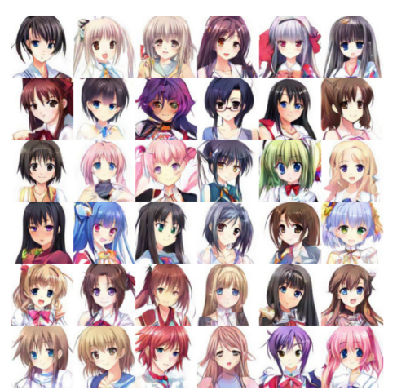
Create Anime Characters

Slide 5
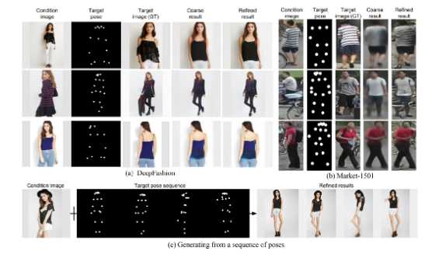
Pose Guided Person Image Generation

Slide 6
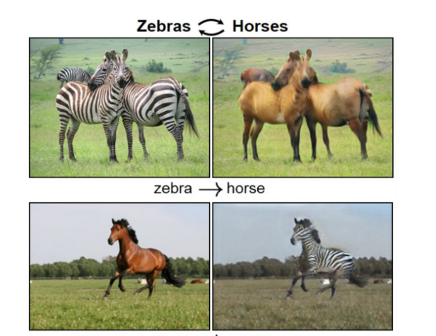
CycleGAN

Slide 7
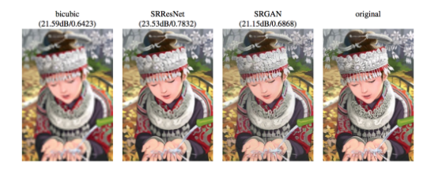
Super Resolution

Slide 8
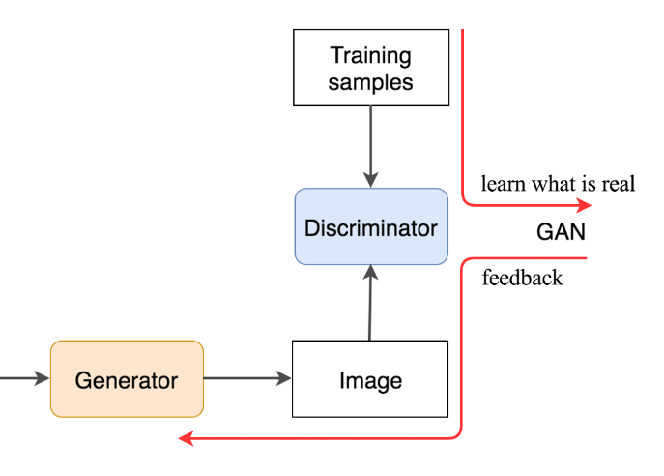
^{Proposed Model}
^{Generator}
^{Discriminator}

Slide 9
^{Working of Two-Stage GAN}
- Stage-I GAN: it sketches the primitive shape and basic colors of the object conditioned on the given text description and draws the background layout from a random noise vector, yielding a low-resolution image.
- Stage-II GAN: it corrects defects in the low-resolution image and completes details of the object by reading the text description again, producing a high-resolution photo-realistic image.

Slide 10
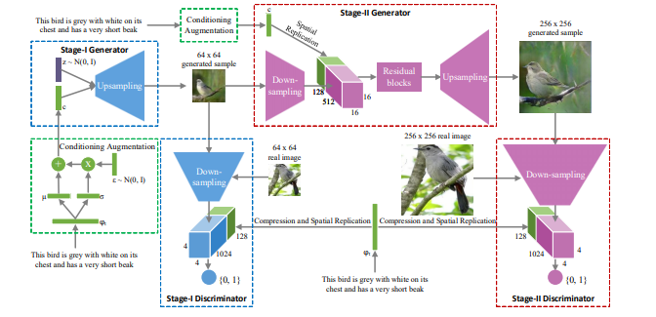
Text to Image Synthesis Model Architecture

Slide 11
^{Feature Selection}
Generating images based on detailed visual descriptions.
Manifold Interpolation regularize
Disentangling of style and content, and bird pose and background transfer from query images onto text descriptions.
In future work, we aim to further scale up the model to higher resolution images and add more types of text.
^{Datasets used:}
Caltech-UCSD Birds dataset and the Oxford-102 Flowers

Slide 12
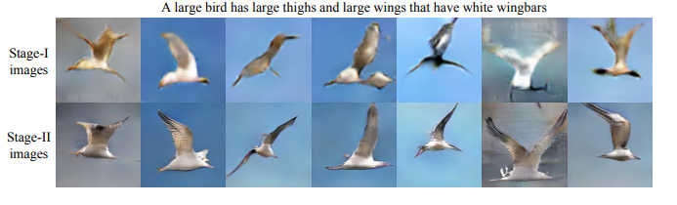
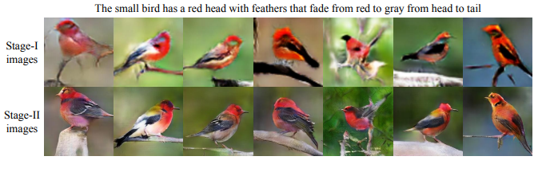
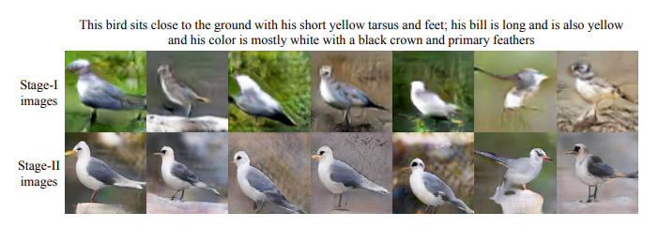
Results

Slide 13




Conclusion
Performed stacked Generative Adversarial Networks (StackGAN) for synthesizing photo-realistic images.
Decomposing the synthesis process into two more manageable stages
Extensive quantitative and qualitative results demonstrate the effectiveness of our proposed method.
Generates higher resolution images (e.g., 256 × 256) with more photo-realistic details.

Slide 14
THANK YOU

