Slide 1
CPSC 483 Project Presentation Hand Written Character Recognition System
Professor: Peter Lo
By,
Mihir Thuse
Purva Chakravarti
Jai Inamdar

Slide 2
Introduction
Problem statement:
With increasing interest in the computer applications, modern society needs the handwritten text into computer readable form.
Outcome:
Our project present a recognition system for hand written character using artificial neural networks.
Kohonen Self Organization Map
pattern classification and recognition
unsupervised learning algorithm.

Slide 3
Know How?
What is Character recognition?
process => classify the input character => according to the predefine character class
What is Kohonen Self Organization map?
A net work, by its self organizing properties, is able to infer relationships and learn more as more inputs are presented to it.
Why Kohonen Self Organization map?
we can expect the system the change with changing condition and inputs.
The system consistently learns

Slide 4
More about Kohonen working..
According to the nature of the pattern to be recognized, recognition may be divided into two major types:
recognition of concrete items and
recognition of abstract items
Beneficial => network is trained form its own classification of the training data
To do this two basic assumptions about the network are made.
The first is that class membership is broadly define as input patterns that share common features.
The other is that the network will be able to identify common features across the range of input patterns

Slide 5
System overview
Learning
Input
Knowledge
Hand written
Character
Pre-processing
Feature Extraction
Knowledge
Output
Result
Classifier

Slide 6
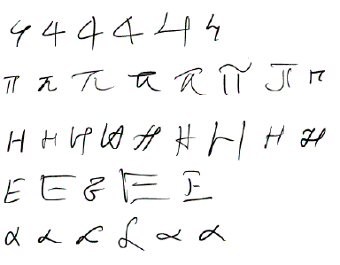
How the system works:
Input Image:
The input to the recognition system => handwritten character
the black part of the image => character and
the white part => paper
Feature Extraction:
Each handwritten character => converted to a real valued vector form of 0s and 1s
characterizes the essential information contain of the input pattern.
0s => white pixels
1s => black pixels.
an M×N image is reduce to a (M/R₁)×(N/R₂)
(here 16×16) size image with the reduction factor
R1 across height and
R2 across width.

Slide 7
Continued…
Cell value of the reduce picture = R₁×R₂ window and calculating the number of black pixels within each window.
If the number of black pixels >= 50% of the total number of pixels in that window,
cell value is considered as 1
otherwise
cell value is considered as 0

Slide 8
Algorithm
for I =1 to M/R₁
for j = 1 to N/R₂
BEGIN
BlackPixelCount = 0.0
for k= (I-1)* R₁ to I*R₁
for L= (j-1)*R₂ to j*R₂
BEGIN
if (ReadPixel(k,L)= BlackPixel) then
BlackPixelCount= BlackPxilCount+1
END
if (BlackPixelCount / (R₁*R₂)>=0.5) then
FeatureMat (I,j) = 1
else
FeatureMat(I,j)= 0
END

Slide 9
Continued..
Learning and Recognition (using Kohonen Self Organization Map):
The Kohenen network has two layers:
an input layer and
a Kohonen out layer.
The input layer is a size determined by the user and must match the size of each row (pattern) in the input data file.
A kohonen layer is composed of neurons that compete with each other.

Slide 10
Kohonen Layer
Each neuron
Output = ∑ w_{ij} x_{j}
Neuron with largest output: Winner
The neuron has a final output of 1.
All other neurons in the layer have an output of zero
Kohonen Winner
Layer
Input Layer
1
0
0
0
0
0
Training Law for The Kohonen Map:
W_{new}=W_{old}+alpha*(Input-W_{old})

Slide 11
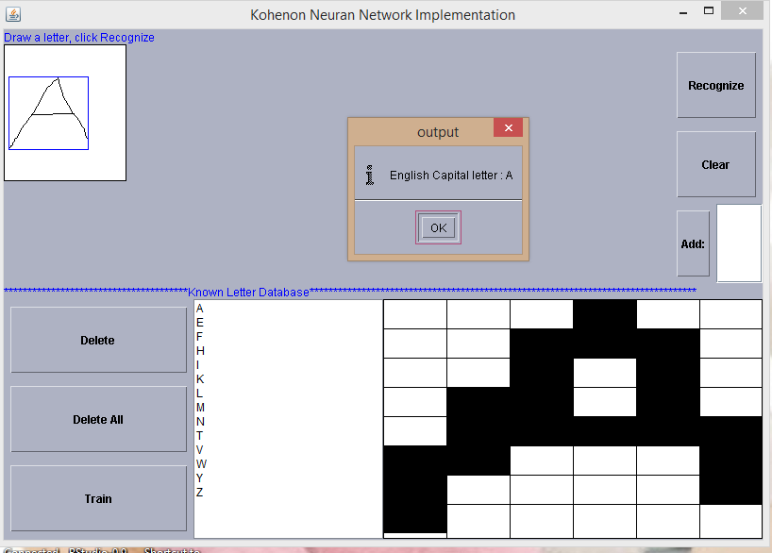
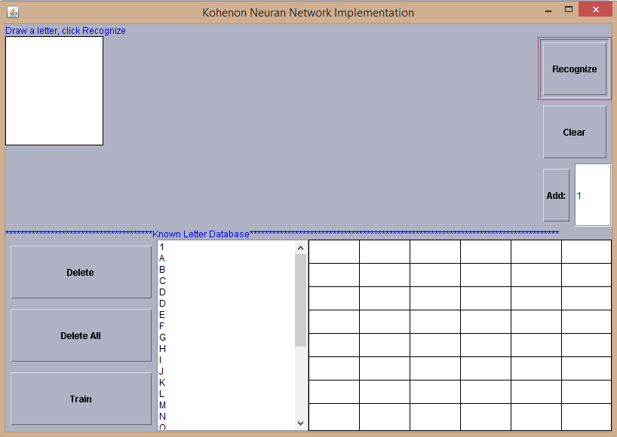
Some screenshots
Write letter A , A gets recognized
Adding 1,Training it and then 1 gets recognized

Slide 12

Result
Peep to the demo

Slide 13
Conclusion
Through this project we have developed a generalized recognition system for hand written character. The performance of project is 95%.
Some time people can’t recognize their own handwriting. And the handwritten character depends on many factors i.e. emotion, pen pressure, and environment. Hence, it is difficult to get 100% accuracy.
If you follows standard writing rules, the filtering and feature extraction is done more accurately, and then it is possible to recognize the handwritten text into computer readable form making life easier !

Slide 14
Thank you

