Slide 1
Show and Tell v23
Final Presentation
Purvansh Jain | Rishi Ghia | Santnam Bakshi

Slide 2
Problem Definition and Goals
Build an Image Captioning System with a visual encoder, and a language decoder
The visual encoder shall identify visual features (CNN, ViT, etc)
The language decoder converts them into natural language (LSTM, Flan-T5, etc)
Evaluate the performance of the system using a suitable metric.

Slide 3
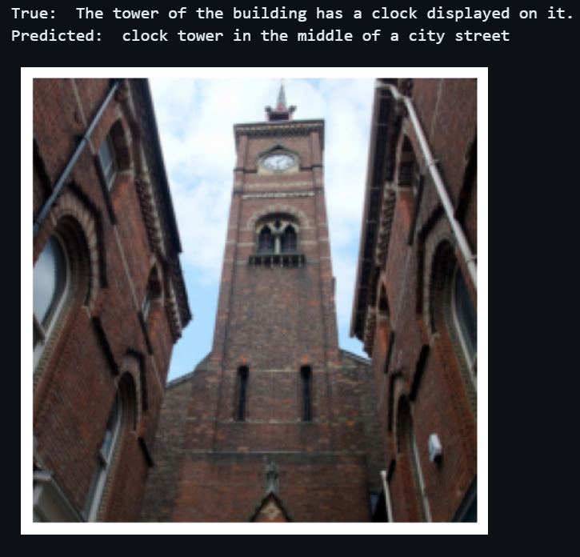
Illustrative Example

Slide 4
What Excites Us About This Project
Blend of Computer Vision and Natural Language Processing
Real world applications:
a. Enhancing a text- based model and allow it to now “understand” images.
b. Functioning as a video summarization system when extended to videos.
c. Making images more searchable when there exists no relevant attached caption.
d. Improving security systems by allowing them to function autonomously

Slide 5
Relevance to Class
Tokenization
LSTMs
Pre-Trained Transformers (BERT, T5-Flan)
Evaluation Techniques (BLEU-4)
Techniques such as Next-Token Generation

Slide 6
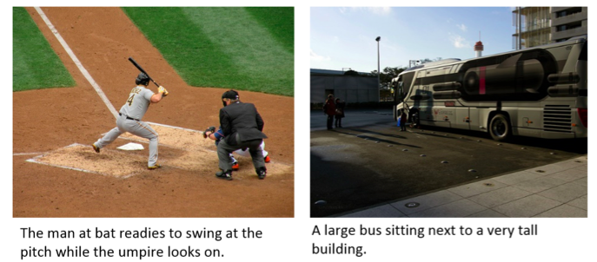
Dataset
We plan to use is the Microsoft Common Objects in Context (MSCOCO) dataset due to its large collection (~118k) of captioned images belonging to several different categories, a pre-existing train, validation and test split, and the lack of any required cleaning to be done before training.
Input: 640x480px PNG image, 5 captions

Slide 7
Evaluation Metric (BLEU-4)
What is BLEU?
Sentence-level BLEU vs Corpus-level BLEU
Smoothing Function
How does it work with multiple captions?

Slide 8
Our Baselines
Simple Baseline: Random token generation based on probability distribution generated from vocabulary of training captions
Strong Baseline: Pre-Trained ResNet50 + Unidirectional LSTM pipeline, to generate coherent and contextual captions (1 caption per image)

Slide 9
Results Achieved
Simple Baseline Results
Strong Baseline Results
Test Scores:
Maximum BLEU Score (1-1) = 0.092
Average BLEU Score (1-1) = 0.033
Corpus BLEU score = 2.122e-155
Train Scores:
Maximum BLEU Score (1-1) = 0.156
Average BLEU Score (1-1) = 0.035
Corpus BLEU score = 1.886e-79
Test Scores:
Maximum BLEU Score (1-1) = 0.365
Average BLEU Score (1-1) = 0.064
Corpus BLEU score = 0.025
Train Scores:
Maximum BLEU Score (1-1) = 0.882
Average BLEU Score (1-1) = 0.098
Corpus BLEU score = 0.074

Slide 10
Extension 1
Pre-trained SWIN Transformer to replace the ResNet50
Also tried the Google ViT (Vision Transformer)
Implemented attention over visual regions
Large image feature vectors created (49x1024)
Implement intermediate neural network between SWIN and LSTM

Slide 11
Results Achieved
Test Scores:
Maximum BLEU Score (1-1) = 0.759
Average BLEU Score (1-1) = 0.071
Corpus BLEU score = 0.0347
Train Scores:
Maximum BLEU Score (1-1) = 0.861
Average BLEU Score (1-1) = 0.093
Corpus BLEU score = 0.042

Slide 12
Extension 2
Image Augmentation Implemented
Error Analysis performed on the same
Experimented with multiple captions per image
FLAN T5 (RIP ☹)
Strategies to store image embeddings to improve computational efficiency

Slide 13
Results Achieved
Original Images
Maximum BLEU Score (1-1) = 0.863
Average BLEU Score (1-1) = 0.128
Corpus BLEU score = 0.086
Random Grayscale (0.2)
Maximum BLEU Score (1-1) = 0.759
Average BLEU Score (1-1) = 0.127
Corpus BLEU score = 0.0814
Error Analysis!
Horizontal Flip (0.5)
Maximum BLEU Score (1-1) = 0.725
Average BLEU Score (1-1) = 0.131
Corpus BLEU score = 0.084

Slide 14
Challenges and Learnings
Handling large amounts of image data
Transitioning from image encoder to language decoder
Incorporating attention in the vision encoder
Challenges in fine-tuning and troubleshooting pre-trained transformers

Slide 15
Possible Improvements
Train over a larger subset of the dataset
Experiment with multiple image augmentation techniques simultaneously
Attention based mechanisms in the language decoder
Attention mechanisms between tokens and image patches
Alternate dimensionality reduction techniques

Slide 16
Thank you!

