Slide 1
Portify
L.J. Institute of Computer Applications
IMCAD_6_D_G30

Slide 2
TABLE OF CONTENTS
No | Description
1 | Introduction
2 | Existing System
3 | Need for the New System
4 | Objective of the New System
5 | Problem Definition
6 | Scope of the Project & Core Components
7 | Project Profile
8 | Assumptions and Constraints
9 | Advantages and Limitations of the Proposed System
10 | Requirement Determination
11 | Targeted Users
12 | System Design (Use-Case)

Slide 3
TABLE OF CONTENTS
No | Description
13 | System Design (Class)
14 | System Design (Interaction)
15 | System Design (Activity)
16 | Data Dictionary
17 | Development
18 | Coding Standards
19 | Screenshot
20 | Agile Documentation
21 | Proposed Enhancement
22 | Conclusion
23 | Bibliography

Slide 4
Developed by
No | Enrollment number | Name
1 | 23018501210273 | Vaghela Purvarajsinh

Slide 5
INTRODUCTION

Slide 6
Introduction
Portify – Automated Portfolio Generator is a web-based application developed using ASP.NET MVC Framework and SQL Server, which helps users create professional portfolio websites in minutes.
The system allows users to:
Choose a portfolio template
Enter personal, academic, and project details
Generate an “About Me” section using AI
Preview the portfolio live
Download the complete ready to host portfolio as HTML, CSS, and JavaScript files
Give Feedback To The Admin
The platform also includes an admin panel for managing templates, users, and system statistics and Feedback.

Slide 7
Existing System
Currently, users create portfolios using:
Manual HTML/CSS coding
Static website builders
Design tools without export options
Paid platforms with limited customization
Problems with existing systems:
Requires technical knowledge
Time-consuming
No AI-assisted content generation
Limited control over final files
Expensive subscription-based tools

Slide 8
Need for the New System
Is easy to use for non-technical users
Saves time
Provides ready-to-host portfolio files
Allows customization through templates
Uses AI to assist users in writing content
100% Free To Use
Portify solves all these problems in a single platform.

Slide 9
Objective of the New System
To automate portfolio website generation
To reduce dependency on coding skills
To provide professional-looking portfolios
To integrate AI for content creation
To allow users to download complete website files
To give admin full control over templates and users

Slide 10
Problem Definition
Design and develop a system that enables users to create professional portfolio websites easily, quickly, and efficiently without technical expertise.
Many students and professionals struggle to create professional portfolios due to:
Lack of web development skills
Time constraints
Poor design knowledge
High cost of existing tools

Slide 11
Scope of the Project & Core Components
Scope:
Portfolio creation using predefined templates
AI-based “About Me” generation
Live portfolio preview
File generation and ZIP download
Admin management panel
Core Components:
User Module
Template Management Module
Portfolio Builder Module
AI Content Generator
File Generator & ZIP Export
Admin Dashboard & Analytics

Slide 12
Project Profile
Project Name: Portify
Project Type: Web Application
Technology Stack:
Frontend: HTML, CSS, JavaScript, Razor Views
Backend: ASP.NET (C#)
Database: SQL Server (SSMS)
AI Integration: Gemini API

Slide 13
Assumptions and Constraints
Assumptions:
Users have basic internet access
Admin uploads valid templates
AI API is available and responsive
Constraints:
Internet dependency
API usage limits
Limited customization beyond templates
Initial templates are predefined

Slide 14
Advantages and Limitations of the Proposed System
Advantages:
Easy to use
No coding required
AI-assisted content creation
Ready-to-deploy portfolio files
Time-efficient
Scalable system
Limitations:
Dependent on template structure
Requires internet connectivity
AI-generated content may need manual editing

Slide 15
Requirement Determination & Analysis

Slide 16
Requirement Determination & Analysis
Functional Requirements:
User registration and login
Template selection
Dynamic form generation
AI content generation
Live preview
Portfolio download
Admin template management
Non-Functional Requirements:
Security
Performance
Scalability
Usability
Maintainability

Slide 17
Targeted Users
College students
Freshers
Job seekers
Freelancers
Professionals
People Who Are Not Familiar With Coding

Slide 18
SYSTEM DESIGN

Slide 19
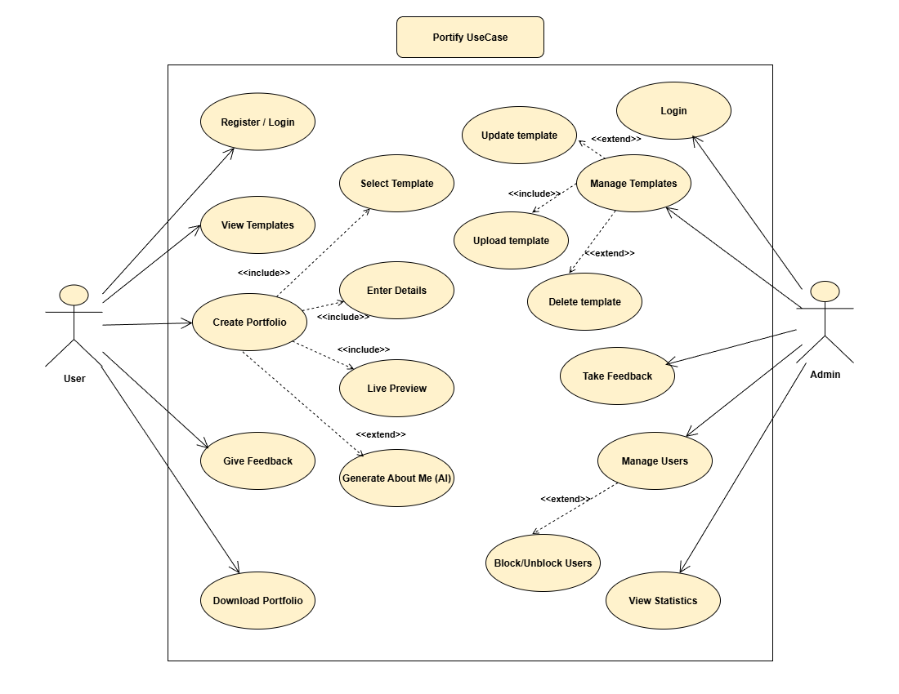
12 Use Case Diagram

Slide 20
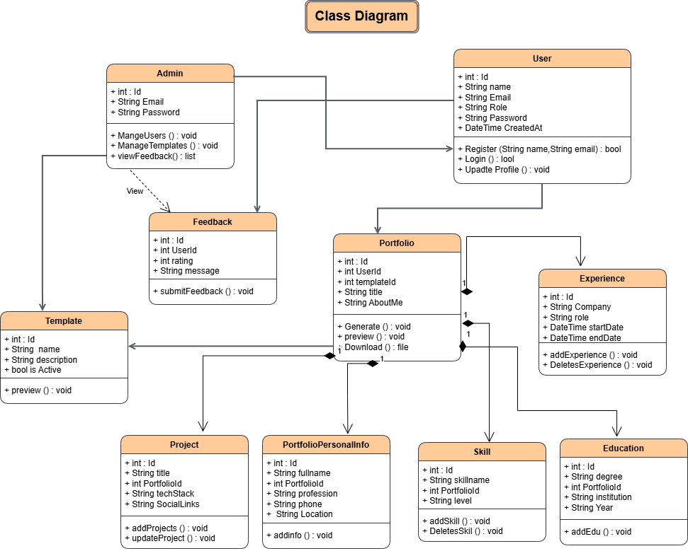
13 Class Diagram

Slide 21
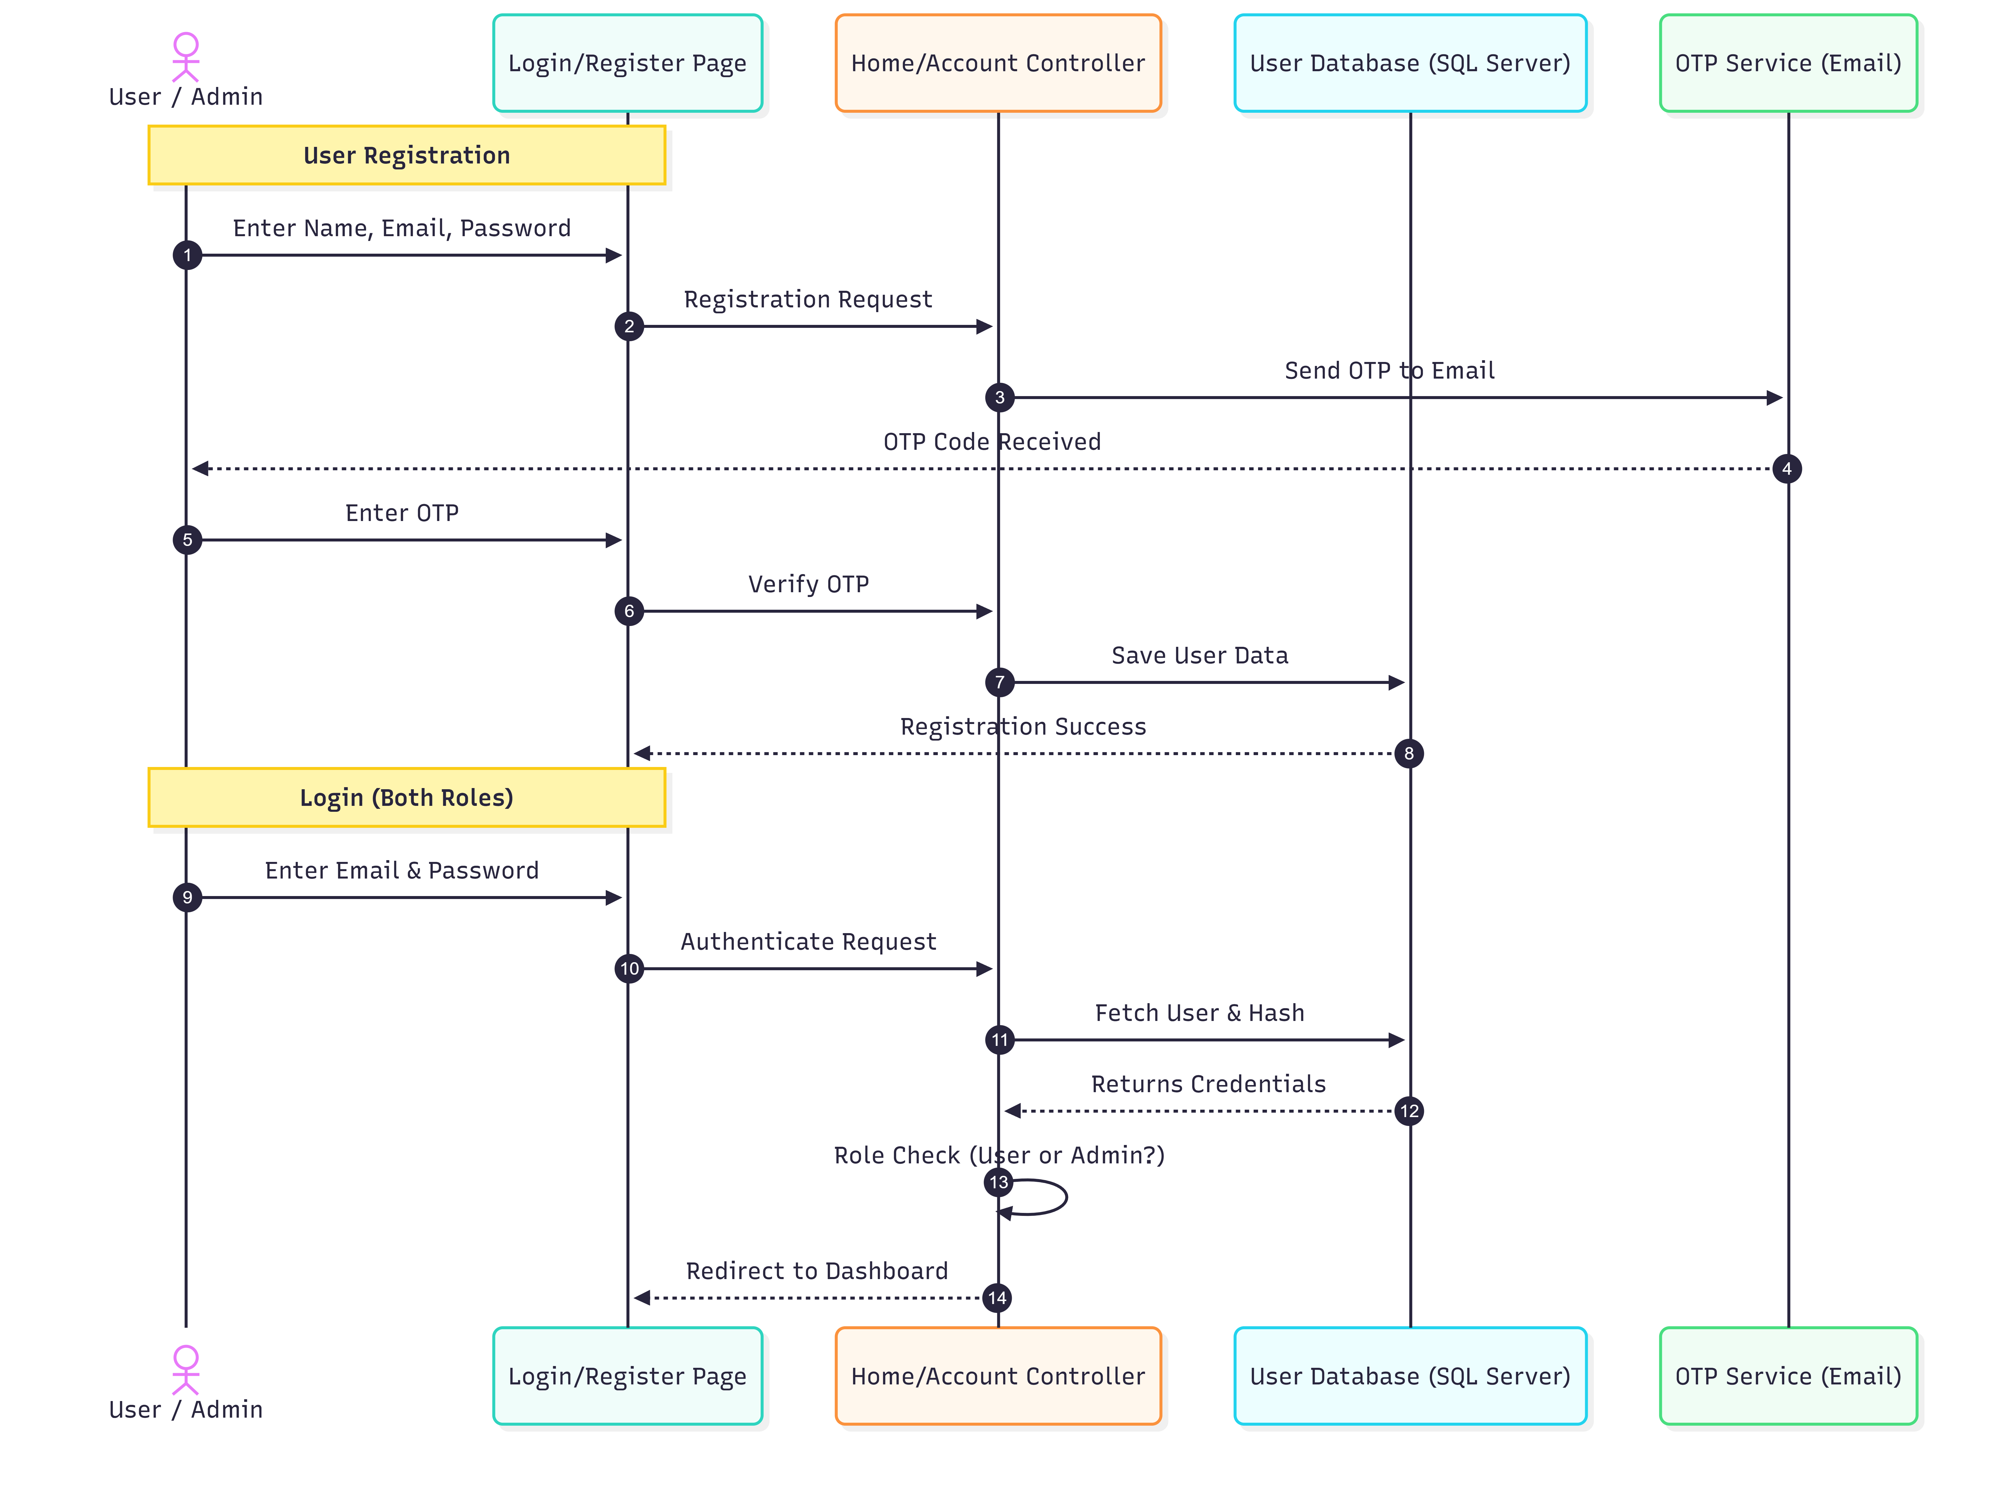
14.1. Intersection Diagram (user Login/Register, Admin Login)

Slide 22
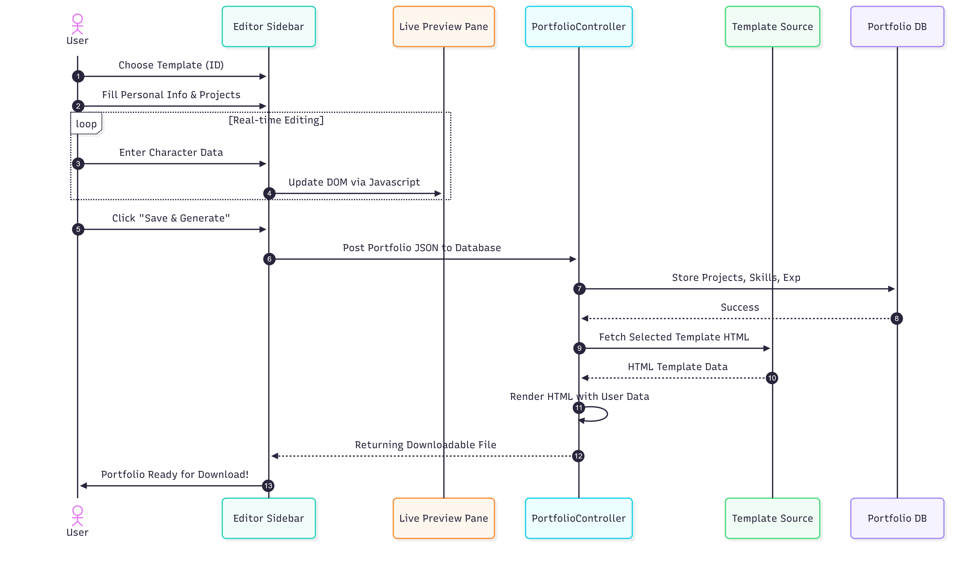
14.2. Intersection Diagram (User)

Slide 23
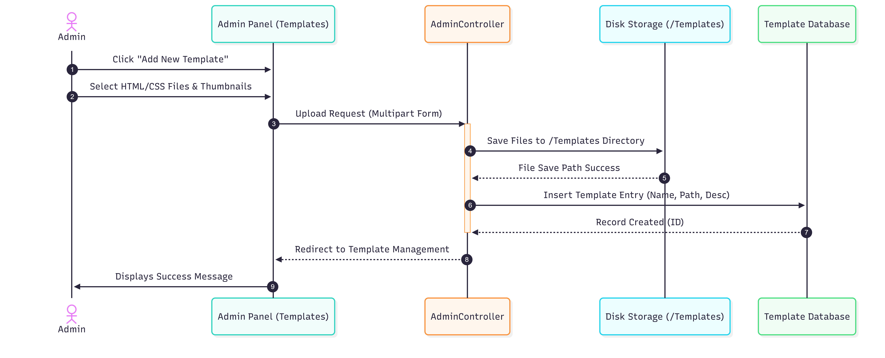
14.4. Intersection Diagram (Admin)

Slide 24
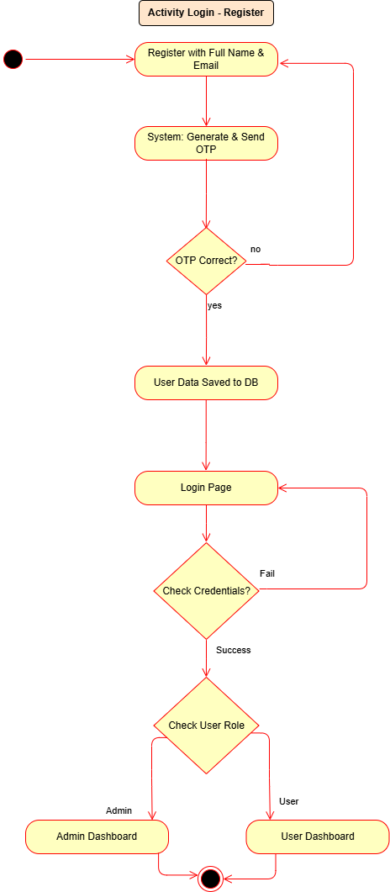
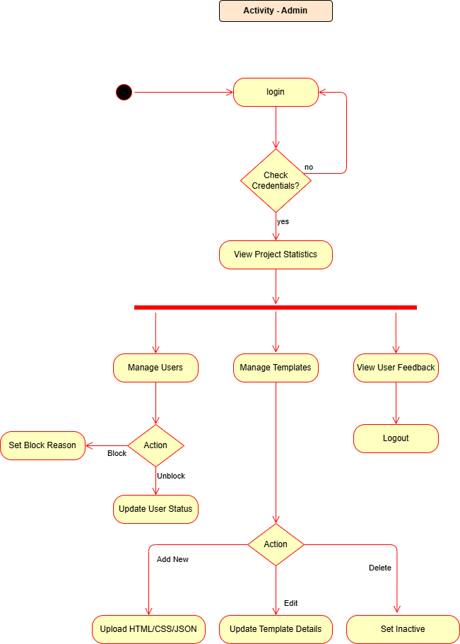
15.1. Activity Diagram

Slide 25
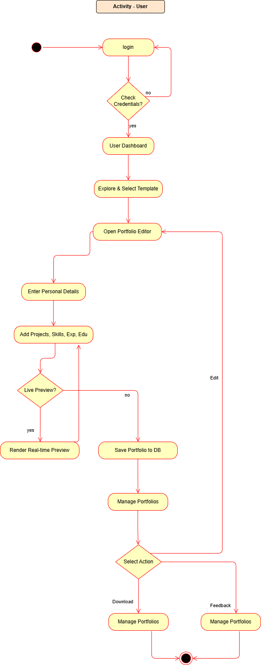
15.2. Activity Diagram

Slide 26
16 Data Dictionary
Table Name: Users
Purpose: Stores information about users (Admins and regular Users).
Field Name | Data Type | Constraints | Description
Id | INT | PRIMARY KEY, IDENTITY | Unique identifier for each user.
FullName | NVARCHAR(100) | NOT NULL | The user's full name.
Email | NVARCHAR(100) | NOT NULL, UNIQUE | User's email address used for login.
PasswordHash | NVARCHAR(255) | NOT NULL | Hashed version of the user's password.
Role | NVARCHAR(20) | NOT NULL, CHECK (Admin/User) | Defines user access level (Admin or User).
IsBlocked | BIT | DEFAULT(0) | Indicates if the user is blocked from the system.
CreatedAt | DATETIME | DEFAULT(GETDATE()) | The date and time when the user registered.

Slide 27
16 Data Dictionary
Table Name: Templates
Purpose: Stores metadata for available portfolio templates.
Field Name | Data Type | Constraints | Description
Id | INT | PRIMARY KEY, IDENTITY | Unique identifier for the template.
TemplateName | NVARCHAR(100) | NOT NULL | Name of the template design.
Description | NVARCHAR(255) | NULL | Brief description of the template's style.
ThumbnailPath | NVARCHAR(255) | NULL | Path to the preview image for the template.
HtmlPath | NVARCHAR(255) | NOT NULL | Path to the base HTML file for generation.
CssPath | NVARCHAR(255) | NOT NULL | Path to the associated CSS file.
JsPath | NVARCHAR(255) | NULL | Path to the associated JavaScript file.
ConfigPath | NVARCHAR(255) | NOT NULL | Path to the template configuration file.
IsActive | BIT | DEFAULT(1) | Flag to show/hide the template for selection.
CreatedAt | DATETIME | DEFAULT(GETDATE()) | Date the template was added.

Slide 28
16 Data Dictionary
Table Name: Portfolios
Purpose: Stores the core portfolio instances created by users.
Field Name | Data Type | Constraints | Description
Id | INT | PRIMARY KEY, IDENTITY | Unique identifier for the portfolio.
UserId | INT | FOREIGN KEY (Users.Id) | ID of the user who owns the portfolio.
TemplateId | INT | FOREIGN KEY (Templates.Id) | ID of the selected template.
Title | NVARCHAR(150) | NULL | User-defined title for the portfolio.
AboutMe | NVARCHAR(MAX) | NULL | "About Me" section content.
CreatedAt | DATETIME | DEFAULT(GETDATE()) | Date when the portfolio was generated.

Slide 29
16 Data Dictionary
Table Name: PortfolioPersonalInfo
Purpose: Stores personal details specific to a generated portfolio.
Field Name | Data Type | Constraints | Description
Id | INT | PRIMARY KEY, IDENTITY | Unique identifier for the entry.
PortfolioId | INT | FOREIGN KEY (Portfolios.Id) | Links info to a specific portfolio.
FullName | NVARCHAR(100) | NULL | Name to display on the portfolio.
Profession | NVARCHAR(100) | NULL | Professional title (e.g., Full Stack Dev).
Email | NVARCHAR(100) | NULL | Contact email for the portfolio visitor.
Phone | NVARCHAR(20) | NULL | Contact phone number.
Location | NVARCHAR(100) | NULL | User's location (City, Country).
ProfileImagePath | NVARCHAR(255) | NULL | Path to the uploaded profile picture.

Slide 30
16 Data Dictionary
Table Name: Experiences
Purpose: Stores work experience entries for resumes/portfolios.
Field Name | Data Type | Constraints | Description
Id | INT | PRIMARY KEY, IDENTITY | Unique identifier for the entry.
PortfolioId | INT | FOREIGN KEY (Portfolios.Id) | Links experience to a portfolio.
CompanyName | NVARCHAR(150) | NULL | Name of the employer/company.
Role | NVARCHAR(100) | NULL | Job title/position held.
StartDate | DATE | NULL | Date the role began.
EndDate | DATE | NULL | Date the role ended (null if current).
Description | NVARCHAR(MAX) | NULL | Description of responsibilities.

Slide 31
16 Data Dictionary
Table Name: Projects
Purpose: Stores project details to be showcased in the portfolio.
Field Name | Data Type | Constraints | Description
Id | INT | PRIMARY KEY, IDENTITY | Unique identifier for the project.
PortfolioId | INT | FOREIGN KEY (Portfolios.Id) | Links project to a portfolio.
ProjectTitle | NVARCHAR(150) | NULL | Name of the project.
Description | NVARCHAR(MAX) | NULL | Overview of the project work.
TechStack | NVARCHAR(255) | NULL | Technologies used (e.g., React, SQL).
GitHubLink | NVARCHAR(255) | NULL | URL to the source code repository.
LiveLink | NVARCHAR(255) | NULL | URL to the hosted project demo.

Slide 32
16 Data Dictionary
Table Name: Skills
Purpose: Stores technical or soft skills and their proficiency levels.
Field Name | Data Type | Constraints | Description
Id | INT | PRIMARY KEY, IDENTITY | Unique identifier for the entry.
PortfolioId | INT | FOREIGN KEY (Portfolios.Id) | Links skill to a portfolio.
SkillName | NVARCHAR(100) | NULL | Name of the skill (e.g., Java).
SkillLevel | NVARCHAR(50) | NULL | Level (e.g., Beginner, Advanced).

Slide 33
16 Data Dictionary
Table Name: SocialLinks
Purpose: Stores social media URLs for the portfolio.
Field Name | Data Type | Constraints | Description
Id | INT | PRIMARY KEY, IDENTITY | Unique identifier for the link.
PortfolioId | INT | FOREIGN KEY (Portfolios.Id) | Links social link to a portfolio.
Platform | NVARCHAR(50) | NULL | e.g. LinkedIn, Twitter, GitHub.
Url | NVARCHAR(255) | NULL | Link to the user's profile.

Slide 34
16 Data Dictionary
Table Name: Feedback
Purpose: Stores user ratings and feedback for the platform itself.
Field Name | Data Type | Constraints | Description
Id | INT | PRIMARY KEY, IDENTITY | Unique identifier for the feedback.
UserId | INT | FOREIGN KEY (Users.Id) | The user giving the feedback.
PortfolioId | INT | FOREIGN KEY (Portfolios.Id) | Optional reference to a portfolio.
Rating | INT | CHECK (1-5) | Star rating given by the user.
Message | NVARCHAR(MAX) | NULL | Review comment or message.
CreatedAt | DATETIME | DEFAULT(GETDATE()) | Date the feedback was submitted.

Slide 35
16 Data Dictionary
Table Name: Education
Purpose: Stores academic qualifications and education history.
Field Name | Data Type | Constraints | Description
Id | INT | PRIMARY KEY, IDENTITY | Unique identifier for the entry.
PortfolioId | INT | FOREIGN KEY (Portfolios.Id) | Links education to a portfolio.
Degree | NVARCHAR(150) | NULL | Name of the degree or course.
Institution | NVARCHAR(150) | NULL | Name of the school, college, or university.
Year | NVARCHAR(50) | NULL | Passing year or duration.

Slide 36
Development

Slide 37
Developed using an agile, solo-developer approach covering the complete project lifecycle from design to deployment
Followed a task-based “Separation of Concerns” strategy for structured development
Project divided into three major phases:
Database Schema Design Backend Development using ASP.NET C# Frontend UI/UX Development
Each module was independently developed and unit-tested before integration
Iterative integration into the MVC framework ensured smooth functionality and maintainability
Portfolio generation logic remained decoupled from the presentation layer for better scalability and system stability

Slide 38
Coding Standards
Followed industry-standard coding practices to maintain clean, readable, and maintainable code
Backend C# naming conventions used PascalCase for classes, methods, properties, and namespaces
Local variables and JavaScript functions/variables used camelCase naming convention
CSS classes and IDs followed kebab-case formatting for better frontend consistency
Database tables and columns used structured PascalCase naming with consistent primary key naming (Id)
Standard 4-space indentation and Allman brace style used throughout the project
XML documentation and necessary inline comments added for better code understanding
Project structured using the MVC architecture pattern for clear separation of data, business logic, and UI components

Slide 39
Screenshots

Slide 40
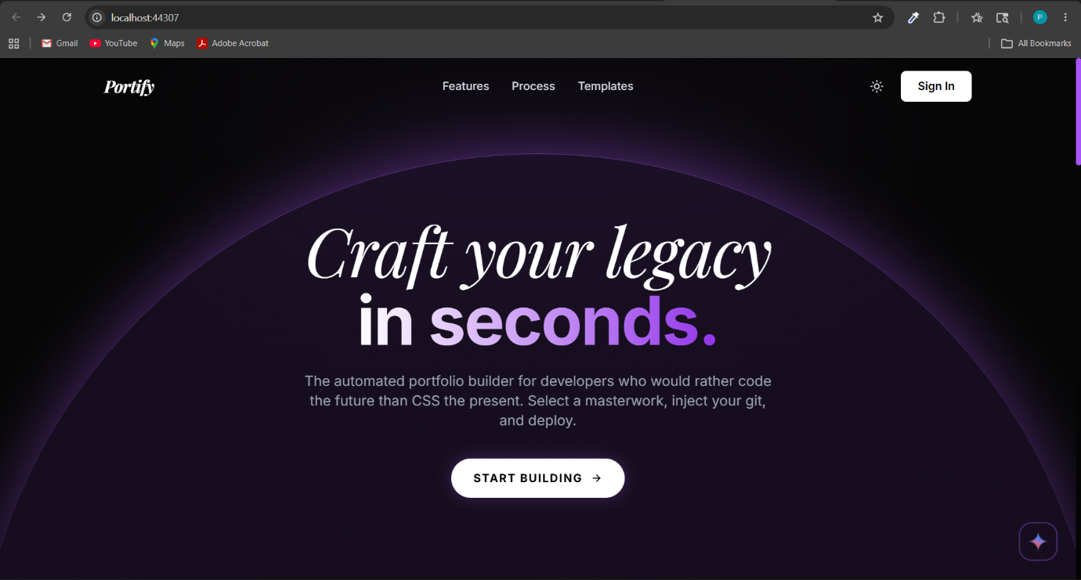
Home Page

Slide 41
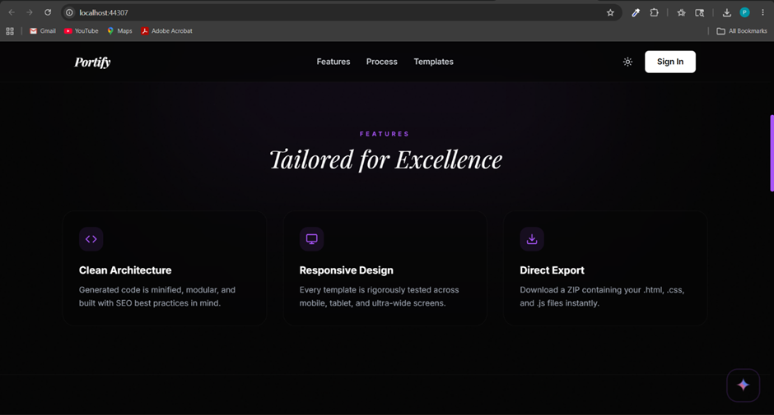
Home Page….

Slide 42
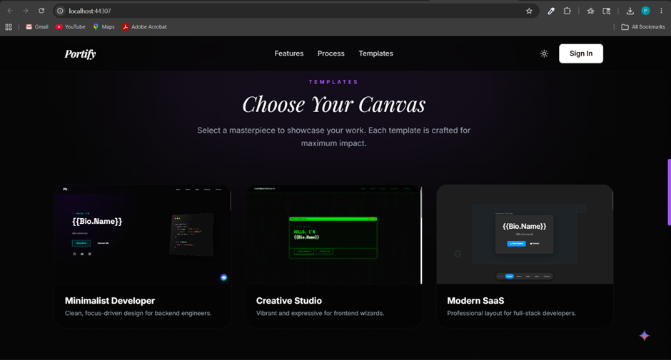
Home Page….

Slide 43
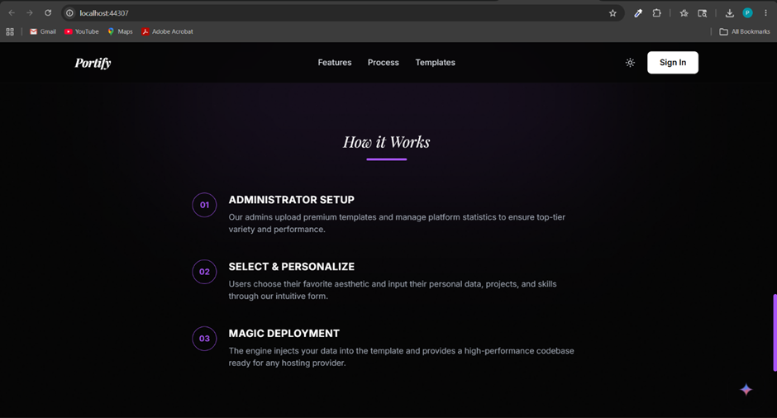
Home Page….

Slide 44
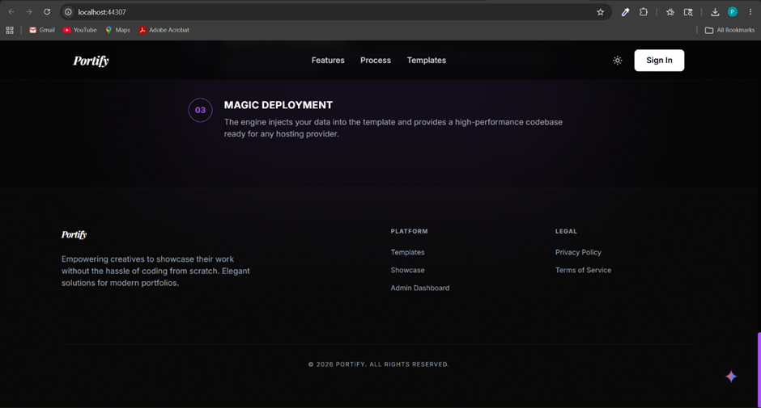
Home Page….

Slide 45
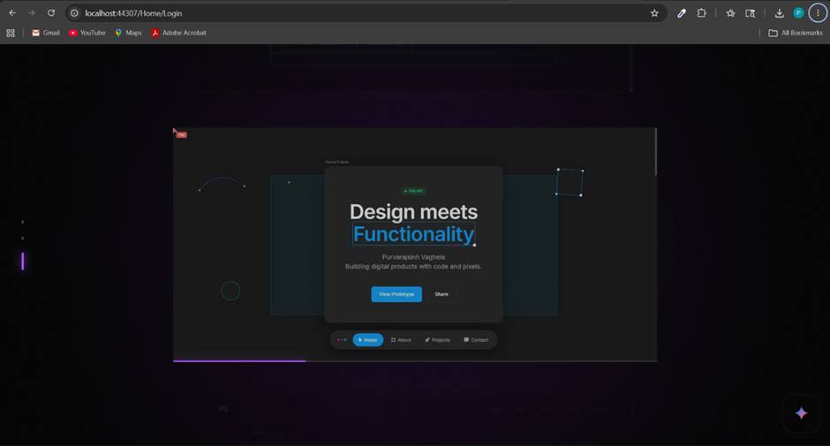
Login / Create Account Page

Slide 46
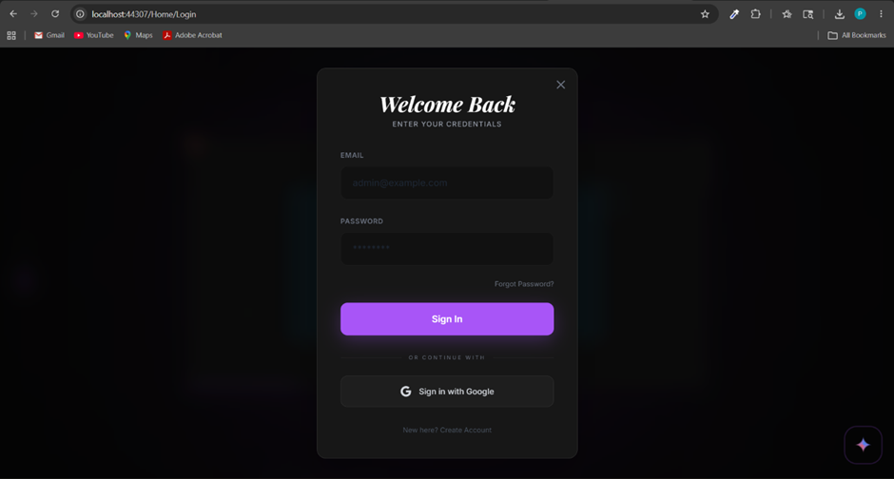
Login / Create Account Page…..

Slide 47
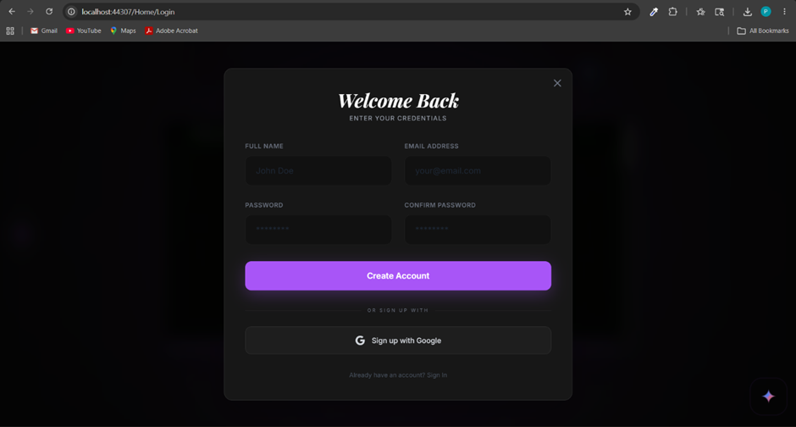
Login / Create Account Page…..

Slide 48
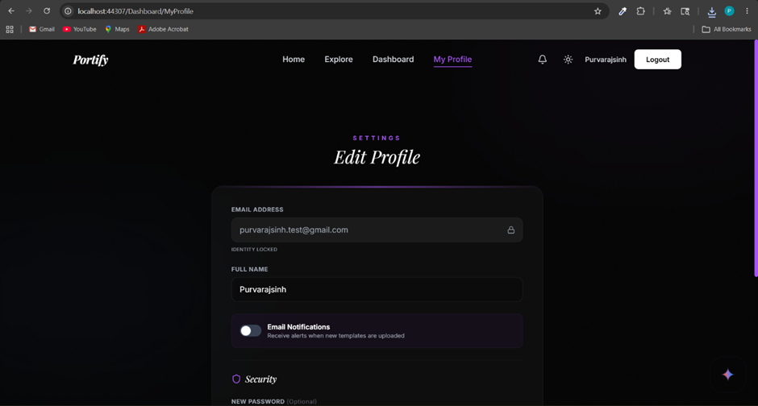
Edit Profile Page

Slide 49
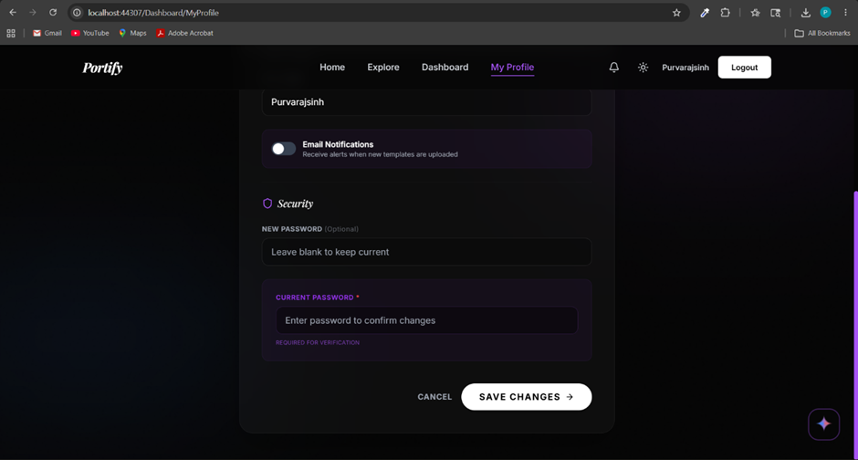
Edit Profile Page……

Slide 50
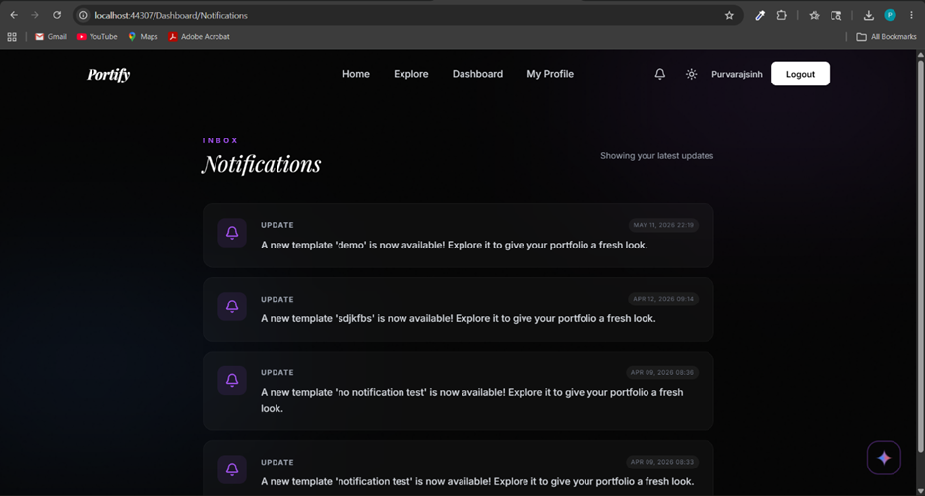
Notification Page

Slide 51
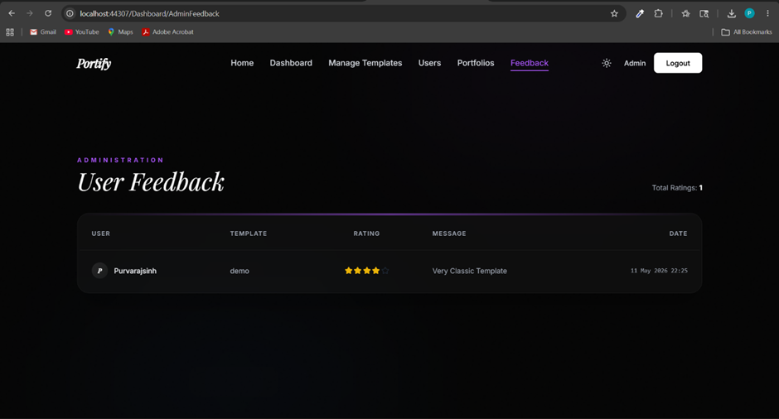
Feedback Page

Slide 52
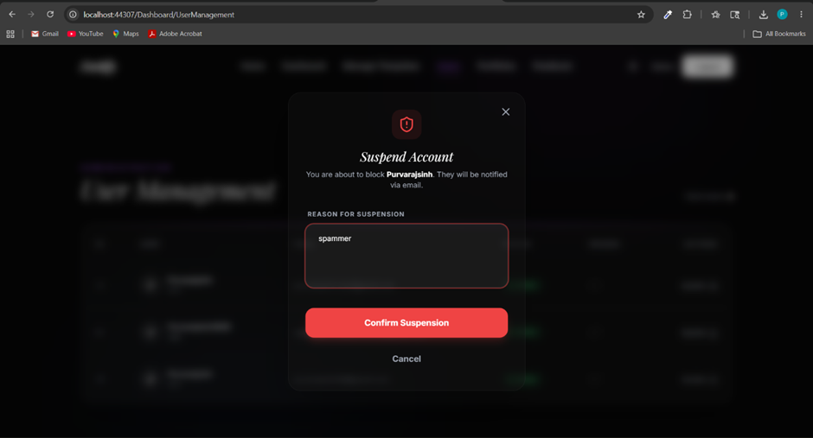
Suspend Account Page (Mange Account Page)

Slide 53
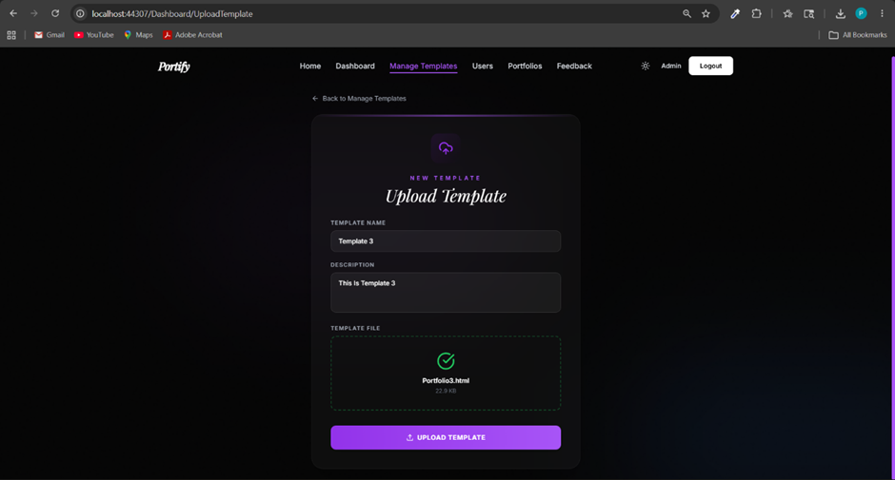
Upload Template Page

Slide 54
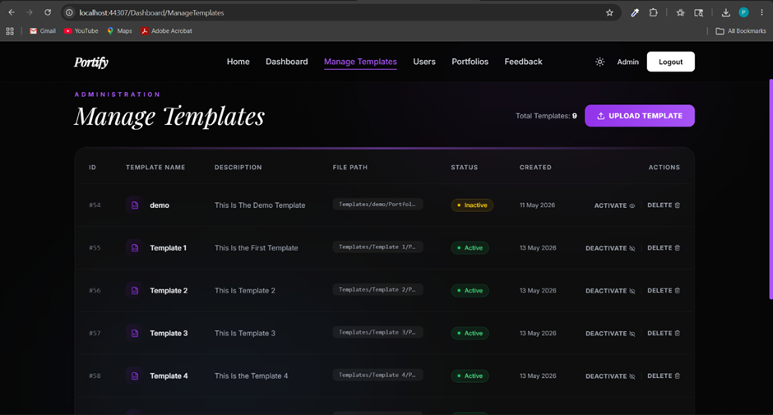
Manage Template Page

Slide 55
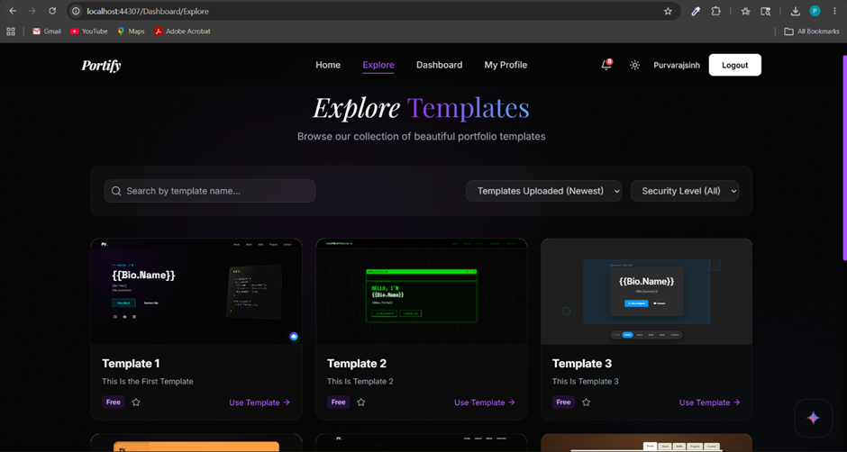
Explore Template Page

Slide 56
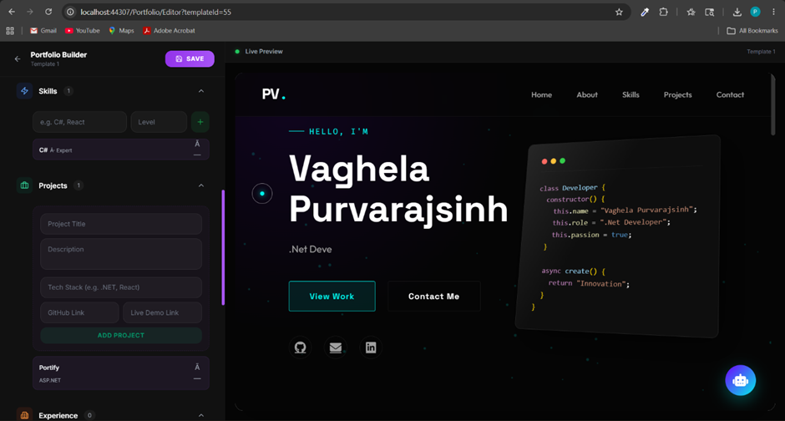
Create Portfolio Page

Slide 57
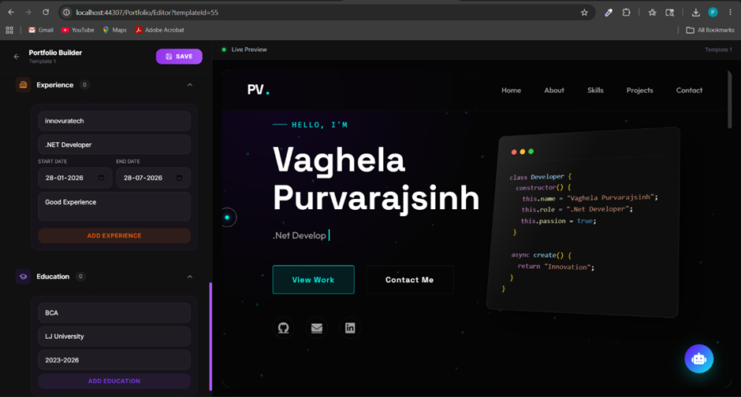
Create Portfolio Page…..

Slide 58
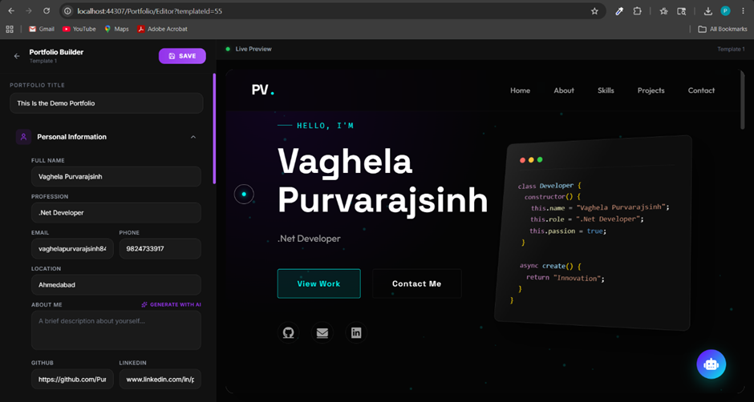
Create Portfolio Page…..

Slide 59
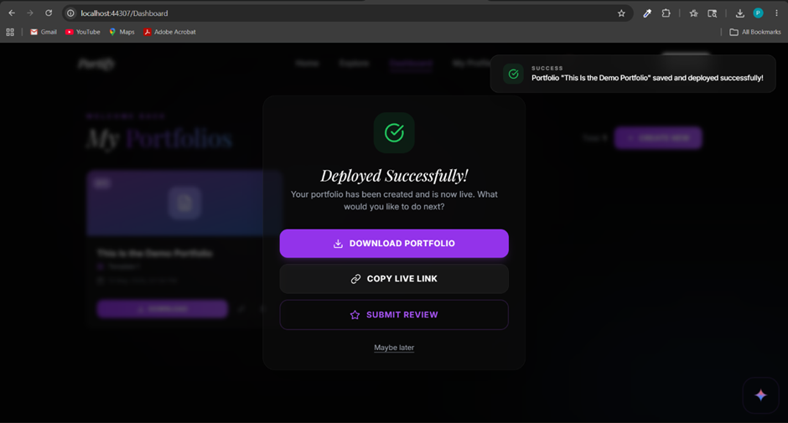
Create Portfolio Page…..

Slide 60
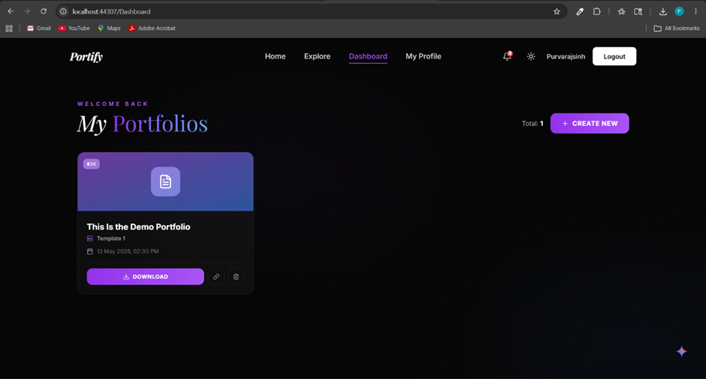
User Dashboard Page

Slide 61
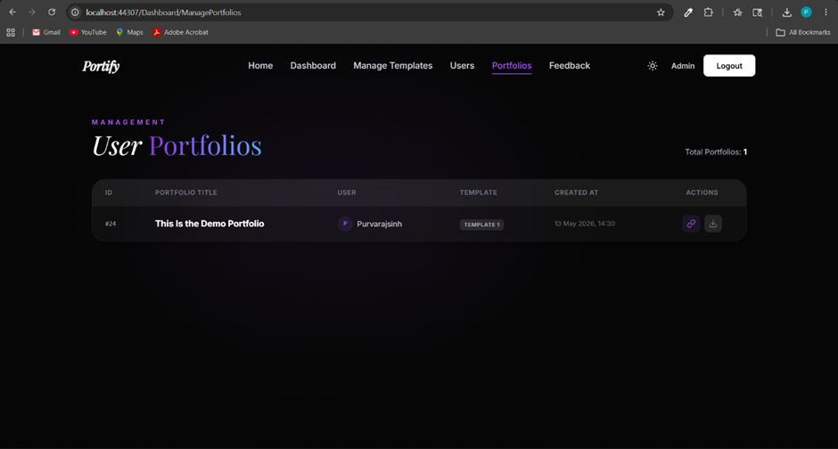
Admin Portfolio Management Page

Slide 62
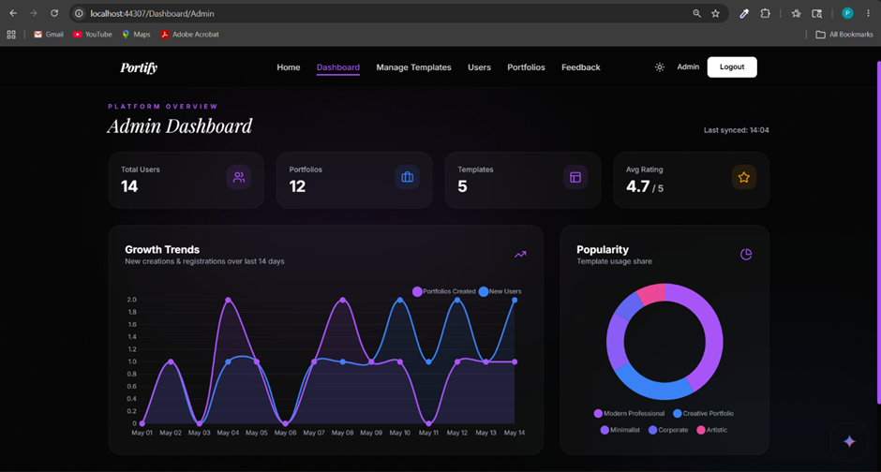
Admin Dashboard Page

Slide 63
Agile Documentation

Slide 64
Agile Project Character
Field Name | Details
Project Name | Portify - Automated Portfolio Generator
Project Champion | Vaghela Purvarajsinh
Project Sponsor | L.J Institute of Computer Application
Project Manager | Vaghela Purvarajsinh
Lead Developer | Vaghela Purvarajsinh
Key Stakeholders | L.J Institute of Computer Application, Students, and Young Professionals
Project Duration | [Insert Start Date] to [Insert Completion Date]

Slide 65
Agile Project Character…..
Category | Category
Project Vision | To become the leading automated platform for generating high-quality, responsive portfolios, providing users with a seamless and efficient tool to build their professional digital presence.
Project Mission | To provide a seamless, automated platform for professionals and students to generate dynamic, customizable web portfolios by simply inputting their resume data and personal details.
Project Scope | The system includes user authentication, a dynamic portfolio editor (for personal, academic, and professional data), template management, a server-side rendering engine, and an export system to download standalone HTML portfolios. It also covers administrative control for managing users and templates.

Slide 66
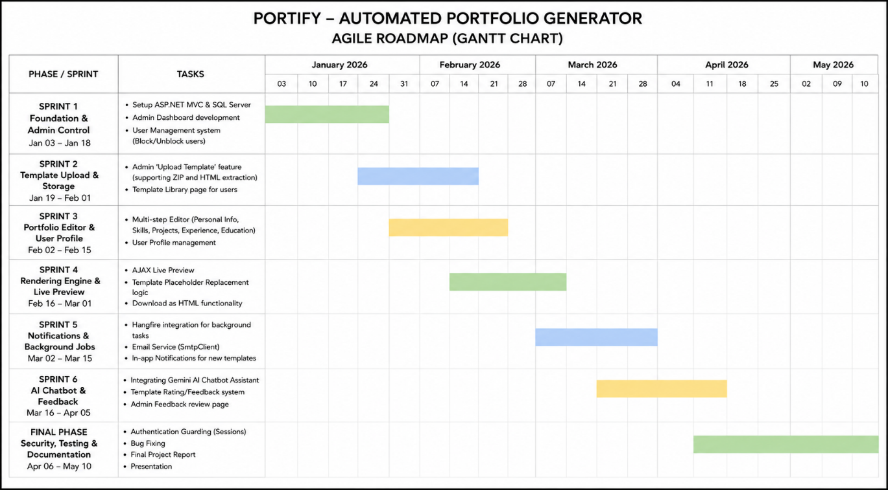
Agile Roadmap

Slide 67
Agile Plan
Sprint | Main Work | Timeline
S1 | Core & Admin | 03–17 Jan
 | DB + Models | 03–07 Jan
 | Admin UI | 08–12 Jan
 | Auth System | 13–17 Jan
S2 | Templates | 18–31 Jan
 | HTML/CSS Design | 18–24 Jan
 | Upload Logic | 25–31 Jan
S3 | Portfolio Editor | 01–15 Feb
 | User Profile | 01–05 Feb
 | Portfolio Forms | 06–15 Feb
S4 | Preview Engine | 16 Feb–01 Mar
 | Live Preview | 16–22 Feb
 | Placeholder Logic | 23 Feb–01 Mar
Sprint | Main Work | Timeline
S5 | Notifications | 02–15 Mar
 | Hangfire Setup | 02–07 Mar
 | SMTP + Alerts | 08–15 Mar
S6 | AI & Feedback | 16–29 Mar
 | Gemini AI | 16–24 Mar
 | Ratings System | 25–29 Mar
S7 | Testing & Deploy | 30 Mar–10 Apr
 | Security Audit | 30 Mar–02 Apr
 | Bug Fixes | 03–06 Apr
 | Deployment | 07–10 Apr

Slide 68
Agile User Story
ID | User Type | Action | Purpose
1 | User | Select template | Choose matching portfolio design
2 | User | Enter details | Create portfolio without coding
3 | User | View live preview | Check design before download
4 | User | Download HTML portfolio | Host website anywhere
ID | User Type | Action | Purpose
5 | User | Use AI Assistant | Get instant help and guidance
6 | Admin | Upload templates | Add new modern designs
7 | Admin | Manage/block users | Keep platform secure
8 | Admin | View feedback & ratings | Improve templates and system

Slide 69
Agile Release Plan
Sprint | Main Task | Timeline | Release
S1 | Core & Admin | 03–17 Jan | 17 Jan
 | DB Setup | 03–07 Jan | 07 Jan
 | Auth Module | 08–17 Jan | 17 Jan
S2 | Template System | 18–31 Jan | 31 Jan
 | Template UI | 18–24 Jan | 24 Jan
 | ZIP Upload Logic | 25–31 Jan | 31 Jan
S3 | Portfolio Editor | 01–15 Feb | 15 Feb
 | Data Forms | 01–10 Feb | 10 Feb
 | Profile Settings | 11–15 Feb | 15 Feb

Slide 70
Agile Release Plan….
Sprint | Main Task | Timeline | Release
S4 | Preview Engine | 16 Feb–01 Mar | 01 Mar
 | AJAX Preview | 16–22 Feb | 22 Feb
 | HTML Rendering | 23 Feb–01 Mar | 01 Mar
S5 | Notifications | 02–15 Mar | 15 Mar
 | Hangfire Email | 02–09 Mar | 09 Mar
 | In-App Alerts | 10–15 Mar | 15 Mar
S6 | AI & Feedback | 16–29 Mar | 29 Mar
 | Gemini AI | 16–24 Mar | 24 Mar
 | Rating System | 25–29 Mar | 29 Mar
S7 | Final Testing | 30 Mar–10 Apr | 10 Apr
 | Bug & Security Fix | 30 Mar–04 Apr | 04 Apr
 | Documentation | 05–10 Apr | 10 Apr

Slide 71
Agile Spring Backlog
Task | Priority | Status | Points
Sprint 1: Core & Auth | High | Complete | 10
DB & Entity Framework | High | Complete | 8
Session Guarding & Auth | High | Complete | 6
Sprint 2: Template Mgmt | High | Complete | 8
ZIP Upload Logic | High | Complete | 9
Template Dashboard UI | Medium | Complete | 4
Sprint 3: Portfolio Editor | High | Complete | 10
Multi-tab Forms | High | Complete | 8
JSON Serialization | High | Complete | 5
Task | Priority | Status | Points
Sprint 4: Preview Engine | High | Complete | 10
AJAX Live Preview | High | Complete | 9
Regex Placeholder Engine | High | Complete | 7
Sprint 5: Notifications | Medium | Complete | 6
Hangfire Jobs | Medium | Complete | 7
Email Integration | Medium | Complete | 5
Sprint 6: AI & Feedback | Medium | Complete | 8
Gemini AI API | Medium | Complete | 9
Feedback & Ratings | Low | Complete | 3
Sprint 7: Launch | High | Complete | 5
Security & Error Handling | High | Complete | 4
Documentation Manual | High | Complete | 5

Slide 72
Agile Test Pan
Project Name | Device
Portify | Windows 11 PC / Laptop
Field | Details
Test Case Id | 01
Test Title | Create, Preview, and Download Portfolio
Module Name | Portfolio Management
Tested By | Vaghela Purvarajsinh
Priority | High
Execution Date | 05-04-2026

Slide 73
Agile Test Pan
Test | Action | Expected Result | Pass
1 | Open Templates | Display all active templates | Yes
2 | Select Template | Open portfolio editor | Yes
3 | Live Preview | Update preview instantly | Yes
4 | Save Portfolio | Save data successfully | Yes
5 | Download HTML | Download working HTML file | Yes

Slide 74
Agile Test Pan
Field | Details
Test Case ID | 02
Test Title | AI Chatbot Interaction
Module | Chatbot Module
Tested By | Vaghela Purvarajsinh
Priority | Medium
Execution Date | 06-04-2026
Field | Details
Test Case ID | 02
Test Title | AI Chatbot Interaction
Module | Chatbot Module
Tested By | Vaghela Purvarajsinh
Priority | Medium
Execution Date | 06-04-2026

Slide 75
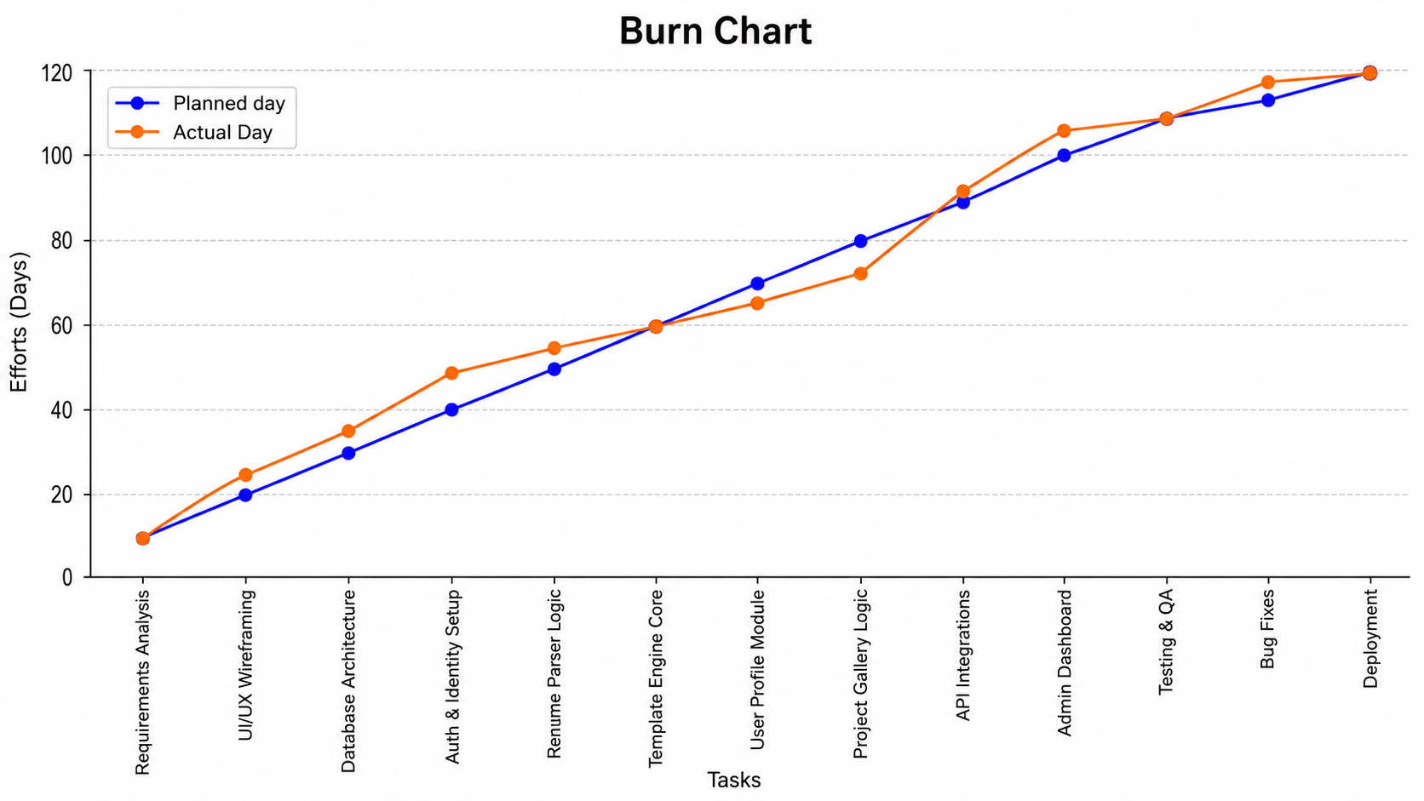
Earned Value and burn charts

Slide 76
Prospered Enhancement
No. | Proposed Enhancement | Description
1 | Export to PDF / Resume Format | Add a feature to convert portfolios into downloadable one-page PDF resumes for job applications.
2 | Portfolio Visitor Analytics Dashboard | Enable users to track portfolio visits, popular projects, and visitor locations using analytics tools.
3 | One-Click Cloud Deployment | Integrate hosting platforms like GitHub Pages, Netlify, or Vercel for instant portfolio publishing.
4 | Custom Domain Mapping | Allow users to connect personal domains (e.g., www.yourname.com) to their portfolios.
5 | Collaborative Portfolio Review Mode | Introduce review links where mentors or friends can comment on portfolio drafts before publishing.
6 | Interactive 3D & WebGL Templates | Add advanced 3D portfolio themes using WebGL and Three.js for more interactive user experiences.

Slide 77
Conclusion
Portify simplifies professional portfolio creation for users without coding skills
The platform generates responsive and professional portfolio websites quickly and efficiently
Key features include dynamic template rendering, Gemini AI integration, secure admin management, and Agile-based development
The project provided practical experience in ASP.NET MVC, SQL Server, and API integration
Portify is a scalable and efficient career-enablement platform ready for future enhancements and deployment

Slide 78
Bibliography
Category | Resources / References
Books & Publications | Pro C# 9 with .NET 5 – Andrew Troelsen & Philip Japikse, Pro ASP.NET Core MVC 2 – Adam Freeman, Programming Entity Framework – Julie Lerman
Official Documentation | Microsoft Learn ASP.NET MVC Docs, Google Gemini API Docs, Hangfire Documentation, MDN Web Docs
Web Resources & Tools | W3Schools, Stack Overflow, Font Awesome, NuGet Package Manager
Software & IDEs Used | Visual Studio 2022, SQL Server Management Studio (SSMS), Postman

Slide 79


