Slide 1
Happiest Health · Digital Twin Challenge 2026
ThermoTwin
A hypertension digital twin that knows how your medicines handle India's heat
[Team name] · [College / incubator]
Notes:
Introduce the team. One line: ThermoTwin predicts heat-triggered crises in people with hypertension, and corrects for the medicines that fool normal wearables.

Slide 2
Heat is hiding inside heart deaths
India's heat toll is massively under-counted, and hypertension sits at the centre of it
14
~30,000
315 M
~380 M
official heatstroke deaths in India, 2025
estimated excess deaths from a single five-day heatwave
Indian adults living with hypertension
workers whose jobs expose them to heat
Many heat deaths are recorded as cardiac arrest. Blood-pressure medicines change how the body handles heat, but no tool connects a patient's record to today's weather.
Sources: NCDC via Deccan Herald (2025); Frontiers in Environmental Health 2026; ICMR-INDIAB (Lancet Diabetes Endocrinol 2023); Lancet Countdown India 2025.
Notes:
Lead with the gap between 14 official deaths and about 30,000 excess deaths. Heat hides in cardiac-arrest counts, and hypertension is where heat and heart risk meet.

Slide 3
The blind spot: beta-blockers fool wearables
Heat models read core temperature from heart rate, and beta-blockers stop heart rate rising
Wearable heat models assume heart rate rises with core temperature.
Beta-blockers blunt that rise, so estimates read low for exactly the patients at risk.
ThermoTwin reads the medication record and corrects the physiology before estimating.
Danger minutes (≥ 38 °C) caught, β-blocker patients
62%
18%
Tested on real heat-trial data (PROSPIE) with a simulated beta-blocker effect on heart rate.
Heart-rate model
ThermoTwin
Notes:
This is the core insight. On real heat-trial data, a plain heart-rate model caught 18% of dangerous minutes for a beta-blocked patient. ThermoTwin caught 62%, with an 8% false-alarm rate.

Slide 4
ThermoTwin in one slide
A digital twin of a hypertensive outdoor worker, updated minute by minute
1
Condition
Hypertension, with the medicines that treat it (β-blockers, ACE-i/ARB, CCB, diuretics)
2
Adverse event
Core temperature ≥ 38 °C: now, and forecast 60 minutes ahead
3
Inputs
Static EHR + 1-minute wearable heart rate and activity + weather
4
Users
PHC doctor (dashboard, pre-summer review) and worker (rest alert)
Notes:
The condition is hypertension, which the brief names directly. Heat is the stressor. The twin fuses the static record with the live stream and predicts a specific event: core temperature reaching 38 degrees.

Slide 5
ThermoTwin architecture
Hybrid physics + ML twin: the medication record changes the physiology model, not just the score
DATA STREAMS
TWIN ENGINE (PYTHON)
SERVICE
USERS
Static EHR (synthetic)
BP meds by class, eGFR history, NSAIDs, age, BMI
1 ECTemp Kalman filter
Core temperature from heart rate
FastAPI
/patients
/timeline
/whatif
/review
Dashboard
React: live twin, what-if, review
Wearable stream
1-min heart rate + activity (JOS-3 simulated shifts)
2 Medication correction
β-blocker: un-blunt HR, widen noise
Weather
Open-Meteo archive: Delhi heatwave, May 2024
3 Personal bias learning
Thermometer readings from past shifts
Review rules
Triple whammy, eGFR decline, β-blocker masking, heat strain
PHC doctor
Pre-summer medication review
Real heat trials
PROSPIE (22 people, 99 trials): validation only
4 60-min forecaster
Gagge physics + gradient boosting
Deploy: Docker Compose (non-root API with health check · nginx serves dashboard and proxies /api) · Quality: pytest suite, participant-held-out real-data validation, multi-seed evaluation
Notes:
Walk left to right: data streams, the four-step twin engine, the API and review rules, then the dashboard. PROSPIE is validation only.

Slide 6
How the twin thinks
Physics first, then personalisation, then forecasting
1
2
3
4
Estimate
Correct
Personalise
Forecast
ECTemp Kalman filter turns 1-minute heart rate into core temperature (Buller et al. 2013).
If the EHR lists a β-blocker, un-blunt heart rate with population priors and widen uncertainty.
Learn each worker's bias from a few thermometer readings on earlier shifts.
Gagge two-node physics + gradient boosting predict ≥ 38 °C within 60 minutes.
Honest by design: ground truth comes from a different physiology model (JOS-3) than the twin uses, and each patient's true drug response is hidden from it.
Notes:
Step 2 is where the record changes the physics. To avoid circular results, the simulator uses JOS-3 and the twin uses ECTemp and Gagge, and each patient's true drug response is hidden.

Slide 7
Validated on real heat trials
PROSPIE: 22 participants, 99 trials, rectal core temperature, held-out participants
β-blocker scenario (real data) | Error | Danger caught | False alarms
Heart-rate model | 0.63 °C | 18% | 0%
ThermoTwin (medication-aware) | 0.39 °C | 62% | 8%
+ learned personal bias * | 0.37 °C | 79% | 38%
0.32 °C
core-temperature error of our heart-rate engine on real people, in line with the published ~0.3 °C
* Separate run with a different random drug response: 0.44 → 0.37 °C and 59% → 79% caught, but false alarms rise 13% → 38%, a trade-off we report. Skin-temperature fusion gave no real gain, so we don't claim it.
PROSPIE dataset, Loughborough University (CC BY-NC 4.0). The beta-blocker effect is simulated on real heart rate; participants were healthy volunteers.
Notes:
Emphasise that these are real core temperatures. Our filter matches the published accuracy. The medication-aware twin roughly triples detection for beta-blocked patients.

Slide 8
60-minute forecast on a real Delhi heatwave
200 simulated workers on May–June 2024 weather (peaks of 46 °C), tested on unseen patients, 3 seeds
AUROC, mean of 3 seeds (higher is better)
+0.11
AUROC gain from learning each worker, consistent on every seed
31%
of danger episodes warned ≥ 30 min ahead (weather-only alert: 0%)
Weather-only alert
0.53
Twin nowcast
0.74
Twin forecast
0.69
Nowcast + personal
0.83
Forecast + personal
0.80
Oracle ceiling
0.97
Notes:
Weather-only alerts are near chance for individuals. Learning each worker adds about 0.11 AUROC. The oracle row shows the remaining gap is in estimating current temperature: our next research step.

Slide 9
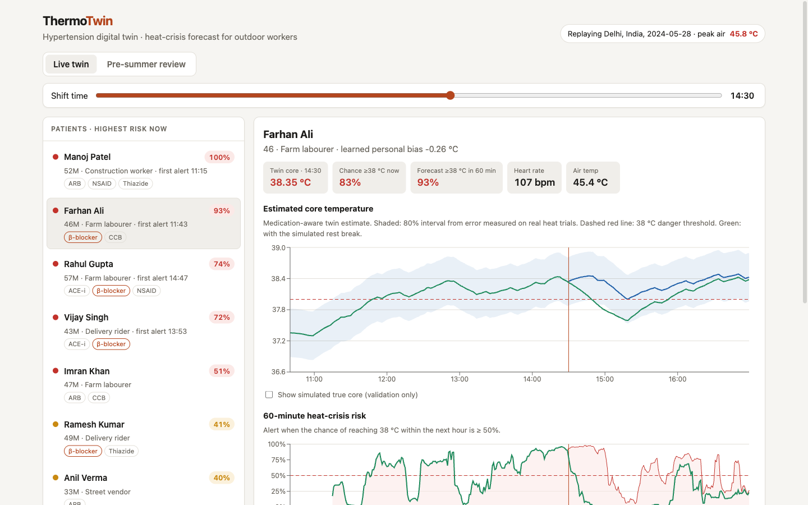
The clinician's live twin
Real 28 May 2024 Delhi replay: patients ranked by risk, estimate with an 80% interval sized from real-data error
Two numbers, never contradictory:
chance ≥ 38 °C now, and forecast within 60 min
Medication chips
β-blockers highlighted: their wearable readings are corrected
Validation toggle
overlay simulated true core temperature
Notes:
Show Farhan Ali, a farm labourer on a beta-blocker. The band is honest uncertainty from real-data error, not the filter's overconfident variance.

Slide 10
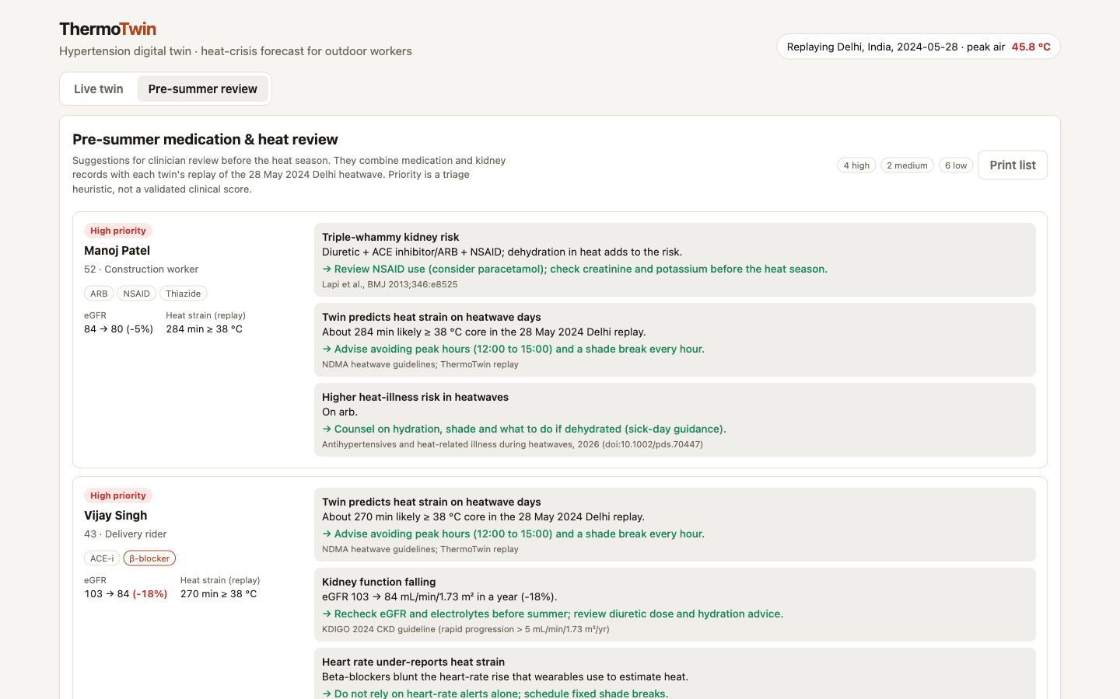
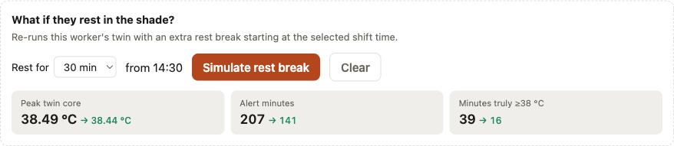
From prediction to action
What-if rest breaks for today; a medication review before summer
What if Farhan rests 30 min in the shade at 14:30?
True minutes ≥ 38 °C fall from 39 to 16; alert minutes from 207 to 141.
Pre-summer review ranks patients with cited rules: triple-whammy kidney risk (BMJ 2013), falling eGFR (KDIGO 2024), β-blocker masking, heat-illness drugs (2026 cohort) and predicted heat strain.
Printable list for the PHC doctor · suggestions for clinician review, not orders
Notes:
The twin doesn't just alarm. It re-simulates a rest break, and before the season it gives the doctor a ranked, evidence-cited medication review.

Slide 11
What makes ThermoTwin different
Compared with a typical risk-score prototype
 | Typical prototype | ThermoTwin
Role of the EHR | Extra model features | Changes the physiology model
What “twin” means | Classifier + dashboard | Kalman filter + physics + personal learning
Validation | Synthetic only | Real heat trials, held-out participants
Honesty | Single accuracy number | Baselines, oracle ceiling, 3 seeds, negative results
Action | “Risk is high” | What-if rest breaks + medication review
India fit | Generic | Real Delhi heatwave, PHC workflow, outdoor workers
Notes:
Keep this short: the record changes the physics, it is validated on real data, and every result is reported against baselines.

Slide 12
What we have not proven yet
Stated plainly, with the next step for each
Simulated patients
Only the weather and validation data are real.
→ Pilot with a PHC hypertension clinic under ethics approval
Drug effect simulated
PROSPIE volunteers were healthy; the β-blocker response was applied to their heart rate.
→ Validate on real β-blocker users
Gap to the oracle
Forecast AUROC 0.80 vs 0.97 if current core were known.
→ Better per-person heart-rate models
False alarms
Personal learning raises detection but also alerts.
→ Calibrate thresholds with clinicians
Notes:
Judges will ask these questions, so we answer them first. Research prototype, not a medical device.

Slide 13
ThermoTwin
The patient's record should change how we read their body in the heat.
Run it: docker compose up --build → http://localhost:8080
Code, results and evaluation reports: GitHub repository (MIT licence)
Research prototype on simulated patients and real weather. Not a medical device.
Notes:
Close on the one idea: the medical record should change how we read the body in the heat. Invite judges to run it with one command.

