Slide 1
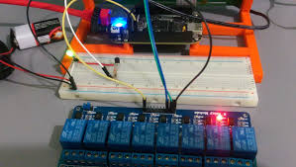
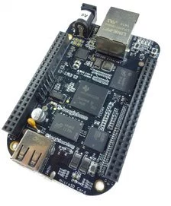
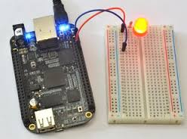
PROGRAMMING LABORATORY-III
Embedded operating system

Slide 2

Practical List
Assignment No | Problem Statement
A1 | Develop an application using Beaglebone Black/ARM Cortex A5 development board to simulate the operations of LIFT.
A2 | Develop an application using Beaglebone Black/ ARM Cortex A5 development board to simulate the working of signal lights
B1 | Write an application to and demonstrate the change in Beagleboard/ARM Cortex A5/Microprocessor/CPU frequency or square wave of Programmable frequency.
B8 | Develop a network based application by setting IP address on BeagleBoard/ARM Cortex A5
C1 | Develop Robotics(Stepper Motor)Application using Beagle Board.

Slide 3
Course Objectives & Outcomes
Course Objectives:
To learn Embedded Operating system programming
To learn writing software engineering document
To learn Embedded/Concurrent and distributed programming
Course Outcomes:
Ability to perform embedded operating systems programming
Ability to write software engineering document
Ability to perform concurrent and distributed programming.

Slide 4

was founded to give developers, hobbyists and students robust open-source hardware development platforms
so they could quickly and cost effectively assemble systems by leveraging the many advantages of the open-source ecosystem.
BeagleBoard, BeagleBoard-xM, BeagleBone and now BeagleBone Black provide flexible and expandable opensource platforms for all electronic artists

Slide 5
Features of BBB
Based on the Sitara AM3358BZCZ100 ARM Cortex-A8 processor from TI
1GHz Linux Computer
4KB EEPROM
512MB of low-power DDR3L RAM
4GB 8-bit eMMC
microSD card slot: expandable up to 32GB
USB Host, Ethernet & HDMI interface
2 X 46 pin header
Debian OS

Slide 6
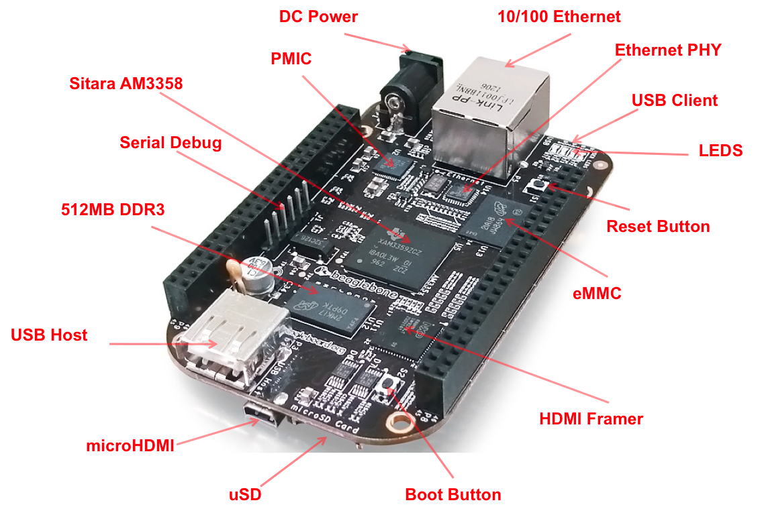
Beagleboard

Slide 7
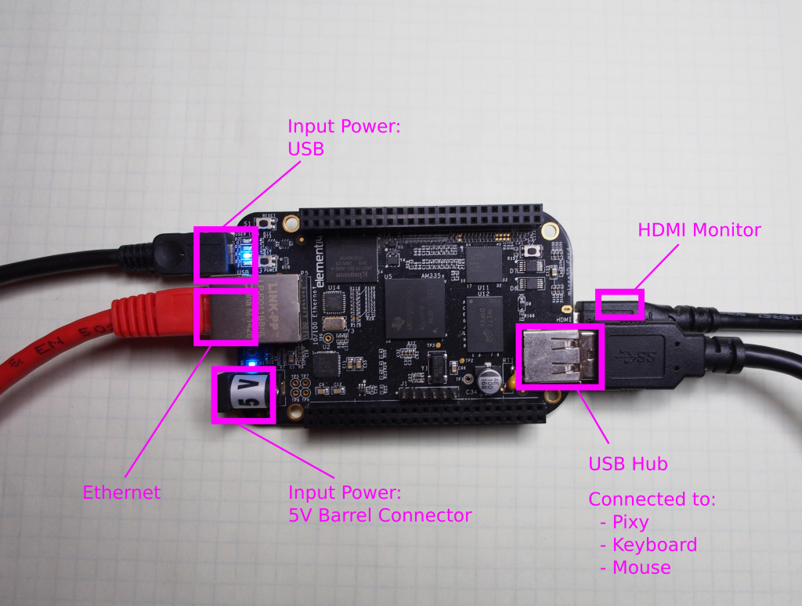

Slide 8
KIT Description
DC Power is the main DC input that accepts 5V power.
Power Button alerts the processor to initiate the power down sequence.
10/100 Ethernet is the connection to the LAN.
Serial Debug is the serial debug port.
USB Client is a miniUSB connection to a PC that can also power the board.
BOOT switch can be used to force a boot from the SD card.

Slide 9
There are four blue LED’S that can be used by the user.
Reset Button allows the user to reset the processor.
uSD slot is where a uSD card can be installed.
microHDMI connector is where the display is connected to.
USB Host can be connected different USB interfaces such as Wi-Fi, BT, Keyboard, etc.

Slide 10
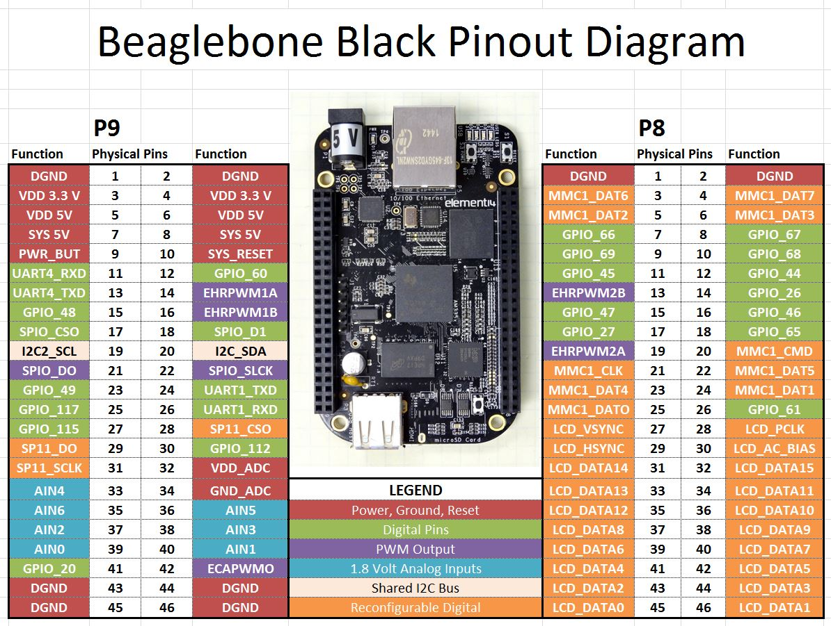

Slide 11
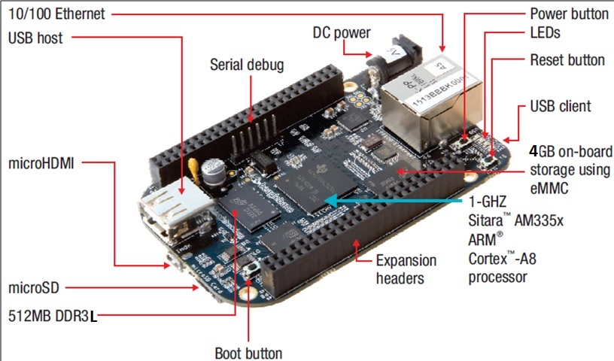
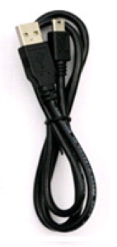
Connectivity Options

Slide 12
Expansion Header
Enable cape hardware and includes
65 digital I/O
7 analog
4 serial
2 SPI
2 I2C
8 PWMs
4 Timers
And much more

Slide 13
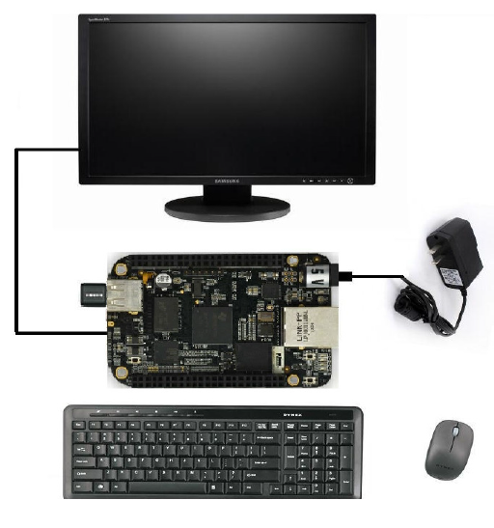
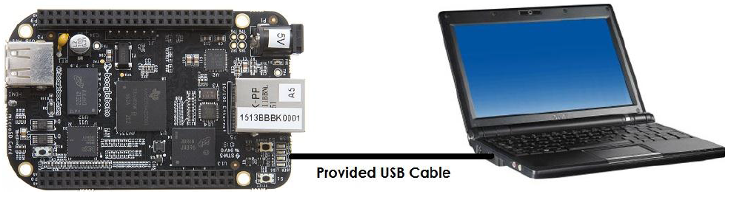
Typical Setup
Two Options:
Tethered to a PC
Standalone
Tethered to PC
Host machine (e.g. Ubuntu)
Target Board (e.g. BBB)
Mini USB to USB Type A Cable (P4 port)
Standalone
5VDC 1A Power Supply
HDMI monitor
Micro HDMI to HDMI Cable
USB wireless K/B mouse combo

Slide 14
Communication between BeagleBoard and host machine using Minicom
Objective: A successful communication between Linux and BeagleBoard using Minicom terminal.
Installation of Minicom
Connect to Beagle board
Configure Minicom
Run minicom as root and test

Slide 15
Installation of Minicom
you need to install Minicom so you can communicate with Beagle Board. Minicom is a text-based modem control and terminal emulation program for Unix-like operating systems.
If you are using CentOS or Fedora then you can type following command to install minicom. You need to perform this installation as a root.
$ su
$ yum install minicom
If you are using Ubuntu as a guest Linux OS then you need to type following command.
$ sudo aptget install minicom

Slide 16
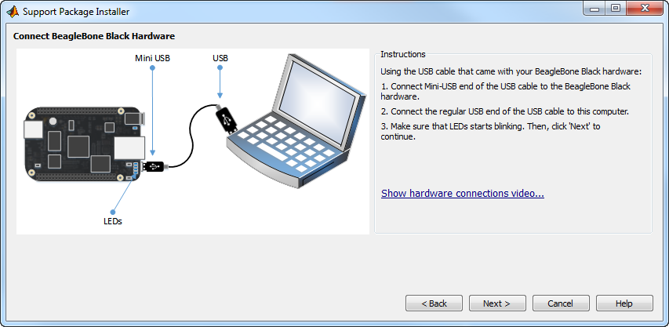
Connect to Beagle board

Slide 17
Configure Minicom
If you are using Minicom first time, you need to set up its configuration and save it as a default configuration.
So next time you can directly use default configuration and no need to set all parameters again.
To open Minicom configuration window write following command.
$ minicom -s

Slide 18
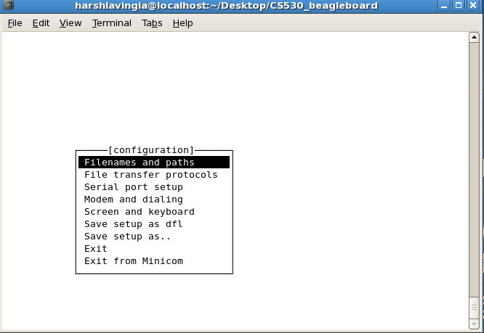
You will get the screen as below.

Slide 19
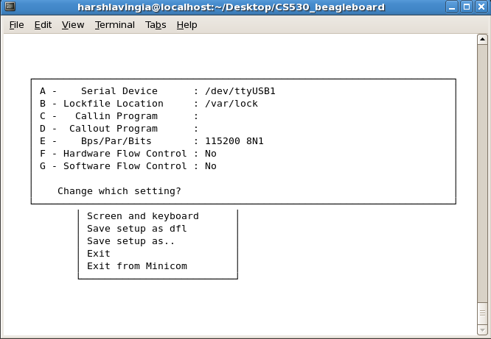
Serial Port setup: By using Up and Down arrow key you can select Serial port setup option and you can see the following screen.

Slide 20
Selecting Serial Device:
If you already connected beagle board as shown in Snapshot 1, then you can find USB/Serial (Laptop/PC) port then you can find it using dmsg command. I am experimenting with my notebook so I need to find which USB port is connected to Beagle Board.

Slide 21
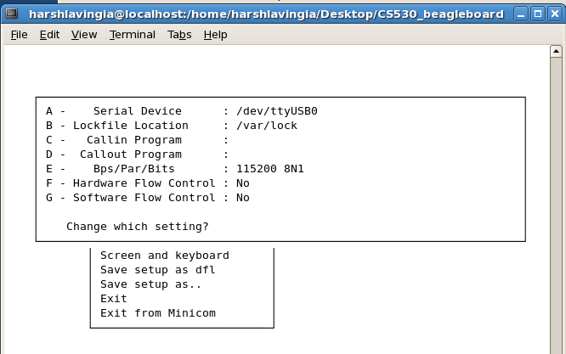
Press A to change serial device to ttyUSB0.

Slide 22
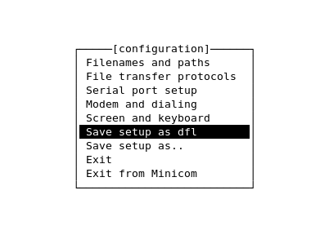
select “Save Setup as dfl”
Then click on “Exit from Minicom” next.

Slide 23
Boot into BBB
After connection open terminal in Ubuntu
Switch to super user ($sudo su)
It may ask password…
Open minicom setup (minicom –s)
In serial port setting
‘A’ setting must be /dev/ttyACM0
‘G’ & ‘H’ (H/w & S/w flow Control) setting must be ‘NO’
Save setup as default & exit
Target will boot & will ask login&password
After login switch to super user ($ su)

Slide 24
Programming steps with BBB
Create folder for your project
Create source file in the folder, use vim Text Editor create source file
Compile source file (use g++ compiler)
Execute output file
Verify output

Slide 25
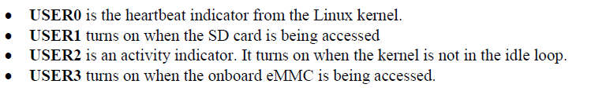
Programming Beaglebone Black
Connecting using Minicom
Type
$ minicom –s
device name – ttyACM0

Slide 26
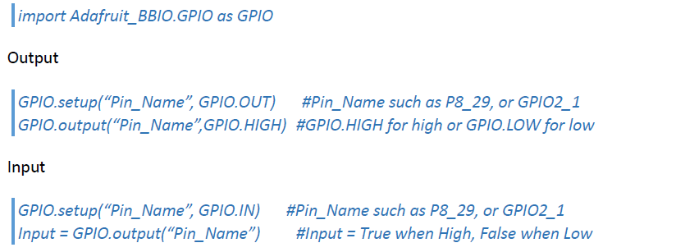
Programming Beaglebone Black (Python)

Slide 27
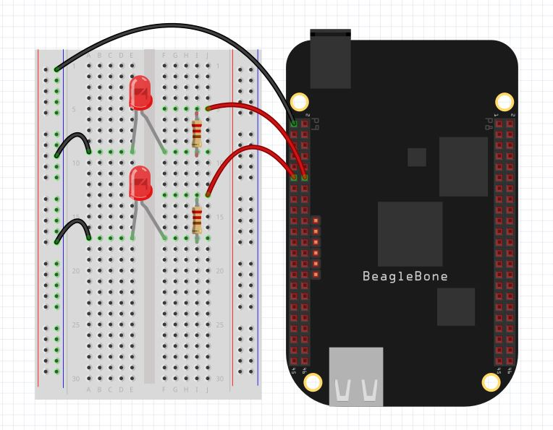
Blinking LEDs through GPIO Pins

Slide 28
Programming Beaglebone Black (Python) – Blinking LED
import Adafruit_BBIO.GPIO as GPIO
LEDTop=“P8_9”
LEDBottom=“P8_10”
GPIO.setup(LEDTop, GPIO.OUT)
GPIO.setup(LEDBottom, GPIO.OUT) from time import sleep
for I in range(0,5):
GPIO.output(LEDTop,GPIO.HIGH)
sleep(1)
GPIO.output(LEDTop,GPIO.LOW)
sleep(1)
GPIO.cleanup()

Slide 29
Programming Beaglebone Black (Python) – Blinking LED
import Adafruit_BBIO.GPIO as GPIO import time GPIO.setup("P8_9", GPIO.OUT) while True: GPIO.output("P8_9", GPIO.HIGH) time.sleep(0.5) GPIO.output("P8_9", GPIO.LOW) time.sleep(0.5)

Slide 31
Reference
element14 BeagleBone Black System Reference Manual, April 2014

Slide 32

Thank you !

