Slide 1
Glassdoor review analysis
By Purvi Joshi

Slide 2
EDA
Data Cleaning
Filling missing values in pros and cons
Convert pros and cons from object data type to string
Feature selection
Performed following text pre-processing steps to select most frequent words from pros and cons:
Ex - It’s good company, pay is good. I am very happy with my team :#:).
Tokenization - [It’s, good, management, pay, is, good. , I, am, very, happy, with, my, team, :#:).
Remove stop words - [good, management, pay, good. , very, happy, my, team, :#:)].
Remove special characters using Regular Expression - [good, management, pay, good , very, happy, my, team]
Found most frequent words (Example - salary, pay, management, team, culture,growth, etc) using Counter and default dict

Slide 3
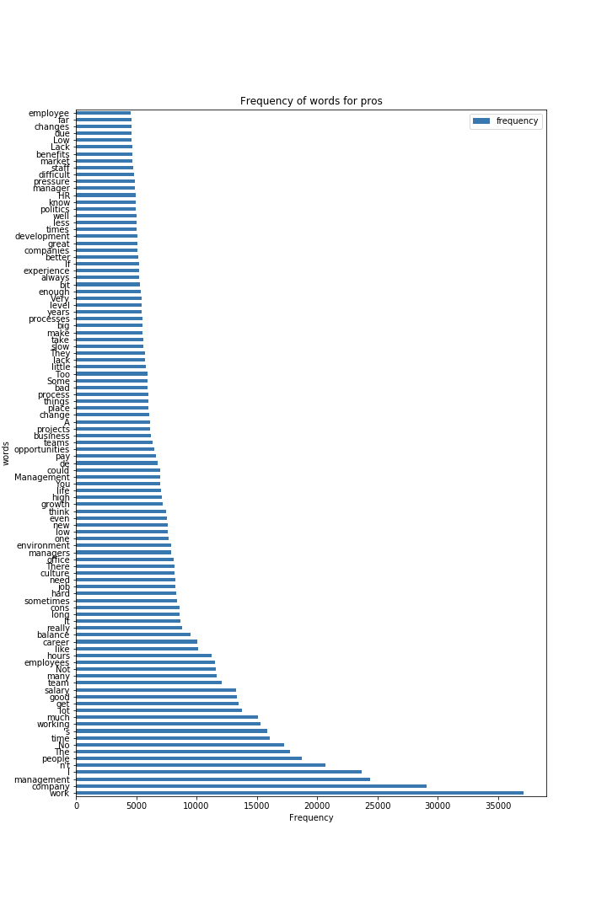

Slide 4
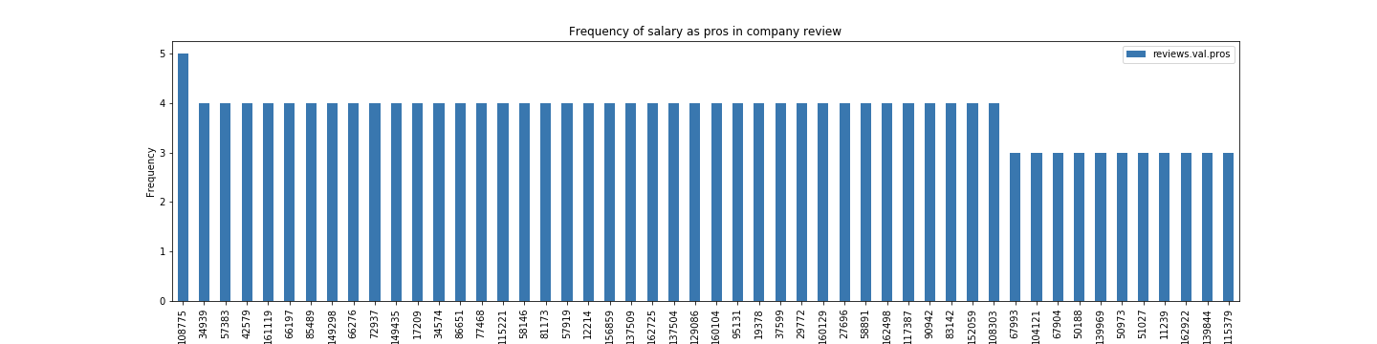
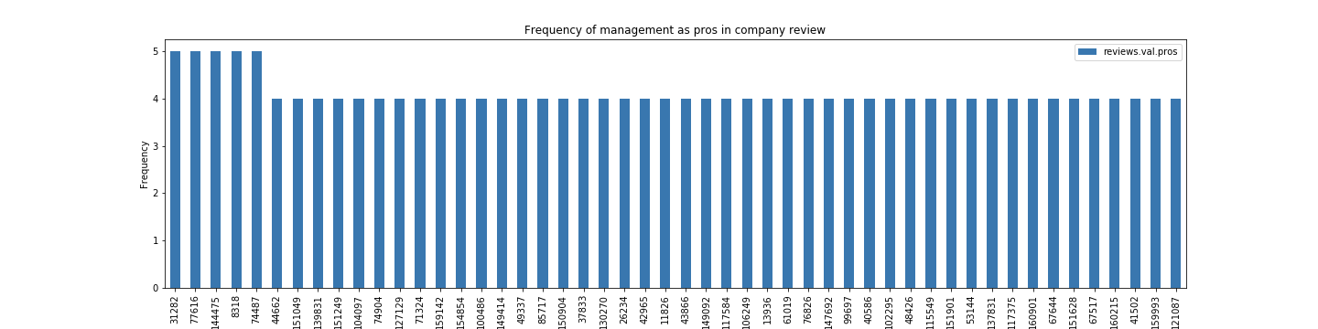
EDA - how many people are saying salary and management as pros in 50 companies(max 5 reviews/company)
Company id
Company id

Slide 5
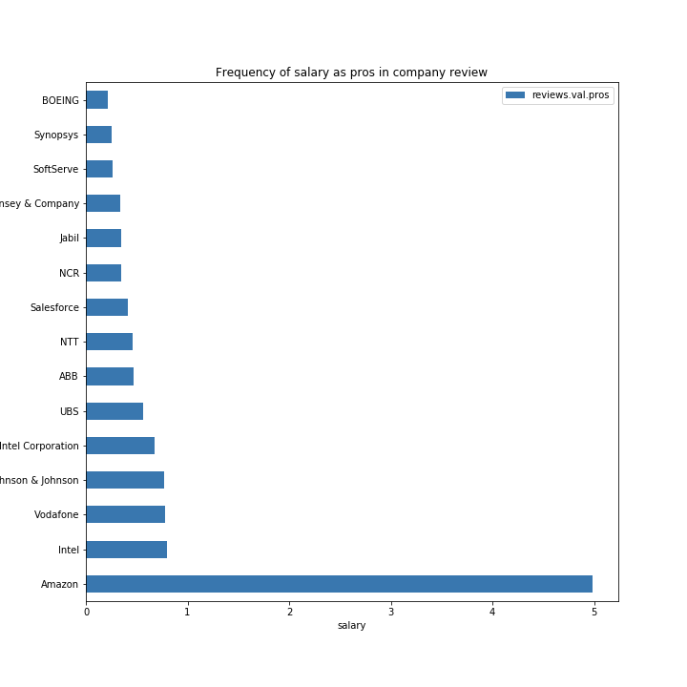
EDA - how many people are saying salary as pros in 15 companies

Slide 6
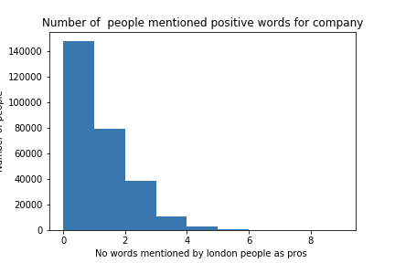
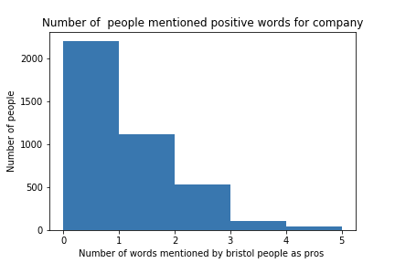
London vs Bristol pros mentions for frequent words

Slide 7
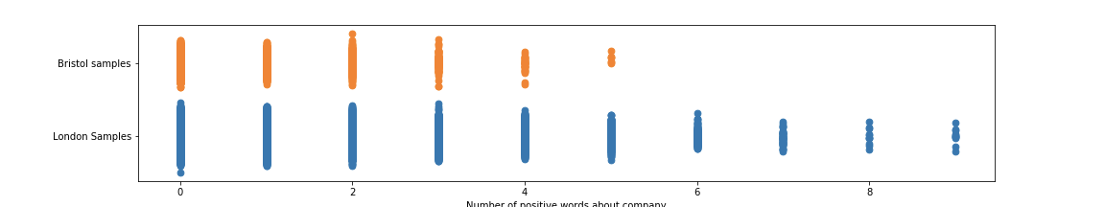
Weltch t test and u test result
N0 : People of london and bristol are equally happy with their jobs
NA : People of london are more happy with their jobs
pvalue=0.000123427 i.e reject N0

Slide 8
Conclusion and Future work

Slide 9
EDA Steps
Type conversion (from object to string)
Filling missing values with empty string. (can not drop it as if pros missing value, cons may not be missing for that company and vise versa)
Applied following text pre-processing steps:
Tokenization
Stop word removal
Feature selection: get most frequent words people are commenting about for all companies
Plotted 100 companies among 165290 companies where people are happy with salary,manager, managment.
Found common words between pros and cons people have commented about companies
Performed hypothesis test

Slide 10
company_freq_words = ["work","management","salary","pay","team","carrier","balance","environment","oppurtunties",
"oppurtunty","development","politics","manager","people","benefits","benefit","flexibility","carrier","flexible",
"carrier","technology","supervisor","people","vision"]

