Slide 1
Fake News Detection using Machine Learning
Machine Learning DE-3 IA-2
-Purvi Harniya 1814023
-Neelay Jagani 1814024
-Esha Gupta 1814025

Slide 2
Introduction
Data has been increasing at an unprecedented range in an exponential manner and is producing 2.7 quintillion bytes of data everyday.
The definition of fake news is information that pushes people down the wrong road. Fake news is spreading like wildfire these days, and people are sharing it without confirming it. This is frequently done to promote or impose specific views, and it is frequently accomplished through political agendas.
As a result, it is vital to recognise phoney news.

Slide 3
Problem Definition
Fake News have become more prevalent in recent years and with great amount of dynamism in internet and social media, differentiating between facts and opinions, relating to commercial or political upheavals has become more difficult than ever.
Fake information is purposely or unintentionally spread throughout the internet. The massive dissemination of fake news has left an indelible mark on people and culture.
We use various NLP and preprocessing methodologies like tokenization, stop words removal, lemmatization, stemming and machine learning classification algorithms - logistic regression, pac, ada, naive bayes, svm, random forest, xgboost, decision trees and rnn, to build a model that differentiates between fake news and real news and also analyze the performance of these various classification methodologies to choose the best classifier on out dataset.

Slide 4
Types of Data in Social Media Posts
There are three major ways by which social media networking sites read news items:
Text: Computational linguistics analyzes text , focusing on the genesis of text semantically and methodically. Because many of the posts are written in the form of texts, much work has been carried out into analysing them.
Multimedia: Several types of media are combined in a single post. Audio, video, photos, and graphics may all be included. This is highly appealing, because it captures the attention of the visitors without requiring them to read the content.
Hyperlinks: Hyperlinks allow the post's creator to cross-reference to other sources, gaining viewers' trust by confirming the post's genesis. Cross-reference to other social media networking sites, as well as the embedding of photos, is common practise.

Slide 5
Types of Fake News and patterns that help in detection
Visual Based: These false news posts make extensive use of graphics as compared to content, which may include manipulated photographs, doctored video, or a combination of the two.
User Generated News: This sort of falsified news is generated by phoney accounts and is targeted to certain audiences, which might reflect specific age groups, gender, culture, or political affiliations.
Knowledge based: These posts provide scientific (so-called) explanations to some unresolved problems, leading people to feel they are genuine. For example, natural therapies for high blood sugar levels in the human body.
Style based: Pseudo Journalists who impersonate and mimic the style of some accredited journalists write style-based posts.
Stance based: It is a portrayal of true statements in such a way that its meaning and purpose are altered.

Slide 6
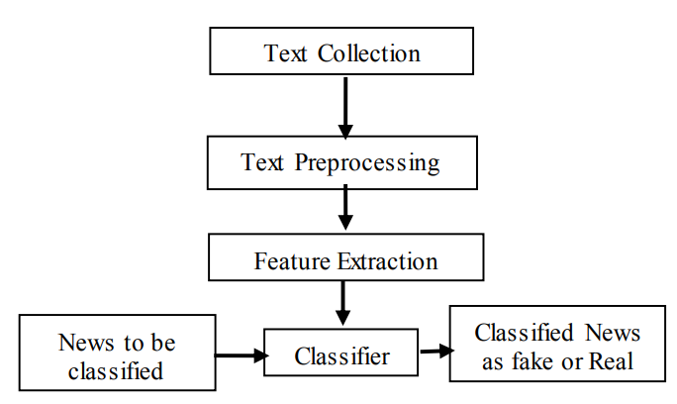
Methodology
The fake news model detection is built using steps like Text Collection, Text Preprocessing, Feature Extraction and then finally classification using different classifiers.

Slide 7
Text Collection
The text collection process is carried out by referring to Kaggle ISOT Fake News datasets. Data is gathered from 244 websites.
It is made up of approximately 44898 posts that were recorded over the course of 30 days. The true news data set is made of 23481 posts and the fake news data set is made of 21417.
The title and text are among the features (news body), the subject, date, and label are all required. The news topics are divided into several categories, including 'politicsNews,' 'worldnews,' 'News,' and 'political’, 'Government News,' 'Left News,' 'US News,' 'Middle East.'

Slide 8
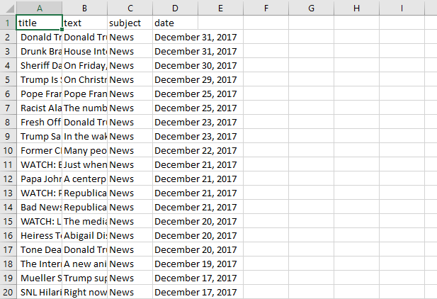
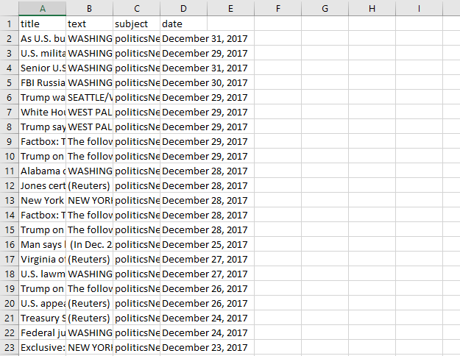
Text Collection
The ISOT dataset was compiled exclusively from real-world sources. The true news was gathered by crawling Reuters.com articles and bogus news taken from untrustworthy websites highlighted by Politifact and Wikipedia.

Slide 9
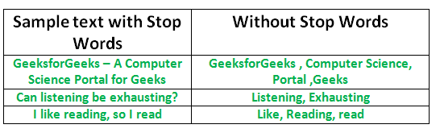
Text Pre-processing
Text data must be preprocessed before being input into machine learning and deep learning models, by employing NLP methods such as stop word removal, tokenization, sentence segmentation, and punctuation removal.
Following the acquisition of content, pre-processing is performed.
All of the letters in the document are converted to lowercase.
Numbers are removed
Punctuation and accent marks are removed.
White spaces are removed
Stop words are removed

Slide 10
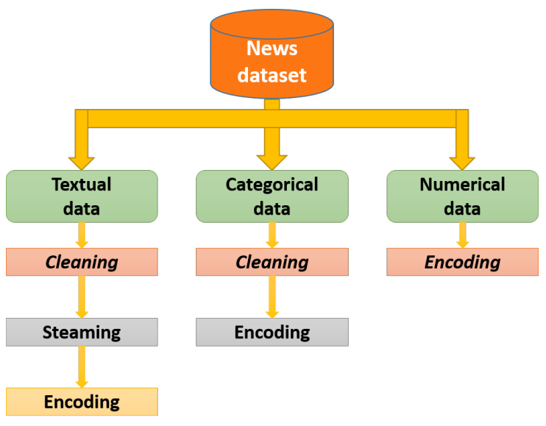
In-depth text pre-processing
Textual data: Text written by the author in a news, pre-processed by the following operations:
1. Cleaning: eliminating stop words and special characters.
2. Stemming: transforming the useful words into roots.
3. Encoding: transforming all the words into a numerical vector. This needs two steps: bag of words and N-grams, then the application of the TF-IDF method on the result.
Categorical data: Source of the news- TV channel, newspaper or magazine; its author. The pre-treatment of these data is performed through two steps:
– Cleaning: eliminating special characters and transforming letters into lowercase.
– Encoding: for sources we used a label encoding. For authors, the names were encoded into numerics. A list containing two fields was created, the first for the source and the second for its authors, then we replaced each author by its index number.
Numerical data: The date of posting and the sentiment given by the text. Split the date into three unique values: day, month and year. For the sentiment given by the text, we calculate the sum of the sentiment degrees of the words.

Slide 11
Feature Extraction
Before feeding the text into the machine learning algorithm, the text must be parsed in order to evaluate words, and words must be encoded as integers or floating-point values.
Bag of Words: Machine learning from text employs a technique known as the bag of words, which takes any text and counts the frequency of words after removing all stop words.
Countvectorizer: The Count Vectorizer provides an easy way to tokenize a group of content archives or documents and create a jargon of known words, as well as encode new reports using that jargon.
TF-IDF: This is used to convert content to vectors while keeping the semantics of the word in mind. TF is a typical tokenization technique that calculates document similarity by counting the number of words in the documents. Using the TF approach, each document is represented by a vector containing the word counts. Then, for each vector, the sum of its elements will be one, converting the word counts into probabilities. The TF-IDF metric is a weighting metric that is extensively used in text classification problems.
Word Embedding using Spacy: To generate a vector, this concept of feature representation is used. A dense matrix with a low dimension is obtained here. Spacy is a Natural Language Processing library that generates numeric vectors that represent words for word embedding.

Slide 12
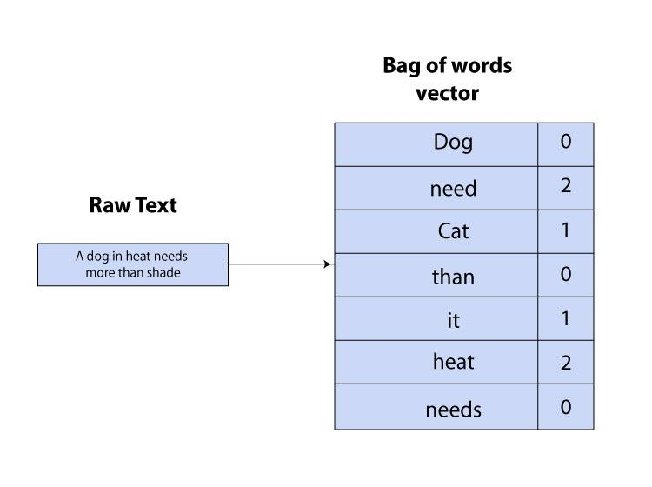
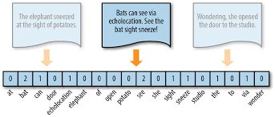
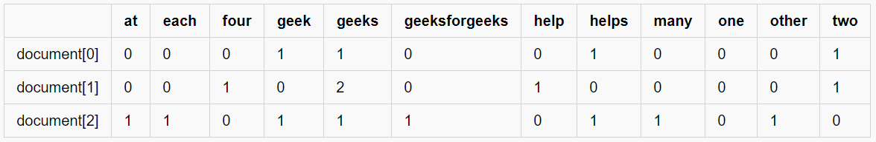
TF-IDF vectorizer
Bag of words
Countvectorizer

Slide 13

Classifiers
Support Vector Machine:
-One of the most widely used models for binary and multi-classification tasks.
-Supervised machine learning classifier that has been used by numerous academics to solve binary and multi-classification issues.
In a binary classification issue, the instances are separated by a hyperplane in such a way that wTx + b = 0, where w is a dimensional coefficient weight vector that is normal to the hyperplane. The bias term b represents the values offset from the origin, while data points are represented by x. The fundamental job of SVM is to determine the values of w and b.
Drawing decision boundaries is known as creating a hyperplane that separates two classes. Unoptimized decision boundaries may result in misclassification; to overcome this, SVM are regarded as important by examining extreme cases.

Slide 14



Logistic Regression:
- popular classification approach in machine learning to predict the values of the predictive variable y in a binary classification issue, where y = [0, 1].
- The negative class is represented by 0 and the positive class by 1.
- To classify two classes, 0 and 1, a hypothesis h(𝛩) = θ^{T}X will be constructed, and the classifier's output threshold is when h(x) = 0.5.
- If the value of hypothesis h(x) ≥ 0.5, it predicts y = 1, indicating that the news is true.
- If the value of hypothesis h(x) < 0.5, it predicts y = 0, indicating that the news is false.
- Hence, the prediction of logistic regression under the condition 0 ≤ hθ(x) ≤ 1 is done.
- Logistic regression sigmoid function can be written in equation 5 as follows:
- here:
- Logistic regression Cost function:

Slide 15


Decision Trees:
- well-known supervised learning algorithm.
- The primary principle behind DT is that it creates a model to forecast the value of a dependent component by learning numerous decision rules derived from the entire set of data.
- Decision Tree features a top-down structure and tree-like shapes, with nodes that can only be a leaf node that is bound with a label class or a decision node that is responsible for making decisions.
- because it is a slow learner, it may perform poorly on small datasets.
- The most important learning process in DT is choosing the right attribute. To tackle this problem, different trees employ different measures, such as information gain in the ID3 algorithm and gain ratio in the C4.5 algorithm.
- For attribute A, the gain ratio and information gain can be calculated as follows:
where intrinsic value of attribute A can be calculated as:

Slide 16

Random Forest:
- an ensemble of unpruned decision trees bagged with a randomised set of features at each split. Each tree in the random forest makes a forecast and the forecast with the highest number of votes becomes our final prediction. According to the No Free Lunch theorem, no algorithm is always the most accurate; hence, RF is more accurate and robust than individual classifiers.
The decision tree's high variance was reduced to a low variance by using row sampling and feature sampling. The number of decision trees could be determined using hyperparameters. It's an ensemble algorithm that combines more than one calculation of the same or distinguishing kind for characterizing objects.
The random forest algorithm can be expressed as:
If F(x) represents the random forest model, j represents the target category variable, and F represents the characteristic function. To ensure the decision tree's diversity, the sample selection of random forest and the candidate attributes of node splitting are both random.
Algorithm: Random Forest
Require: | Training set (m is the number of training set, f is the feature set)
Ensure: | Random forest with msub CART trees
1: | Draw Bootstrap sample sets msub with replacement
2: | Choose a sample set as the root node and train in a completely split way
3: | Select fsub randomly from f and choose the best feature to split the node by using minimum principle of Gini impurities
4: | Let the nodes grow to the maximum extent. Label the nodes with a minimum impurity as leaf node
5: | Repeat steps 2-4 until all nodes have been trained or labeled as leaf nodes.
6: | Repeat steps 2-5 until all CART has been trained
7: | Output the random forest with msub CART trees

Slide 17

Gradient Boosting
Gradient boosting in machine learning is used for regression and classification. It's a way for boosting. Leaf indicates an initial prediction, which is log(odds) for classification; this is turned into a probability using the logistic function (10).
XG-Boost:
It's a very strong Gradient boosting classifier. Designed for usage with large, complex datasets. It is an ensemble strategy that prevents overfitting and thereby regularizes boosting. In all circumstances, it is scalable. It can handle sparse data as well as parallel and distributed processing, making learning faster and more efficient.

Slide 18
K-NN:
- K-NN is a well-known machine learning algorithm.
- The K-NN techniques are extremely straightforward.
- Given a test sample, it initially determines the k nearest neighbours based on a distance measure.
- Then, using the major vote strategy, it predicts the class label of the test instance.
- Sometimes the classification performance of K-NN is poor, owing to the curse of dimensionality.
- K-NN is also a lazy learning method that can take a long time to classify data.
Algorithm: KNN Algorithm
1: | for all unlabeled data u do
2: | for all labeled data v do
3: | compute the distance between u and v
4: | find k smallest distances and locate the corresponding labeled instances v1,.. vk
5: | assign unlabeled data u to the label appearing most frequently in the located ‘ labeled instances
6: | end for
7: | end for
8: | End

Slide 19
Other Approaches
Neural Networks
A neural network is made up of densely interconnected processing pieces called neurons that cooperate to solve very specific problems.
Deep neural networks are one of the most popular deep learning techniques in machine learning.
Deep neural networks and advances in pre-trained word embedding have become a source of fresh creative ideas in recent years.
However, the entire model ignores the importance of key words and instead treats all words as a network of input, with no particular consideration given to significant words.
As a result of integrating the benefits of the two methods, redesigning the neural network model, and boosting the weight keywords in the network, the final text classification results should increase significantly

Slide 20
Summary of steps and procedure
Algorithm
Input: | News Content
1. | Convert text to lowercase
2. | Remove punctuations, digits, stop words from text
3. | Repeat: Input: Receive each news article Calculate count vector for it Append the count vector to count_feature vector Until the end of news article
4. | Repeat Input: Receive each news article Calculate the TF-IDF vector for it Append the count vector to tfidf_feature vector Until the end of news article
5. | Repeat Input: Receive each news article Calculate the Spacy vector for it Append the spacy vector to Spacy_feature vector Until the end of news article
6. | Parse count_feature vector, tfidf_feature vector and spacy_feature vector into classifier Return feature vector gives us highest accuracy
7. | Build model with the feature vector
Output: | Predict label of news - Fake or Real

Slide 21
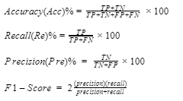
Results and Analysis
We can evaluate machine learning algorithms using various metrics like:
Accuracy
Precision
Recall
F1-Score
Hence we evaluate and analyse the result based on these
metrics for different datasets, classifiers and different methods of
feature extraction methodology.

Slide 22
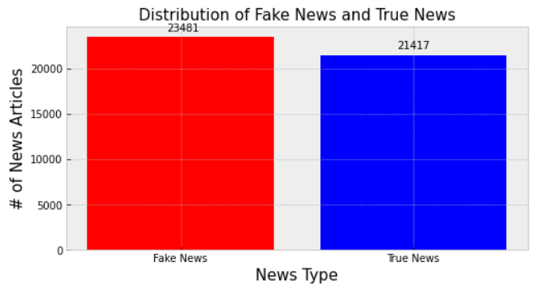
Implementation and results
Google Colab link- https://colab.research.google.com/drive/1Jgn0uP2frisa9GS1AaI5iUlsHnt9ziO5?usp=sharing
Github link - https://github.com/Purviharniya/Fake-news-detection
After loading the dataset, we check for null values and the distribution of fake and true news in the dataset:

Slide 23
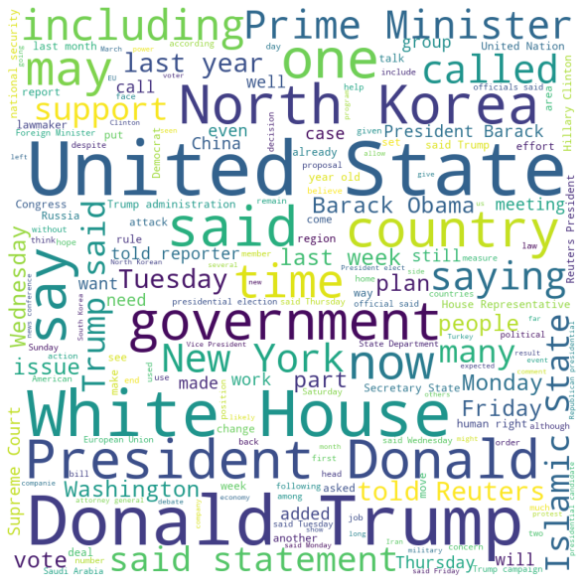
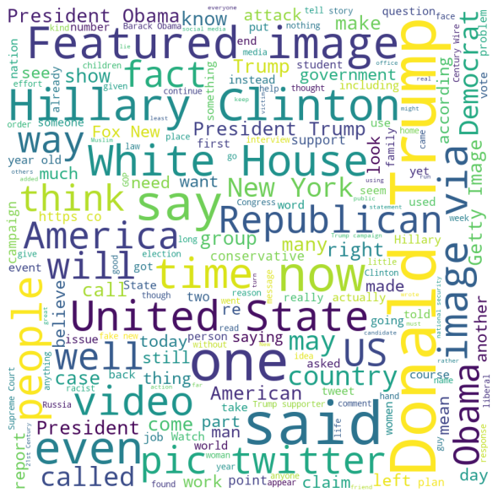
Implementation and results
WordCloud of true news:
WordCloud of fake news:

Slide 24
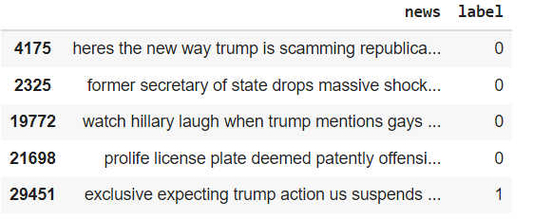
Implementation and results
We preprocess the news text by using NLP techniques as follows:
We iterate through each row and do the following:
We first normalize the text by removing any non-words and extra spaces using regex
Tokenize the text and remove stopwords
Lemmatize the text so that the words are converted to their base forms.

Slide 25
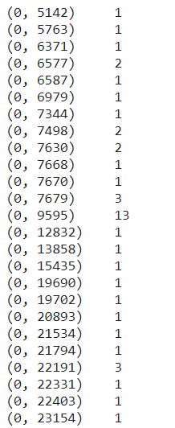
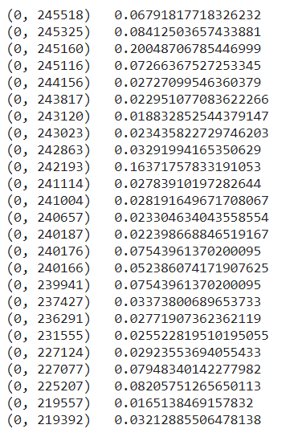
Implementation and results
We then use Count Vectorizer to convert the text documents to a matrix of token counts.
We transform the count vectorizer matrix using tf-idf vectorizer to get a matrix of tf-idf features.

Slide 26
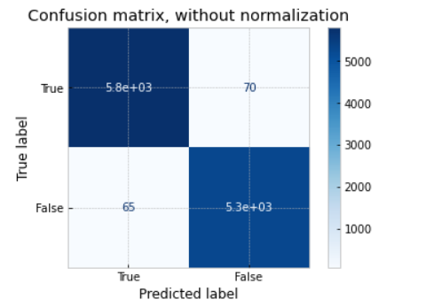
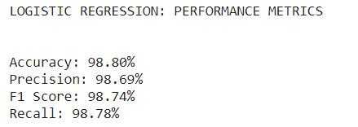

Implementation and results
After splitting the data into testing and training, we use the training data to train various models and testing data to evaluate their performance. The following are the models and their performance measures.
Logistic Regression:

Slide 27
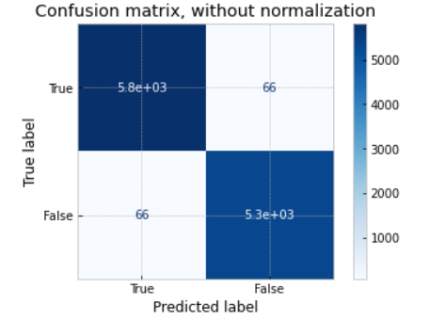
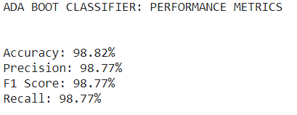

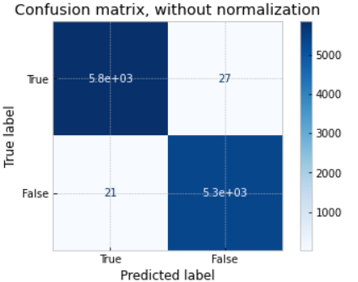
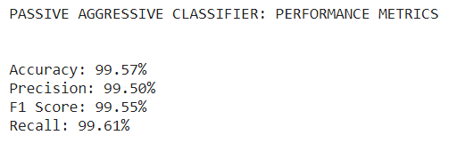

Implementation and results
2. ADABoost Classifier
3. Passive Aggressive Classifier

Slide 28
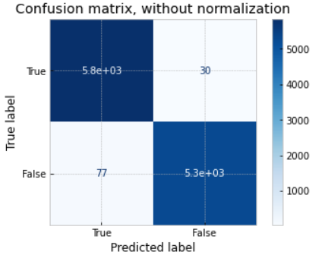
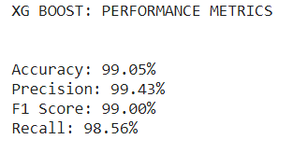

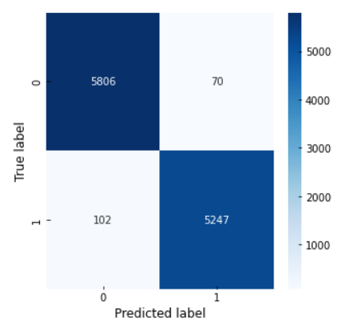

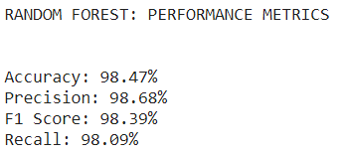
Implementation and results
4. XGBoost Classifier
5. Random Forest Classifier

Slide 29
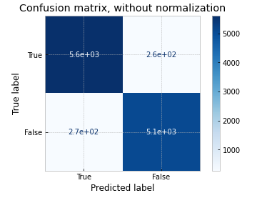
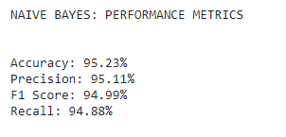

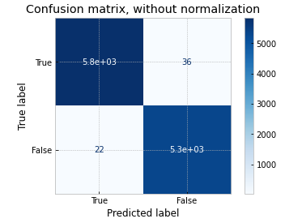
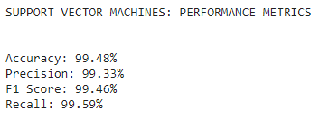

Implementation and results
6. Naive Bayes Classifier
7. SVM Classifier

Slide 30
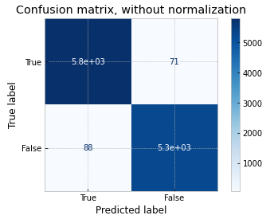
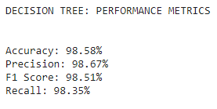

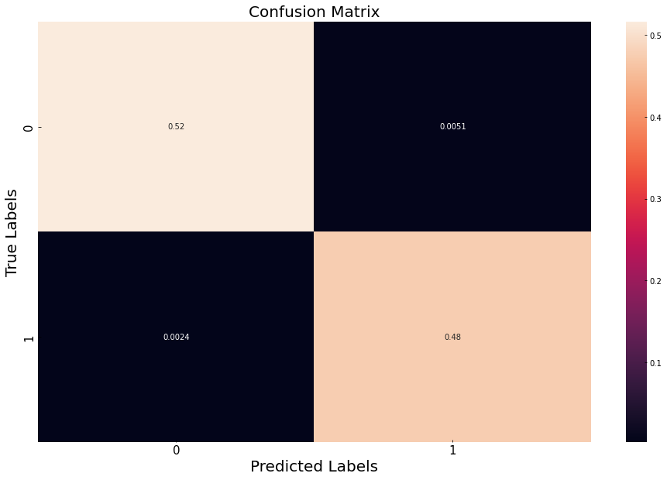
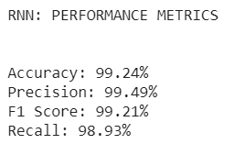

Implementation and results
8. Decision Tree Classifier
9. RNN

Slide 31
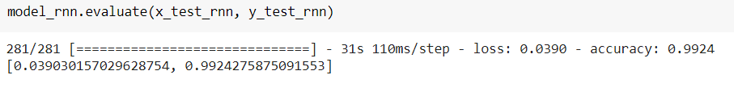
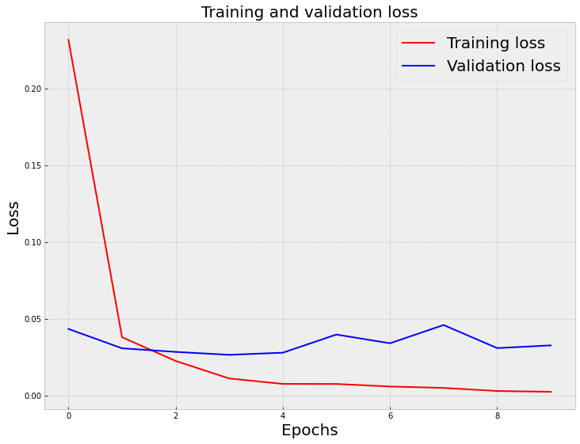
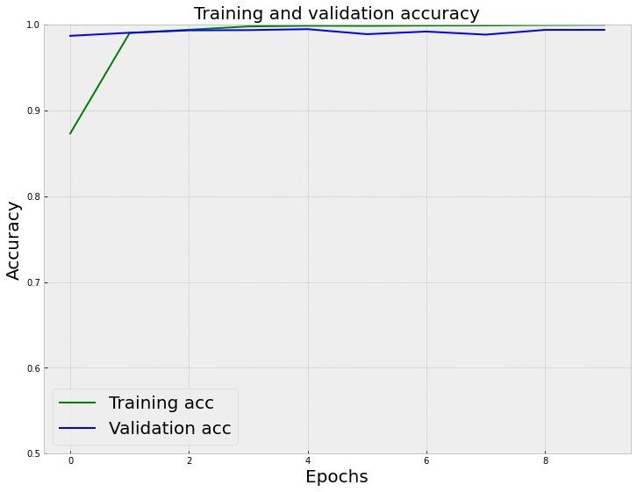
Implementation and results
9. RNN

Slide 32
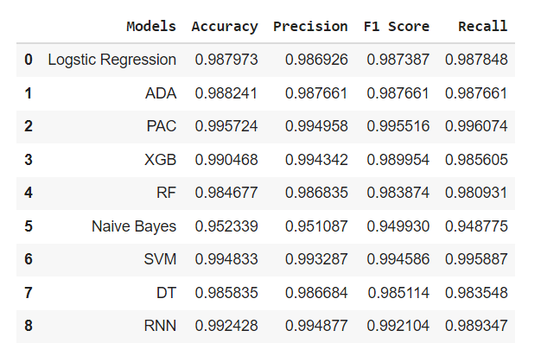
Implementation and results
Summary of all the model performance metrics

Slide 33
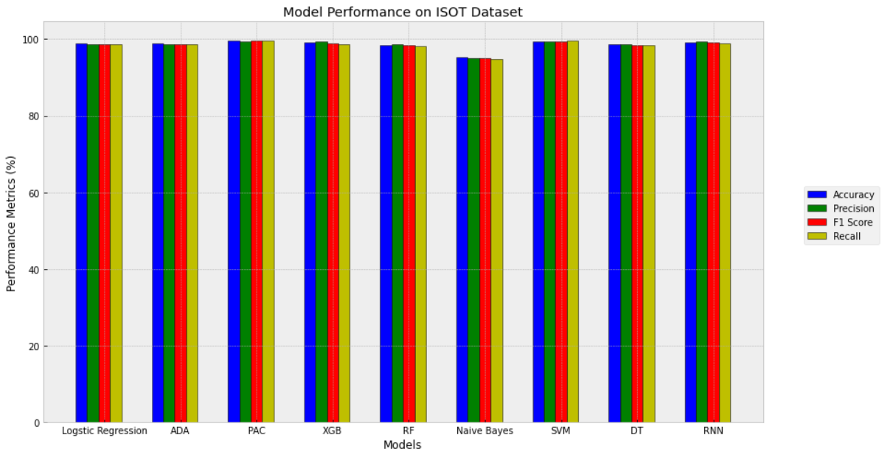
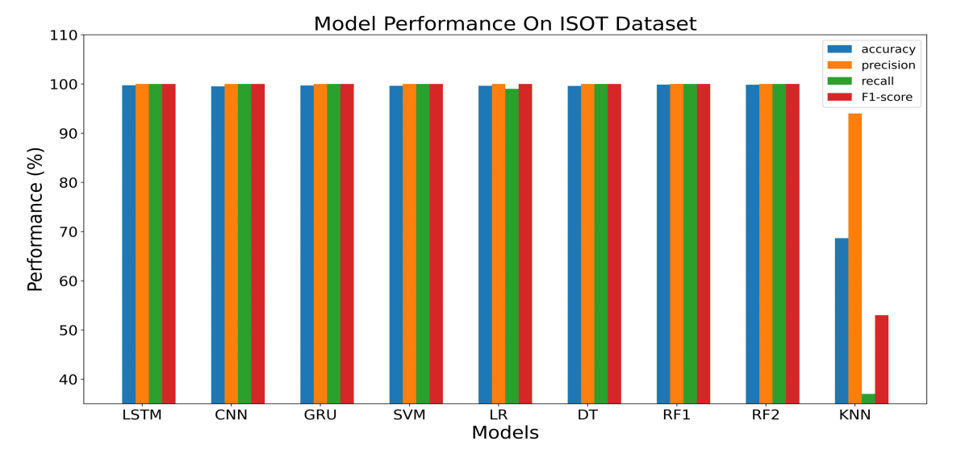
Implementation and results
Our results:
Results in the research paper

Slide 34
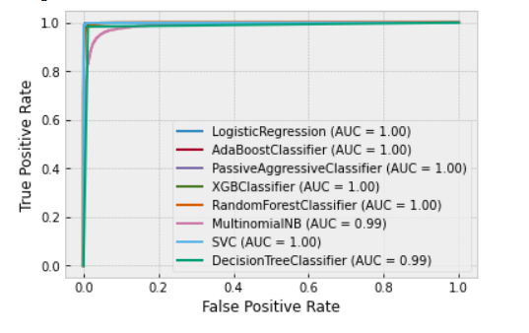
Implementation and results
ROC Curves of all the classifiers:
We see that SVM has the best ROC curve and hence is the best classifier for our dataset.

Slide 35
Conclusion
In recent years, deceptive content has grown in popularity, and its influence on online users has increased.
We downloaded the ISOT dataset from the website given below: https://www.uvic.ca/ecs/ece/isot/datasets/index.php and uploaded it to our drive, and then loaded it and preprocessed it using various NLP algorithms like tokenization, stop words removal, lemmatization and stemming. We vectorized the text documents using count vectorizer and tf-idf vectorizer. After preprocessing, we split the data into testing and training and we built nine models using nine different classification algorithms and used the predictions to calculate the performance metrics.

Slide 36
Conclusion
The details of our implementation results are given below:
Sr | Models | Accuracy | Precision | F1 Score | Recall
1 | Logistic Regression | 0.987973 | 0.986926 | 0.987387 | 0.987848
2 | ADABoost Classifier | 0.988241 | 0.987661 | 0.987661 | 0.987661
3 | Passive Aggressive Classifier | 0.995367 | 0.994585 | 0.995142 | 0.995700
4 | XG Boost | 0.990468 | 0.994342 | 0.989954 | 0.985605
5 | Random Forest | 0.983697 | 0.986075 | 0.982838 | 0.979622
6 | Naive Bayes | 0.952339 | 0.951087 | 0.949930 | 0.948775
7 | SVM | 0.994833 | 0.993287 | 0.994586 | 0.995887
8 | Decision Tree | 0.986726 | 0.987256 | 0.986055 | 0.984857
9 | RNN | 0.993875 | 0.993517 | 0.993632 | 0.993747

Slide 37
Conclusion
From the ROC curve and the bar plot which compares the performance of all the models, we conclude that the SVM (accuracy-99.48%, precision - 99.33%, f1 score-99.46%, recall-99.59%) is the best algorithm on our ISOT dataset for the task of fake news detection and classification. The colab notebook of our implementation is available at - https://colab.research.google.com/drive/1Jgn0uP2frisa9GS1AaI5iUlsHnt9ziO5?usp=sharing .
Github link - https://github.com/Purviharniya/Fake-news-detection
The greatest accuracy that the authors of the research paper attained by classification techniques was by using SVM Linear classification algorithm with TF-IDF feature extraction with 0.94 accuracy.
Even though both RNN and SVM achieve almost the same accuracy, the RNN takes longer to train and is more sophisticated. So, in our proposed system, Linear SVM is used, which is less difficult and takes less time to compute.
Hence we managed to achieve a better accuracy (99.48%) than the research paper(94%) that we referred to even though the classifier that we got was the same.

Slide 38
Future Work
Deep learning methods and sentiment analysis to categorise news with high accuracy.
More useful text such as the publication of the news, URL domain, and so on, could be extracted for the process.
For more accuracy, a dataset with a higher number of articles from various sources can be employed, as it includes more jargon and notable material.

Slide 39
References
[1] N. Smitha and R. Bharath, "Performance Comparison of Machine Learning Classifiers for Fake News Detection," 2020 Second International Conference on Inventive Research in Computing Applications (ICIRCA), 2020, pp. 696-700.
[2] A. Benamira, B. Devillers, E. Lesot, A. K. Ray, M. Saadi and F. D. Malliaros, "Semi-Supervised Learning and Graph Neural Networks for Fake News Detection," 2019 IEEE/ACM International Conference on Advances in Social Networks Analysis and Mining (ASONAM), 2019, pp. 568-569.
[3] S. I. Manzoor, J. Singla and Nikita, "Fake News Detection Using Machine Learning approaches: A Systematic Review," 2019 3rd International Conference on Trends in Electronics and Informatics (ICOEI), 2019, pp. 230-234.
[4] A. Kesarwani, S. S. Chauhan and A. R. Nair, "Fake News Detection on Social Media using K-Nearest Neighbor Classifier," 2020 International Conference on Advances in Computing and Communication Engineering (ICACCE), 2020, pp. 1-4.
[5] K. Poddar, G. B. Amali D. and K. S. Umadevi, "Comparison of Various Machine Learning Models for Accurate Detection of Fake News," 2019 Innovations in Power and Advanced Computing Technologies (i-PACT), 2019, pp. 1-5.

Slide 40
[6] K. Rajesh, A. Kumar and R. Kadu, "Fraudulent News Detection using Machine Learning Approaches," 2019 Global Conference for Advancement in Technology (GCAT), 2019, pp. 1-5.
[7] N. F. Baarir and A. Djeffal, "Fake News detection Using Machine Learning," 2020 2nd International Workshop on Human-Centric Smart Environments for Health and Well-being (IHSH), 2021, pp. 125-130.
[8] T. Jiang, J. P. Li, A. U. Haq, A. Saboor and A. Ali, "A Novel Stacking Approach for Accurate Detection of Fake News," in IEEE Access, vol. 9, pp. 22626-22639, 2021.

Slide 41
Thank You!

