Slide 1

SHREE UTTAR GUJARAT BBA & BCA COLLEGE
SEMINAR REPORT
ON
MOBILE COMPUTING
SUBMITTED BY:
GUIDED BY:
purvisha kathrotiya
khushbu patel

Slide 2
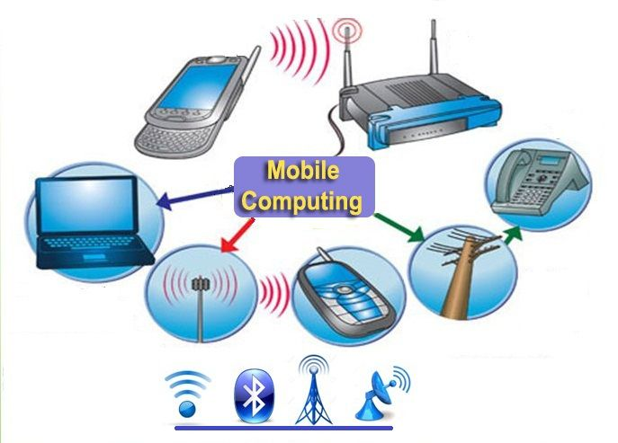

Slide 3
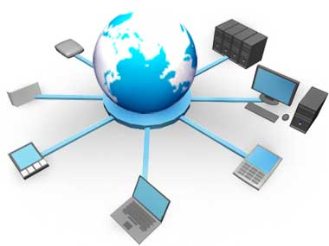
TABLE OF CONTENTS
History
Introduction
What is Mobility
Applications of mobile computing
Advantages
Disadvantages
Future of mobile computing

Slide 4
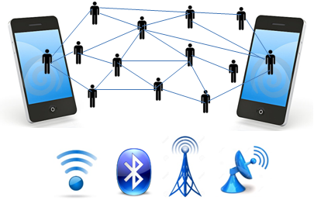
HISTORY
Developments in mobile technology have led to many different types of mobile computing.
Though mobile computing technology has existed since the 1980s,it was in the late 1990s and 2000s that advances in the technology put it into the of numerous consumers.

Slide 5
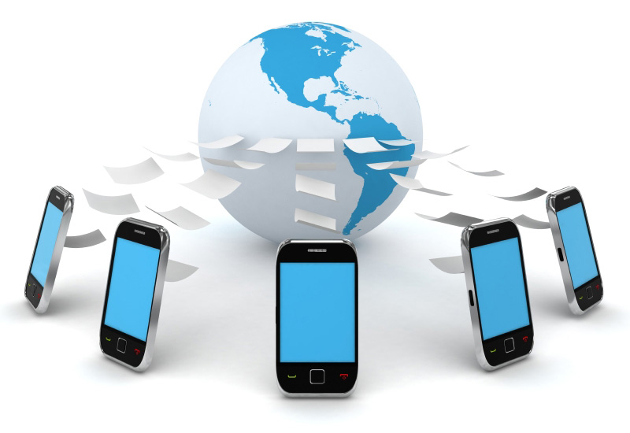
INTRODUCTION
Mobile computing
Mobile(moving)
+
Computing(using computer)
Mobile computing refers to a technology that allows transmission of data , voice and video via a computer or any other wireless device. It is free from having any physical links.

Slide 6
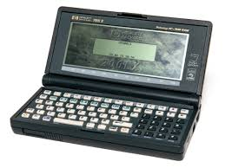
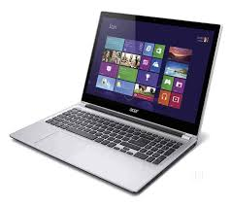
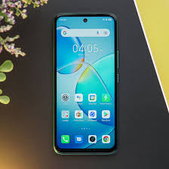
WHAT IS MOBILITY?
A device that moves
Between different geographical location
Between different networks
Between different applications
Such as a palm-top , laptop and cellphones
A device due to which mobile communication is possible
Modems

Slide 7
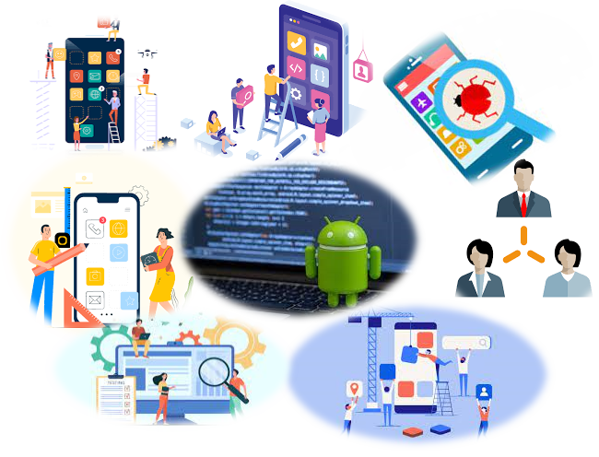
APPLICATION OF MOBILE COMPUTING
For Estate Agents
In Courts
In Companies
Stock Information Collection/Control
Credit Card Verification
Taxi/Truck Dispatch
Electronic Mail/Paging

Slide 8
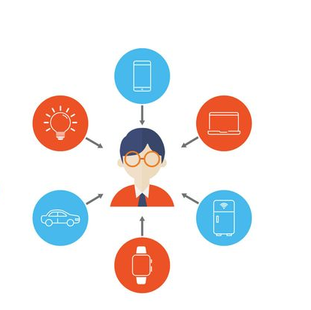
ADVANTAGES
Location Flexibility
Saves Time
Enhanced Productivity
Ease of Research
Entertainment Streamlining Of Business Processes

Slide 9
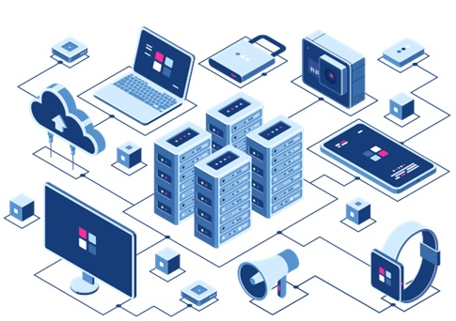
DISADVANTAGES
Expensive
Short Battery Life
Small Screen Display
Slow Internet Speed
Communications Depends Upon Network
Risky To Carry
Security

Slide 10
FUTURE OF MOBILE COMPUTING
SOME FEATURES OF FUTURE MOBILE COMPUTING DEVICES
Hardware
Lighter ,Smaller, Energy Management, User Interface
High Bandwidth Facility
Shift Industrial Paradigm from Piecewise Solution to end-to-end
Information Systems
Improved Radio Technology And Antennas

Slide 11
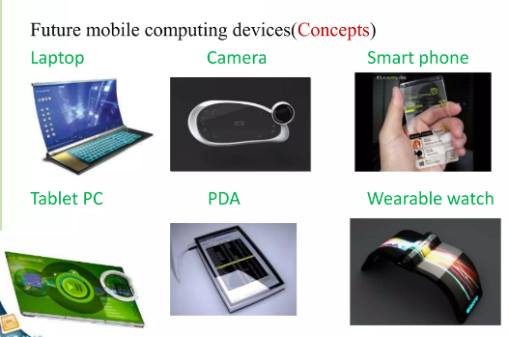
FUTURE OF MOBILE COMPUTING DEVICES

Slide 12


