Slide 1
INTERNSHIP CAPSTONE
Heart Disease
Prediction Using
Machine Learning
Machine Learning Classification Project
CLINICAL DATA • CLASSIFICATION • EVALUATION
01

Slide 2
PROJECT FRAMING
02
Problem Statement
Can clinical measurements help classify whether heart disease is present?
Clinical challenge
Modeling task
Decision criterion
Heart disease status must be inferred from multiple patient clinical measurements rather than a single variable.
Build binary classifiers that predict “Disease Present” when the original severity target is greater than zero.
Compare Logistic Regression and Decision Tree performance using held-out test metrics and ROC AUC.
Target definition: 0 = No Disease • 1 = Disease Present
The project treats this as a screening-oriented binary classification problem.
HEART DISEASE PREDICTION • MACHINE LEARNING CAPSTONE
02 / 18

Slide 3
WHAT THE PROJECT DELIVERS
03
Objectives
Prepare reliable inputs
Understand the data
Train two classifiers
Clean duplicate records, resolve types, and impute missing values.
Inspect class balance, feature distributions, and numeric correlations.
Fit Logistic Regression and a depth-limited Decision Tree.
Evaluate rigorously
Select a model
Demonstrate inference
Use accuracy, precision, recall, F1-score, confusion matrices, and ROC AUC.
Choose the model that is most appropriate for the test-set evidence.
Run a sample held-out prediction and document limitations.
HEART DISEASE PREDICTION • MACHINE LEARNING CAPSTONE
03 / 18

Slide 4
HEART DISEASE UCI
04
Dataset Overview
Combined multi-center clinical dataset
920
16
4
918
14
Raw patient records
Raw columns
Data sources
Rows after cleaning
Model features
Sources
Duplicate handling
Binary target
Cleveland
Hungary
VA Long Beach
Switzerland
2 duplicate rows were removed after dropping the non-predictive id column.
Original num values 0–4 were mapped to target:
0 = No Disease
1 = Disease Present (num > 0)
HEART DISEASE PREDICTION • MACHINE LEARNING CAPSTONE
04 / 18

Slide 5
CLINICAL VARIABLES USED FOR MODELING
05
Dataset Features
Demographics
Symptoms
Vital signs
age, sex, dataset
cp (chest pain type), exang (exercise-induced angina)
trestbps (resting blood pressure), thalch (max heart rate)
Lab measure
ECG & stress
Vessel / thalassemia
chol (serum cholesterol), fbs (fasting blood sugar)
restecg, oldpeak, slope
ca, thal
HEART DISEASE PREDICTION • MACHINE LEARNING CAPSTONE
05 / 18

Slide 6
END-TO-END PIPELINE
06
Machine Learning Workflow
1
2
3
4
5
6
7
Load & inspect
Clean & impute
EDA
Encode & split
Scale
Train
Evaluate
Data split
Models
Evaluation
80/20 train/test split with stratification and random_state = 42.
Logistic Regression (max_iter=1000) and Decision Tree (max_depth=5).
Accuracy, Precision, Recall, F1-score, Confusion Matrix, and ROC AUC.
StandardScaler was fit on the training data only to avoid data leakage.
HEART DISEASE PREDICTION • MACHINE LEARNING CAPSTONE
06 / 18

Slide 7
DOCUMENTED CLEANING DECISIONS
07
Data Preprocessing
Drop id
Remove duplicates
Fix boolean fields
Identifier removed because it is not predictive.
2 duplicate rows removed.
fbs and exang converted from TRUE/FALSE to 0/1.
Binarize target
Impute missing values
Encode & scale
num > 0 mapped to Disease Present.
Median for numeric fields; mode for categorical fields.
Categoricals label-encoded; StandardScaler applied after split.
Important limitation: ca and thal had high raw missingness and were mode-imputed.
HEART DISEASE PREDICTION • MACHINE LEARNING CAPSTONE
07 / 18

Slide 8
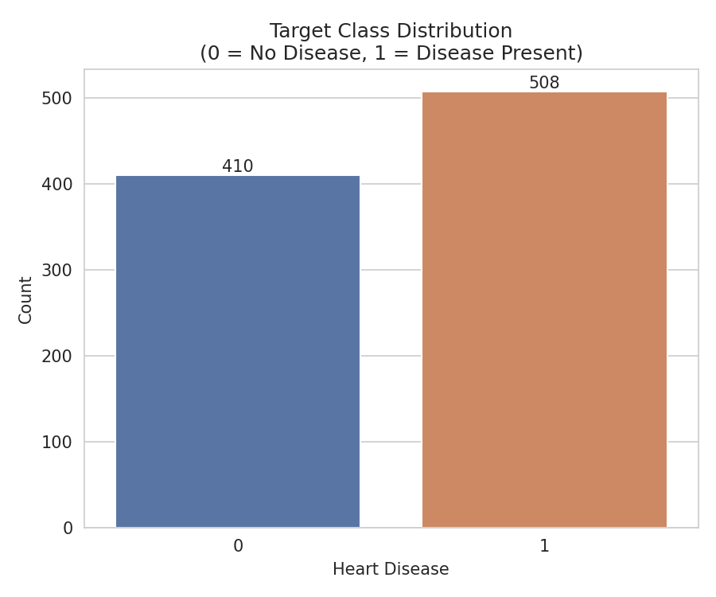
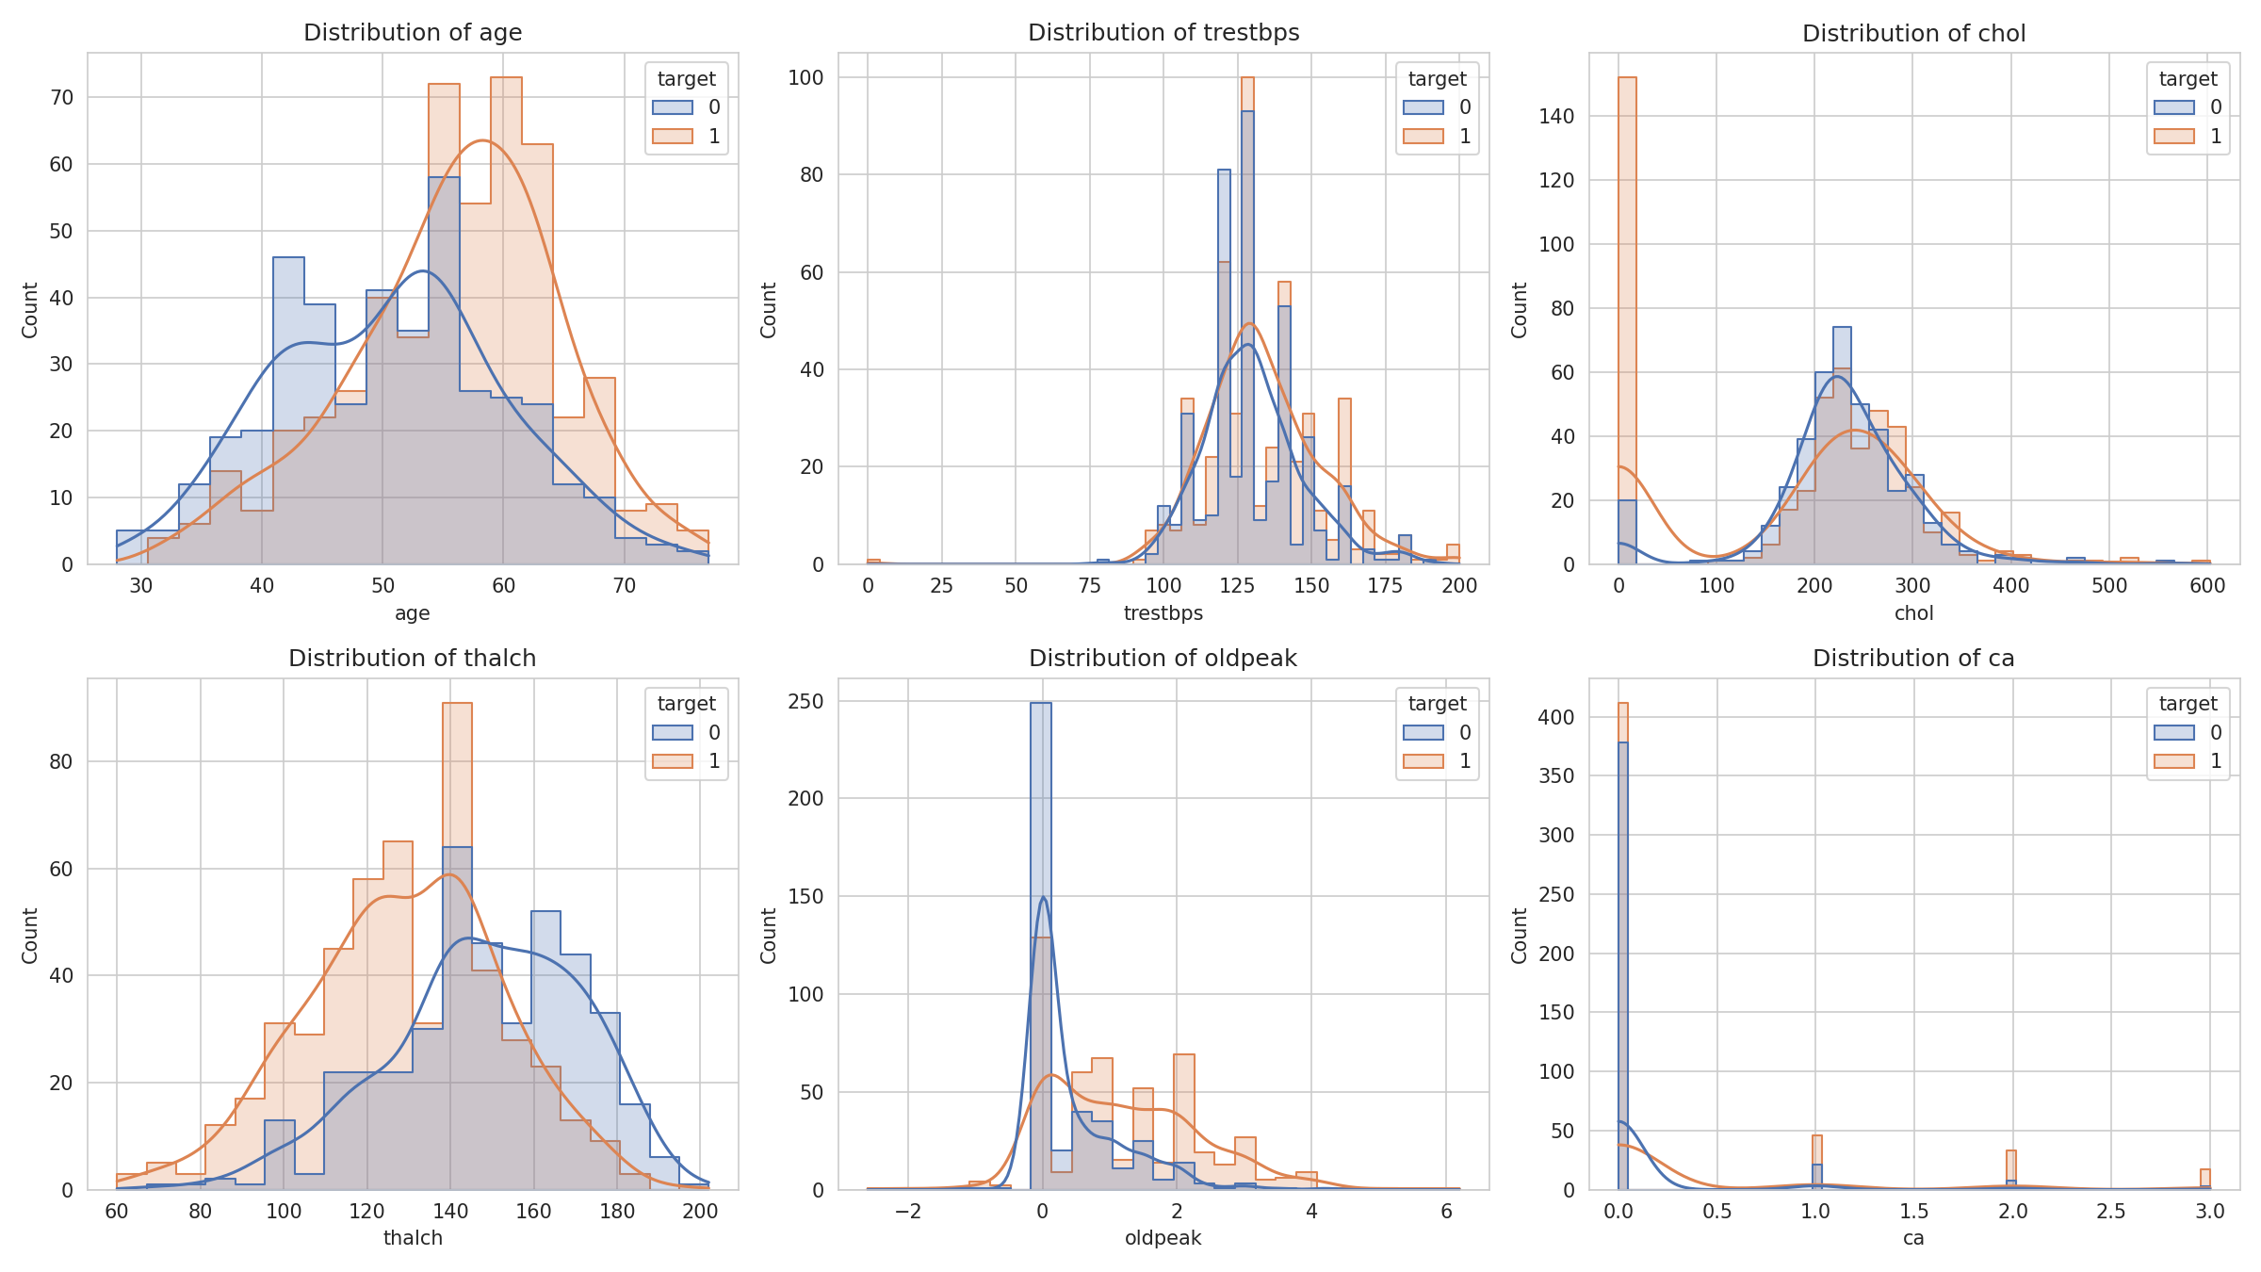
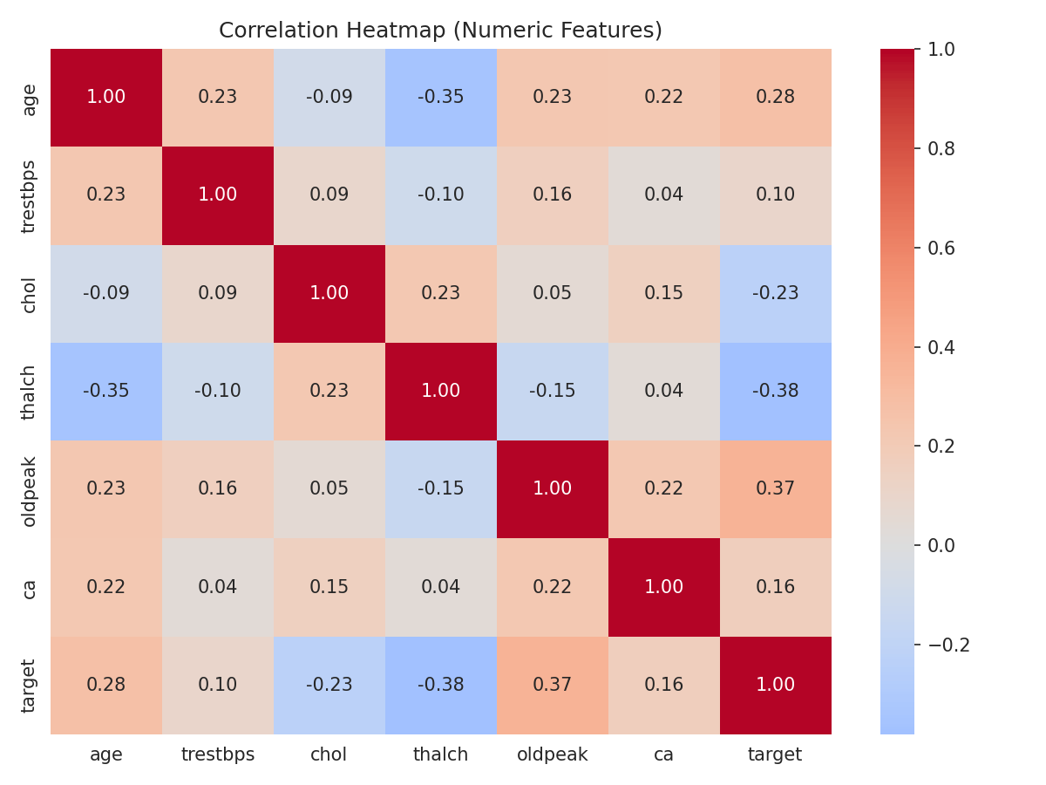
CLASS BALANCE, DISTRIBUTIONS, AND CORRELATIONS
08
Exploratory Data Analysis
EDA takeaways
• Final binary distribution: 410 No Disease vs 508 Disease.
• Numeric distributions were inspected by disease class.
• Correlation heatmap was generated for numeric features and target.
HEART DISEASE PREDICTION • MACHINE LEARNING CAPSTONE
08 / 18

Slide 9
LINEAR PROBABILISTIC CLASSIFIER
09
Logistic Regression
Configuration
0.9073
0.8627
0.8381
LogisticRegression
random_state = 42
max_iter = 1000
ROC AUC
Recall
F1-score
Why it was selected
• Matched Decision Tree accuracy at 0.8152.
• Delivered higher ROC AUC than the Decision Tree (0.9073 vs 0.8684).
• Delivered higher recall (0.8627 vs 0.8039), reducing false negatives in this screening-oriented context.
Test-set output
Accuracy: 0.8152
Precision: 0.8148
Recall: 0.8627
F1-score: 0.8381
ROC AUC: 0.9073
HEART DISEASE PREDICTION • MACHINE LEARNING CAPSTONE
09 / 18

Slide 10
NONLINEAR RULE-BASED CLASSIFIER
10
Decision Tree
Performance profile
Configuration
DecisionTreeClassifier
random_state = 42
max_depth = 5
Root
Rule 1
Rule 2
Test-set output
Accuracy: 0.8152
Precision: 0.8542
Recall: 0.8039
F1-score: 0.8283
ROC AUC: 0.8684
Leaf
Leaf
Leaf
Leaf
The tree achieved the highest precision (0.8542) but lower recall and ROC AUC than Logistic Regression.
HEART DISEASE PREDICTION • MACHINE LEARNING CAPSTONE
10 / 18

Slide 11
HOW MODELS WERE ASSESSED
11
Evaluation Metrics
Accuracy
Precision
Recall
Overall fraction of correct predictions.
Among predicted disease cases, fraction that were correct.
Among actual disease cases, fraction detected by the model.
F1-score
Confusion matrix
ROC AUC
Balance of precision and recall.
Counts of correct and incorrect predictions by class.
Threshold-independent ranking ability across false-positive and true-positive rates.
HEART DISEASE PREDICTION • MACHINE LEARNING CAPSTONE
11 / 18

Slide 12
TEST SET • 184 ROWS
12
Logistic Regression Confusion Matrix
Rows = actual class • Columns = predicted class
Predicted
No Disease
Disease
Matrix summary
True Negatives: 62
False Positives: 20
False Negatives: 14
True Positives: 88
No Disease
62
20
Actual
Disease
14
88
Recall = 88 / (88 + 14) = 0.8627
HEART DISEASE PREDICTION • MACHINE LEARNING CAPSTONE
12 / 18

Slide 13
TEST SET • 184 ROWS
13
Decision Tree Confusion Matrix
Rows = actual class • Columns = predicted class
Predicted
No Disease
Disease
Matrix summary
True Negatives: 68
False Positives: 14
False Negatives: 20
True Positives: 82
No Disease
68
14
Actual
Disease
20
82
Precision = 82 / (82 + 14) = 0.8542
HEART DISEASE PREDICTION • MACHINE LEARNING CAPSTONE
13 / 18

Slide 14
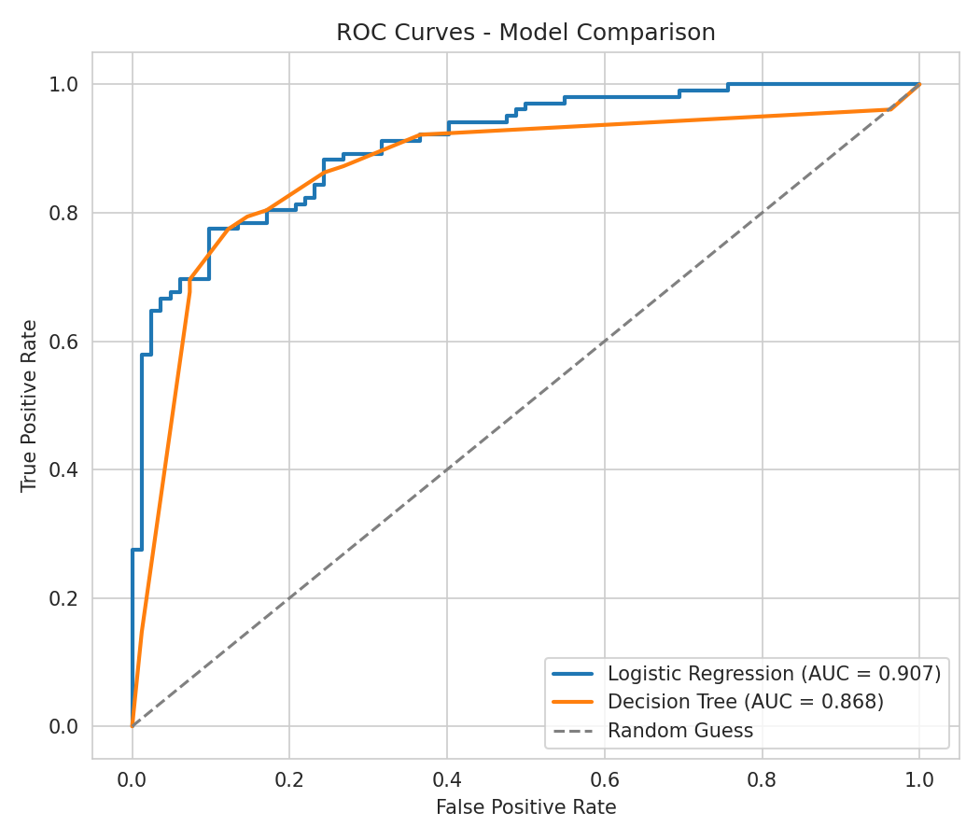
THRESHOLD-INDEPENDENT COMPARISON
14
ROC Curve + AUC
Logistic Regression
ROC AUC = 0.9073
Decision Tree
ROC AUC = 0.8684
Higher AUC indicates better ranking of disease-positive patients above disease-negative patients across thresholds.
HEART DISEASE PREDICTION • MACHINE LEARNING CAPSTONE
14 / 18

Slide 15
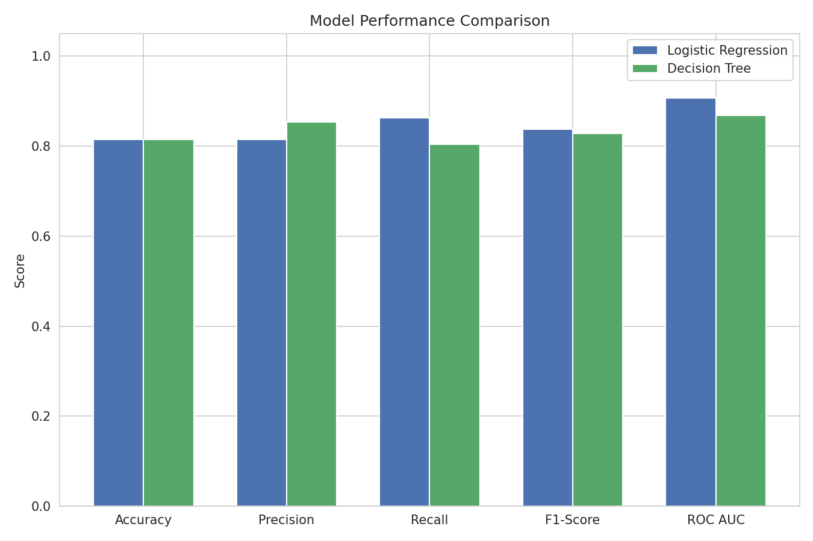
TEST-SET METRICS
15
Model Performance Comparison
Model
Accuracy
Precision
Recall
F1-Score
ROC AUC
Logistic Regression
0.8152
0.8148
0.8627
0.8381
0.9073
Decision Tree
0.8152
0.8542
0.8039
0.8283
0.8684
Comparison conclusion
Accuracy was tied at 0.8152. Logistic Regression led on Recall, F1-score, and ROC AUC; Decision Tree led on Precision.
HEART DISEASE PREDICTION • MACHINE LEARNING CAPSTONE
15 / 18

Slide 16
EVIDENCE-BASED MODEL SELECTION
16
Results & Discussion
0.8152
0.9073
0.8627
Accuracy for both models
Best ROC AUC
Best recall
What tied
What separated them
Screening implication
Both classifiers correctly classified 0.8152 of the held-out test set.
Logistic Regression achieved stronger discrimination: ROC AUC 0.9073 vs 0.8684.
Logistic Regression detected more actual disease cases: recall 0.8627 vs 0.8039.
Selected model: Logistic Regression
HEART DISEASE PREDICTION • MACHINE LEARNING CAPSTONE
16 / 18

Slide 17
PRACTICAL INTERPRETATION
17
Sample Prediction + Limitations/Future Scope
Held-out sample prediction
Limitations
Future scope
Actual label: Disease
Model prediction: No Disease
Predicted probability of disease: 0.343
This real test example illustrates an error near the decision boundary.
• ca and thal have >50% raw missing values.
• Mode imputation may reduce predictive signal.
• Multi-center collection practices may contribute to missingness.
• Multiple imputation or missingness indicators.
• External validation.
• Threshold tuning for screening needs.
• Additional model development with careful validation.
This system is an analytical model evaluation, not a clinical diagnostic tool.
HEART DISEASE PREDICTION • MACHINE LEARNING CAPSTONE
17 / 18

Slide 18
CONCLUSION
Logistic Regression was the
strongest model for this project.
It matched the Decision Tree’s accuracy while delivering the best ROC AUC and recall on the held-out test set.
0.8152
0.9073
0.8627
Accuracy
ROC AUC
Recall
Data-driven classification • transparent evaluation • documented limitations
18

