Slide 1
JAVA
SPRING FRAMEWORK

Slide 2
Concept
Spring is a framework that provides infrastructural support for any applications including Java EE applications.
Spring is used for handling application’s infrastructure.

Slide 3
Modules
Core Container (IoC and DI)
Spring Context
Sping AOP
Spring DAO
Spring ORM
Sping Web module
Spring MVC Framework

Slide 4
Core Container
Inversion of Control (IoC) is a design principle describes designs in which inverts control flow as compared to traditional procedural programming.
Dependency Injection (DI) or Bean Wiring

Slide 5
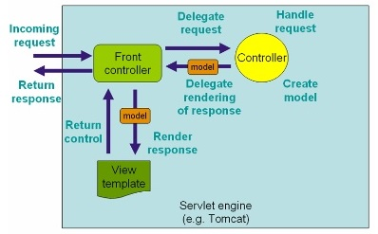
Spring MVC
Spring MVC: a MVC framework designed around a front controller named DispatcherServlet that dispatches requests to handlers.

Slide 6
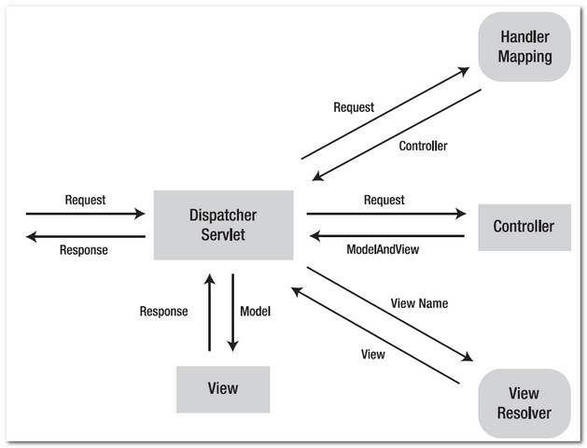

Slide 7
THANK YOU
FOR LISTENING

