Slide 1
Spring
Java

Slide 2
Table of Content
Spring
Spring AOP
Spring Core
IoC
DI
Spring MVC

Slide 3
Spring
Spring framework (Spring) is a lightweight framework that provides infrastructural support for any applications including Java EE applications.
Spring is used for handling application’s infrastructure.

Slide 4
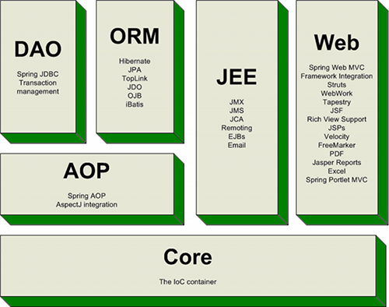
Spring
Spring’s architecture:

Slide 5
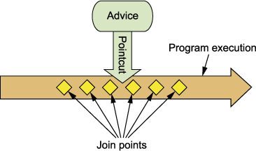
Spring AOP
AOP (Aspect-oriented programming): a programming paradigm that entails breaking down program logic into distinct parts (called concerns).
Spring AOP module provides interceptors to intercept an application by:
Spring old style (dtd based).
AspectJ
Spring XML configuration

Slide 6
Spring Core
Spring Core components:
Spring IoC container:
Spring Bean: an object that is instantiated, assembled, and managed by a Spring IoC container

Slide 7
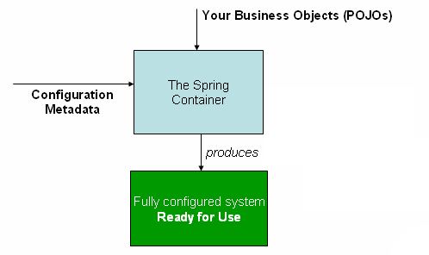
Spring IoC Container
The core of Spring framework.
The container will:
Create the objects.
Wire them together.
Configure them.
Manage their complete lifecycle.
Spring provide 2 types of container:
BeanFactory container
ApplicationContext container

Slide 8
Inversion of Control
Inversion of Control (IoC) is a design principle describes designs in which inverts control flow as compared to traditional procedural programming.
Traditional: application code => framework code.
IoC: framework code => application code.
IOC is used to increase modularity of the program and make it extensible.

Slide 9
Dependency Injection
Dependency Injection (DI): a software design pattern that resolves dependencies from a program.
In DI:
Container injects dependencies to objects.
Low-level modules (class) will be injected to high-level modules (interface).

Slide 10
Dependency Injection
There are 2 methods to do a DI in Spring framework:
Setter injection
Constructor injection

Slide 11
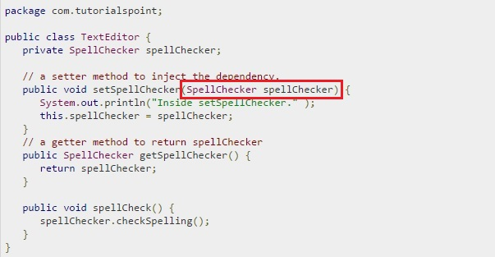
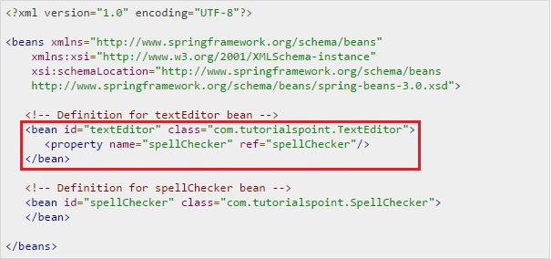
Dependency Injection
Setter injection
Container injects dependency to parameter of setter method

Slide 12
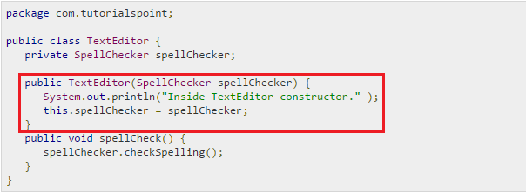
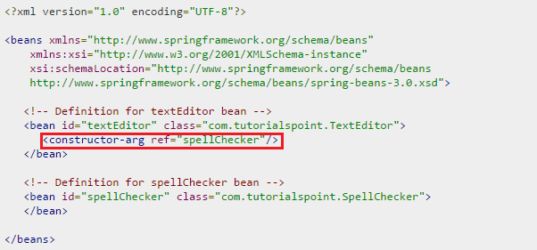
Dependency Injection
Constructor injection
Container injects dependency to argument of constructor

Slide 13
Dependency Injection
Pros:
Loosely Coupled
Much Better Testability
Separation Of Concerns
Cons:
Difficult to understand.
Increase code complexity.
Complicates Debugging & Code Flow.

Slide 14
Spring MVC
Spring MVC: a framework that supports MVC (Model-View-Controller) architecture to support web application developments.
Spring MVC is designed around a front controller (DispatcherServlet).

Slide 15
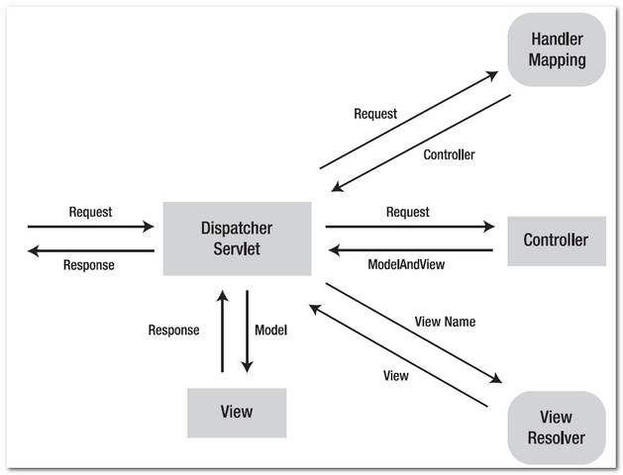
Spring MVC
Map Request to Controller
Dispatch requests to handlers.
Holder for both Model and View
Map View Name to View
Usually a JSP page

Slide 16
THANK YOU FOR LISTENING!

