Slide 1
Spring & Hibernate
Java

Slide 2
Table of Content
Spring
Spring
Spring Core
IoC
DI
Spring MVC
Hibernate

Slide 3
Spring

Slide 4
Spring
Spring framework (Spring) is a lightweight framework that provides infrastructural support for any applications including Java EE applications.
Spring is used for handling application’s infrastructure.

Slide 5
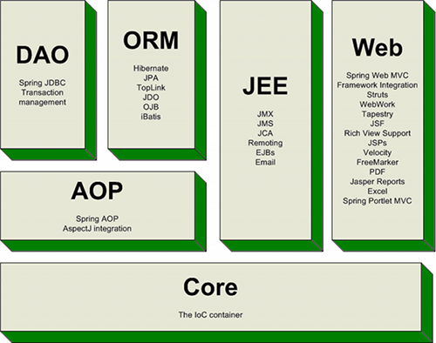
Spring
Architecture:

Slide 6
Spring Core
Spring Core is a container providing Inversion of Control (IoC) and Dependency Injection (DI).
The container will:
Create the objects.
Wire them together.
Configure them.
Manage their complete lifecycle.

Slide 7
Inversion of Control
Inversion of Control (IoC) is a design principle describes designs in which inverts control flow as compared to traditional procedural programming.
Traditional: application code => framework code.
IoC: framework code => application code.
IOC is used to increase modularity of the program and make it extensible.

Slide 8
Dependency Injection
Dependency Injection (DI) is a way to implement IoC.
In DI:
Low-level modules (class) will be injected to high-level modules (interface).
Modules communicate via interfaces.
Objects are given their dependencies rather than construct them.

Slide 9
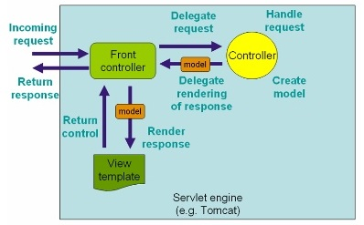
Spring MVC
Spring MVC: a MVC framework designed around a front controller named DispatcherServlet that dispatches requests to handlers.

Slide 10
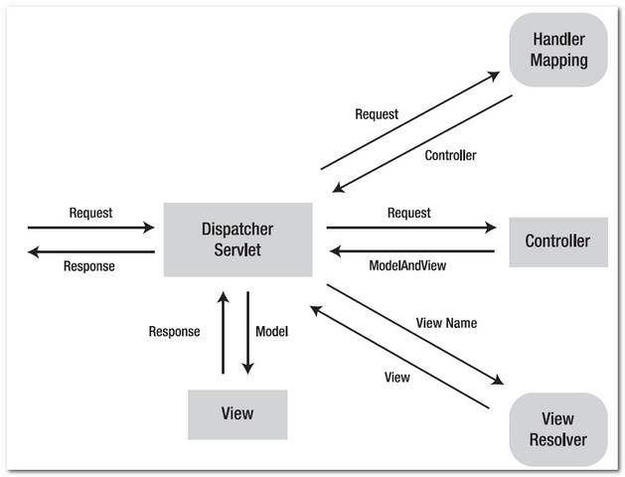
Spring MVC
Handler Mapping: map request to a Controller
ModelAndView: holder for both Model and View
View Resolver: map view name to a View

Slide 11
Hibernate

Slide 12
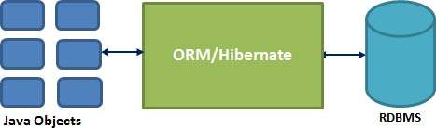
Hibernate
Hibernate ORM (Hibernate) is an ORM and persistence framework that allows mapping between objects (even POJOs) and database.

Slide 13
Hibernate
Hibernate uses HQL (Hibernate Query Language) to query Hibernate objects.
Hibernate generates database-specific SQL queries based on dialect configuration.

Slide 14
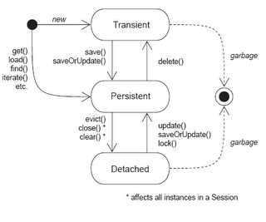
Hibernate
Hibernate object states:
Transient : has just been instantiated and not associated with a Session.
Persistent : is associated with a Session and has an identifier value.
Detached : has been persistent but its Session has been closed.

Slide 15
Hibernate
Pros:
Work with java objects => more familiar.
Simplify CRUD operation programming.
Database independent. => No SQL queries is required.
Support cache.
Cons:
Lots of APIs => Hard to learn.
Not suitable for Batch processing.

Slide 16
THANK YOU FOR LISTENING!

