Slide 1

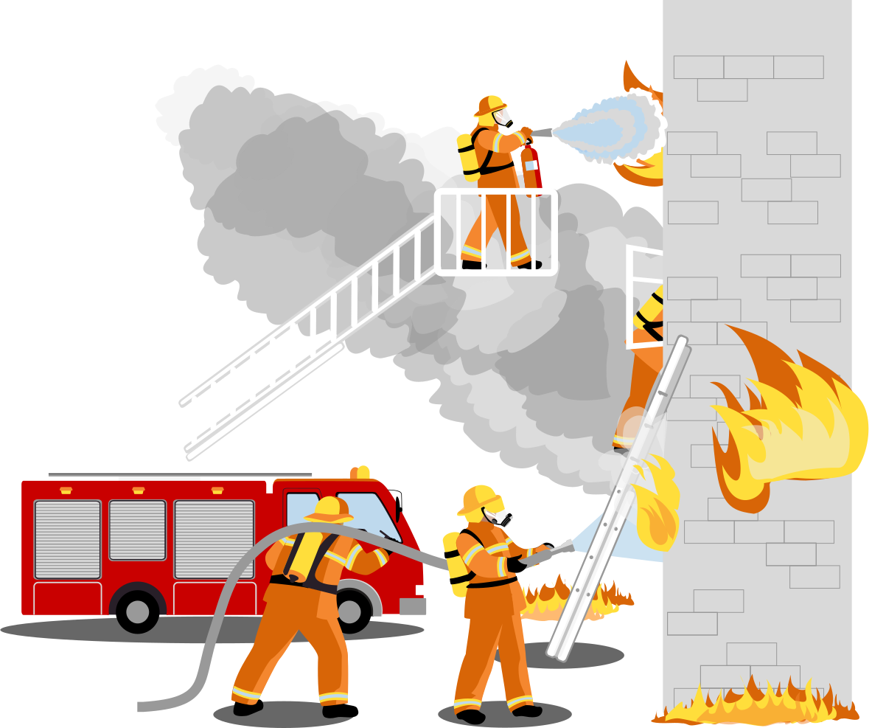
Flame
Guard
Save the Professor’s Life When Fires
W19 (Endicott) Network Upgrade & Networked Fire Alarm
Project proposal presentation
By:Pushkal, Islam, Emon, Hassan, Sadat

Slide 2


STUDENT INFORMATION
Member | Technical R&R | R&R
Pushkal | System integration & testing | Leader
Islam | Iot sensor & hardware | Co-leader
Emon | Wireless NW | Schedule and task tracking
Sadat | Wired NW | Budget & Equipment
Hassan | Alert and monitoring software | Presentation maker

Slide 3










Project Summary
Slow WiFi
No networked
IoT
Missing Fire
Scenario Tests

Slide 4
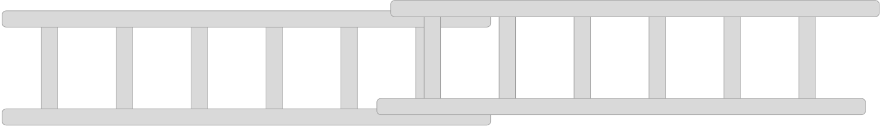
Project Summary
01
03
Validate and perform simulations
Survey
02
04
Design In Packet Tracer
Cost estimate

Slide 5
Project Summary
WE THINK..... | SO WE WILL......
Overload access layer | PoE + access switches , collapsed core
Thin WiFi | WiFi 6 AP and a wireless controller
Fire devices not networked | Detector, alarm and siren per office on a fire VLAN and Qos
Packet Tracer cannot test a fire | Fire scenarios on our 3D model

Slide 6

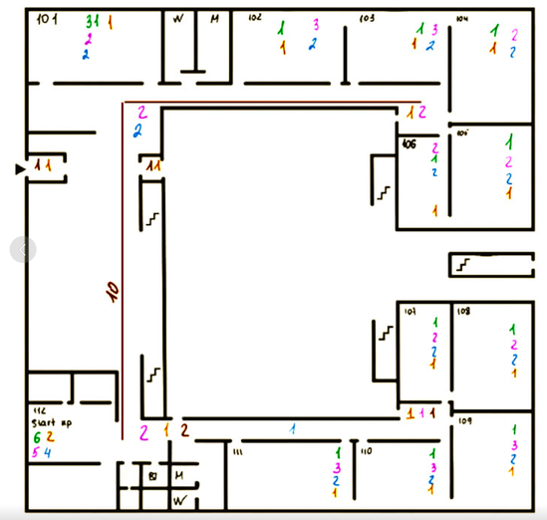
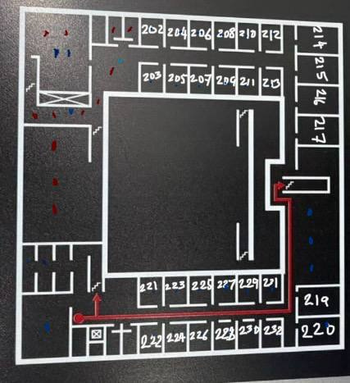
Background: W19 and Our Survey
Figure 1-1F survey map
Figure 2-2F survey map
-3 floors around a courtyard, ~54x54 m
-2F: 13 professors’ offices (220–232) on the south corridor
-Professors often work alone, late, behind closed doors

Slide 7
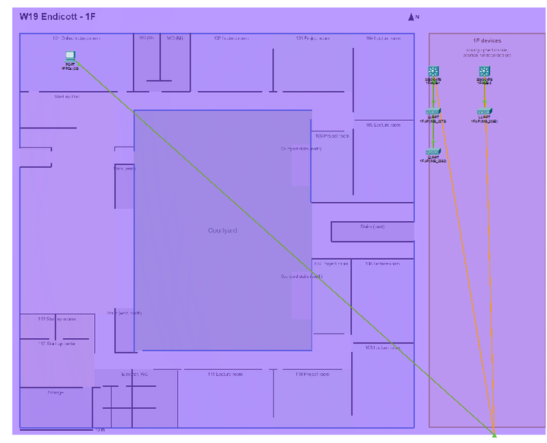
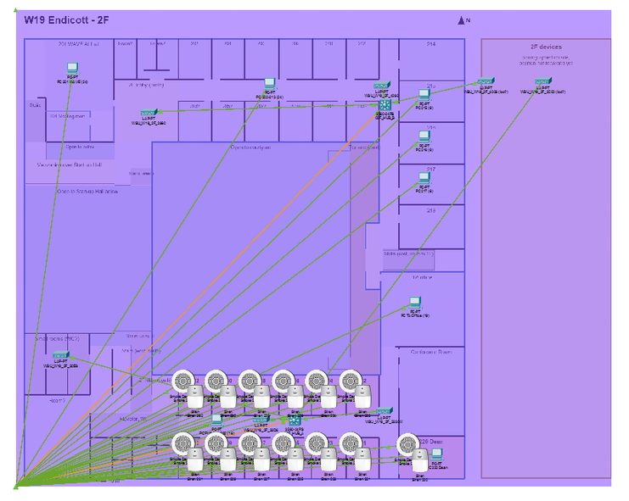
Initial W19 Network in Packet Tracer
Figure 1-1F Packet
Tracer Layout
Figure 4-2F Packet Tracer Layout

Slide 8



















As-Is Network and the Problem
Found
Layer | Symptom or likely cause
L1 | Old ports and cabling, shared ceiling hubs
L2 | Flat network, IoT, CCTV and users mixed
L3 | Uplink unknown, no QoS for safety traffic
Wireless | Too few APs (~1per 420m²), weak corridor
IoT | No remote alerts, no per-office alarms
Main Bottleneck | Access layer and WiFi capacity on 2F (hypothesis)
-5 Cisco APs on 2F, 2 ceiling “hub” units
-~103 PCs on 2F, 24 on 1F
-54 smoke detectors , not networked
-CCTV and motion sensors
Unknown
Core switches, uplink, cable category, VLANs

Slide 9






Why packet tracer is not enough
 | Packet Tracer
VLANs, routing, WLC
IoT Device Alarms
Real device & Cable Positions
Fire Simulation

Slide 10














W19 3D Layout

Slide 11
Project Constraints
Technical
Time
Environment
Newest Cisco models may not be in Packet Tracer
4 weeks before final presentation
We may not be allowed to access network closets to investigate
Tool
Scope
Packet tracer limits full real life simulations
Only W19 building is considered in this scope, nearby buildings are not needed

Slide 12

Goals and design direction
Technical goals
Learning goals
upgraded hierarchical network, alarm in 13 offices, 3D fire simulation, cost estimate
Cisco configuration, campus design, IoT integration, designing for failure
Target architecture
IoT Devices
Catalyst 8300 edge → Catalyst 9500 collapsed core (×2) → Catalyst 9300/9200 PoE+ access → Catalyst 9800-L WLC + Wi-Fi 6 APs
Use IoT devices together with regular network devices and research on packet tracer availability

Slide 13








Success criteria
Goal | Verification
Upgraded Network | DHCP, inter-VLAN routing work
Fire IoT Devices | Adjustable
Survives a fire simulation | 100% of offices outside the fire zone still alerted in S1–S5
Wi-Fi coverage | Every room is not too far from a Wireless AP
Cost | An Itemised total for the upgrade can be produced

Slide 14

Schedule
11/25
12/09
11/11
Completion: final .pkt + 3D demo
final presentation
Proposal presentation
Progress: upgraded topology + fire chain in 1 office + 3D fire mode v1
11/04
11/18
12/02
Survey, 2D maps, 3D model ✅
Closet visit, speed tests, as-is topology, VLAN plan
All 13 offices, scenarios S1–S5, cost estimate

Slide 15

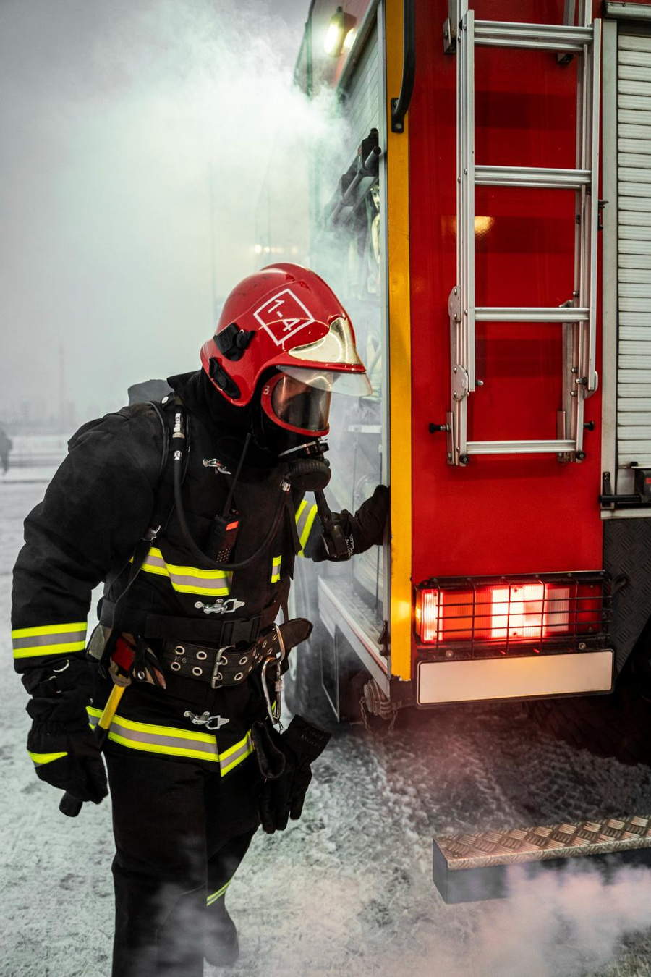
Risks & response
Risk | Response
No closet access | Ask IT now; else design-guide assumptions
Device missing from packet tracer | Stand-in + real model in itemised cost
3D fire trace takes too long | Minimum version first
PT and 3D model drift apart | One shared device list (JSON)
Member unavailable | Backup owner, work logged in Notion

Slide 16







References
  Cisco, Campus LAN & WLAN Solution Design Guide (2020)
  Cisco, Catalyst 8300/8200 Software Configuration Guide (IOS XE 17)
  I. Shemsi, “Boosting Campus Network Design Using Cisco Packet Tracer,” IJISRT, 2017
  E. Y. Kim, Computer Networks PBL – Week 1 Introduction (LMS)
  Cisco NetAcad – Getting Started with Packet Tracer · NFPA 72
  Team Flame Guard – W19 survey maps & 3D model (github.com/Pushkaltoocool/FlameGuard)

Slide 17

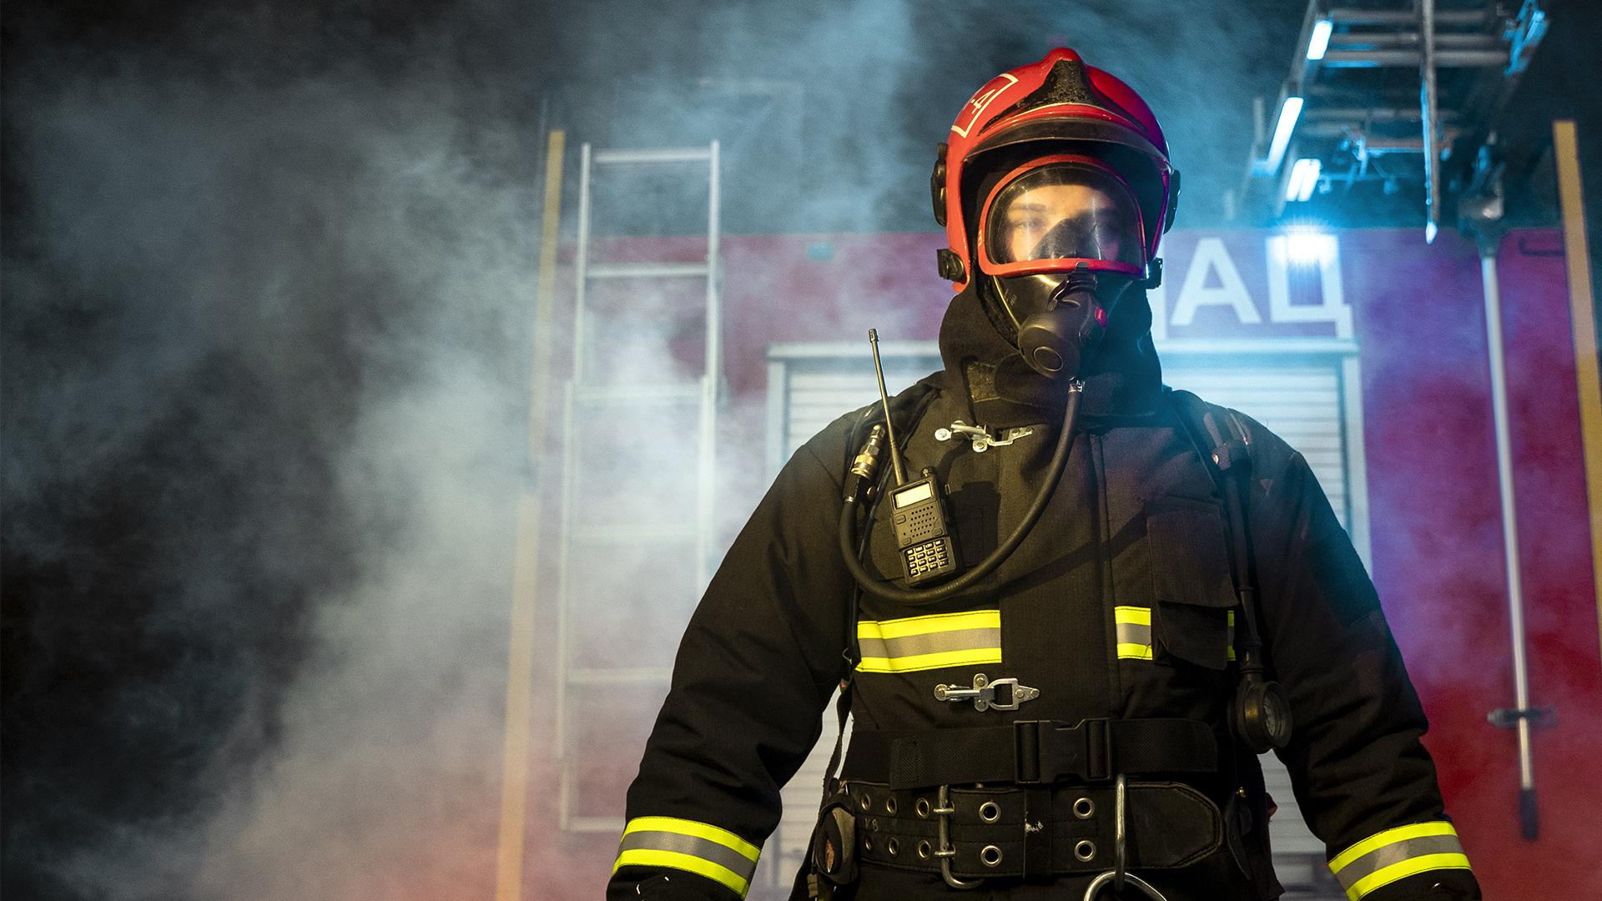
Thank you!
Questions?

