Slide 1
Stock Price Prediction Using ML
Rohit Karalkar 31
Pushkar Mavale 45
Himanshu Mishra 47

Slide 2
Introduction :
Stock Market refers to the market where exchange of stocks take place.
In 2019-20 financial year there were 4.09 crore stock investors, the number increased to 5.5 crore in 2020-21 and 7.3 crore in 2021-22. As the pandemic hit our lives, people realized importance of saving as well as investing their money to get the maximum returns.
Stock market is one of the major fields that investors are dedicated to, thus stock market price trend prediction is always a hot topic for researchers from both financial and technical domains.

Slide 3
Problem Statement
The stock market appears in the news every day. We hear about it every time it reaches a new high or a new low.
The problem here is lack of awareness of technology among local retailers in the stock exchanges which could have helped them to gain the maximum return on their investment.
The rate of investment and business opportunities in the Stock Market can increase if an efficient algorithm could be devised to predict the short term price of an individual stock.

Slide 4
Literature Survey
1) An efficient stock market prediction model using hybrid feature reduction method based on variational autoencoders and recursive feature elimination, Hakan Gunduz
Hourly price data of eight banking stocks listed in the BIST 30 Index were used in this study. Price data included hourly open, close, and high and low prices.
In this study, different types of ML models, such as Support Vector Machines, LightGBM, and Long-Short Term Memory are employed to classify the directions of the stock movements.

Slide 5
Literature Survey
2) Hourly Stock Market Prediction Using Machine Learning Techniques: A Decade Survey on Methodologies, Recent Developments, and Future Directions – Nusrat Rouf, Majid Bashir Malik , Tasleem Arif , Sparsh Sharma , Saurabh Singh , Satyabrata Aich and Hee - Cheol Kim
In this study, different types of ML models, such as Artificial Neural Networks (ANN), Support Vector Machine (SVM),Naïve Bayes (NB),Genetic Algorithms (GA) are employed to classify the directions of the stock movements.
They have explained the performance of various algorithms for predicting the stock prices. They have used SMP model for prediction .

Slide 6
Proposed Solution
To get the insights from the stock data and predict the possible future returns on the stock using ML.
Will make use of LSTM model which is used to predict future values based on previously observed values .
Our main objective is to build a prediction model for price trend prediction, which focuses on short-term price trend prediction.

Slide 7
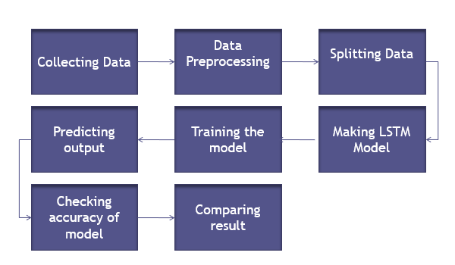
Functional block diagram

Slide 8
Specifications and Algorithms
Data Splitting
Splitting 67% data to training set and rest to the testing set
Total (100%) - 1170
Train (67%) - 794
Test (33%) - 376
Data Scaling
Rescaling all the values from their original to a range of (0, 1)
For ease in calculations
Sklearn.preprocessing
MinMaxScaler()
Training and Predicting
Running the model for a particular number of epochs and then predicting the result on testing data.

Slide 9
Specifications and Algorithms
Forming Model
Used Tensorflow and Keras libraries for forming the deep learning model.
Data sequence
Using previous 30 days closing prices as the measure for predicting the output 31th day.
Then again taking the output as the input for the next sequence.
Input days Output for day
1, 2, 3 … 30 31
2, 3, 4 … 31 32
3, 4, 5 … 32 33
... …
... …
... …

Slide 10
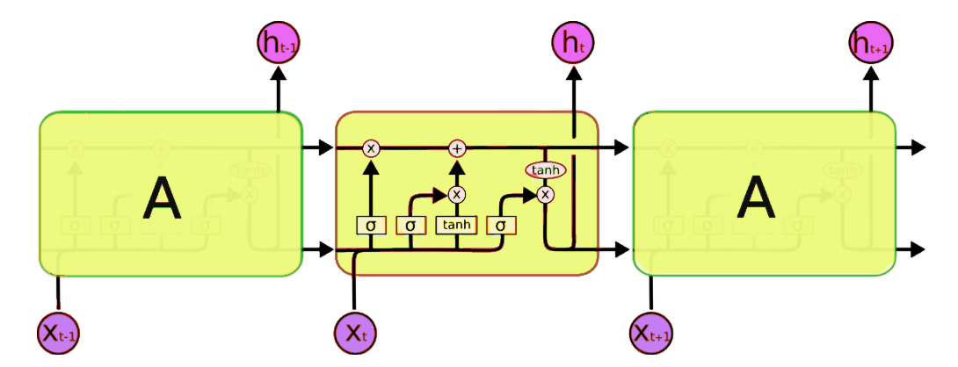
LSTM ALGORITHM WORKFLOW

Slide 11






Usage of Technologies

Slide 12
DATASETS FOR STOCK MARKET PREDICTION
Kaggle Stock Market Dataset
This dataset includes the historical daily prices and volume information for Indian bank stocks and ETFs trading , BSE, and NSE MKT. All data is in CSV format.
Link : https://finance.yahoo.com/lookup

Slide 13
THANK YOU

